Slide 1

VSMS
The complete screening journey, secured
Visual Screening Management System
15-minute demonstration
13 AUG 2026
Notes:
Open with the goal: replace fragile paper hand-offs without compromising personal or clinical data.
[Sources]
- docs/secure_coding/report.md
- react-user-dashboard/public/landing/vsms-screening-hero.webp

Slide 2
01 · WORKFLOW
One record follows arrival to referral
01
02
03
04
05
06
07
08
Login
Register
QR pass
Queue
Stations
Review
Referral
Report
Event-scoped authorization and audit records surround every transition.
02
Notes:
Walk through the lifecycle once. The remaining slides prove that the same simple model survives identity checks, offline work and recovery.
[Sources]
- docs/vsms-participant-flow.md
- backend/docs/openapi.yaml

Slide 3
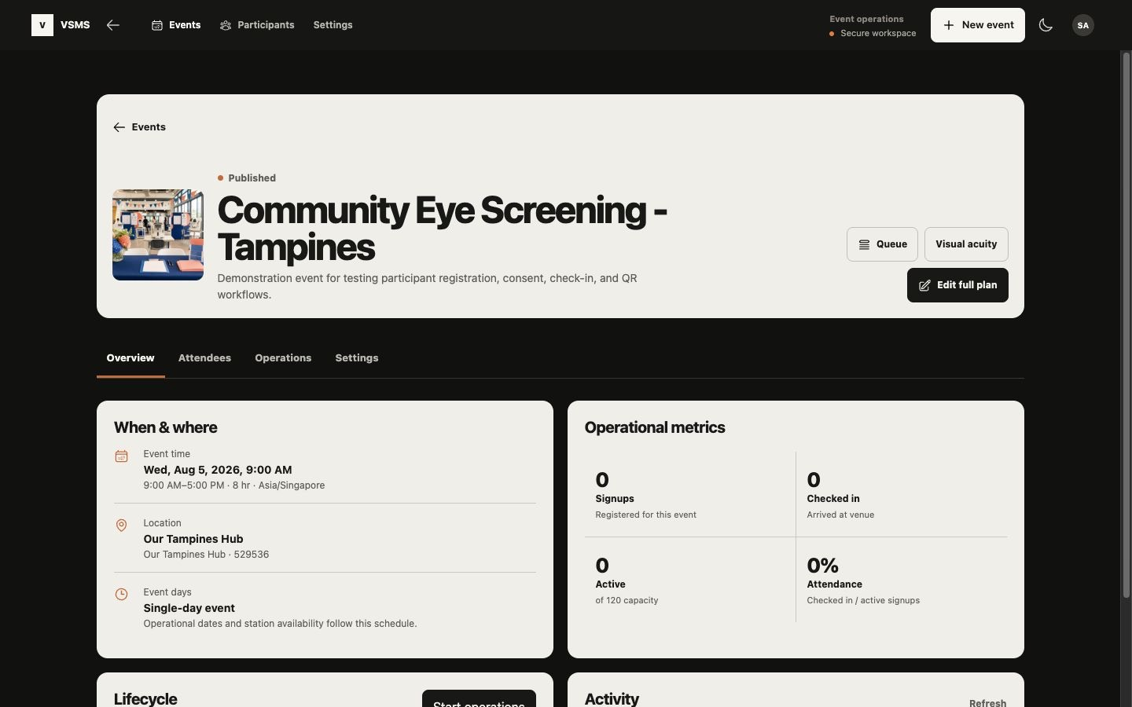
02 · EVENT WORKSPACE
Operational visibility without clinical exposure
Managers see the event, staffing and queue state they own.
Registration staff can search, register and check in.
Screeners receive only assigned station work.
Doctors own review and referral decisions.
03
Notes:
Use the live system for the acceptance replay. This repository screenshot is supporting product evidence, not a replacement for current AWS proof.
[Sources]
- react-user-dashboard/public/landing/event-workspace-preview.jpg
- backend/services/event/

Slide 4
03 · SECURITY
Identity comes first; the API still decides access
Cognito
Session
Account
Event
Duty
PKCE sign-in
Secure cookies + CSRF
Active local state
Membership + role
Assigned station
Denied paths are part of acceptance: wrong role, wrong event and inactive duty must fail closed.
04
Notes:
Demonstrate one allowed path and three denied paths. Do not stop at a successful login; access is event- and duty-scoped.
[Sources]
- backend/routes/authRoutes.js
- backend/middlewares/authorize.js
- infrastructure/cognito.yaml

Slide 5
04 · SCREENING
Four stations. One secure save contract.
01
Visual acuity
Distance vision and rule flags
02
Refraction
Sphere, cylinder and acuity
03
Colour vision
Plate results and acknowledgement
04
Eye health
Observation, urgency and notes
05
Notes:
The acceptance branch restores eye health through route, service, OpenAPI, seed data, frontend and offline sync. Every station reuses server-side validation, authorization and idempotency.
[Sources]
- backend/services/screening/screeningService.js
- backend/docs/openapi.yaml
- react-user-dashboard/src/features/screening/

Slide 6
05 · OFFLINE PWA
Offline work stays encrypted and replay-safe
Prepare
Go offline
Save
Reconnect
Resolve
Assigned pack
Cached shell
AES-GCM outbox
Idempotent batch
Applied / conflict
The service worker caches code. IndexedDB separately encrypts clinical work and purges it on expiry, logout or owner change.
06
Notes:
Preload the pack online, disconnect, hard-refresh the PWA, save one eye-health result, reconnect, and show the same clientActionId cannot be applied twice.
[Sources]
- backend/docs/offline-screening-28.md
- react-user-dashboard/src/features/screening/offlineSync.ts
- react-user-dashboard/vite.config.ts

Slide 7
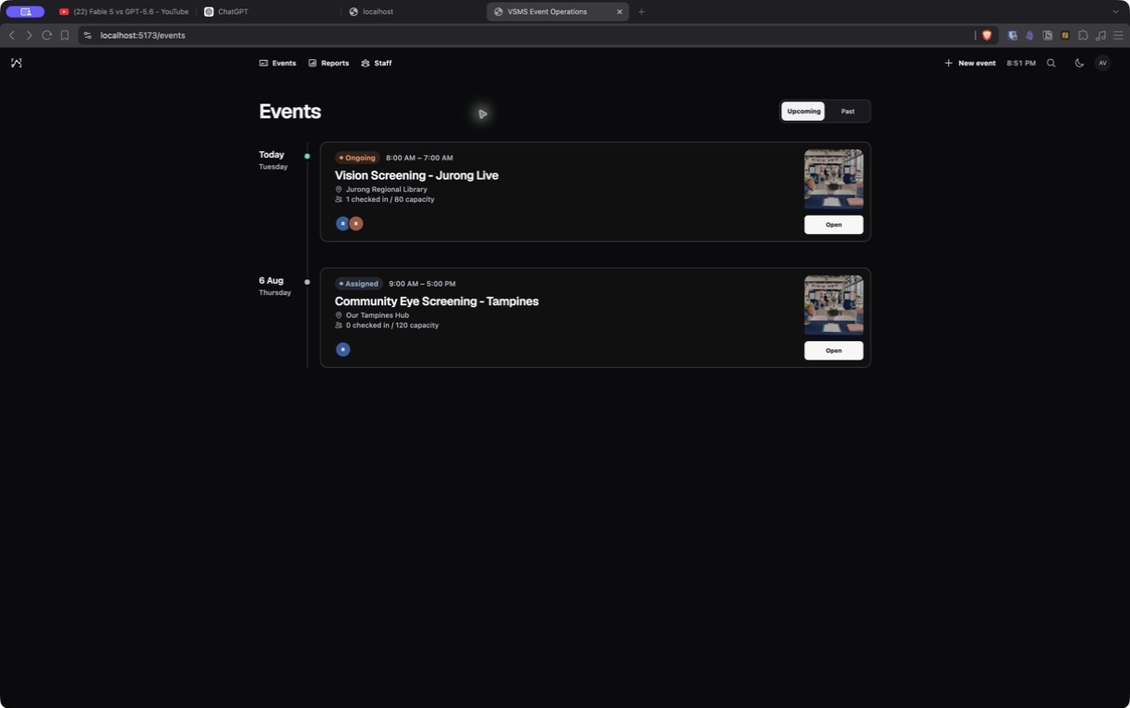
06 · PRODUCT EVIDENCE
One workspace for preparation and live operations
Prepare
Draft the event, allocate stations and assign staff before publishing.
Operate
Track queues, screening completion and exceptions without navigating away from the event.
07
Notes:
Use the live event list to enter the representative sample event. This image documents the implemented visual surface.
[Sources]
- react-user-dashboard/public/landing/vsms-events-workspace.jpg
- react-user-dashboard/src/features/events/

Slide 8
07 · ARCHITECTURE
Identity is public. Clinical data stays private.
Cognito PKCE
Browser PWA
Nginx
Express
Private RDS
Recovery
Amplify + encrypted IndexedDB
TLS + /api proxy
API + workers
Encrypted PostgreSQL
7-day backups + snapshot
Single-AZ RDS and one EC2 host are explicit lab limits.
08
Notes:
Separate historical deployment proof from current availability. The 11 August runbook records this topology; the 13 August API check timed out and must be replayed with renewed AWS access.
[Sources]
- docs/2026-08-11_aws-cloud-deployment-runbook.md
- docs/secure_coding/diagrams/deploymentDiagram.md

Slide 9
08 · PERFORMANCE
500 participants stayed inside every budget
0%
workflow errors
234.70/s
registration throughput
Budgets: reads ≤250 ms · writes ≤500 ms · errors ≤1%
09
Notes:
Explain the mixed workload: 500 participant pollers, ten staff pollers, registration, check-in, screening sync and reporting against a real PostgreSQL service.
[Sources]
- docs/2026-08-13-performance-recovery.md
- .github/workflows/performance-recovery.yml

Slide 10
09 · BACKUP RECOVERY
Recovery verifies data, constraints and indexes
500
500
177
245
participants
screening results
constraints
indexes
Source and restored databases matched exact row counts, constraint identities and index definitions.
10
Notes:
A dump is not a recovery proof. The workflow restores into a fresh database and compares row counts, constraint name/type/validation and exact index definitions.
[Sources]
- backend/scripts/backup-postgres.sh
- backend/scripts/restore-postgres.sh
- docs/2026-08-13-performance-recovery.md

Slide 11
10 · RUBRIC EVIDENCE
Claims are now linked to repeatable evidence
8/8
4/4
10
427
business requirements
offline screening stations
OWASP categories mapped
backend tests passed
Targets remain targets until measured; repository evidence is checked automatically before submission.
11
Notes:
This scorecard links requirements and objectives to repeatable repository evidence.
The 50% registration, 90% paperwork, and 30% throughput targets still require a timed event baseline before they may be claimed as achieved.
[Sources]
- docs/09-Evidence/business-objectives.json
- scripts/check-rubric-evidence.cjs
- docs/04-Security/owasp-verification-matrix.md
- Docker validation completed 2026-08-13

Slide 12
VSMS
The workflow is implemented.
The final live replay is the remaining proof.
Ready now
Needs authorized access
Four stations · installable PWA · measured load · verified restore
Cognito role journeys · live AWS screenshots · signed submission inputs
Notes:
Close honestly: code and repeatable local proof are complete; acceptance cannot be claimed until authorized AWS access is restored and the matrix is replayed.
[Sources]
- docs/secure_coding/report.md
- docs/secure_coding/demo-outline.md
- docs/2026-08-13-performance-recovery.md

