Slide 1
Determining gender using survey information
wIds datathon 2018
Dr. Anne Regel April 9th, 2018

Slide 2

introduction
Women in the poorest part of the world are often excluded from formal financial systems.
InterMedia researches ways to help the world’s poorest people take advantage of widely available mobile phones and other digital technology, in order to access financial tools and participate more fully in their local economies
Using demographic and behavioral information from India on the usage of traditional financial and mobile financial services, the WiDs 2018 Datathon challenged data scientists to predict the gender of survey respondents, based on survey answers.
By predicting gender, key behavior patterns of men and women will be identified. Thus, helping IMSI’s plan to reach women in developing economies and encourage them to adopt new financial tools that will help to lift them and their families out of poverty

Slide 3
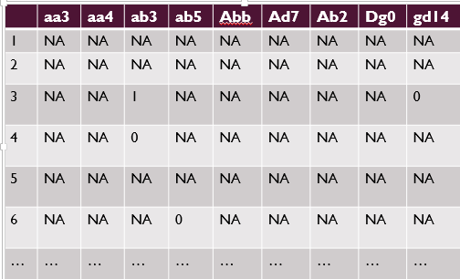
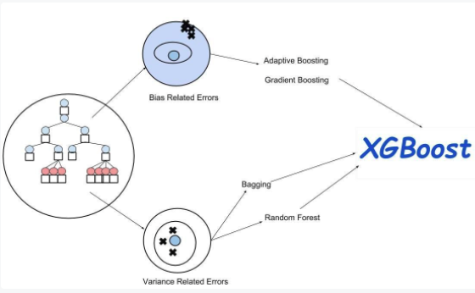
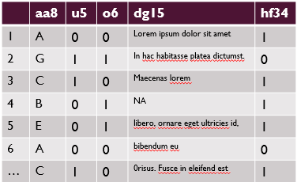
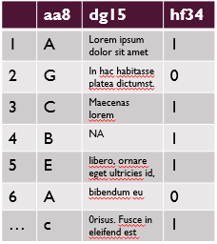
Methodology
Original Sparse
Data
Remove features that are less than 50% filled
Wrangled Data
Parameter
optimization
Feature selection using chi-squared hypothesis testing
Predictive Classification Model
Final Data-Set

Slide 4
Data wrangle
Original data
Labeled test data and unlabeled training data
Sparse
Large number of features
Mixture of categorical, numerical and text
Wrangling steps
Removed any feature that was missing more than 50% of the values for training and test data
Removed any feature that was not present in BOTH training and test sets
Result: 946 features were eliminated

Slide 5
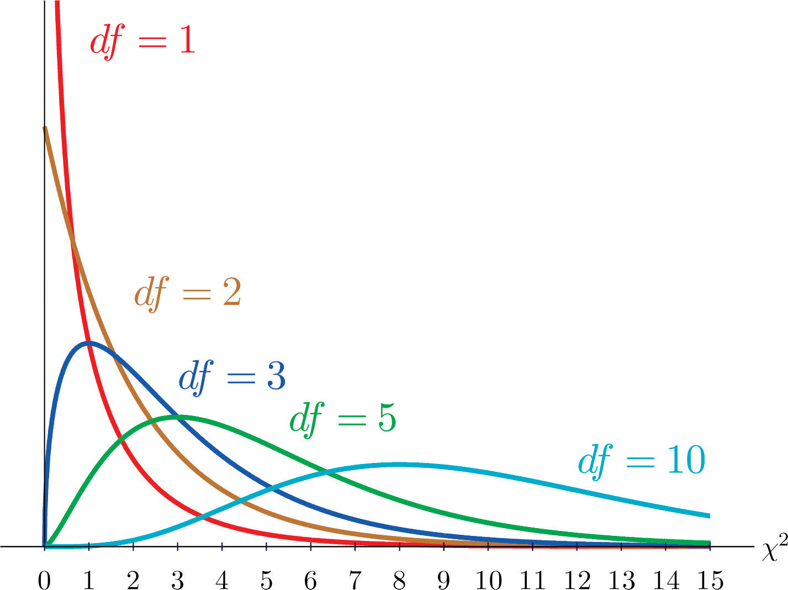
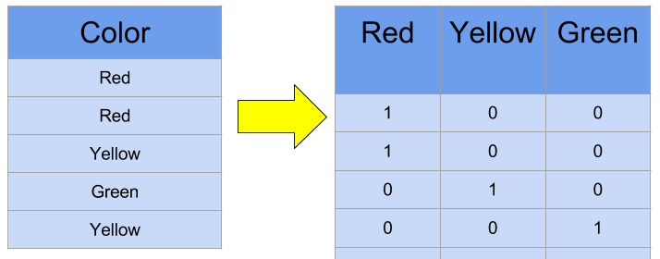
Feature selection on categorical data
Determine if any of the categorical questions are answered differently based on the gender of who is filling out the survey.
Use the chi-squared test statistic to determine if the distribution of answers is dependent on gender
One-hot encode categories
The last step is to determine if using this feature selection method actually improves the model.
chi-squared distributions for different degrees of freedom (df)
One-Hot Encoding

Slide 6
Xgboost model optimization
Used randomized grid search to optimize the following parameters
max_depth
learning_rate
min_child_weight
colsample_bytree
gamma
colsample_bylevel
Final model parameters
objective = binary:logistic, max_delta_step = 0, scale_pos_weight=1, base_score=0.5, random_state=5, subsample=0.8, silent=1, min_child_weight‘= 3, max_depth=8, learning_rate= 0.1, gamma=0, colsample_bytree=0.6, colsample_bylevel=1

Slide 7
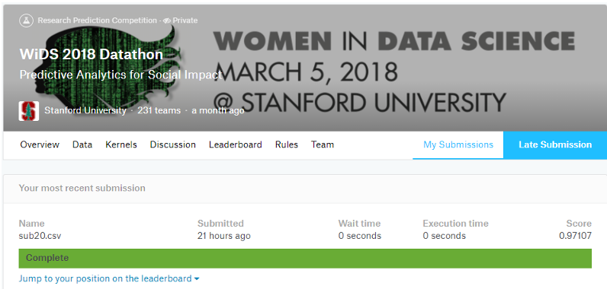
conclusions
Due to the fact I do not own this data I cannot publish the features that are most indicative of gender. However, I will comment on the modeling process itself.
XGBoost worked very well, with very little optimization needed.
An accuracy of 0.97107 was achieved for the test data using thee optimized model
If this were not the case, I would have tried straight logistic regression or random forests. Since the goal of this analysis was to determine the underlying issues women face, I would not use neural nets, because of poor interpretability.

