Slide 1
RTMCA: Real-Time Machine Learning model for large-scale Cybersecurity Attacks
CS-584 Machine Learning
Gomez Valverde, Ignacio
De Lucas García, Mario

Slide 2
Table of contents
Overview
The CICIoT2023 Dataset
The goal
Models
Logistic regression
Random Forest Classifier
eXtreme Gradient Boosting Classifier
Voting Classifier
Results
Demo

Slide 3
Overview
Leverage the power of machine learning to protect people in a highly connected world where cyberattacks are rampant. Use ML models to identify and prevent SYN flood attacks, which try to overload servers with fake requests.
Comparison between different ML models and different classification tasks.
Train and tested in a considerable huge dataset from CICIoT 2023.
Implemented a real-time demonstration for academic purpose only.

Slide 4
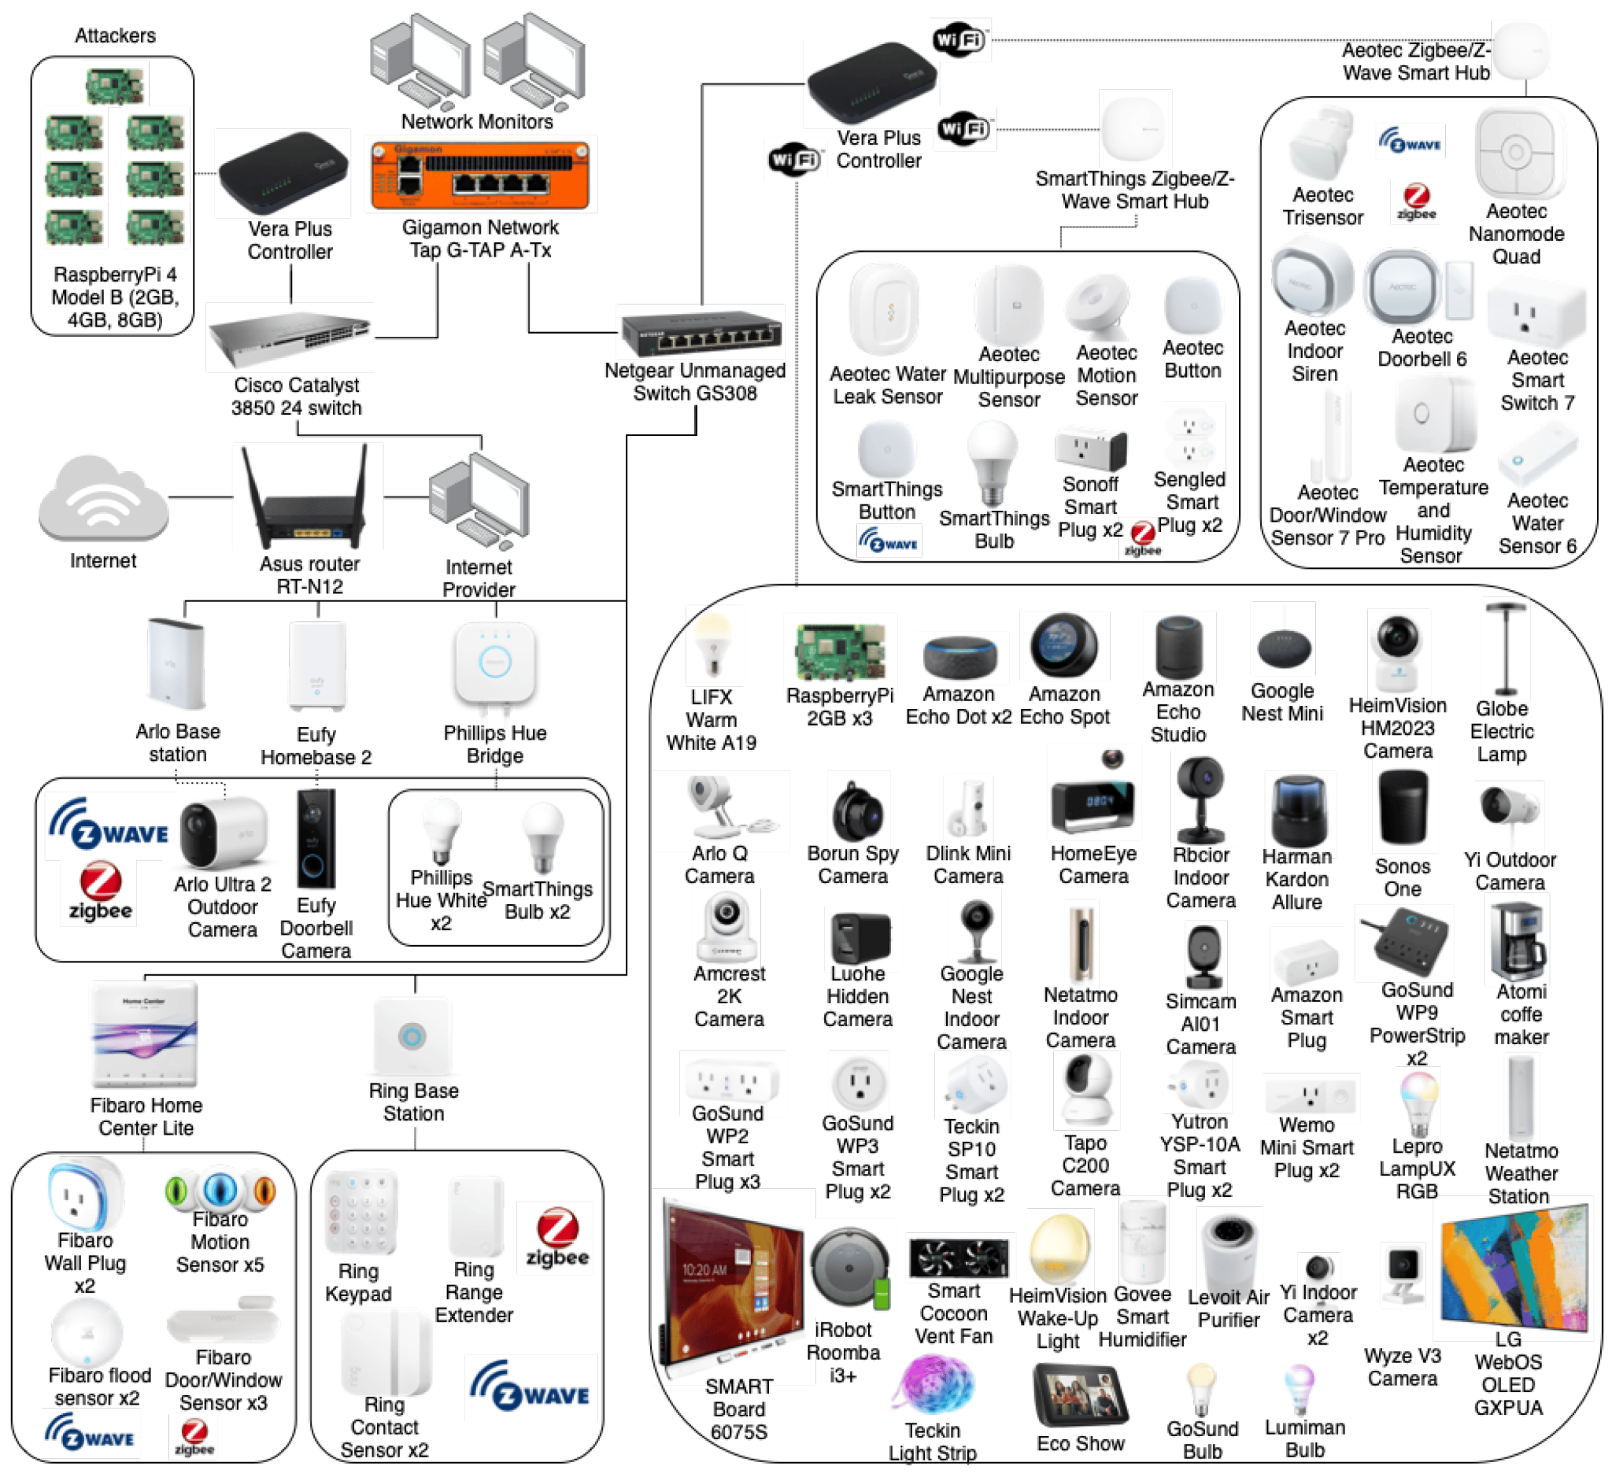
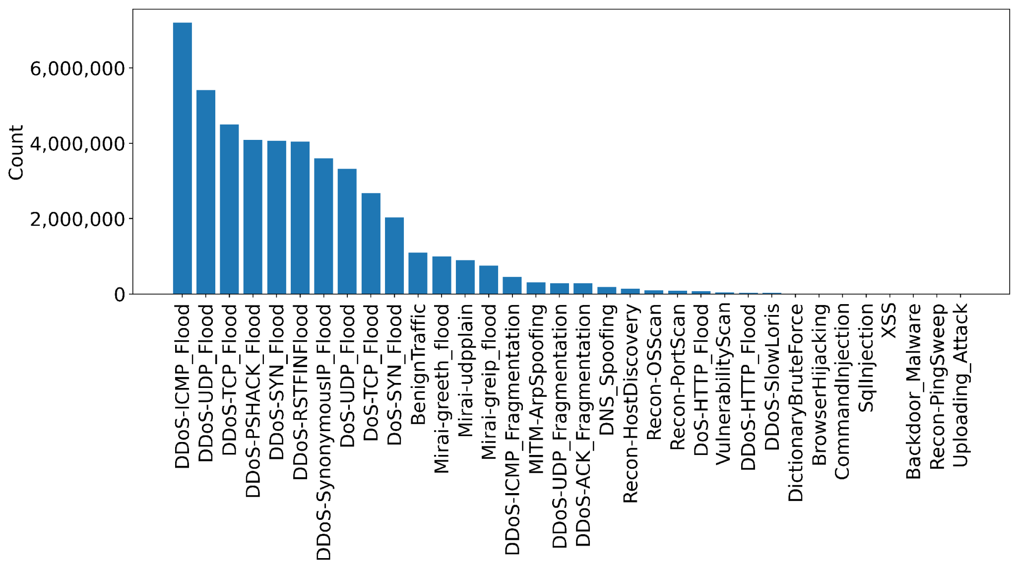
2. The CICIoT2023 Dataset

Slide 5
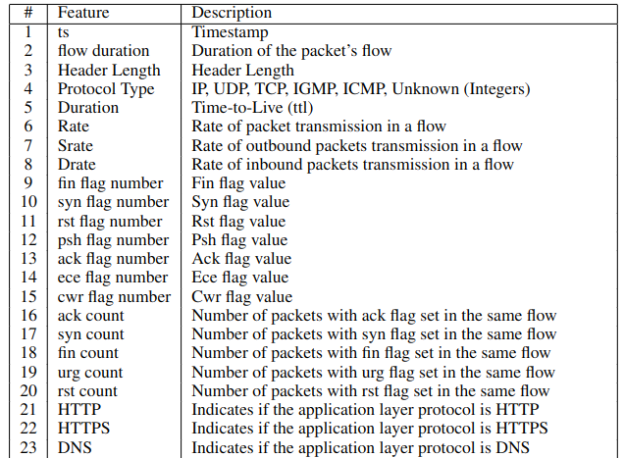
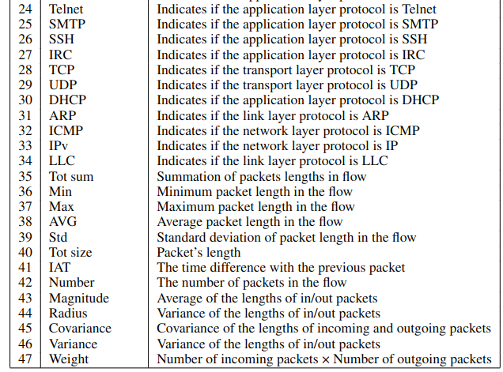
2. The CICIoT2023 Dataset: Features

Slide 6
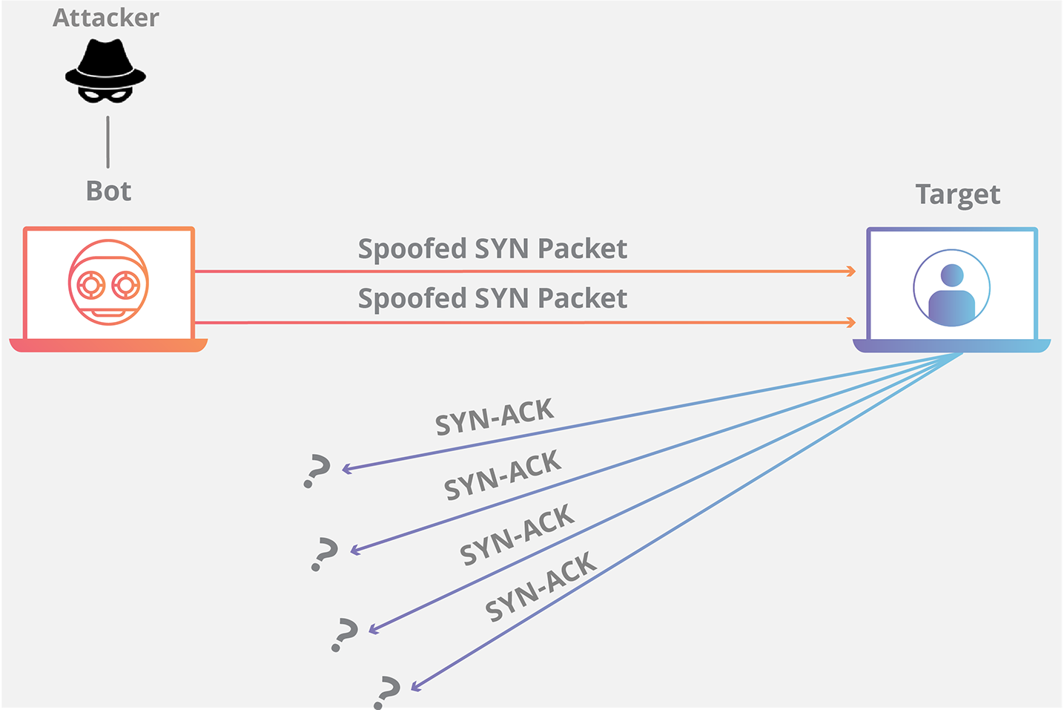
3. The goal
To detect SYN floods attacks within the network by training a binary classifier that discern between:
Bening traffic
SYN flood traffic

Slide 7
4. Models
Logistic Regression
Random Forest Classifier
eXtreme Gradient Boosting (XGBClassifier)
Soft voting classifier
XGB Classifier
Random Forest Classifier
Logistic Regression

Slide 8
5. Results
Packets for
Training: 522,642
Testing: 182,230
After GridSearchCV, we select the XGBoost as best classifier with
{ colsample_bytree=0.5, learning_rate=0.1, max_depth=3}
We got,
Accuracy = 0.999
Recall = 0.999
Precision = 0.999
F1-Score = 0.999

Slide 9
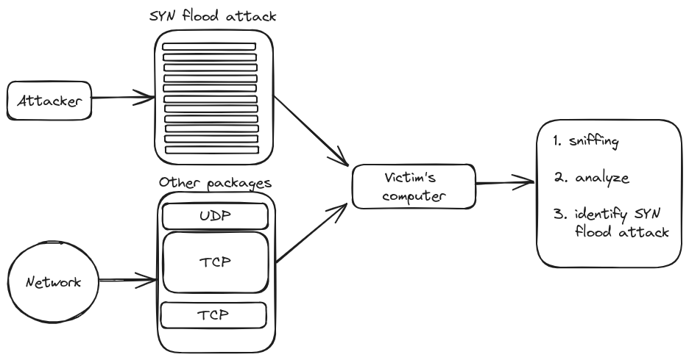
6. Demo
DoS SYN flood attack:
$ sudo hping3 -S --flood <IP_VICTIM>
DdoS SYN flood attack:
$ sudo hping3 -S --flood —rand-source <IP_VICTIM>

Slide 10
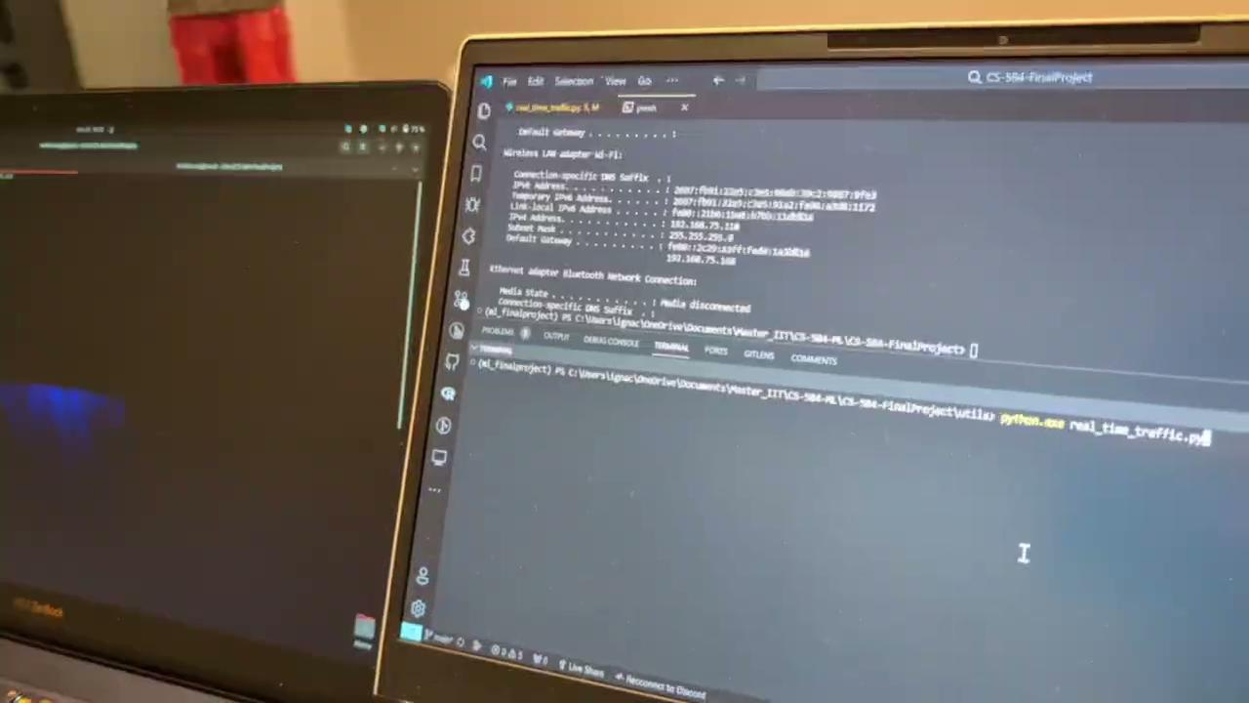
6. Demo
Packets read | 1000
Packets from Attacker (Ground Truth) | 698
Recall | 1
Precision | 0.96
Accuracy | 0.96
Results from the demonstration

Slide 11
7. Conclusions
While the project did not aim to create a state-of-the-art ML model for cyber security attacks, it successfully developed a system that works in real time. This accomplishment is significant as it meets the project’s goal of creating a functional and efficient system.

Slide 12
Thanks for your attention!

