Slide 1

Unraveling wine Quality patterns
Advanced data science
w/ ibm specialization
> capstone project
Ignacio Gomez valverde

Slide 2
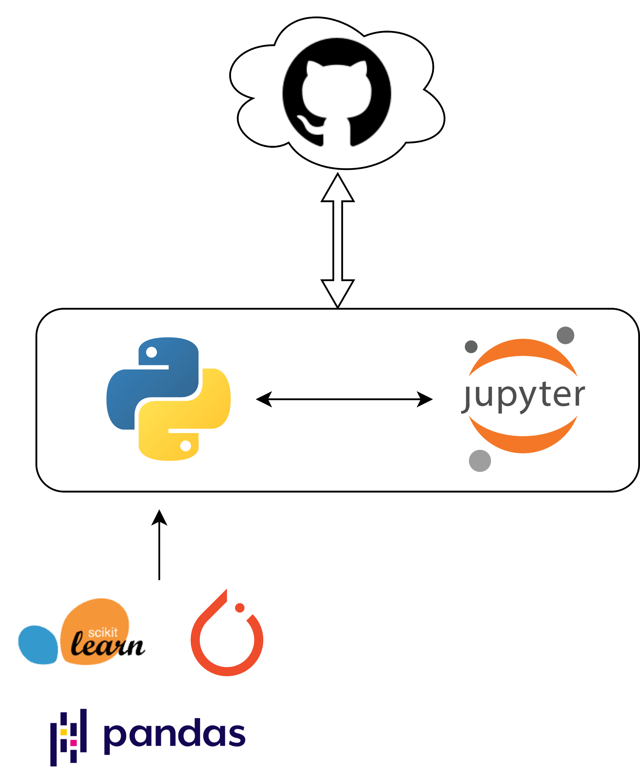
Solution Architecture / Use cases
Wine Quality Prediction
Wine Color Classification
NachoGV/IBM_Project (github.com)

Slide 3
UCI Wine quality Dataset
Fixed Acidity | Volatile Acidity | Citric Acid | Residual Sugar | Chlorides | Free Sulfur Dioxide | Total Sulfur Dioxide | Density | pH | Sulphates | Alcohol | Quality | Color
7.4 | 0.7 | 0 | 1.9 | 0.076 | 11 | 34 | 0.9978 | 3.51 | 0.56 | 9.4 | 5 | red
7.8 | 0.88 | 0 | 2.6 | 0.098 | 25 | 67 | 0.9968 | 3.2 | 0.68 | 9.8 | 5 | red
7.8 | 0.76 | 0.04 | 2.3 | 0.092 | 15 | 54 | 0.997 | 3.26 | 0.65 | 9.8 | 5 | red
11.2 | 0.28 | 0.56 | 1.9 | 0.075 | 17 | 60 | 0.998 | 3.16 | 0.58 | 9.8 | 6 | red
… | … | … | … | … | … | … | … | … | … | … | … | …
6.6 | 0.32 | 0.36 | 8 | 0.047 | 57 | 168 | 0.9949 | 3.15 | 0.46 | 9.6 | 5 | white
6.5 | 0.24 | 0.19 | 1.2 | 0.041 | 30 | 111 | 0.99254 | 2.99 | 0.46 | 9.4 | 6 | white
5.5 | 0.29 | 0.3 | 1.1 | 0.022 | 20 | 110 | 0.98869 | 3.34 | 0.38 | 12.8 | 7 | white
6 | 0.21 | 0.38 | 0.8 | 0.02 | 22 | 98 | 0.98941 | 3.26 | 0.32 | 11.8 | 6 | white
6497 wines x 11 features + 2 targets
https://archive.ics.uci.edu/dataset/186/wine+quality

Slide 4
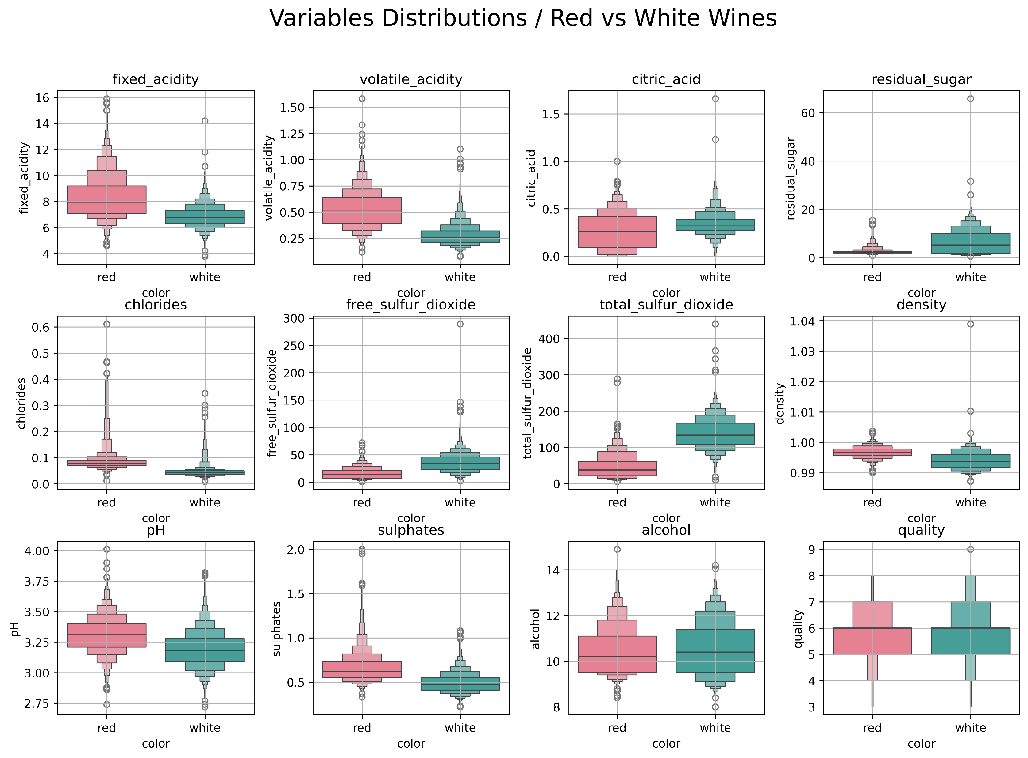
Data Exploration
Pre-processing
Data QA – No missing values
Data types assurance
One Hot Encoding – Color
Normalization – Standard Scaler

Slide 5
models
Model | Scores (Mean Accuraccy)
Logistic Regression | 0.53
Random Forest Regressor | 0.50
Gradient Boost Regressor | 0.49
MLP Regressor | 0.36
PyTorch Neural Network | 0.56
Prediction
BEST
Model | Scores (Accuracy)
Support Vector Classifier | 0.994
Random Forest Classifier | 0.996
Gradient Boost Classifier | 0.996
MLP Classifier | 0.997
PyTorch Neural Network | 0.998
Classification
BEST

Slide 6



THANK YOU!
NachoGV/IBM_Project (github.com)
Ignacio Gómez Valverde | LinkedIn
ignacio.gvalverde@gmail.com

