Slide 1
A Tale of Two Recessions
Comparing/Contrasting 2008/2009 Recession to 2020 Recession
Date: Saturday, April 18, 2020
Project and Presentation by Group 2:
Zahra Ahmadi, Sumeet Maheshwari,
Brian Remite, Bryan Wilson
Notes:
Quick intro to project (Bryan W. speaks)- Then each group member introduces themselves (All speak)

Slide 2
Background Information & Hypothesis
Recessions
Narrowing the Focus
Hypothesis
We have chosen to focus on the two most recent recessions that pertain to the U.S. economy.
2008/2009 (Financial Bubble)
2020 (COVID-19 pandemic)
In this study, we narrowed our research to 3 month time-periods for two reasons:
The 2020 recession only has 3 months of relevant, verified data.
To keep the focus of our research on equal time spans.
The 2020 recession has been worse statistically, in terms of the value lost in the stock market ( % & $ ), as well as unemployment rate. (% and total pop. unemployed)
Notes:
Overview of project purpose, timespan focused on, and state hypothesis. (Bryan W. speks)

Slide 3
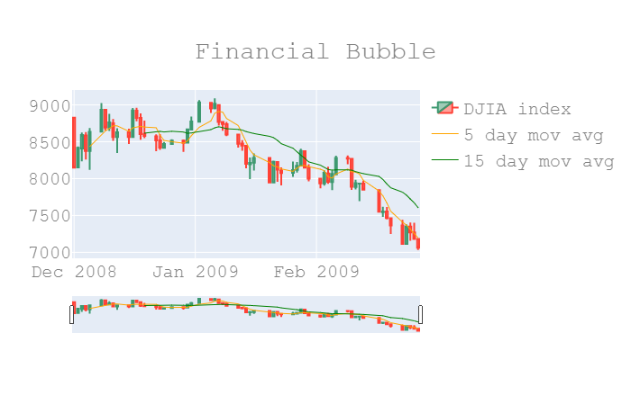
Stock Market Graph (2008-2009)
Notes:
Sumeet speaks

Slide 4
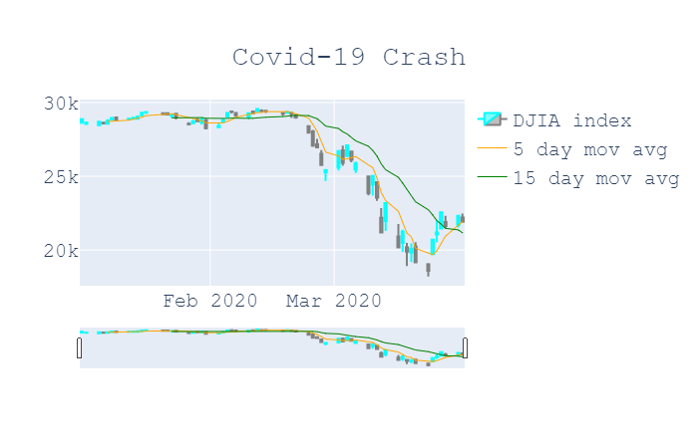
Stock Market Graph (2020)
Notes:
Sumeet speaks

Slide 5
Most Significant Rate of Change for Each Recession
Dates (2008-09): 02/10/09-02/25/09]
Percentage Drop: 9.6%
Rate of Change(Slope): -51.9
Dates (2020): 03/09/20-03/24/20
Percentage Drop: 23.6%
Rate of Change(Slope): -405.2
Notes:
Sumeet speaks

Slide 6
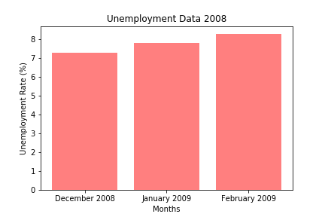
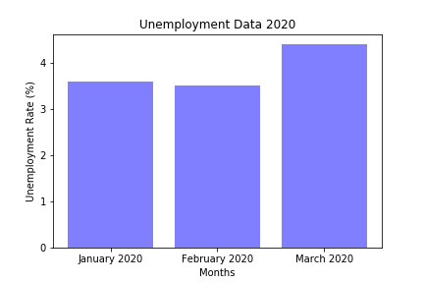
Unemployment Graphs
February 2009: 12.5 million unemployed*
March 2020: 7.1 million
unemployed*
*Source: Bureau of Labor Statistics
Notes:
Zahra speaks

Slide 7
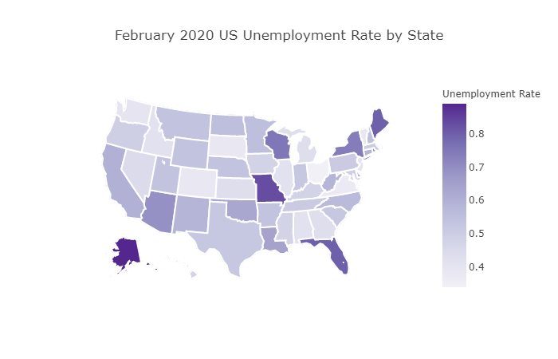
Unemployment Heatmap (Feb. 2020)
Darker shade =
Higher unemployment
Notes:
Zahra speaks

Slide 8
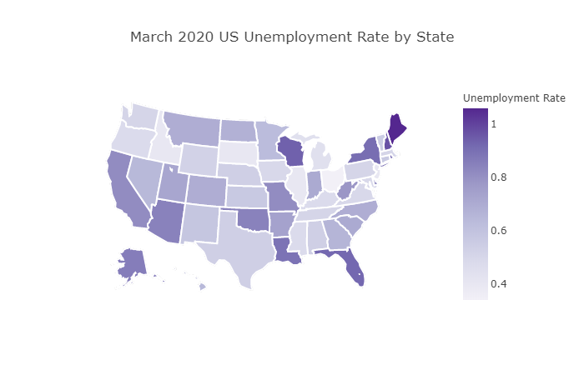
Unemployment Heatmap (Mar. 2020)
Darker shade =
Higher unemployment
Notes:
Zahra speaks

Slide 9
Important Fact Regarding
2020 Unemployment Data
Due to the ongoing nature of the 2020 recession, the most up-to-date (official) unemployment data only goes through March 2020.
According to the most recent reports, the U.S. is poised to shatter the historical unemployment rate high.
**Prediction models are showing a very significant increase in unemployment rate in the next few months.
Prediction: April 2020 (9.5%), May 2020 (12.5%), and June (15%).
**Source for projection data:
TradingEconomic.org
Notes:
Zahra speaks

Slide 10
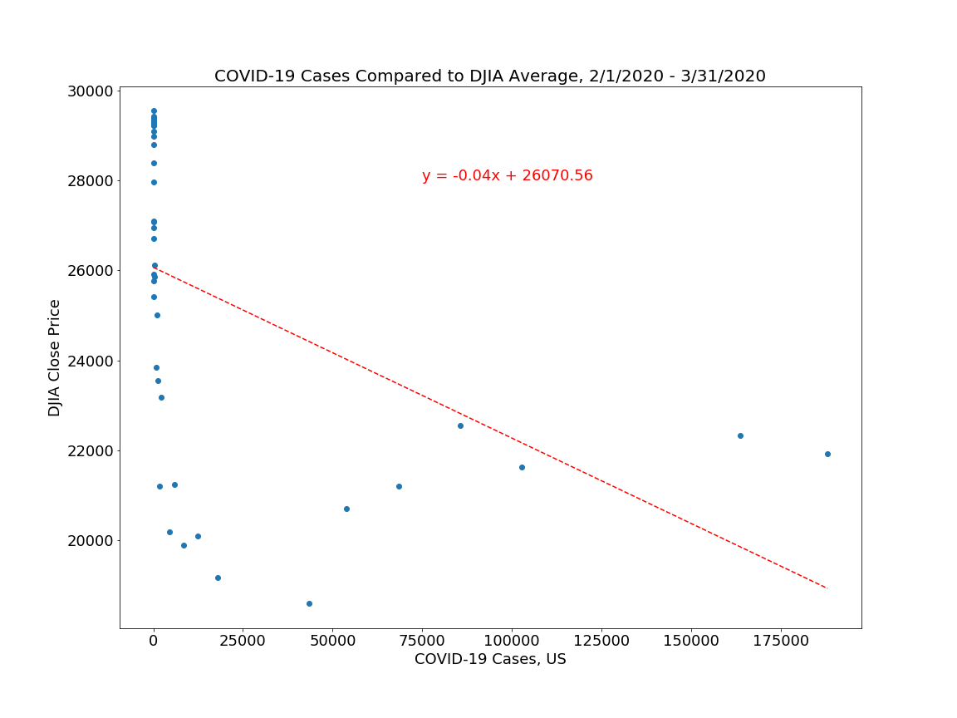
Linear Regression of Covid-19 Cases and DJIA Average
R-squared = 0.21052 [21.05%]
P value = 0.00255 [00.03%]
R-squared -This value indicates that this linear regression accounts for approximately 20% of the variation around its mean within the data, and therefore the correlation is most likely not linear.
P-value
-There is less than a 1% chance that the variation is random.
Notes:
Shows relationship between Stock Market drop and Covid-19 Case Count. (Brian R. speaks)

Slide 11
Transition to “Spotlight” Companies
Notes:
Brian R. hands off to Bryan W.

Slide 12
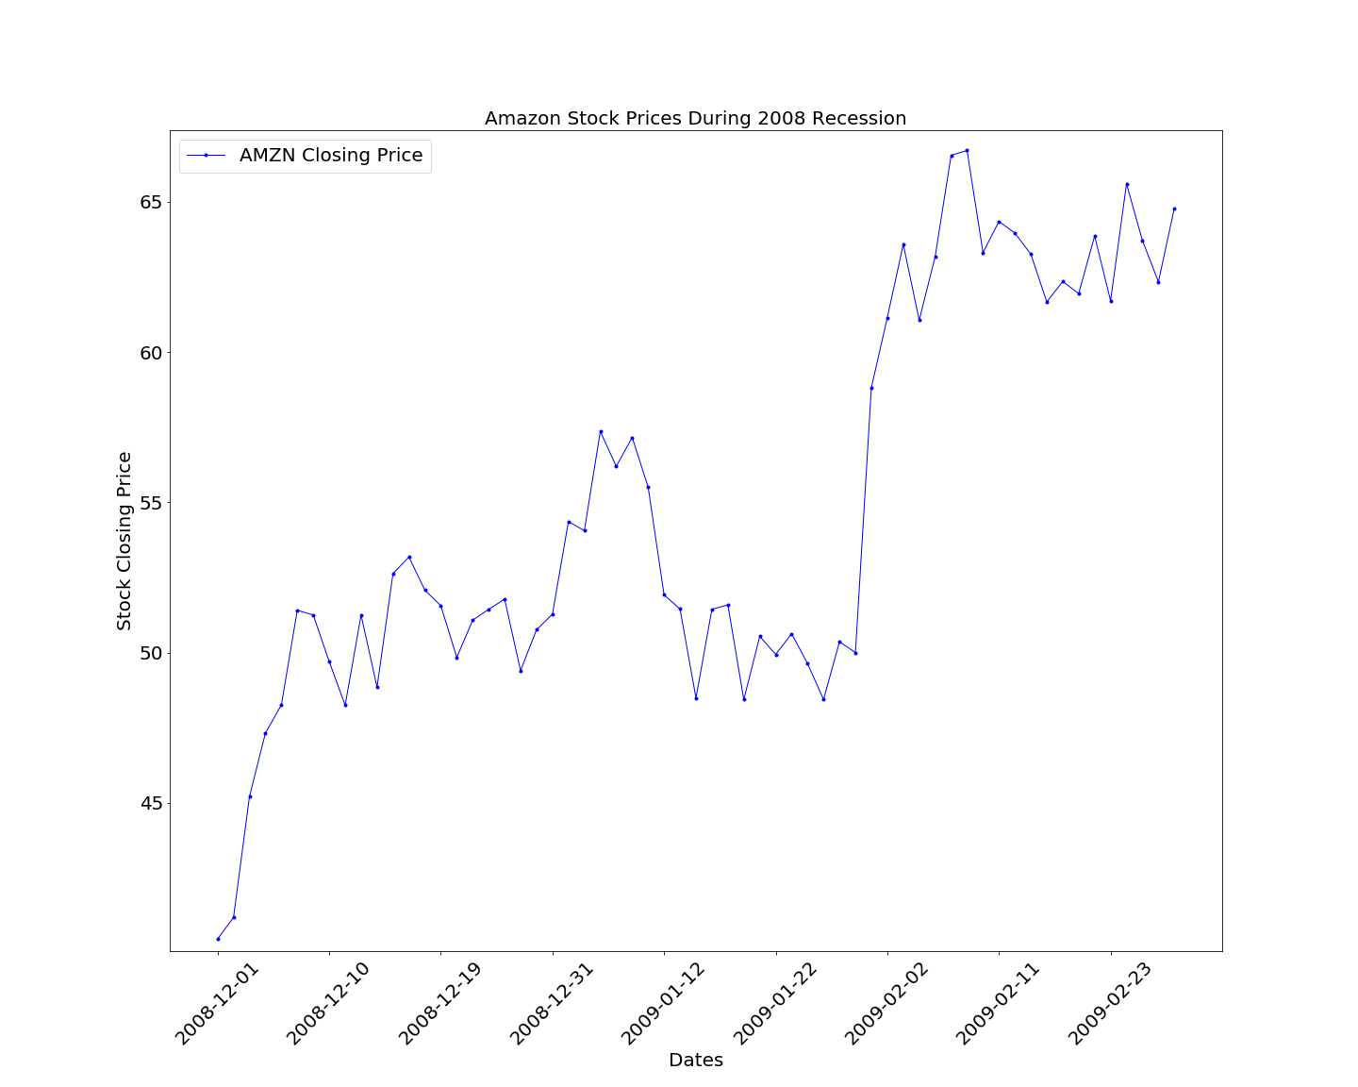
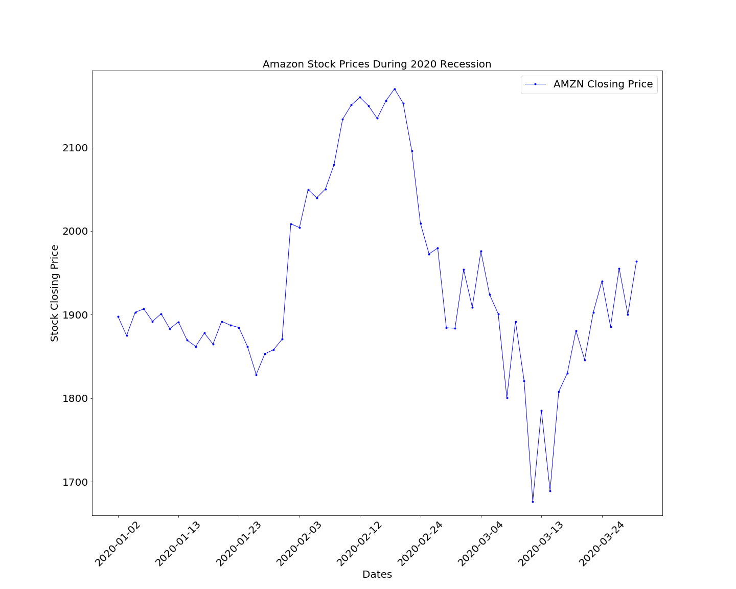
Amazon (AMZN)
2008-2009 Recession
Amazon (AMZN)
2020 Recession

Slide 13
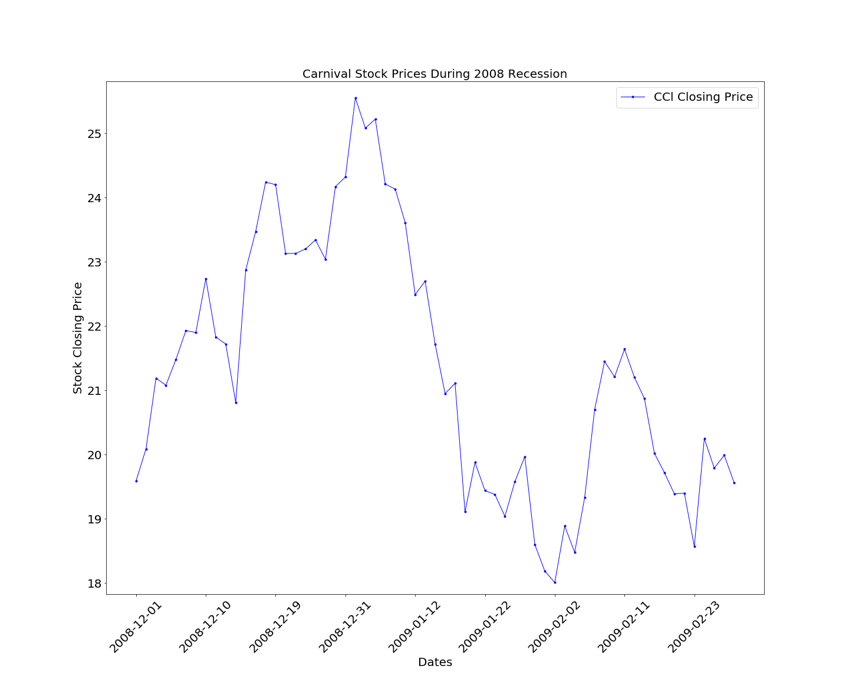
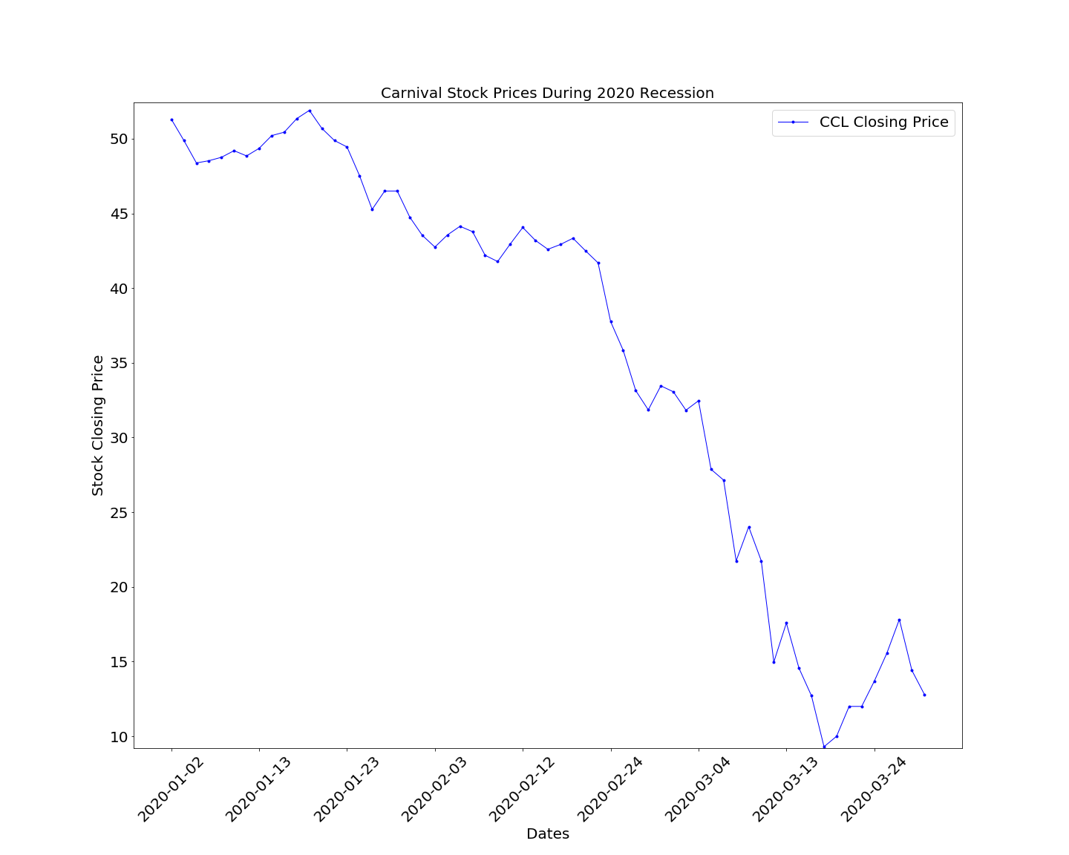
Carnival (CCL)
2008-2009 Recession
Carnival (CCL)
2020 Recession

Slide 14
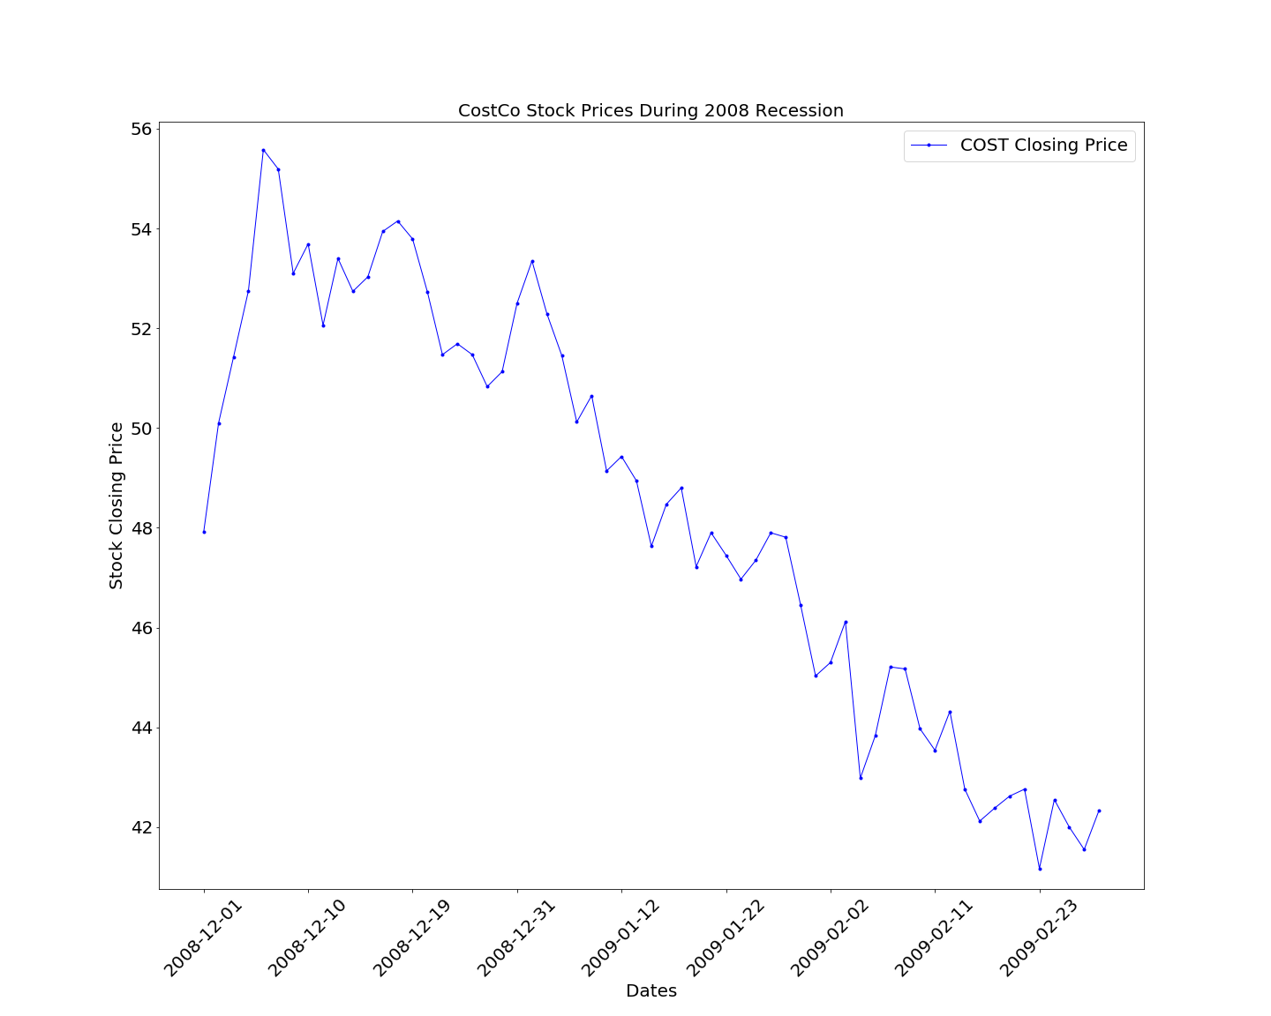
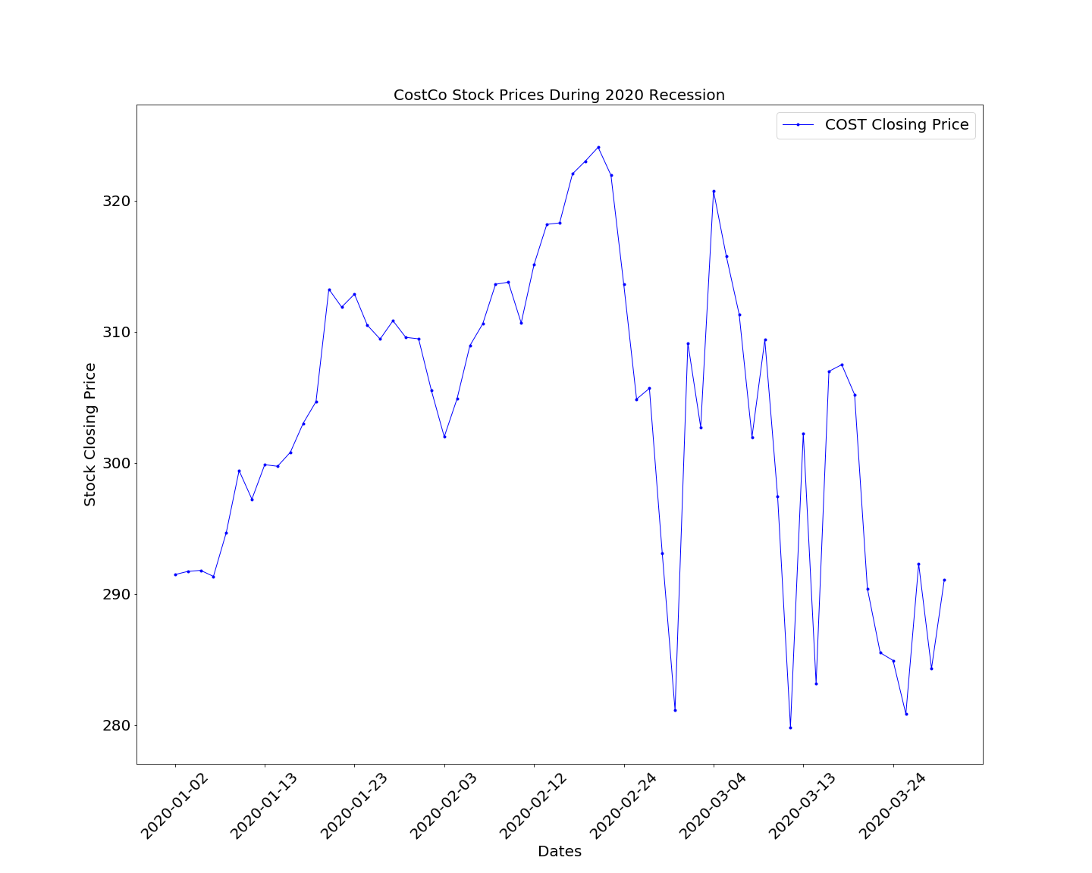
Costco (COST)
2008-2009 Recession
Costco (COST)
2020 Recession

Slide 15
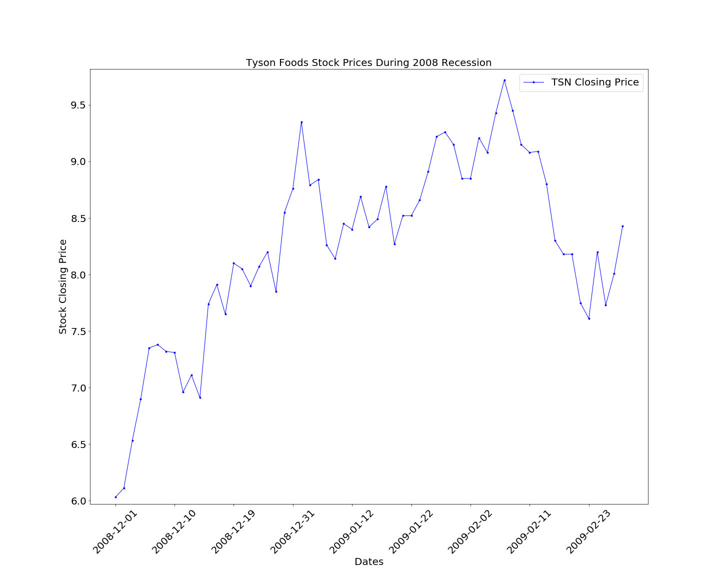
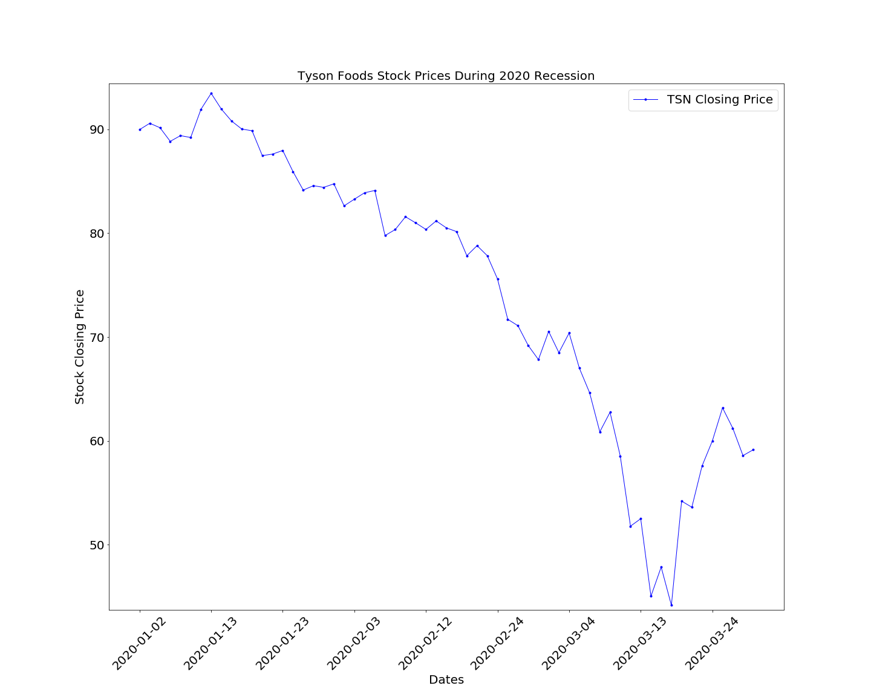
Tyson Foods (TSN)
2008-2009 Recession
Tyson Foods (TSN)
2020 Recession

Slide 16
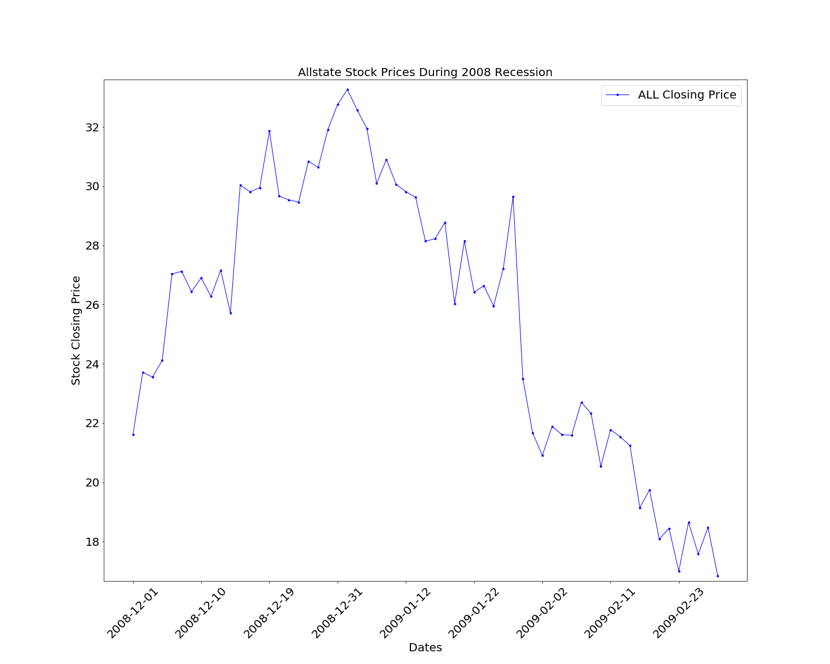
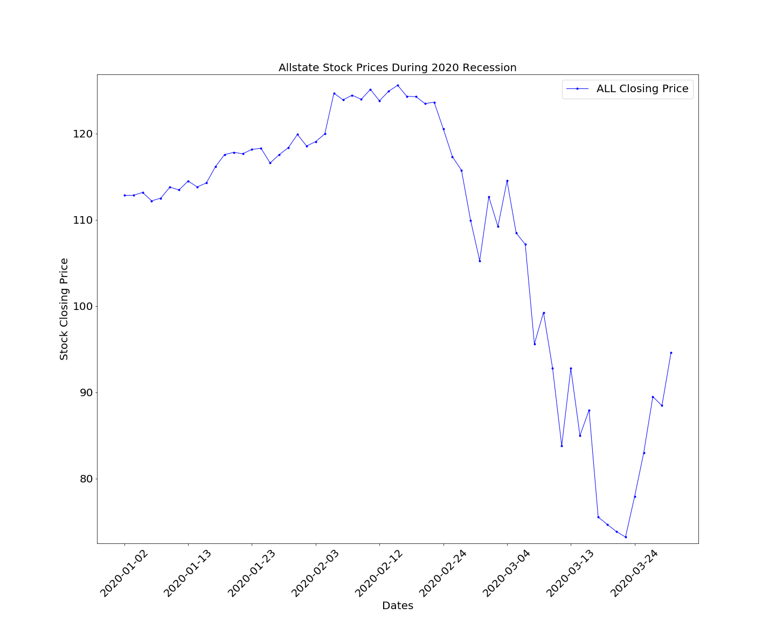
AllState (ALL)
2008-2009 Recession
AllState (ALL)
2020 Recession

Slide 17
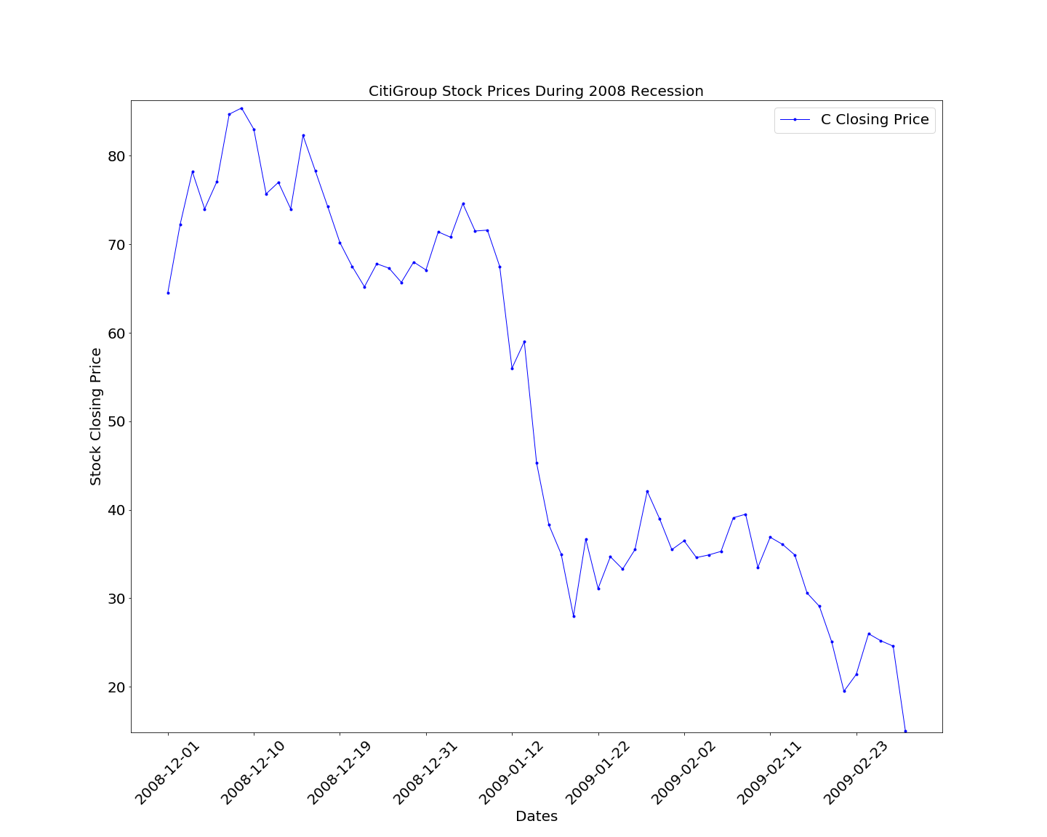
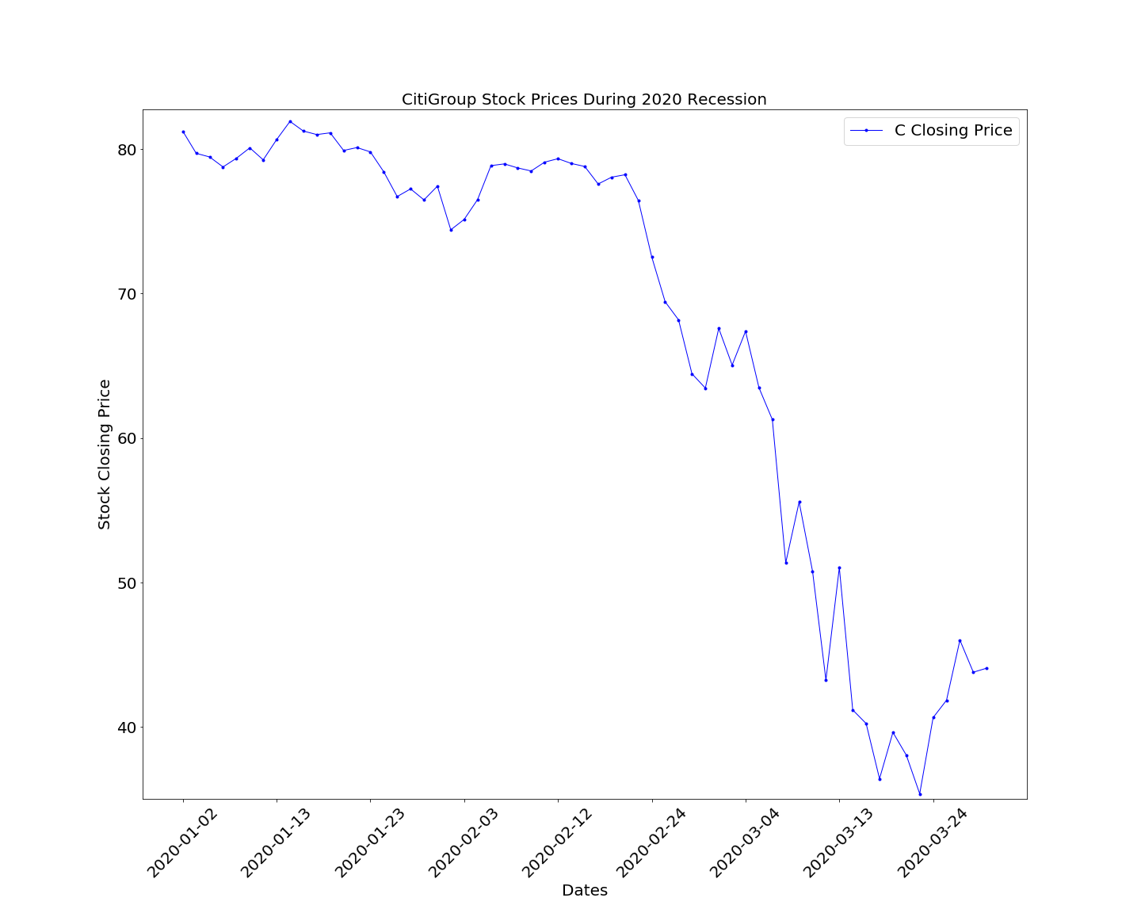
Citi Bank (C)
2008-2009 Recession
Citi Bank (C)
2020 Recession

Slide 18
Conclusion
The linear regression plot of the DJIA vs. COVID cases in the U.S. showed that there was a P-value of .002, meaning that there is less than a 1% chance of the variation being random, however the R-squared value was .20. These values indicate that there is a relationship, but not a linear correlation between those two data sets.
We can not yet definitively prove that unemployment will be worse in this recession, as the unemployment rate for the remainder of the 2020 recession is not yet unavailable. The data we studied showed an upwards trend; however a 3-month projection shows drastic increases in unemployment, which would shatter the all-time unemployment high.
Based on the data regarding the time period we have available to us for COVID-19, our hypothesis was correct on both metrics measured.*
*However, at this time, we must acknowledge the fact that the 2020 recession is still ongoing.

Slide 19
Research data sources (Works Cited)
DJIA Data: Yahoo Finance https://finance.yahoo.com/quote/%5EDJI/history?
Stock Data: Yahoo Finance API pip install yfinance
COVID Data: The New York Times https://github.com/nytimes/covid-19-data
Unemployment Data: Trading Economics
https://tradingeconomics.com/united-states/unemployment-rate
Unemployment Rate by State: https://www.bls.gov/
Data Plot Sources: https://plotly.com/, https://pypi.org/project/chart-studio/

Slide 20
Questions?

