Slide 1

Social Media Website
This project outlines the development of a dynamic social media platform that aims to foster meaningful connections, encourage content sharing, and provide a seamless user experience. The website will cater to a wide audience, enabling users to effortlessly engage with friends, family, and like-minded individuals.
Nachiket Jadhav - 33134
Sahil Joshi - 33135
Viraj Kakade - 33136
Sahil Kenia - 33137
Rudraksh Khandelwal - 33139

Slide 2
Objectives of the Social Media Website
Community Building
Content Curation
User Engagement
Facilitate the creation of online communities where users can interact, share interests, and form meaningful connections.
Empower users to curate and share diverse content, ranging from personal updates to engaging multimedia, fostering a vibrant and dynamic platform.
Develop innovative features that encourage active user participation, such as real-time updates, interactive discussions, and personalized recommendations.

Slide 3
Key Features of the Social Media Website
1
Intuitive User Interface
2
Newsfeed and Sharing
A clean, modern, and responsive design that enhances user experience and navigation.
A personalized newsfeed that allows users to share updates, photos, videos, and other engaging content.
3
Profiles and Connections
Comprehensive user profiles and the ability to connect with friends, family, and like-minded individuals.

Slide 4

Design Principles and Approach
1
User-Centric Design
The website's design and features will be centered around the needs and preferences of the target audience, ensuring a tailored and engaging experience.
2
Responsive and Adaptive
The platform will be optimized for seamless use across various devices, from desktops to mobile, providing a consistent and adaptable experience.
3
Iterative Development
The development process will follow an iterative approach, allowing for continuous feedback, testing, and refinement to deliver a polished and robust solution.

Slide 5
Terminologies and Technologies Used
Front-end Technologies
Back-end Technologies
HTML5, CSS3, JavaScript, Angular
Node.js, Express.js, AppWrite
Database and Storage
MongoDB

Slide 6




Challenges Faced During Development
Scalability
Ensuring the platform can handle a growing user base and increasing content without compromising performance.
Security and Privacy
Implementing robust security measures and data privacy protocols to protect user information and prevent unauthorized access.
Content Moderation
Developing effective content moderation strategies to maintain a safe and inclusive community, while respecting user freedom of expression.

Slide 7
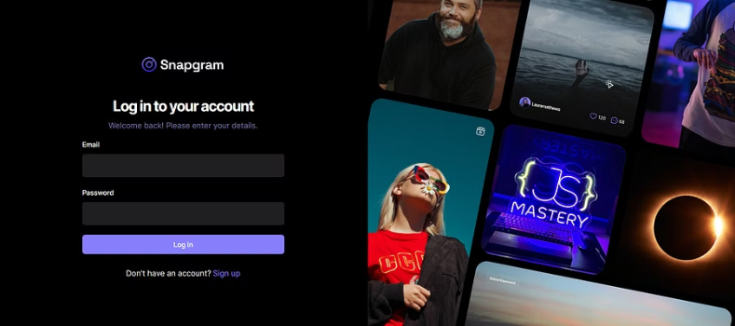
Output 1

Slide 8
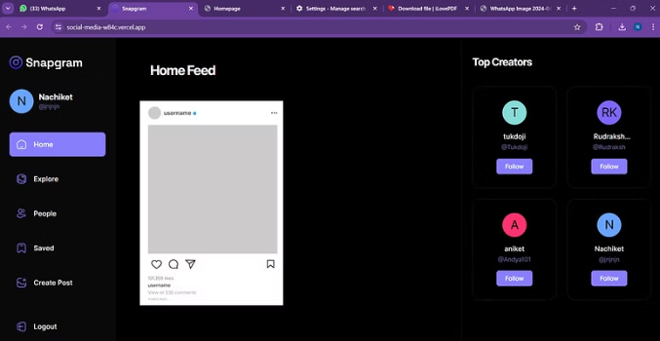
Output 2

Slide 9

Output 3

Slide 10




Future Scope and Enhancements
Mobile App
Live Streaming
AI-powered Features
Ecommerce Integration
Develop a responsive mobile application for seamless social media experience on-the-go.
Integrate live streaming capabilities to enable real-time video sharing and interactive sessions.
Implement AI-driven recommendations, content personalization, and smart user engagement tools.
Explore opportunities for ecommerce integration, allowing users to discover and purchase products within the platform.

Slide 11
References and Resources
Social Media Trends and Industry Insights
Social Media Today
User Experience and Design Best Practices
Nielsen Norman Group
Web Development Frameworks and Libraries
React.js, Angular, Vue.js
Online Privacy and Security Guidelines
Internet Society

