Slide 1
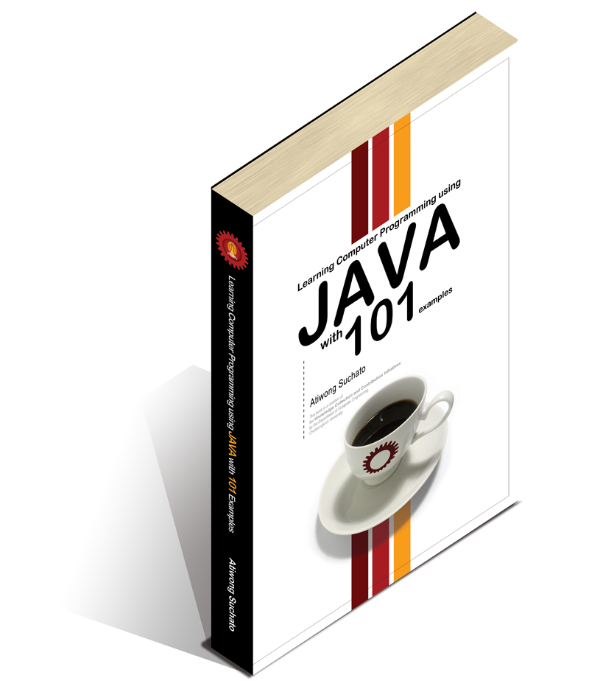
Arrays
Searching & Sorting Data
Chapter 9
Part I

Slide 2
Objectives
Students should:
Be able to define, initialize, and use one-dimensional as well as multidimensional arrays correctly.
Be able to use arrays as well as their elements as parameters to methods.
Be able to write code to sort array elements in any orders desired.
Be able to write code to search for elements in an array.
Be able to use arrays in problem solving using computer programs.
To come in
Part II
Chapter 9
Part I

Slide 3

Requirement for a List of Values
Write a program that counts the number (frequency) of each digit from 0 to 9 in a String entered by the user.
CountDigitFrequency.java
Array
Now, let’s use a single array to keep track of the frequencies of every digit.
A single identifier refers to a structure with multiple slots
a
CountDigitFrequency2.java
Notes:
CountDigitFrequency.java
user inputs a string of numbers and
the program will count the frequency for each digit from 0 to 9
CountDigitFrequency2.java = array version

Slide 4
Array Syntax
Name of variable
Array Variable Declaration
ElementType [ ] identifier;
Array Initialization
new ElementType[NumberOfSlots]
Data type of the elements to be stored in the array
Number of elements to be stored in the array (positive number)

Slide 5
Array Declaration/Initialization
freq
int [] freq;
freq = new int[10];
0
0
0
0
0
0
0
0
0
0
ans
boolean [] ans;
ans = new boolean[3];
false
false
false
names
String [] names = new String[2];
null
null
Notes:
Default value
Int = 0
Boolean = false
String = null

Slide 6
Default Values for Elements
When an array is initialized, all elements are automatically set to default values, which are:
Zeros
false
null
for numeric primitive
data types
for boolean
for non-primitive data types (classes)

Slide 7
null
A Java constant.
can be referenced with any non-primitive variables
normally used as a representation of “nothingness”

Slide 8
null
public class NullDemo{
public static void main(String [] args){
String [] s = new String[5];
for(int i=0;i<s.length;i++){
System.out.println("s["+i+"] = "+s[i]);
}
if(s[0]==null){
System.out.println("Yes, s[0] is null.");
}
System.out.println("Its length is "+s[0].length());
}
}
will throw NullPointerException
NullDemo.java

Slide 9
Accessing an Element
freq
int [] freq;
freq = new int[10];
0
0
0
0
0
0
0
0
0
0
freq
freq[0] = 5;
freq[1] = 8;
freq[9] = 7;
5
8
0
0
0
0
0
0
0
7
System.out.println(freq[1]);
8
Notes:
There are 3 steps:
Reserve a memory
Access to assign value
Access to read value

Slide 10
Indices of an array
The first element in an array is at the index
The last element of an array with n elements is at the index
0
n-1
NOT 1 !!
NOT n !!
Notes:
Start index = 0
End index = n-1

Slide 11
Initializer List
Use to explicitly assign value to each element in the array at the time it is initialized.
int [] a = {1,2,3,4,5};
String [] programs =
{“ADME”, ”AERO”, “ICE”, ”NANO”};
boolean [] allTrue =
{true, true, true};
instead of letting them be the default values at initialization of the array
Can ONLY be used in the same statement where the variable is declared.
!!!
int [] a;
a = {1,2,3,4,5}; // This is invalid.
Notes:
Explicit assignment from the declaration

Slide 12
Array Traversal
String [] programs
= {“NANO”, “ADME”, “ICE”, “AERO”};
for(int i=0;i<programs.length;i++){
System.out.println(programs[i]);
}
An attribute of an array whose value equals the number of slots.
Notes:
Array traversal
- Array.length

Slide 13
Array Variables are Reference Variables
numStudent
[0]
[1]
[2]
[3]
int [] numStudent =
{31,30,35,28};
31
30
35
28
numStudent
[0]
[1]
[2]
[3]
numStudent[2] = 99;
31
30
99
28
numStudent
[0]
[1]
[2]
[3]
numStudent = new int[5];
31
30
99
28
[0]
[1]
[2]
[3]
[4]
0
0
0
0
0

Slide 14

What is the output?
int [] a = {8,7,6,5};
int [] b = {4,3,2,1};
b = a;
a[1] = b[2] + a[2];
System.out.println(b[1]);

Slide 15
int [] a = {8,7,6,5};
int [] b = {4,3,2,1};
b = a;
a[1] = b[2] + a[2];
System.out.println(b[1]);
a
8
7
6
5
b
4
3
2
1
int [] a = {8,7,6,5};
int [] b = {4,3,2,1};
b = a;
a[1] = b[2] + a[2];
System.out.println(b[1]);
a
8
7
6
5
b
4
3
2
1

Slide 16
a
8
7
6
5
b
4
3
2
1
int [] a = {8,7,6,5};
int [] b = {4,3,2,1};
b = a;
a[1] = b[2] + a[2];
System.out.println(b[1]);

Slide 17
a
8
12
6
5
b
4
3
2
1
int [] a = {8,7,6,5};
int [] b = {4,3,2,1};
b = a;
a[1] = b[2] + a[2];
System.out.println(b[1]);
12

Slide 18
Important Algorithms
SEARCHING
looking for a specific value in an array
SORTING
arranging elements in an array so that
they are in specific orders

Slide 19

Sequential Search
“
Checking every element
one at a time
”
in sequence

Slide 20
Sequential Search
Looking for the position that contains 9
Is this
9
?
5
6
0
9
3
[0]
[1]
[2]
[3]
[4]

Slide 21
Sequential Search
Looking for the position that contains 1
Is this
1
?
NOT FOUND!
5
6
0
9
3
[0]
[1]
[2]
[3]
[4]

Slide 22
Sequential Search
public static int seqSearch(int [] a, int k){
int i = 0;
int len = a.length;
while(i<len && a[i]!=k){
i++;
}
if(i>=len) i=-1;
return i;
}

Slide 23
Sorting
a[0]
a[1]
a[2]
a[3]
Sort
Increasingly!
a[0]
a[1]
a[2]
a[3]

Slide 24

Selection Sort
“
or the i^{th} biggest
In the i ^{th} iteration,
find the i ^{th} smallest item
and
place it in the correct position.
”
How many iteration
is needed to sort
elements?
N

Slide 25
Selection Sort
It #
a[0]
a[1]
a[2]
a[3]
1
Find the (1st) smallest item
Place it at a[0]
The correct position

Slide 26
Selection Sort
It #
a[0]
a[1]
a[2]
a[3]
1
Find the (1st) smallest item
Place it at a[0]
Search Range (0 to 3)
The smallest

Slide 27
Selection Sort
It #
a[0]
a[1]
a[2]
a[3]
1
Find the (1st) smallest item
Place it at a[0]
Swap element between a[0] and a[3]
Search Range (0 to 3)

Slide 28
Selection Sort
It #
a[0]
a[1]
a[2]
a[3]
1
Find the (1st) smallest item
Place it at a[0]
Iteration # 1 is finished
with a[0] sorted
Sorted

Slide 29
Selection Sort
It #
a[0]
a[1]
a[2]
a[3]
2
Find the 2nd smallest item
Place it at a[1]
Search Range (1 to 3)
Sorted
The smallest

Slide 30
Selection Sort
It #
a[0]
a[1]
a[2]
a[3]
2
Find the 2nd smallest item
Place it at a[1]
Search Range (1 to 3)
Sorted

Slide 31
Selection Sort
It #
a[0]
a[1]
a[2]
a[3]
2
Find the 2nd smallest item
Place it at a[1]
Iteration # 2 is finished
with a[0]-a[1] sorted
Sorted

Slide 32
Selection Sort
It #
a[0]
a[1]
a[2]
a[3]
3
Find the 3rd smallest item
Place it at a[2]
Search Range (2 to 3)
The smallest
Sorted

Slide 33
Selection Sort
It #
a[0]
a[1]
a[2]
a[3]
3
Find the 3rd smallest item
Place it at a[2]
Search Range (2 to 3)
Sorted

Slide 34
Selection Sort
It #
a[0]
a[1]
a[2]
a[3]
3
Find the 3rd smallest item
Place it at a[2]
Iteration # 3 is finished
with a[0]-a[2] sorted
Sorted

Slide 35
Selection Sort
It #
a[0]
a[1]
a[2]
a[3]
3
Find the 3rd smallest item
Place it at a[2]
How about
a[3]
Sorted

Slide 36
Selection Sort Algorithm
Sorting N elements
Let k be the first index the unsorted array.
[0]
[1]
…
[k-1]
[k]
…
[N]
Sorted
Unsorted

Slide 37
Selection Sort Algorithm
Sorting N elements
Let k be the first index the unsorted array.
How does the value of k change
during the entire sorting procedure?
k is
[0]
[1]
…
[k-1]
[k]
…
[N]
At the beginning, | 0
When the sorting is completed | N-1
Sorted
Unsorted

Slide 38
Selection Sort Algorithm
Sorting N elements
k = 0
Let k be the first index the unsorted array.
k <=(N-1)
Find the smallest element
in the unsorted part.
[0]
[1]
…
[k-1]
[k]
…
[N]
Swap the smallest element
with the k^{th} element.
Sorted
Unsorted
Done
k++

Slide 39
SelectionSort
k = 0
public static void
selectionSort(double [] a){
// Try implementing
// the procedure
// in the flowchart
}
k <=(N-1)
Find the smallest element
in the unsorted part.
Swap the smallest element
with the kth element.
Return
k++

