Slide 1

Arrays
Multi-dimensional Arrays
Chapter 9
Part II

Slide 2
Objectives
Students should:
Be able to define, initialize, and use one-dimensional as well as multidimensional arrays correctly.
Be able to use arrays as well as their elements as parameters to methods.
Be able to write code to sort array elements in any orders desired.
Be able to write code to search for elements in an array.
Be able to use arrays in problem solving using computer programs.
Chapter 9
Part II
Notes:
คุ้นเคยกับองค์ประกอบของระบบคอมพิวเตอร์และหน้าที่ของมัน
เพื่อให้ได้แนวคิดเกี่ยวกับการแก้ปัญหาโดยการทำโปรแกรมคอมพิวเตอร์

Slide 3
Multi-dimensional Arrays
a
They are just arrays of which
1
6
9
Each
Element
b
An array of
int
is also
An Array
1
2
An array of
arrays of int
3
6
9
0
0
0
0

Slide 4
Element Indices
b
b[0]
b[1]
b[2]
The type of b is array of arrays of int
b[2][0]
b[2][1]
1
2
b[1][0]
b[1][1]
b[1][2]
Two-dimensional
Array of int
3
6
9
b[0][0]
b[0][1]
b[0][2]
b[0][3]
0
0
0
0
4

Slide 5
Variable Declaration/Initialization
int [][] lookUpTable;
String [][] classRoster;
double [][][] data;
lookUpTable = new int[2][3];
classRoster = new String[5][10];
data = new double[5][2][3];
array of
arrays of
arrays of
double

Slide 6
Visualizing Multi-dim Array
double [][][] data = new double[5][2][3];
d
d[0]
d[1]
d[2]
d[3]
d[4]
d[1][1][0]
d[1][1][1]
d[1][1][2]
0.0
0.0
0.0
d[1][0]
d[1][1]
d[1][0][0]
d[1][0][1]
d[1][0][2]
0.0
0.0
0.0
d[0][0]
d[0][1]
d[0][1][0]
d[0][1][1]
d[0][1][2]
0.0
0.0
0.0
d[0][0][0]
d[0][0][1]
d[0][0][2]
0.0
0.0
0.0

Slide 7
Initializer List
int [][] k ={{1,2},{3,4,5},{8,10,12,14}};
k[0]
k[1]
k[2]
k
1
2
k[0]
k[1]
3
4
5
k[2]
8
10
12
14

Slide 8
Example
public class MultiDimArrayPeople1 {
public static void main(String [] args) {
String [][] people = {
{"Ann","Betty"},
{"Celine","David","Ella"},
{"Finn","George"}
};
System.out.println(people[0][0]);
System.out.println(people[1][2]);
System.out.println(people[2].length);
System.out.println(people.length);
}
}
Notes:
Ann
Ella
2
3

Slide 9
people[0][0]
people
people
“Betty”
people[0]
“Ann”
people[1][2]
people[1]
people[2]
“Ella”
“David”
“Celine”
people[2]
“George”
“Finn”

Slide 10
Example
public class MultiDimArrayPeople2 {
public static void main(String [] args) {
String [][] people = {
{"Ann","Betty"},
{"Celine","David","Ella"},
{"Finn","George"}
};
String [] group1 = {"Aaron","Barry","Brian"};
people[0] = group1;
System.out.println(people[0][1]);
}
}
Notes:
Barry

Slide 11
String [] group1 = {"Aaron","Barry","Brian"};
“Aaron”
“Barry”
“Brian”
Group1
people
“Betty”
people[0]
“Ann”
people[1]
people[2]
“Ella”
“David”
“Celine”
“George”
“Finn”

Slide 12
people[0] = group1;
“Aaron”
“Barry”
“Brian”
Group1
people
“Betty”
people[0]
“Ann”
people[1]
people[2]
“Ella”
“David”
“Celine”
System.out.println(people[0][1]);
“Barry”
“George”
“Finn”

Slide 13
Multi-dimension traversal (1)
int [][][] d = {
{ {1, 3, 2}, {5, 4}, {7, 6, 8, 9} },
{ {3, 2, 1}, {4, 3, 1, 5} } };
for (int i = 0; i < d.length; i++) {
for (int j = 0; j < d[i].length; j++) {
for (int k = 0; k < d[i][j].length; k++) {
// you can access element i,j,k
// d[i][j][k]
}
}
}
ArrayTravelsal.java

Slide 14
Multi-dimension traversal (2)
int [][][] array3D = {
{ {1, 3, 2}, {5, 4}, {7, 6, 8, 9} },
{ {3, 2, 1}, {4, 3, 1, 5} } };
for (int[][] array2D : array3D) {
for (int [] array1D : array2D) {
for (int data: array1D) {
// you can access each element
// in array as data
}
}
}
ArrayTravelsalForEach.java

Slide 15
Hands-on Experiment
Practice using multi-dim arrays through simple image processing tasks.

Slide 16
RGB-colored Pixels
Red Component: 0 - 255
255 255 255
Green Component: 0 - 255
Blue Component: 0 - 255
0 0 0
255 0 0
0 255 0
0 0 255
127 127 127

Slide 17
Hands-on Experiment
An image of w pixel-wide and h pixel-high is represented using an int[w][h][3] array.
where
The int value at [i][j][0] is the “Red” component of the pixel at (i,j).
The int value at [i][j][1] is the “Green” component of the pixel at (i,j).
The int value at [i][j][2] is the “Blue” component of the pixel at (i,j).

Slide 18
int[][][] image1 = new int[3][5][3];
rgb
Width=3
Height=5 (column3)
0
0
0
0
0
0
255
255
0
Height=5 (column1)
Height=5 (column2)
0
0
0
0
0
0
0
0
0
0
0
0
0
0
0
255
0
0
100
100
100
0
255
0
0
0
0
0
0
255
0
0
0
0
0
0

Slide 19
Hands-on Experiment
Given with:
Java101ImageUtil
static int [ ][ ][ ] getRGBArrayFromFile()
static void showViewer(int [ ][ ][ ] rgb,title)
static void showViewer(
int [ ][ ][ ] rgb1,
int [ ][ ][ ] rgb2,
title)
static void showViewer(int [ ][ ][ ][ ] rgbs,title)

Slide 20
Hands-on Experiment
static int [ ][ ][ ] getRGBArrayFromFile()
Once called, the method show a file chooser dialog box for the user to pick an image file of either the .jpg or .gif format. The method tries to open the file and returns the 3D array containing the RGB values of the pixels in the image. It returns null if the user clicks the cancel button of the dialog box.

Slide 21
Hands-on Experiment
static void showViewer(
int [ ][ ][ ] rgb,title)
The method shows a GUI window with the specified title and a panel hosting an images whose pixels are corresponding to the RGB values in rgb.
From Ch. 8 Method
Method Overloading
Example: Ch. 8 Page 38 – numericAdd
How many showViewer?

Slide 22
Hands-on Experiment
static void showViewer(
int [ ][ ][ ] rgb1,
int [ ][ ][ ] rgb2,
title)
The method shows a GUI window with the specified title and two panels hosting images. The first panel shows an image corresponding to the RGB values in rgb1 while the other panel shows an image corresponding to the RGB values in rgb2.
2 panels; 1 image for each panel

Slide 23
Hands-on Experiment
static void showViewer(
int [ ][ ][ ][ ] rgbs,title)
The method shows a GUI window with the specified title and a series of panels hosting images each of which is corresponding to the RGB values in rgbs[i], where i is from 0 to rgbs.length().

Slide 24
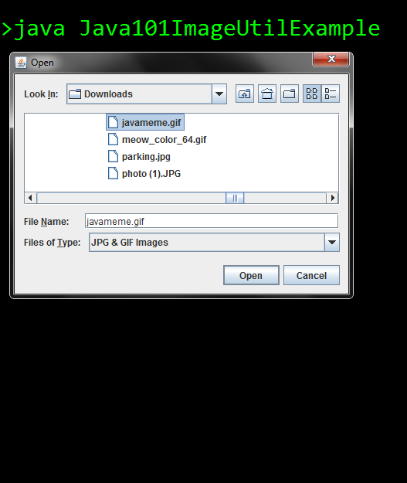
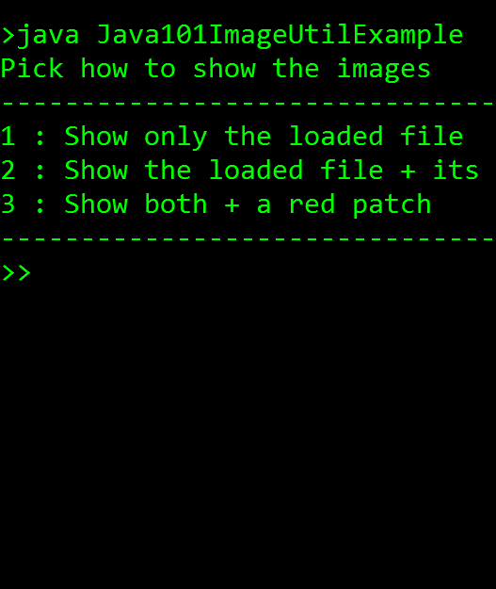
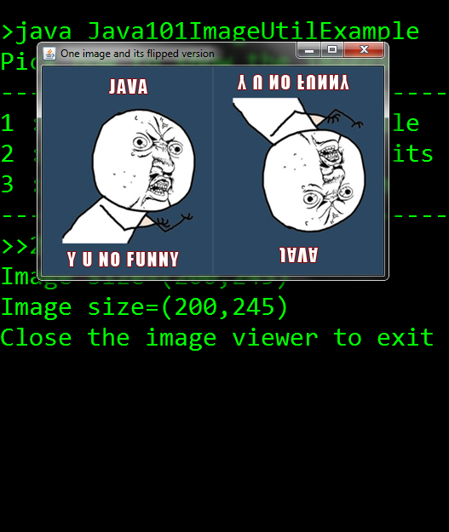
Hands-on Experiment
Notes:
int[][][] rgb1 = Java101ImageUtil.getRGBArrayFromFile();
if (rgb1 == null) {
return;
}
int[][][] rgb2 = flipVertical(rgb1);
int[][][] rgb3 = genAllRed(64, 128);
→ Modify to “green” or “blue” (R, G, B) 255
char choice = getUserChoice(genChoiceMenu());
--------------------------------
for (int channel = 0; channel < 3; channel++) {
newRgb[i][j][channel] = rgb[i][(h - 1) - j][channel];
}
(h-1) – j หมายถึง ถ้ารูป h=10 จะสลับ 0->9, 1->8,2->7

