Slide 1

ML INTERNSHIP PROGRAM · TASK 1
Uber Fare Prediction
Exploring the data before we try to predict anything
Prepared by Nada Elghaweet
Computer Science, AI Track. Nile University

Slide 2





THE APPROACH
Before Modeling, Let's Understand the Data
This deck looks at 27,646 Uber rides in New York City. The goal is simple: figure out what actually changes the fare, what doesn't, and catch anything odd in the data before it causes problems later.
01
02
03
04
05
Fare & Distance
What Doesn't Matter
Airport Rides
Time & Demand
A Hidden Bug
how they relate, and why distance matters most
car condition, traffic, passengers
are they really pricier?
when people ride, and when it costs more
a coordinate mistake we caught in time
02

Slide 3
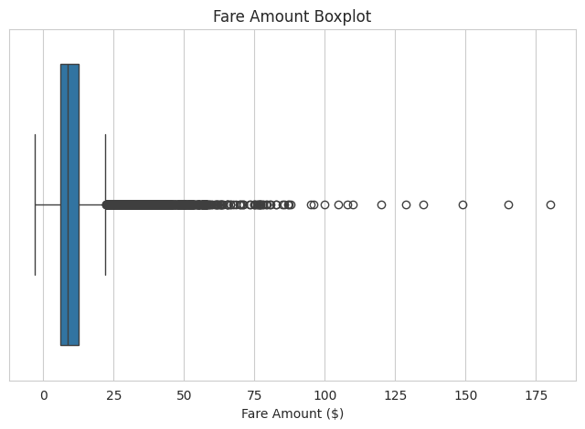
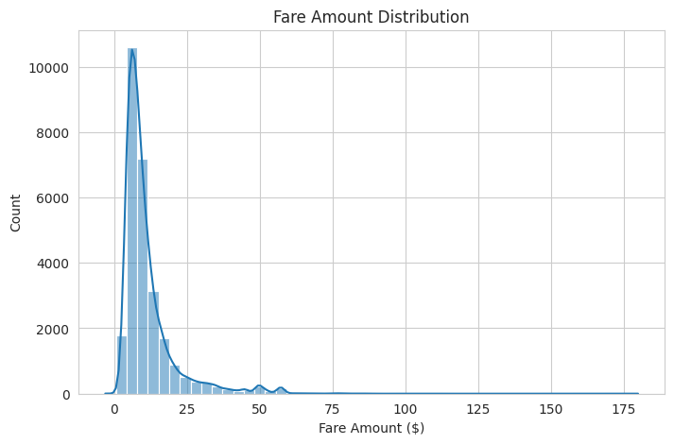
FARE AMOUNT
How Is the Fare Distributed?
WHAT IT MEANS
Most rides have a low, similar fare. But some trips cost a lot more, and those pull the average up. The boxplot shows a clear cluster of expensive rides above the normal range. These look like real premium trips, not mistakes, so the model will need to handle them carefully instead of just removing them.
03

Slide 4
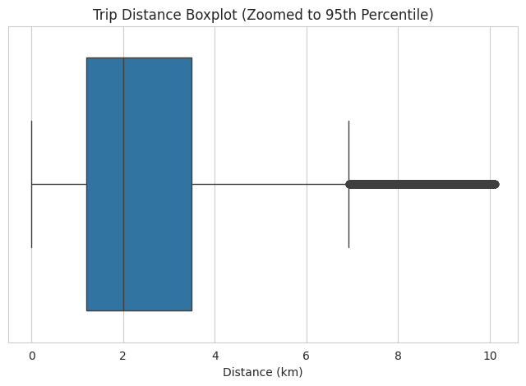
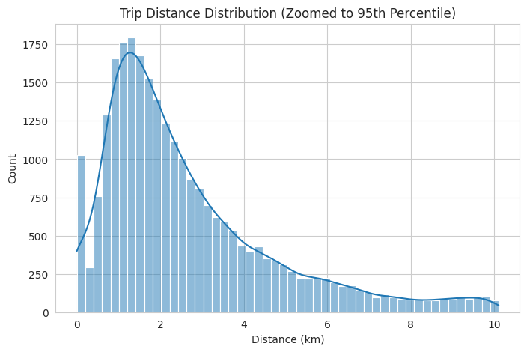

TRIP DISTANCE
How Far Do Rides Actually Go?
WHAT IT MEANS
Worth flagging
Zoomed into the typical range, most trips run 1 to 4 km, a normal short hop across the city. But the full data tells a different story: the median trip is 2.1 km, yet the longest one on record is 12400 km.
An 12400 km trip isn't real. It's a GPS error we'll need to clean out before Task 2.
04

Slide 5
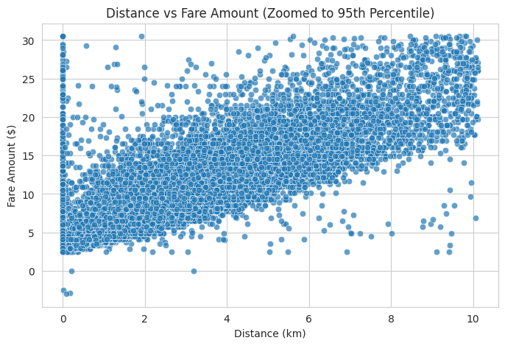

THE KEY RELATIONSHIP
Distance Is the Biggest Driver of Fare
The strongest link we found
We checked every numeric feature against fare. Distance came out clearly on top, far ahead of anything else, including passenger count, hour, and even the airport-distance columns.
WHAT IT MEANS
As distance goes up, fare goes up with it in a steady, almost straight line. This makes distance the single most useful feature to build the model around in Task 2.
05

Slide 6



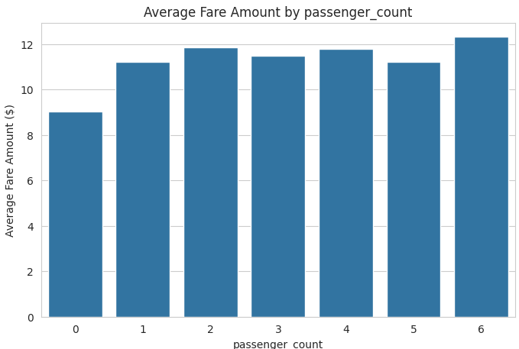
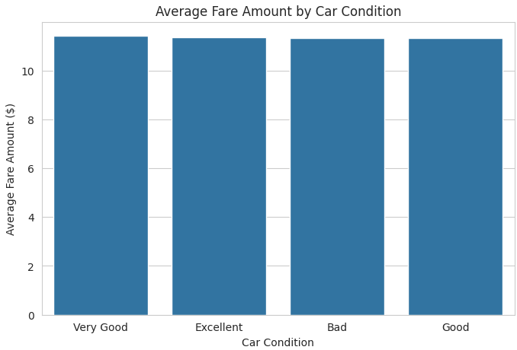
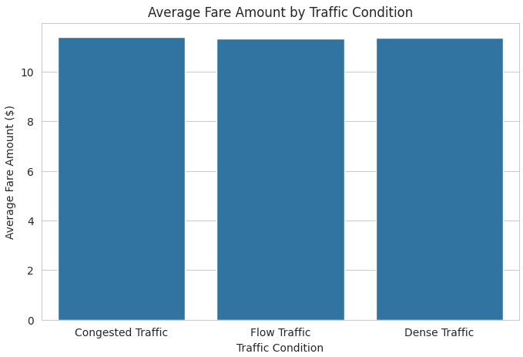
WHAT DOESN'T MOVE THE PRICE
Three Things That Barely Affect Fare
We also checked passenger count, car condition, and traffic condition against fare. All three came back nearly flat.
Passenger Count
Car Condition
Traffic Condition
$9.02 to $12.32
$11.19 to $11.54
$11.27 to $11.43
Whether it's 1 passenger or 6, the fare stays about the same. Uber charges per trip, not per person, and it shows.
Average fare for Bad, Good, Excellent, and Very Good cars all sit within about 35 cents of each other. Condition just doesn't move the price.
Congested, Dense, and Flow traffic barely differ in average fare, even though heavier traffic usually means a longer, pricier ride.
06

Slide 7
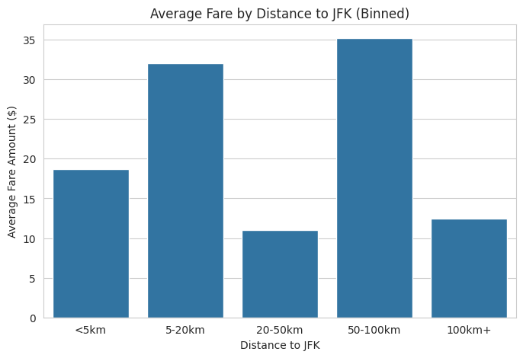

AIRPORT RIDES
Are Airport Rides Really More Expensive?
Why we grouped it into bins
The raw distance-to-JFK column had some wild outliers, up to 30,000 km, when the real range should be about 1 to 44 km. A scatter plot was unreadable, so we grouped distances into simple bands (under 5km, 5 to 20km, and so on) and compared the average fare in each.
Worth flagging
The raw distance-to-JFK column had some wild outliers, up to 30,000 km, when the real range should be about 1 to 44 km. A scatter plot was unreadable, so we grouped distances into simple bands (under 5km, 5 to 20km, and so on) and compared the average fare in each.
WHAT IT MEANS
The average fare doesn’t rise smoothly with distance JFK , it jumps around instead. This points to jfk_dist having same data quality issues as distance , some values likely don’t reflect real distances. So this is another cleanup flag for Task 2 , not a real pricing problem
07

Slide 8
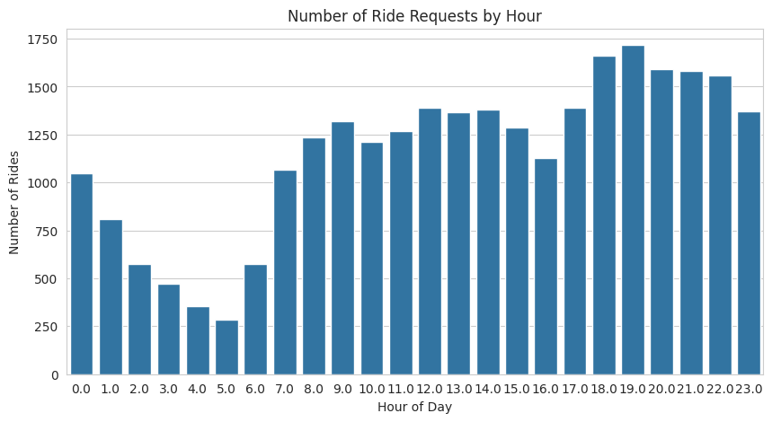

RIDE DEMAND
When Do People Actually Ride?
What it means
Rides are quiet overnight, then climb steadily through the day and peak in the evening. We also checked demand across days of the week, and it stayed fairly even. So time of day matters a lot more than which day it is.
08

Slide 9
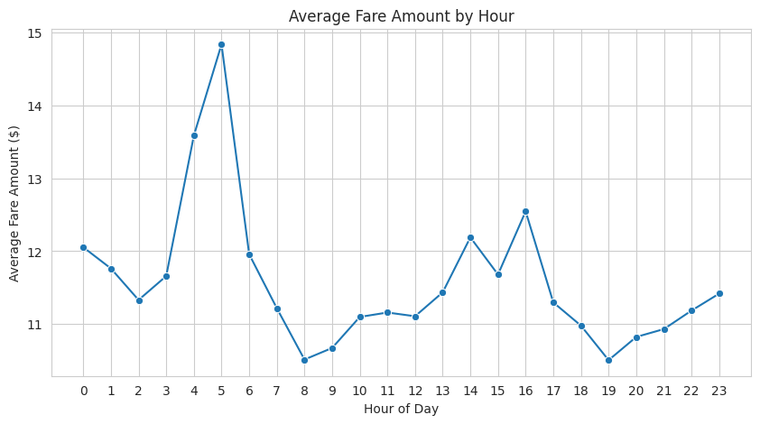
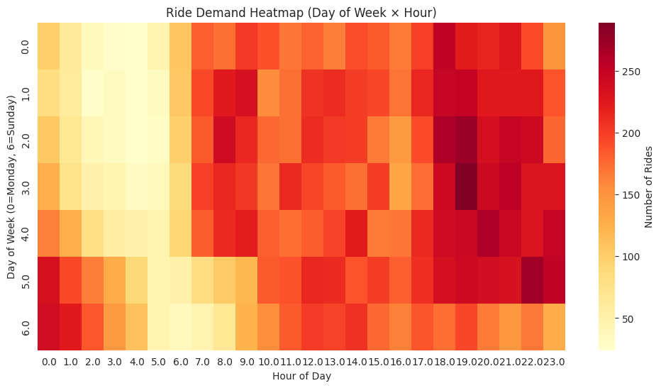
PRICE PATTERNS
When Are Fares Highest?
FARE BY HOUR
HOUR AND DAY COMBINED
Fare stays fairly steady through the day, but jumps early in the morning, around 4 to 6 AM. These are likely longer trips like airport runs, taken when the roads are empty.
Putting hour and day of week together shows demand piling up in the evenings on almost every day, especially around commute time and weekend nights.
09

Slide 10
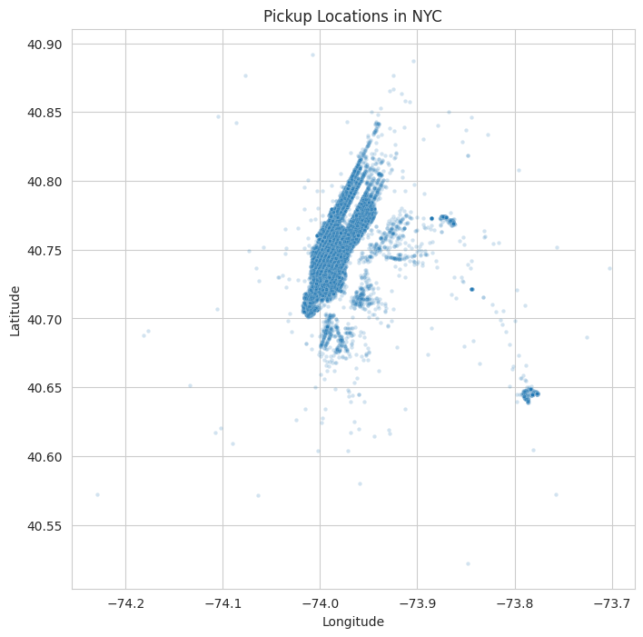


KEY DISCOVERY
A Bug Hiding in the Coordinates
The first plot looked broken
Filtering the pickup coordinates to normal NYC map bounds returned an empty plot. Something was clearly off.
The coordinates were stored in radians
A median longitude of -1.29 turns into -73.9 degrees once converted, a real NYC location. After applying that fix to both columns, the pickup map suddenly made sense.
WHY IT MATTERS
A model trained on the raw radian columns would fail quietly, with no obvious error. We only caught this because we looked at the data before building anything on top of it.
10

Slide 11

CLOSING SUMMARY
What This Means for Task 2
Distance is the main driver
Clean up the outliers
It's the strongest, most consistent predictor of fare. Build the model around it.
Distance and the airport-distance columns all contain values that just aren't physically possible.
Fix the coordinate bug
Drop the weak signals
Pickup and dropoff coordinates are in radians. Convert them before doing anything location-based.
Car condition, traffic, and passenger count add very little to predicting fare.
Keep the airport feature
Add time-based features
Distance to JFK, grouped into bins, shows a real fare premium worth keeping.
Hour of day and hour combined with day of week both show real, if modest, patterns.
11

