Slide 1

Team members: 19K41A04G9 NADA TAHANI 19K41A05G6 R. SUDHAN JEE 19K41A05G7 R. AKSHITHA
MOVIE REVIEW ANALYSIS
Under the guidance of:
D. Ramesh(Assoc. prof.)
Notes:
NOTE:
To change the image on this slide, select the picture and delete it. Then click the Pictures icon in the placeholder to insert your own image.

Slide 2
Title and Content
Title
Introduction
Problem Statement
Title
Title
Dataset
Pre-Processing
Title
Flow chart
Result and conclusions
Model Used
Literature review

Slide 3
INTRODUCTION
Nowadays, if you want to a successful business, it is very important to act according to your viewers’ comments. When we look at today’s most prominent and successful companies like Amazon or Netflix, we can see that they are the companies that use data best and know their customers best.
These days, people have become smart enough to read or watch a movie review investing their money in a ticket.
Movies shape the minds of many. Film reviewing is a creative job but is also a responsible one. A film critic cannot give biased opinions. film reviewers can manipulate the audience.
Before seeing a movie, we read public reviews. Priority is given to this movie rating. We will thus develop a service that gives a movie review.
Based on the public tweets, this app rates the movies. We gather tweets on a certain movie and determine the polarity of each one. The rating for the film is between 0 and 10, depending on the polarity. The movie's rating will be made publicly available through an Android application.

Slide 4
PROBLEM STATEMENT
The job of a film critic is a highly responsible job. The lot depends on the movie reviews nowadays and therefore they are important.
Films reviews provide advance information about the film before it reaches the final audience.
Film critic cannot give biased opinions and they should know what they are talking about. It is seen on many instances that film reviewers knowingly or unknowingly manipulate the audience. A reviewer should keep their personal comments aside while reviewing a film and should talk about the style and craft.
This application's primary goal is to offer the user an accurate movie review or rating without any biasedness.

Slide 5
LITERATURE REVIEW
Year | Model | Data-Set | Features applied | Author | Results
2010 | LSTM-CNN CNN-LSTM | IMDB | Sentiment analysis | Aswathi,Sajeevan | 79%: LSTM-CNN 59%: CNN-LSTM
2015 | - | Microblog comments | Micro-Blog SA | L. Yanmei, C. Yuda, | Proposed model can improve the accuracy of emotional orientation, validation.
2016 | WSDNNs | 4 languages reviews from amazon | Transfer Learning for Cross-Lingual Sentiment Classification 4 languages reviews | G. Zhou, Z. Zeng, | Proposed approach is more powerful than the previous studies by applying experiments on 18 tasks of cross lingual sentiment classification.
2016 | HBRNN | 150,175 labelled reviews | Sentiment Analysis of Customer Reviews | R. Silhavy, R. Senkerik | The experimental results explored that that HBRNN outperformed all other methods.
2015 | LSTM | 9337 post Samples from different social sources | sentiment Analysis on Bangla and Romanized Bangla Text (BRBT) | A. Hassan, M. R. Amin | Deep recurrent model especially lstm with accuracy 78%
2010 | SAR | RIMDB,CHES | Transfer Learning | R. Ghosh, K. Ravi. | General Analysis on pos/neg
2016 | LSTM,DCNN | Thai Twitter Data 3,813,173 tweets | Sentiment Analysis on Thai Twitter Data | Vateekul and T. Koomsubha | LSTM– 75.30% DCNN- 75.35%
2011 | DBLSTM | provided by Go dataset (1.6 million tweets) | Sentiment Analysis of Social Data | Goebel and W. Wahlster | 85.86% accuracy was achieved on STS (Stanford Twitter Sentiment)
2010 | CNN | IMDB | Sentiment Classification | X. Ouyang, P. Zhou, C. H. | The proposed model outperformed the previous models with the 45.5% accuracy

Slide 6
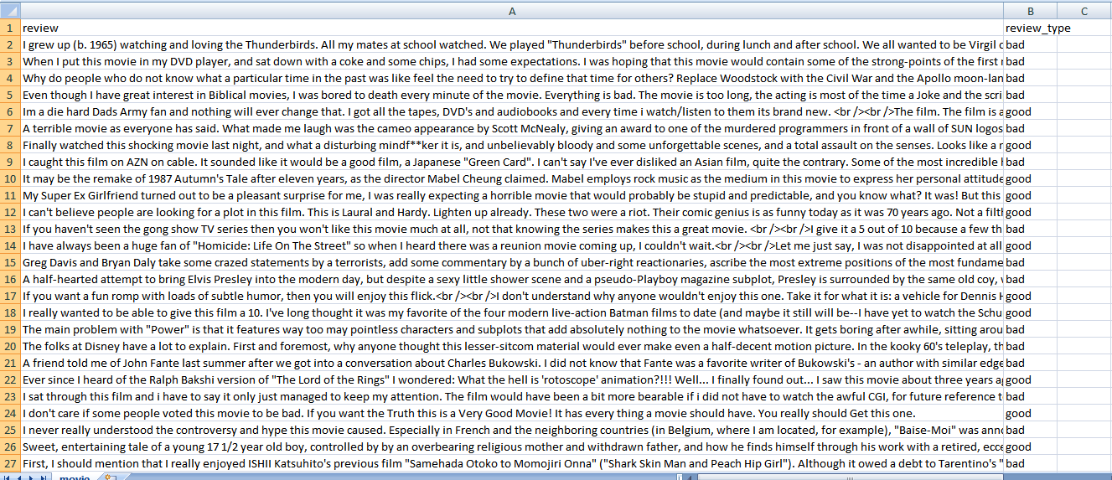
Dataset

Slide 7
PRE-PROCESSING OF DATASET
We used a dataset that is collected from kaggle which has 20,000 statements.
Acquire the dataset
Import all the crucial libraries
Import the dataset
Text cleaning
Embedding the data
Splitting the dataset
Model training
The data is pre-processed, meaning special characters and null sentences are removed. Sentences are then transformed into numerical vectors using USE. Now we create a customized LSTM model. Using training data, we now train the model and test it.
A grading method is used to determine and display the total polarity of sentences.

Slide 8
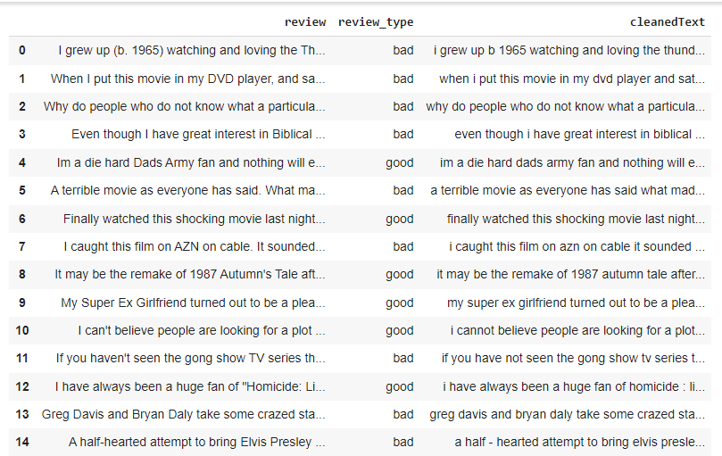
PRE-PROCESSING OF DATASET

Slide 9
MODEL USED
We will use LSTM(Long Short-Term Memory) to know the polarity of the texts.
LSTM networks are well-suited to classifying, processing and making predictions based on time series data.
LSTM is an updated version of Recurrent Neural Network(RNN) to overcome the vanishing gradient problem. It can be able to remember a lot of information from previous states so, the polarity of the tweet can be more accurate.
In our model the first layer is embedding layer. The embedding is done using universal sentence encoder.
After the embedding layer, there are 3 LSTM layers and 1 dense layer.

Slide 10
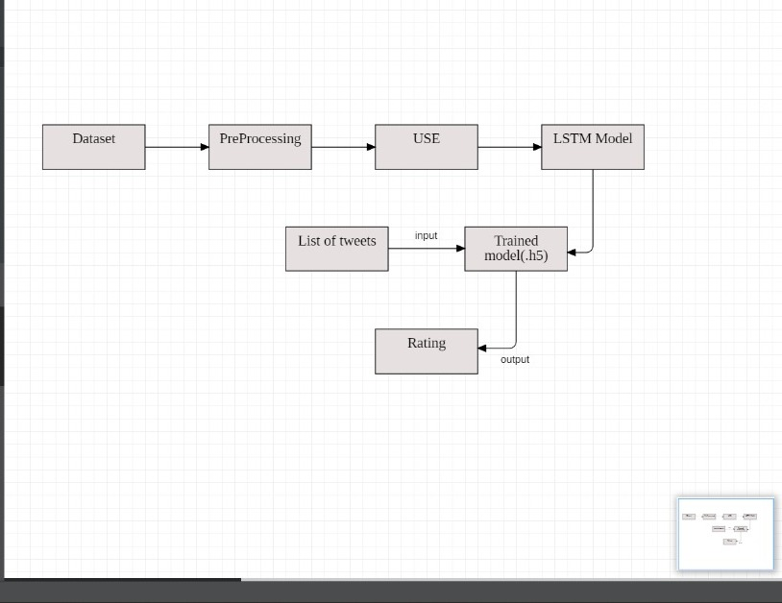
Flow Chart

Slide 11
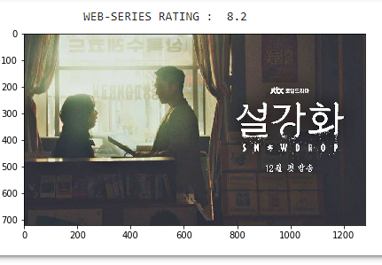
Results

Slide 12
Conclusion
Movies are widely appreciated and criticized art forms.
They are a significant source of entertainment and lead to web forums like IMDB and amazon reviews for users to give their feedback about the movies and web series. These reviews and feedback draw incredible consideration.
Although this information is unstructured, it is very crucial. We were inspired to work on this project to resolve this problem of unstructured movie reviews and that people need not spend a lot of time reading the whole review to understand whether the reviewer thinks about the movie in a positive or negative view.

