Slide 1
Title proposal: Overlapped speech detection and speaker counting on variable frame lengths using deep learning
For conference paper: “Speaker counting on variable frame lengths using deep learning”.

Slide 2
Table of contents
Introduction
Human listeners experiments description and conclusions
Pattern recognition and statistical inference methods
Dataset creation: corpus, annotating frames, frame & count selection
Feature set selection: intuition discussion per feature
DNN architectures
Training process
Inference results
Conclusions

Slide 3
Chapter 1

Slide 4
Introduction
A step forward towards blind speech source separation comparable to human selective auditory attention
Applications for crowd-sensing, surveillance, etc.
Prior work discussion and add Stoeter’s ICASSP paper as reference. Exemplify references in chronological order.
Clearly state what is missing from existing work: short timeframes analysis (e.g. Stoeter’s work targets frames larger than 1 second which does not fare well with ASR systems QoS restrictions, Stoeter’s DNN’s are not optimized for an ASR use-case where speaker count is likely less or equal to 4, discuss about regression and classification architectures).
Describe how the current paper aggregates and completes all our prior work in the 3 Interspeech papers.

Slide 5
Chapter 2

Slide 6
Human listeners experiments description and conclusions
Describe the experiments and compare with existing work (e.g. the ones referenced by Stoeter).
Human listeners cannot be accurate when presented recordings with 4 or more speakers, therefore this is the limit we are targeting with our experiments.
Human listeners perform better when they have more time to analyze the speech signal – however the minimum duration for our experiments was 5 seconds.
Interestingly, when human listeners are listening to known voices, the counting performance drops – we speculate that this is because they focus on a known voice, ignoring the others.

Slide 7
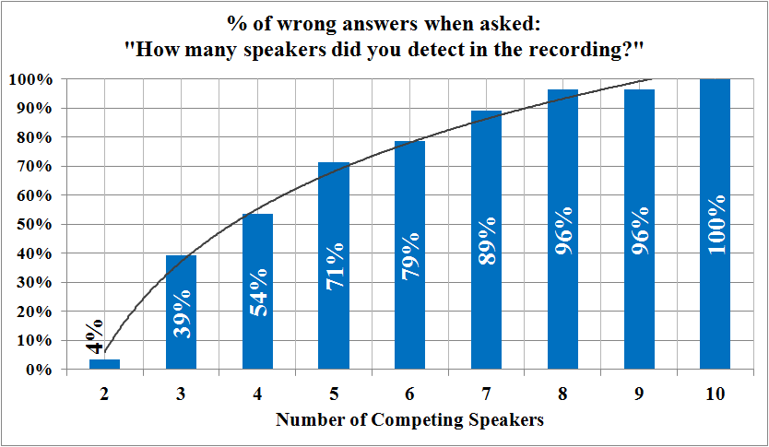
Diagrams
This is a scenario where the listening duration is unconstrained. We can see reasonable classification error up to 4 competing speakers, therefore this is the limit we are targeting for our automated speaker counting system.

Slide 8
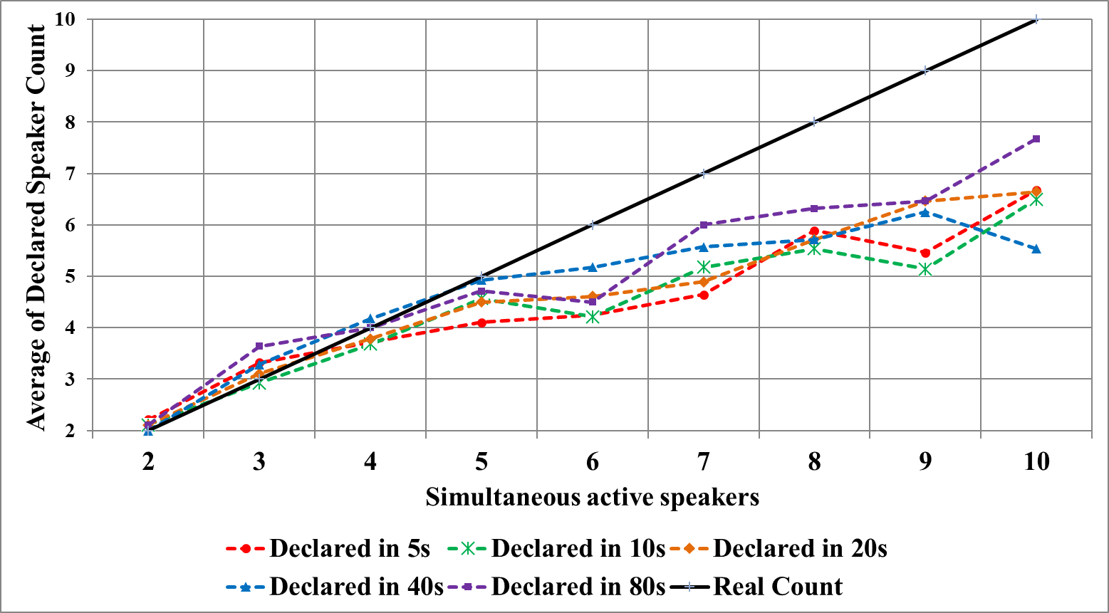
Diagrams
Interestingly, although the listening duration is varied across a wide range, the impact on the classification error is low.

Slide 9
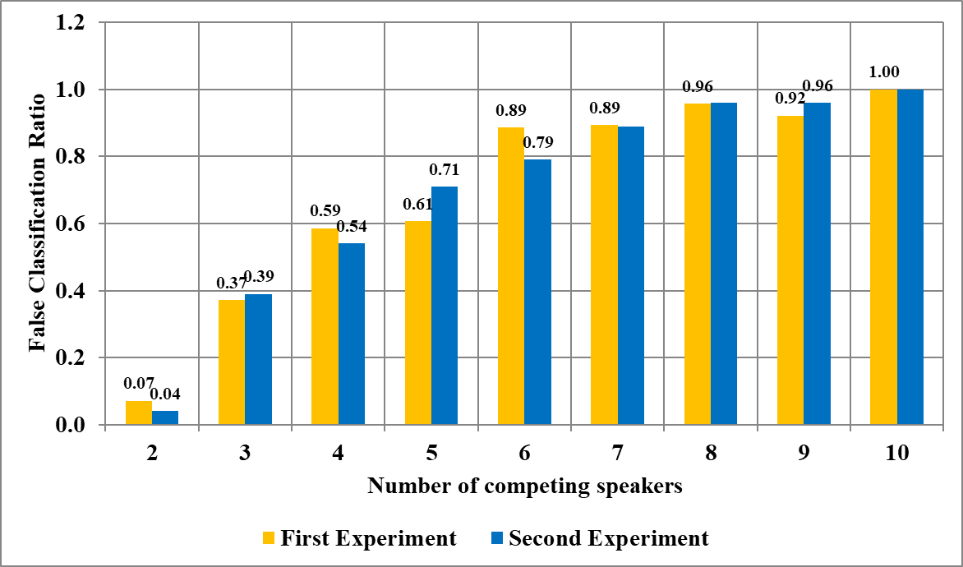
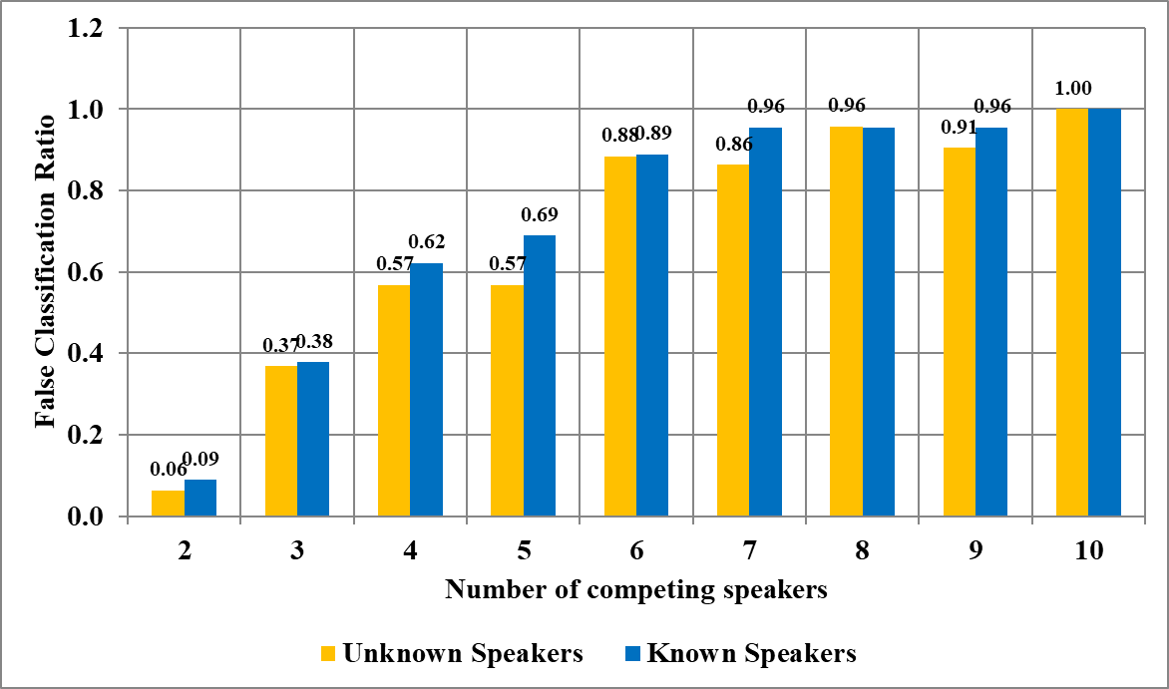
Diagrams
The second experiment was designed to analyze the impact of knowing the speakers personally, and to validate the results of the first experiment. The mixtures were changed completely. We can draw 2 conclusions:
The results between the 2 experiments are similar.
The impact of known speakers is minimal.

Slide 10
Chapter 3

Slide 11
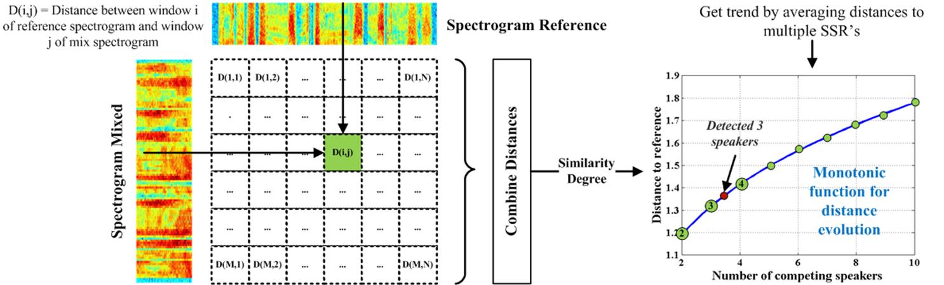
Pattern recognition and statistical inference methods
Mention the idea behind the algorithm presented at Interspeech: as speaker count grows, the signal becomes gradually more distanced from a set single speaker references.
Briefly describe the algorithm.
Present reasons that made us move towards deep learning approach: speed, we needed better performance on shorter durations.

Slide 12
Chapter 4

Slide 13
Dataset creation: corpus, annotating frames, frame & count selection
Claim that in order for the DNN to be trainable, the overlapped speech frames need to be tagged perfectly and present reasoning.
Describe how the annotation using Voicebox’s VADSOHN was done.
Describe the speech mixing process. Comment on the possibility of using a room impulse response for adding n-th order reverberations.
Mention that for Interspeech 2017 we used our own speaker database with only male speakers and that for current updated experiments, we are using Librispeech. Highlight that results are similar since the system should be language agnostic. Comment on combining male and female voices in the current experiment.
Describe why we stopped at 1000ms (or 2000ms if we can run that). Show a histogram with continuous speech durations per entire Librispeech dev corpus and highlight that 1 second is on the high-end. Also mention that practical restrictions impose a timeframe as low as possible.

Slide 14
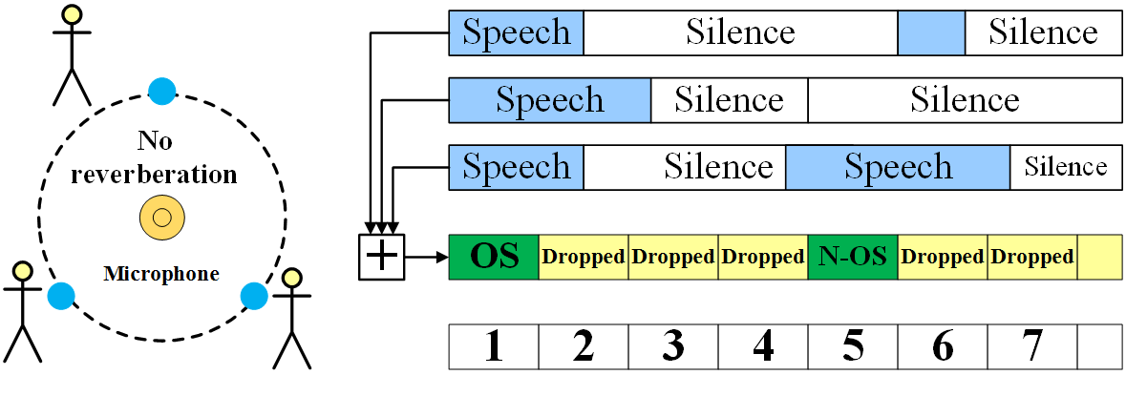
Data annotation diagram
Comment that the main objective is to make sure that frames selected for mixtures do not contain silence periods.
We are not using reverberation, like room impulse models, and we could speculate that room impulse might shift numerical properties of the resulted signal, making it easier for the model to detect specifics of overlapped speech.
Comment that this strategy limits the frame duration to a size given by the longest words in a language.

Slide 15
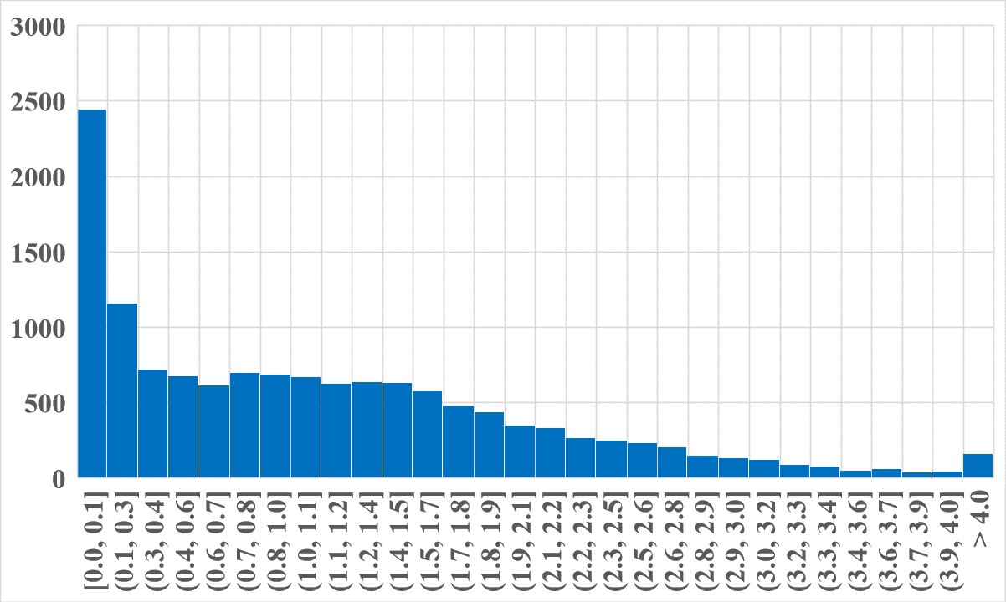
Word duration histogram
VADSOHN implementation from Voicebox with 0.9 as speech threshold, 3 frames minimum for speech and 5 for silence.
Main majority of continuous speech frames are below 1 second, therefore this justifies our selection to aim for maximum one second frames. Another justification is given by practical reasons.
Results are consistent with this research: https://www1.icsi.berkeley.edu/~steveng/PDF/Temporal_Properties.pdf

Slide 16
Chapter 5

Slide 17
Feature set selection: intuition discussion per feature
Comment on each feature:
Unprocessed signal: carries maximum quantity of information but due to its properties can create a huge amount of local minima and it is impractical.
Signal envelope using Hilbert transform: reduces the amount of local minima. We expect the envelope to be more bound to the higher signal power values when increasing speaker count.
Signal histogram: we expect higher power when speaker count grows.
Signal’s frequency spectrum: carries a high amount of information. We expect more “dense” spectrums as the speaker count increases.
Spectrogram: adds time information. We expect a denser spectrogram with speaker count. Exemplify how it’s being used as a gold input in many speech processing systems: DeepSpeech, Wavenet, etc.
MFCC: current research still uses them. We discovered MFCC’s to be particularly good at preserving the quantity of information that we can use for classification, in a reduced number of features (e.g. compare MFCC vs Spectrogram performance).
Show a picture with 1, 2 and 4 competing speakers with envelopes, spectrograms side by side, for 500ms or 1000ms frame.

Slide 18
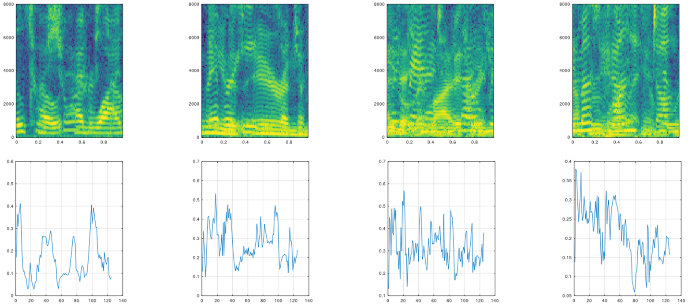
Feature representation picture
This diagram represents spectrogram for 1, 2, 3, 4 simultaneous speakers and the mixtures’ envelopes. It shows that the “naked” eye cannot spot a rule of classifying. One intuition was that with the increasing number of speakers the spectrogram becomes more “dense” and the envelope would become less “periodic”.
The high numerical complexity of the feature set advocates for the usage of a deep learning model with a high number of trainable parameters.

Slide 19
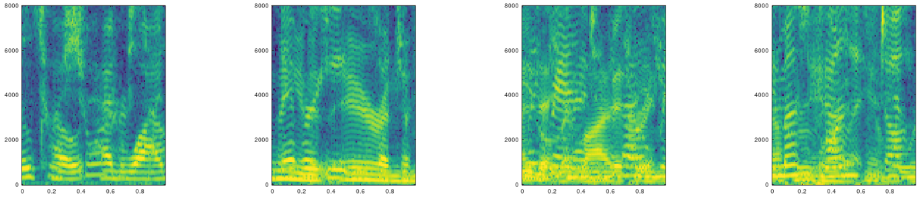
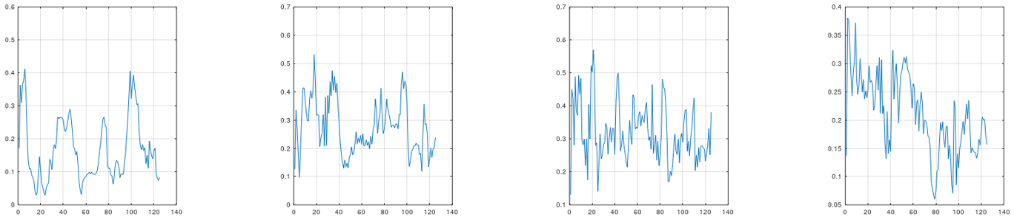
Feature representation picture

Slide 20
Chapter 6

Slide 21
DNN Architecture
Comment on why not LSTM designs. LSTM is good for sequences but we speculate that each input sample should be treated independently and we should maximize model performance for this case. We speculate that an LSTM can tie the performance not just to the phonetic characteristics of a language, but to its syntax, grammar and semantics.
Describe Deep Speech 2, Wavenet and existing work that advocates for the use of CNN’s with speech signals.
Explain that intuitively, the spectrogram can be analyzed as an image which is more suitable for 2D CNN’s.
TODO: study if LSTM’s bring additional difficulties (e.g. is attention beneficial for this task, can LSTM’s operate with 2D input, etc.)

Slide 22
DNN Architecture Diagram
Convolutional Block
Convolutional Block
Batch Normalization
Dropout
Fully Connected
Dropout
Fully Connected
Dropout
Fully Connected
Dropout
Conv Layer
Softmax
Max Pooling
Conv Layer
Max Pooling
Conv Layer
Max Pooling
Comment on the 1D vs 2D convolutional layers, influenced by feature type.
Explain the benefit of Max Pooling
Explain the benefit of Batch Normalization
Explain the benefit of Dropout
Describe how the model was implemented.

Slide 23
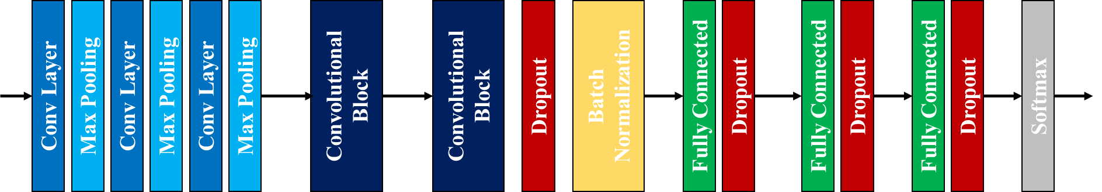
DNN Architecture Diagram

Slide 24
Chapter 7

Slide 25
Training Strategy
Highlight that we have trained a model for each frame duration.
Explain that we investigate the bias and variance of the models in order to define the next steps in training. If bias is high, we usually increase either the number of training examples, either the model size. High variance can be generally solved by regularization techniques.
Comment on the selection of Adam optimizer and on the learning rate. Even though Adam optimizer adapts its learning rate, we were able to converge to a better inference result with a lower learning rate.
Explain that we are stopping the training when we see no progress in the loss function drop after a certain number of epochs, that depends on the frame duration.

Slide 26
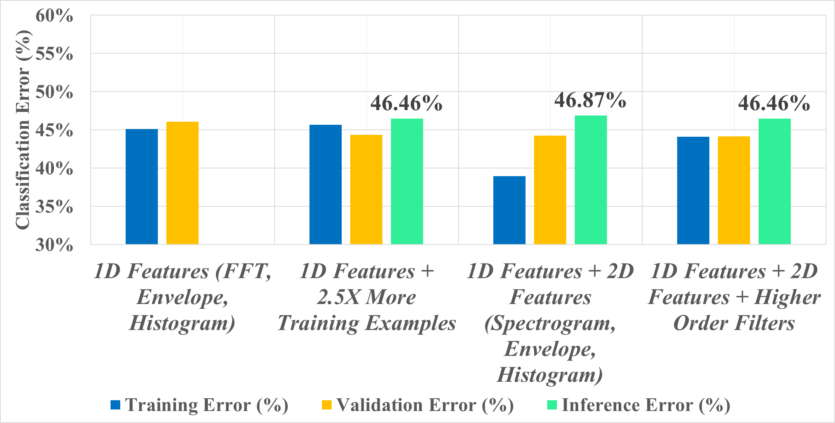
Model and feature selection for 100 ms duration
Mention that for inference we will select the model with the best MAE metric, given that the inference accuracies are similar.
We can observe that FFT and Spectrogram have similar classification power.
Mention that adding more training examples did not significantly impact classification performance.

Slide 27
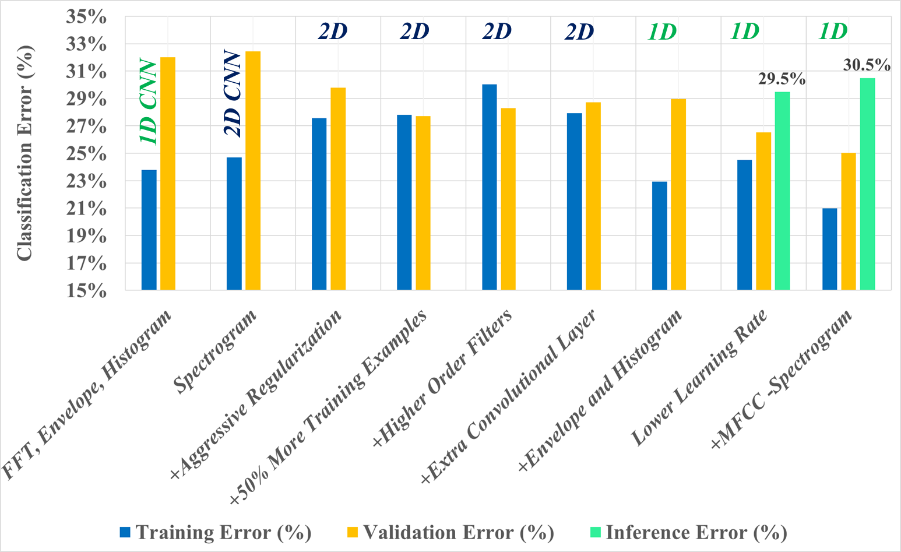
Model and feature selection for 500 ms duration
Explain that 1D features means 1D convolutional layers and 2D means 2D convolutional layers. (should be explained at the DNN architecture).
Both 1D and 2D features have good classification potential, but combined they fare slightly higher.
Regularization improved generalization capacity of the model.
Adding 50% more training examples did not significantly increase accuracy, suggesting we have enough.
Increasing network size and filter order did not significantly improve accuracy, thus we are reasonably close to optimal model size.
Even though MFCC shows better validation accuracy, inference is lower.

Slide 28
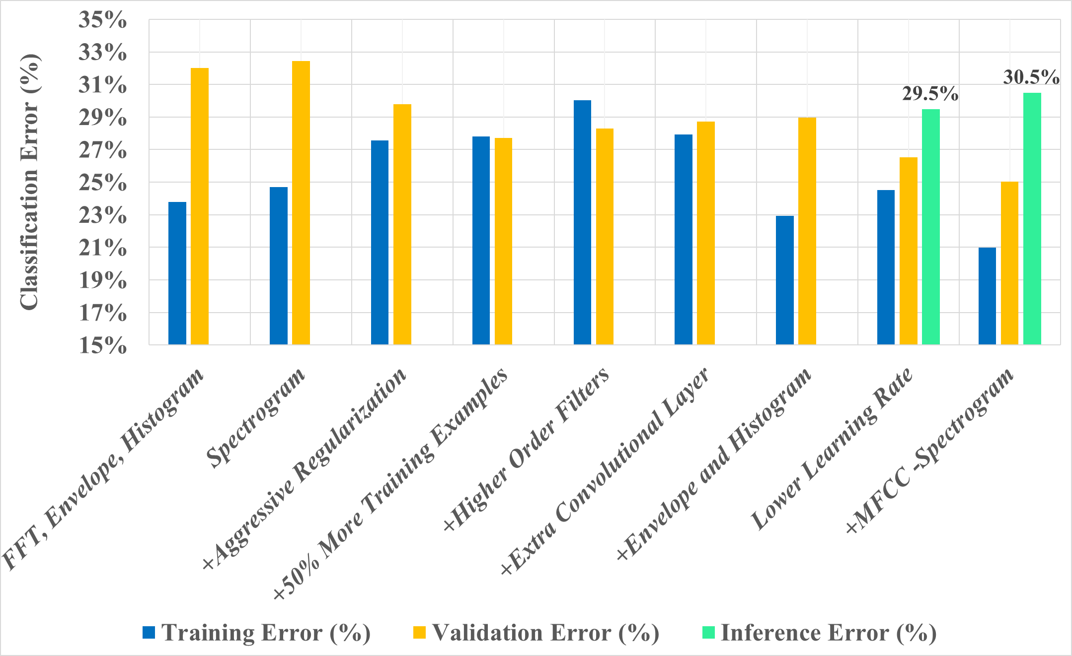
Model and feature selection for 500 ms duration
2D
2D
2D
2D
1D
1D
1D
1D CNN
2D CNN

Slide 29
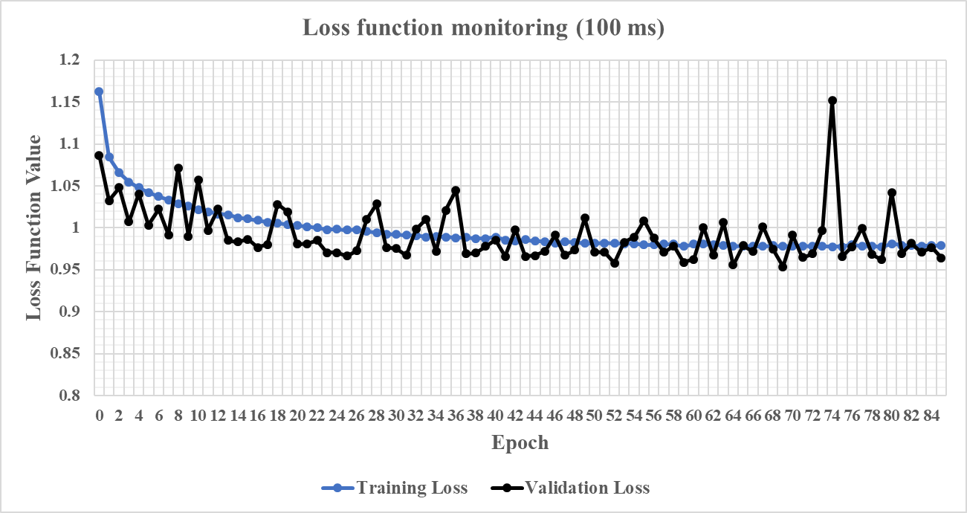
Loss function monitoring
Show loss function evolution for a couple of sizes (50ms, 100ms, 500ms) to demonstrate that we waited enough for training and that the loss does not decrease in steps.

Slide 30
Chapter 8

Slide 31
Inferencing strategy
Duration (ms) | Training Samples | Validation Samples | Inference Samples | Input Features | Features
25 | 1000000 | 40000 | 100000 | 278 | SPECGRAM, ENV, HIST
50 | 600000 | 24000 | 100000 | 582 | SPECGRAM, ENV, HIST
100 | 600000 | 24000 | 100000 | 1267 | SPECGRAM, ENV, HIST
200 | 600000 | 24000 | 100000 | 2787 | SPECGRAM, ENV, HIST
300 | 600000 | 24000 | 100000 | 4258 | SPECGRAM, ENV, HIST
400 | 600000 | 24000 | 100000 | 5727 | SPECGRAM, ENV, HIST
500 | 600000 | 24000 | 100000 | 7197 | SPECGRAM, ENV, HIST
1000 | 600000 | 24000 | 100000 | 3837 | MFCC, ENV, HIST
Discuss about the ratio between validation and training samples. Explain why we used a larger dataset for 25 ms (affordable and more difficult task).
Explain why for 1000 ms we switched to MFCC (resource compute constraints mainly. Explain cost would have increased ~3X for a single use case due to the need for memory and storage, plus compute power. Explain that MFCC performance seemed reasonably close for 500 ms, compared to SPECGRAM).
Briefly explain why feature count increases with duration.
Comment if we expect that a larger inference would yield different results.
Explain that training was done on Librispeech dev-clean and inference on Librispeech test-clean.

Slide 32
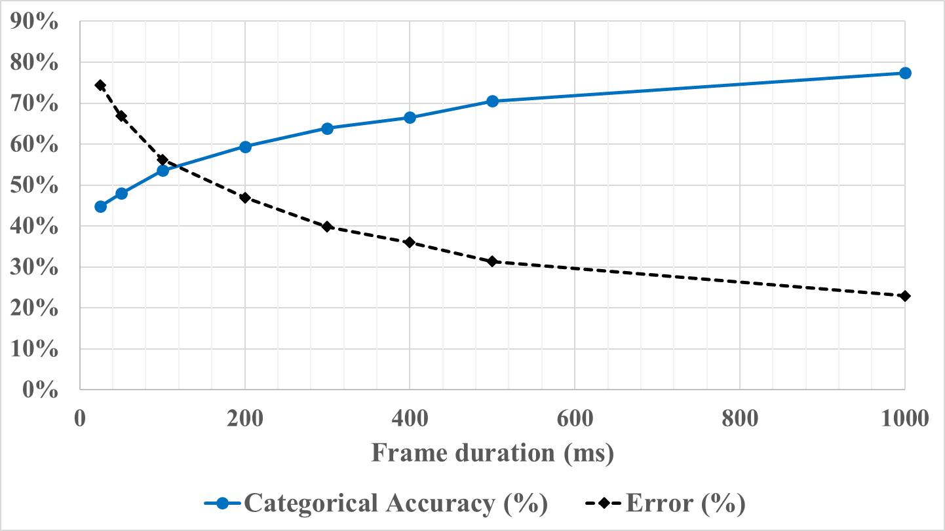
Inference performance at speaker counting
Comment on the asymptotic shape of the curve and compare with existing work (e.g. Stoeter).
Discuss practical usages for various durations

Slide 33
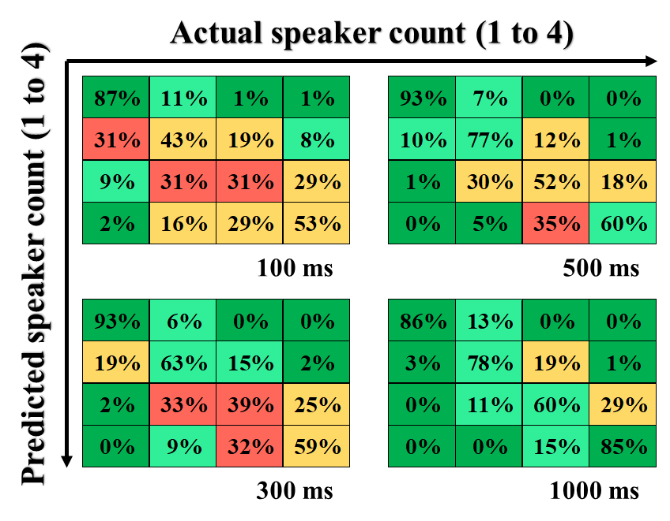
Confusion matrices
Actual speaker count (1 to 4)
Predicted speaker count (1 to 4)
100 ms
500 ms
300 ms
1000 ms
Explain how the confusion matrices are colored: with green we color the cells where we consider the accuracy and error to be good. With red we color cells where we would like to see more hits in case of class matches and less hits in case of class mismatches.
We can clearly see how the 100 ms confusion matrix is colored more towards red, since it also has an overall higher MAE and lower categorical accuracy.

Slide 34
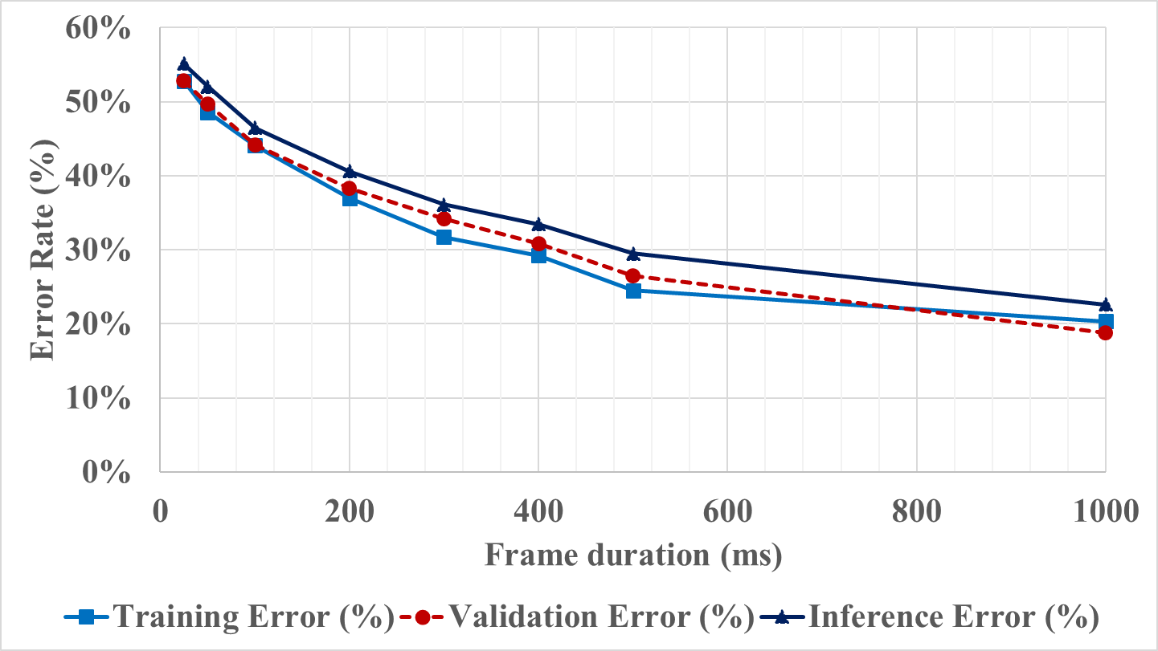
Categorical accuracy: training, validation, inference
Discuss about the difference between training and validation accuracy, and the importance of regularization (done with dropout in our case) and why in some cases validation is more accurate than training.
Mention the accuracy drop between validation and inference as a range, minimum and maximum.
Provide intuition if the gap between inference and training accuracy can be closed: talk about dataset size, about overfitting.

Slide 35
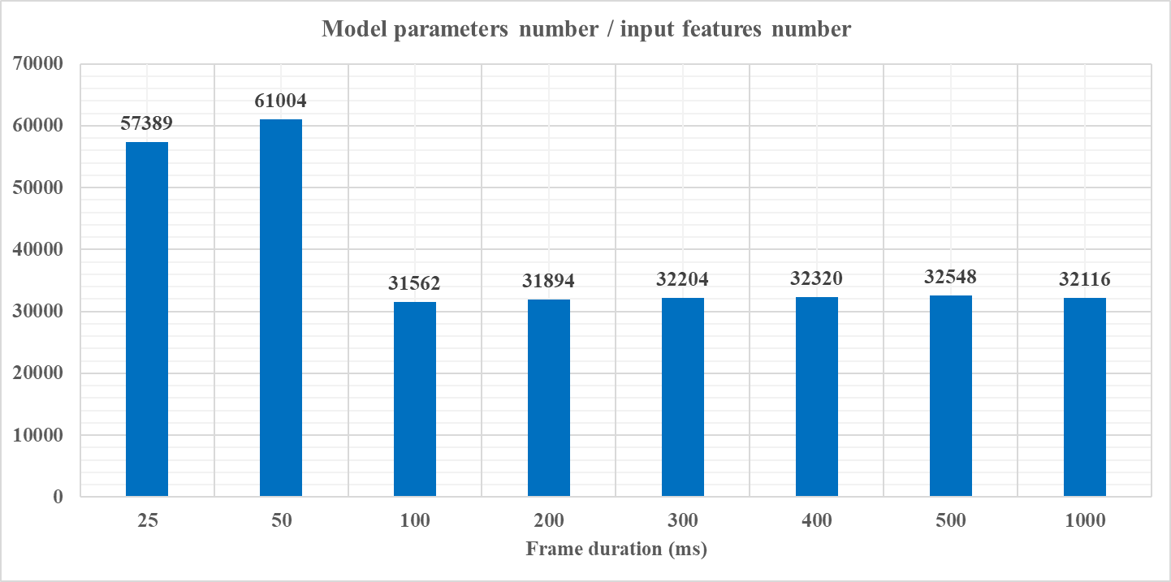
Relation between model parameters count and input features count
Explain how after 100ms, ratio is constant. Feature count is growing since spectrogram and envelopes are larger.
Explain that for 25 and 50ms we did not use a max pooling for one of the convolutional layers to avoid “over-compression” before fully connected layers.

Slide 36
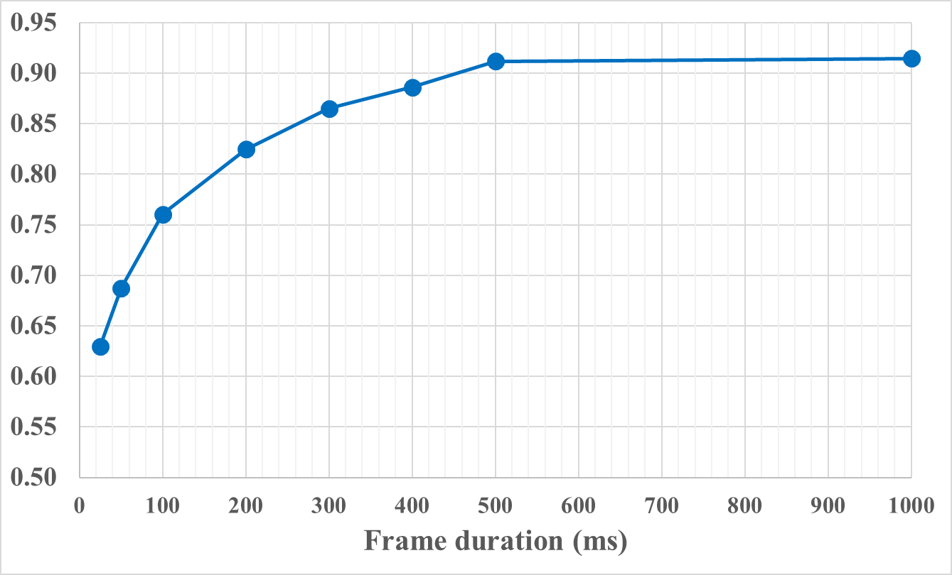
Inference performance at overlapped speech detection
Comment on the asymptotic shape of the curve and compare with existing work (e.g. Stoeter).
Compare with Interspeech ‘17 results and explain that those models were trained to label overlapped and non-overlapped. The current results are extrapolated from speaker counting. Interspeech ‘17 results also have maximum 3 concurrent speakers.

Slide 37
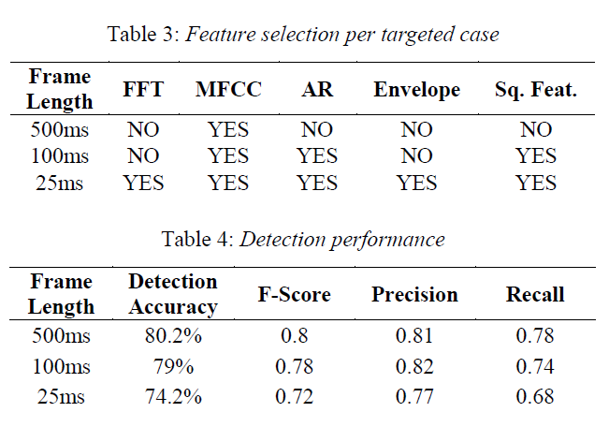
Inference performance at overlapped speech detection
These are the results obtained for Interspeech 2017. Argument that these models were trained as a binary classifier, detecting overlapped or non-overlapped speech. For 100ms results are comparable, for 25ms the IS results are much better due to more feature sets and the usage of squared features. For 500ms, the current results are better, mainly because the models are much larger.

