Slide 1
GLOBAL SUPERSTORE ANALYTICS
From Raw Transactions to a Data Warehouse
and a 3-Dashboard Power BI Story
Enterprise Data Warehouse Design • SQL Analytics • Executive, Product & Customer Intelligence
Presented by: Osama Medhat , Adham Mohamed , Nada Mostafa ,Habiba Hany
Dr. Muhammed Safwat Eng. Dina Mohsen

Slide 2






ROADMAP
What We'll Walk Through
01
02
Business Context
Data Warehouse
Why this project, and the questions it answers
From raw CSV to a clean star schema
03
04
Executive Overview
Product Performance
Company-wide performance at a glance
Category & product-level profitability
05
06
Customer & Geography
Findings & Recommendations
Who buys, and where
What the data tells leadership to do next
02

Slide 3
BUSINESS CONTEXT
One Retailer. Four Years. A World of Data.
Global Superstore sells Technology, Furniture and Office Supplies across 147 countries. Leadership had transaction-level data but no unified way to see performance, spot the products worth doubling down on, or know which customers and regions deserved more attention.
PROJECT SCALE
51,290
Sales Transactions
10,292
Unique Products
GUIDING QUESTIONS
1
Where is the company making money — and where is it not?
1,590
Customers
2
Which products and categories should we invest in?
Which customers and markets drive the most value?
147
Countries Served
3
4 yrs
2011 – 2014 History
03

Slide 4




ENGINEERING
Building the Data Warehouse
The raw Global Superstore export was cleaned in Python (pandas), split into conformed dimension tables, and re-linked through surrogate keys — turning a single flat file into an analysis-ready star schema.
→
→
→
→
Raw CSV Export
Clean & De-duplicate
Build Dimensions
Assemble Fact Table
Load & Model
Global_Superstore_Cleaned.csv — one flat table, one row per order line
pandas: standardize types, drop duplicate product / customer / location rows
Dim_Product, Dim_Customer, Dim_Location, Dim_Date — each with a surrogate key
Fact_Sales: Sales, Quantity, Discount, Profit, Shipping Cost + foreign keys
Loaded into the warehouse and modeled in Power BI for DAX & dashboards
04

Slide 5



DATA MODEL
Star Schema — One Fact, Four Dimensions
Dim_Product
Dim_Location
10,292 products
3,819 locations
Category • Sub-Category
Country • Market • Region
Fact_Sales
Sales • Quantity • Discount
Profit • Shipping Cost
51,290 rows
Dim_Customer
Dim_Date
1,590 customers
1,430 dates
Segment
Order Year • Month
05

Slide 6
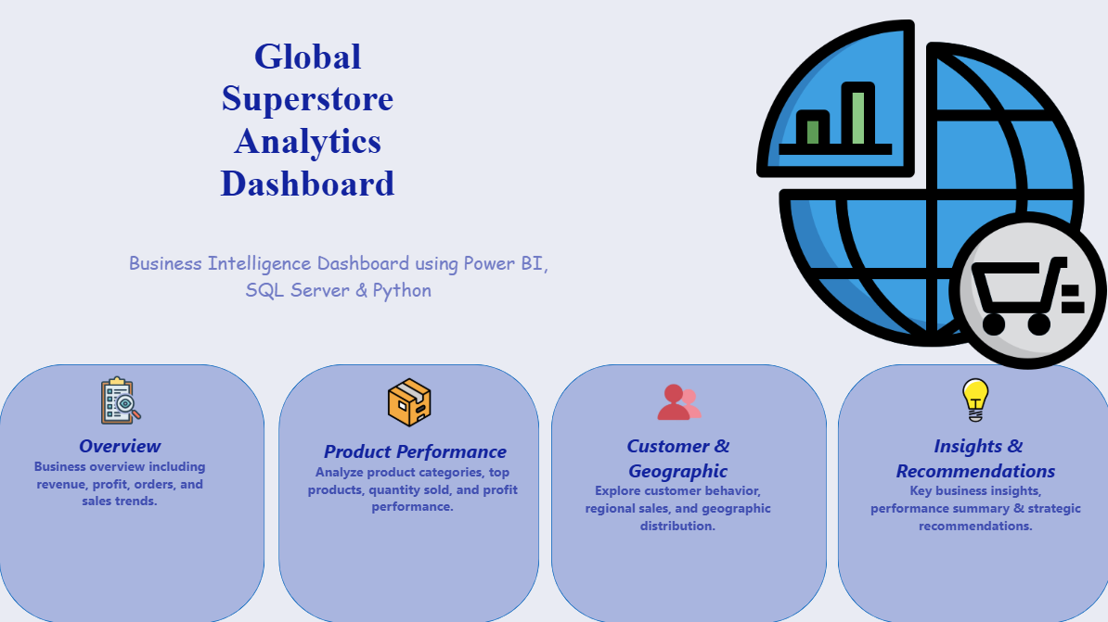

Slide 7
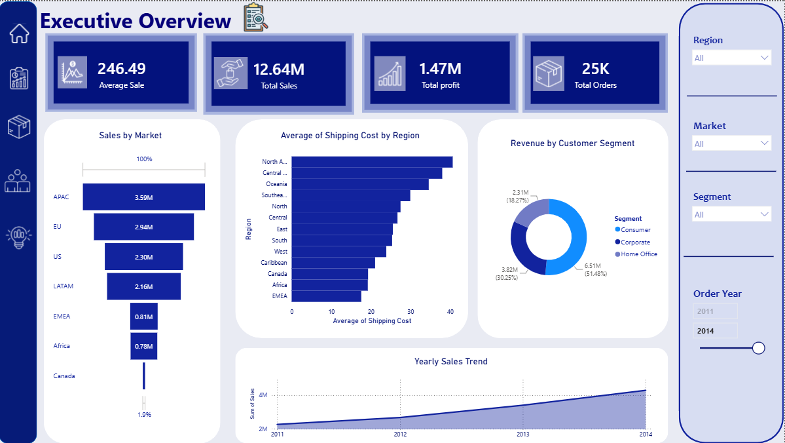

Slide 8
DASHBOARD 01
Executive Overview
A single page for leadership to gauge overall health — revenue, profit, order volume and average sale, filterable by Region, Market, Segment and Year.
$12.64M
$1.47M
25,035
$246.49
Total Sales
Total Profit
Total Orders
Average Sale
KEY TAKEAWAYS
APAC is the strongest market at $3.59M in sales
Interactive Filters
The Consumer segment drives 51% of total revenue
Region • Market • Segment • Order Year (2011–2014)
Sales grew every year from 2011 to 2014
Every KPI, chart and ranking on this page recalculates live as leadership slices by any of these four filters.
Heavier discounting is linked to lower profit
06

Slide 9
DASHBOARD 01
Where the Revenue Comes From
REVENUE BY SEGMENT
Consumer
$6.51M
51.5%
Corporate
$3.82M
30.2%
Home Office
$2.31M
18.3%
YEARLY SALES TREND
2011
$2.26M
2012
$2.68M
2013
$3.41M
2014
$4.30M
07

Slide 10
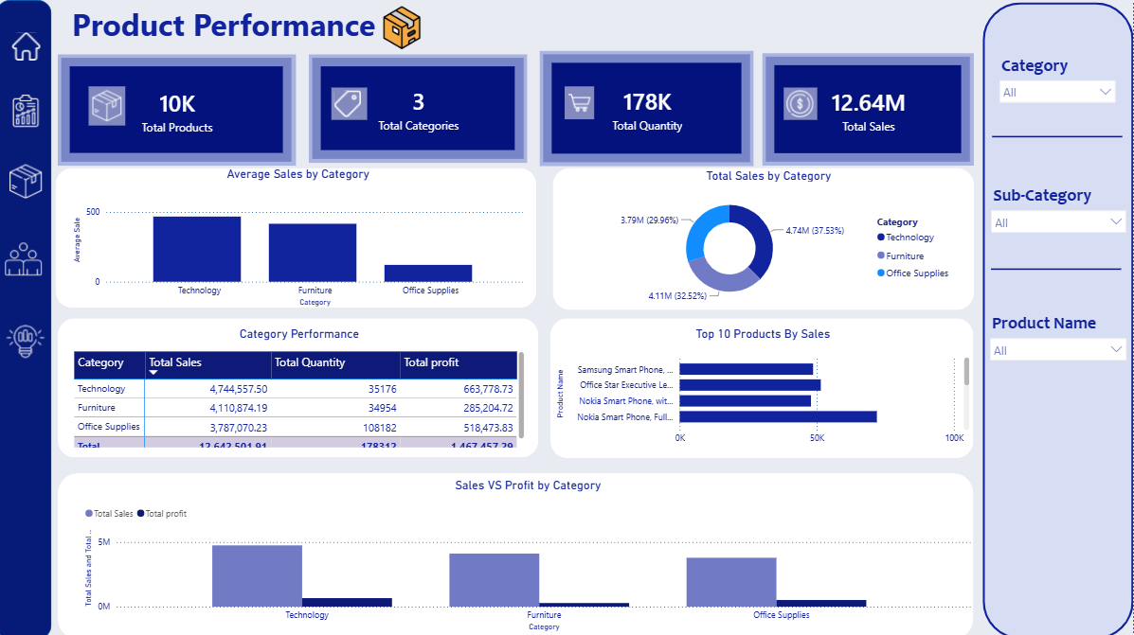

Slide 11
DASHBOARD 02
Product Performance
A category-owner's view of the catalog — which products sell, which categories are most profitable, and where quantity and profit diverge.
10,292
3
178,312
$12.64M
Total Products
Categories
Units Sold
Total Sales
KEY TAKEAWAYS
Technology leads in both sales and profit
Interactive Filters
Office Supplies sells the most units, at thinner margins
Category • Sub-Category • Product Name
Smartphones dominate the top-selling product list
Category owners drill from a 3-category view down to a single SKU without leaving the page.
Furniture shows the widest sales-to-profit gap
08

Slide 12
DASHBOARD 02
Sales vs. Profit by Category
CATEGORY SCORECARD
Technology
37.5% of total sales
35,176 units • $663.8K profit
Furniture
32.5% of total sales
34,954 units • $285.2K profit
Office Supplies
30.0% of total sales
108,182 units • $518.5K profit
09

Slide 13
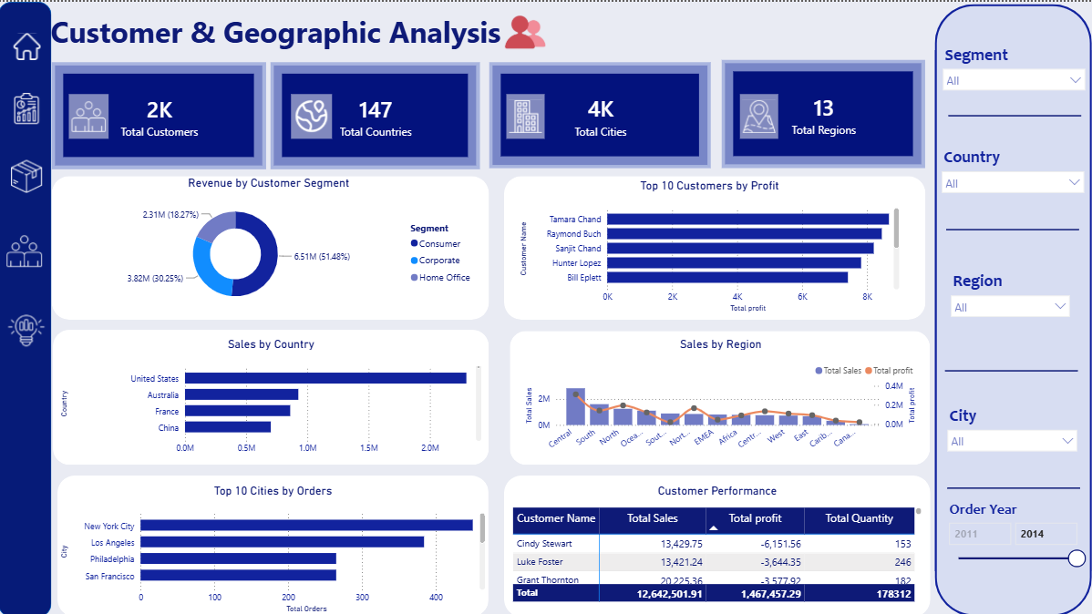

Slide 14
DASHBOARD 03
Customer & Geographic Analysis
A map of the customer base — how many customers, where they are, and which ones and which places generate the most value.
1,590
147
3,636
13
Total Customers
Countries
Cities
Regions
KEY TAKEAWAYS
The United States leads all countries in sales
Interactive Filters
The Central region posts the strongest sales performance
Country • Region • Segment
Raymond Buch and Tamara Chand top the profit ranking
Regional managers can isolate their own territory and benchmark it against company-wide performance.
A small group of customers drives outsized revenue
10

Slide 15
DASHBOARD 03
Where Performance Concentrates
TOP 5 COUNTRIES BY SALES
United States
$2.30M
Australia
$0.93M
France
$0.86M
China
$0.70M
Germany
$0.63M
11

Slide 16
SYNTHESIS
What the Three Dashboards Add Up To
Protect the Core
Fix the Margins
Grow Deliberately
APAC, the Consumer segment and the US market are already strong — keep investment and coverage steady where performance is proven.
Furniture and Office Supplies sell well but convert less into profit. Review pricing, discounting and cost-to-serve on these lines.
Use the Central region's success as a playbook, and apply it to under-performing regions before shifting more budget their way.
the three dashboards move leadership from “what happened” to “what to do next” — with the same numbers everyone can trust.
12

Slide 17

HOW IT WAS BUILT
Tools & Technology Stack
Python & pandas
SQL
Power BI
Star Schema Design
Data cleaning, de-duplication and star-schema construction
Warehouse queries powering every KPI and ranking shown
Data modeling, measures and the three interactive dashboards
Fact_Sales linked to four conformed dimension tables
13

Slide 18

Thank You
Global Superstore Analytics — Data Warehouse & Power BI Dashboards
Presented by: Osama Medhat , Adham Mohamed , Nada Mostafa ,Habiba Hany
Dr. Muhammed Safwat Eng. Dina Mohsen

