Slide 1
INDIA

Slide 2
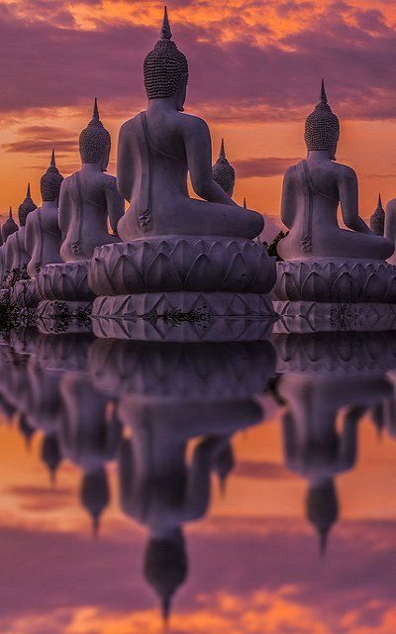
INDIA

Slide 3
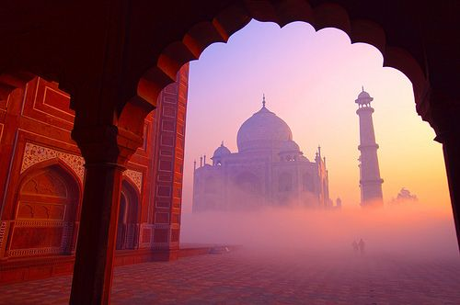
INDIA

