Slide 1
Classifying Data Using Support Vector Machines (SVMs) in Python

Slide 2

Contents
Introduction
Dataset Description and Use Cases
Approach and Methodology
Dataset Results
Conclusion

Slide 3

Introduction
In this presentation, we will delve into the fundamentals of using SVMs to classify various datasets, exploring different kernels and regularization techniques to achieve accurate classiﬁcation.

Slide 4
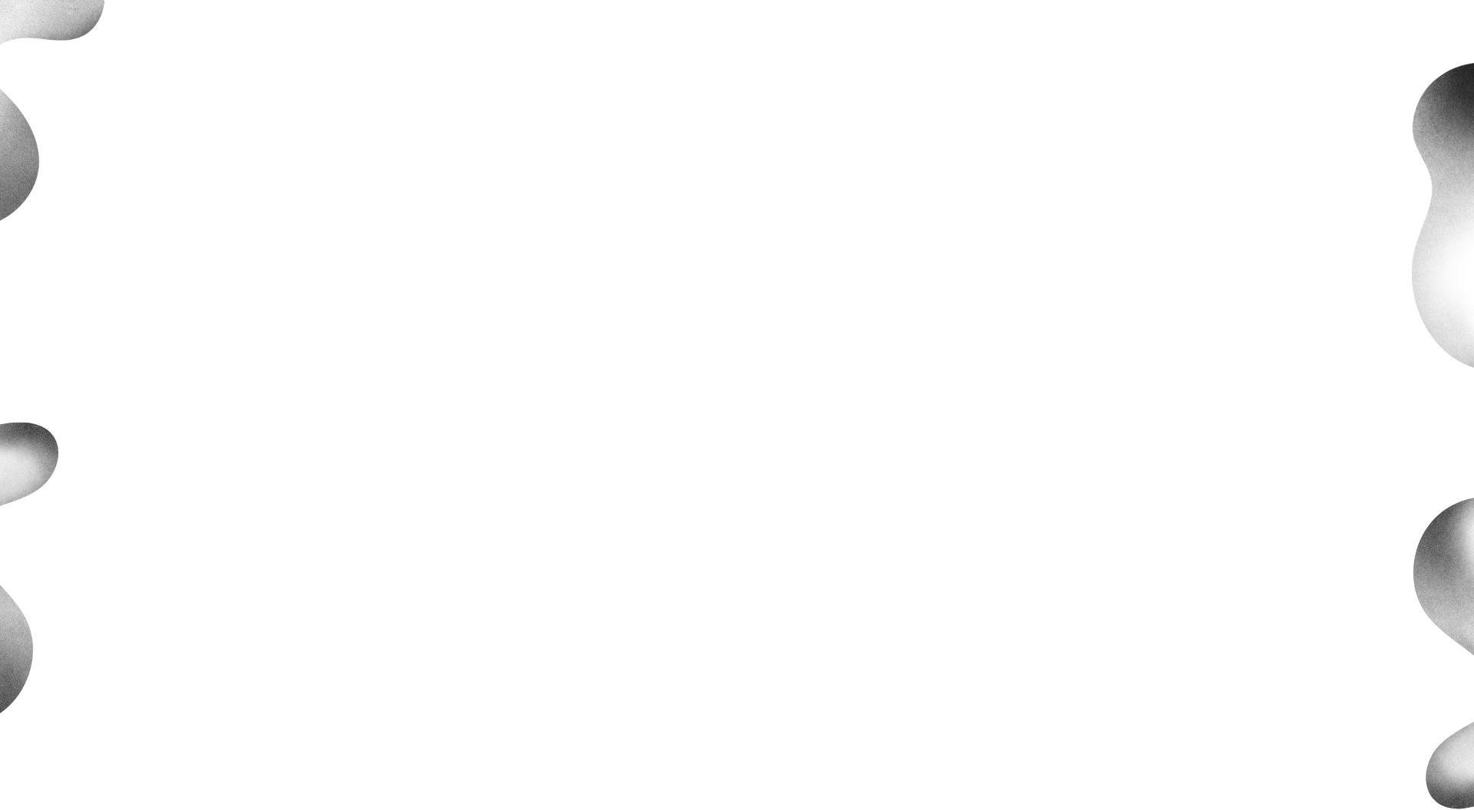
Dataset Description and Use Cases
Aggregation
The Aggregation dataset contains densely packed clusters useful for testing clustering algorithms in scenarios with irregular shaped clusters.
Compound
The Compound dataset consists of data points in several connected components, challenging for clustering algorithms to identify the underlying structures.
Flame
The Flame dataset consists of data points resembling ﬂame shapes, used for testing clustering algorithms when dealing with clusters of different sizes and shapes.

Slide 5


4
Jian
The Jian dataset contains two C shaped clusters and is used to evaluate the performance of clustering algorithms with irregularly shaped clusters.
Pathbased
The Pathbased dataset contains paths of varying shapes and orientations, useful for assessing the ability of classiﬁers to handle complex structures and patterns.
Spiral
The Spiral dataset consists of three intertwined spirals, a popular example for testing the capabilities of classiﬁcation algorithms that need to capture non-linear decision boundaries.
5
6

Slide 6

Approach and Methodology
The approach includes data pre-processing, model parameter tuning, training, evaluation, and implementation using tools such as scikit-learn for SVM implementation, NumPy for numerical operations, and Matplotlib for data visualization.

Slide 7

Aggregation and Compound Dataset Results
1 Regularization Eﬀect
The accuracy is 100% with regularization and 36% without regularization for the Aggregation dataset.
2 Kernel Inﬂuence
The type of kernel has minimal impact on accuracy for this dataset.

Slide 8

Flame and Jian Dataset Results
1 Regularization Eﬀect
Regularization signiﬁcantly impacts accuracy for the Flame and Jian datasets.
2 Kernel Inﬂuence
The linear kernel gives the worst results for both datasets.

Slide 9
Pathbased and Spiral Dataset Results
Regularization Effect
The accuracy is better with regularization for the Pathbased dataset.
Kernel Inﬂuence
The radial basis function (RBF) kernel performed better than the other kernels for the Spiral dataset.

Slide 10

Thank You

