Slide 1
Sampling, Missing Data & Recommendation
Part E — Can You Trust This Sample at All? | Part F — Recommendation
Statistical Analysis Presentation
Sampling Design • Missing Data • Commute Time & Academic Performance

Slide 2
Part E — Can You Trust This Sample at All?
• Assess the original sampling method and potential selection bias.
• Check whether every ITI student had an equal chance of being selected.
• Identify systematic differences in response and missing-data patterns.
• Design a more appropriate sampling strategy for future data collection.
2

Slide 3
E1 — Question 1
Name the sampling method.
Answer
The sampling method is not simple random, stratified, cluster, or multistage sampling.
It is a voluntary response / self-selection sample because the memo states: "Anyone who wanted to answer, answered."
3

Slide 4
E1 — Question 2
Did every ITI student have an equal chance of being selected?
Answer
No. Every student did not have an equal chance of selection.
The exact sentence that breaks the requirement is: "Anyone who wanted to answer, answered."
This creates self-selection. The analysis also notes that Cairo students may have had greater exposure if coordinators publicized the survey through a branch group chat.
4

Slide 5
E1 — Question 3
Which students are systematically less likely to have responded?
Answer
Students without a laptop are likely to have less convenient access to the internal portal.
In the cleaned data:
• Has laptop = Yes: 212 students
• Has laptop = No: 53 students
Therefore, 20% of the cleaned observations are students without a laptop, which may contribute to response bias.
5

Slide 6
E1 — Question 4
Identify the assumption in the memo and explain the possible effect.
Answer
The assumption is: "We assumed they were the ones who did not care."
This may be unfair because non-response does not necessarily mean lack of interest. A student may not have seen the survey or may have had limited access to it.
If non-responders differ systematically from responders, the survey results may be biased.
6

Slide 7
E2 — Design It Properly
• Population: 2,000 students.
• Five branches × five tracks.
• Goal: obtain a representative sample without relying on voluntary participation.
• Recommended design: Stratified Random Sampling.
7

Slide 8
E2 — Question 1
Design the sampling strategy for the next term.
Sampling strategy
Use Stratified Random Sampling.
Define strata using Branch × Track. With 5 branches and 5 tracks, there are 25 possible strata.
Students are selected randomly within each stratum, with the number selected from each stratum proportional to its size.
8

Slide 9
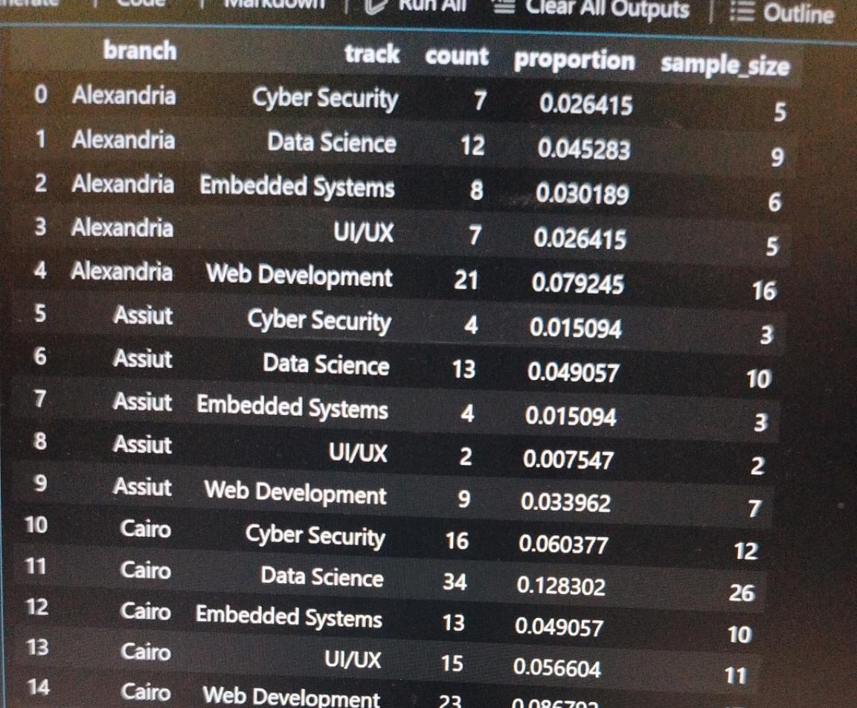
E2 — Q1 | Proportional Allocation Table (1/2)
Cleaned dataset — strata, proportions, and proposed sample sizes
Branch | Track | Count | Proportion | Sample Size
Alexandria | Cyber Security | 7 | 0.026415 | 5
Alexandria | Data Science | 12 | 0.045283 | 9
Alexandria | Embedded Systems | 8 | 0.030189 | 6
Alexandria | UI/UX | 7 | 0.026415 | 5
Alexandria | Web Development | 21 | 0.079245 | 16
Assiut | Cyber Security | 4 | 0.015094 | 3
Assiut | Data Science | 13 | 0.049057 | 10
Assiut | Embedded Systems | 4 | 0.015094 | 3
Assiut | UI/UX | 2 | 0.007547 | 2
Assiut | Web Development | 9 | 0.033962 | 7
Cairo | Cyber Security | 16 | 0.060377 | 12
Cairo | Data Science | 34 | 0.128302 | 26
Cairo | Embedded Systems | 13 | 0.049057 | 10
Cairo | UI/UX | 15 | 0.056604 | 11
Cairo | Web Development | 23 | 0.086792 | 17
9

Slide 10
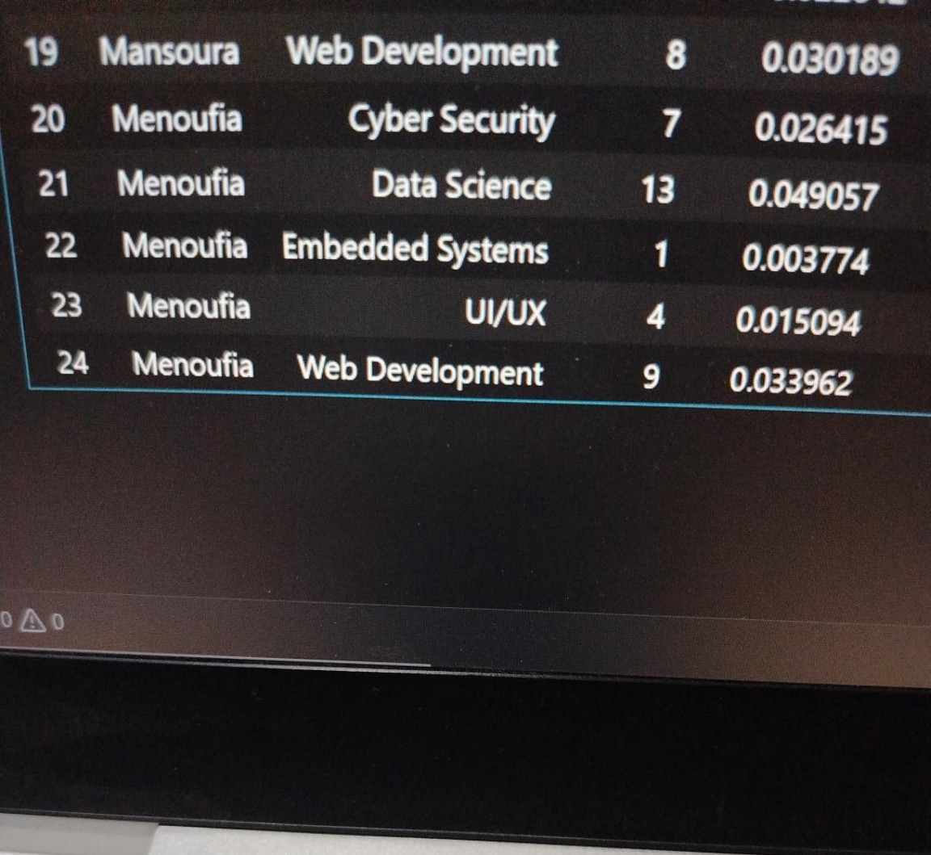
E2 — Q1 | Proportional Allocation Table (2/2)
Cleaned dataset — remaining branch × track strata
Branch | Track | Count | Proportion | Sample Size
Mansoura | Cyber Security | 6 | 0.022642 | 5
Mansoura | Data Science | 16 | 0.060377 | 12
Mansoura | Embedded Systems | 7 | 0.026415 | 5
Mansoura | UI/UX | 6 | 0.022642 | 5
Mansoura | Web Development | 8 | 0.030189 | 6
Menoufia | Cyber Security | 7 | 0.026415 | 5
Menoufia | Data Science | 13 | 0.049057 | 10
Menoufia | Embedded Systems | 1 | 0.003774 | 1
Menoufia | UI/UX | 4 | 0.015094 | 3
Menoufia | Web Development | 9 | 0.033962 | 7
10

Slide 11
E2 — Q1 | Proportional Allocation Code
# Count students in each Branch × Track stratum
strata = (
df_clean
.groupby(["branch", "track"])
.size()
.reset_index(name="count")
)
# Calculate each stratum's proportion
strata["proportion"] = strata["count"] / len(df_clean)
# Proportional allocation for a sample of 200 students
sample_size = 200
strata["sample_size"] = (
strata["proportion"] * sample_size
).round().astype(int)
11

Slide 12
E2 — Q1 | Explanation of the Results
Answer
I would use Stratified Random Sampling.
The strata would be defined by branch and track, giving us 25 possible branch-track strata (5 branches × 5 tracks).
Using the cleaned dataset, we calculate the proportion of students in each branch-track stratum. For a target sample of 200 students, the sample is allocated proportionally across the strata.
For each stratum: Sample size = Stratum proportion × 200.
For example, if a branch-track group represents 10% of the cleaned sample, approximately 20 students would be selected from that group.
Students should then be selected randomly within each branch-track group. This ensures representation of different branches and tracks rather than relying on voluntary responses.
12

Slide 13
E2 — Q1 | Important Note
Interpretation
The cleaned dataset is used here to demonstrate proportional allocation.
The actual population counts for all 25 branch-track strata would be needed to calculate the exact allocation for the full population of 2,000 students.
13

Slide 14
E2 — Question 2
Why is stratified sampling better than a simple random sample of the same size?
• It helps ensure that all five branches and five tracks are represented.
• A simple random sample could, by chance, contain too many students from some groups and too few from others.
• Stratification improves representation of the different groups in the population.
• Students are still randomly selected within each stratum, preserving the random-selection principle.
14

Slide 15
E2 — Question 3
Randomly pick two whole branches and survey everyone in them.
Answer
Sampling method: Cluster Sampling.
Gain: It is easier and cheaper to collect data because the survey is concentrated in only two branches.
Risk: The selected branches may not represent the other branches. This could reduce representativeness if branches differ in commute time, tracks, or other characteristics.
15

Slide 16
E2 — Question 4
Represent every branch and every track.
Answer
Choose Stratified Random Sampling, using branch and track as the strata.
This ensures that every branch and every track is represented while students are randomly selected within each group.
It reduces the risk of some branches or tracks being overrepresented or underrepresented in the sample.
16

Slide 17
E3 — Missing Data
• Identify the variable with the largest number of missing observations.
• Check whether missingness is distributed evenly across branches.
• Check whether missingness is distributed evenly across tracks.
• Explain how unequal missingness can affect conclusions and generalization.
17

Slide 18
E3 — Question 1
Which variable has the most missing values?
Answer
The variable with the most missing values is favorite_sport, with 56 missing values in the cleaned data.
18

Slide 19
E3 — Question 2
Is missing data evenly distributed across branches?
Answer
No. The missing values are not evenly distributed across branches.
• Menoufia has the highest missing-data percentage: approximately 29.4%.
• Mansoura has the lowest: approximately 16.3%.
This suggests that missingness may be concentrated in certain branches rather than being completely random.
19

Slide 20
E3 — Question 3
What about across tracks?
Answer
Missing data is also not evenly distributed across tracks.
• UI/UX: about 29.4%
• Web Development: about 27.1%
• Cyber Security: about 20.0%
• Data Science: about 17.0%
• Embedded Systems: about 12.1%
Some tracks therefore have noticeably higher missing-data rates than others.
20

Slide 21
E3 — Question 4
Why does this matter for your conclusions?
Answer
If missing values are concentrated in particular branches or tracks, simply ignoring those students can change the composition of the analyzed sample.
For example, if one track has much more missing data than another, analyses using that variable may represent students with available responses more than the whole population.
Therefore, the amount and distribution of missing data should be reported, and conclusions should be generalized carefully.
21

Slide 22
Part F — Recommendation
• Assess the relationship between commute time and final score.
• Compare commute groups and branch-level commute patterns.
• Identify a practical threshold for relatively long commutes.
• Interpret the evidence alongside sampling and missing-data limitations.
22

Slide 23
Part F — Recommendation
Main finding
Conclusion from the cleaned dataset
Commute time does not show a strong relationship with students’ final scores.
The correlation between commute time and final score is -0.059, indicating a very weak negative relationship.
Therefore, the data does not provide strong evidence that longer commuting is associated with substantially lower academic performance.
23

Slide 24
Part F — Evidence
• Overall mean commute time: 45.09 minutes.
• Median commute time: 33 minutes.
• The difference between mean and median, together with the right-skewed distribution, indicates some students have much longer commutes.
• Cairo has the highest mean commute time: 59.97 minutes.
• Assiut has the lowest commute-time standard deviation: 16.06 minutes, indicating less variation within that branch.
• Median split: short-commute mean final score = 79.74; long-commute mean = 78.96.
• Difference between the two groups = 0.78 points.
24

Slide 25
Part F — Comparison with Other Variables
• Study hours vs. final score: correlation = 0.645.
• Sleep hours vs. final score: correlation = 0.164.
• Commute time vs. final score: correlation = -0.059.
• The study-hours correlation is substantially stronger than the commute-time correlation.
• These correlations describe association only; they do not establish causation.
25

Slide 26
Part F — Eligibility Threshold
Identifying relatively long commutes
Practical screening threshold
The third quartile (Q3) of commute time is 58.3 minutes.
Students with commute times of 58.3 minutes or more can therefore be classified as having relatively long commutes for further investigation.
This is a screening criterion, not evidence that these students necessarily have lower academic performance.
26

Slide 27
Part F — Limitations
• The sample was based on voluntary responses rather than random selection, which can introduce response bias.
• The dataset contains missing values, particularly in favorite_sport (56 missing observations).
• Correlation does not establish causation.
• The weak commute–score correlation does not prove that commuting has no effect on academic performance.
• Other factors, such as study time, branch, or individual circumstances, may also affect final scores.
27

Slide 28
Part F — Next Steps
• Collect a more representative sample using stratified random sampling.
• Ensure that branches and tracks are adequately represented.
• Record additional factors that may affect academic performance, such as study conditions and other relevant student circumstances.
• Identify students meeting the 58.3-minute threshold for further investigation.
• Do not base support decisions on commute time alone; stronger conclusions require additional data and a more representative sample.
28

Slide 29
Key Takeaways
• The original survey used voluntary response / self-selection, not a probability sampling method.
• Stratified random sampling by branch × track is a suitable design for the next survey.
• Missing data is not evenly distributed across branches and tracks and should be considered in analysis.
• Commute time has a very weak observed correlation with final score in the cleaned dataset.
• A more representative sample and additional variables are needed before making stronger generalizations.
29

