Slide 1
Coding in Python for Health and Life Sciences HPDM171 2024/24 02/12/2024

Slide 2
What did we cover last week?
Experience more complex plotting in pandas
Multi-panel plots
Introduction to the seaborn package
Introduction to bootstrapping

Slide 3
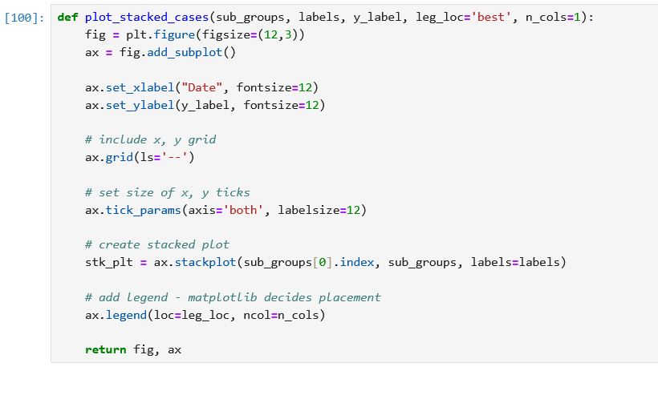
We also need a legend

Slide 4
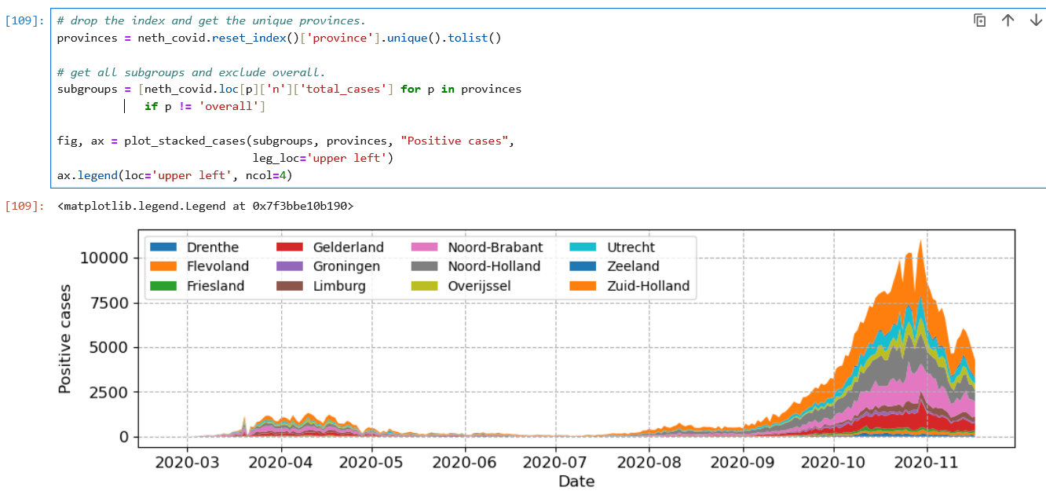
Now add them all

Slide 5
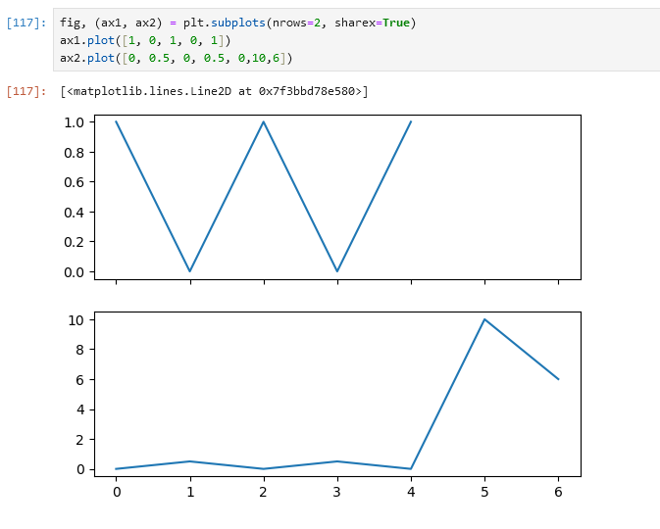
… which we can force to share axes

Slide 6
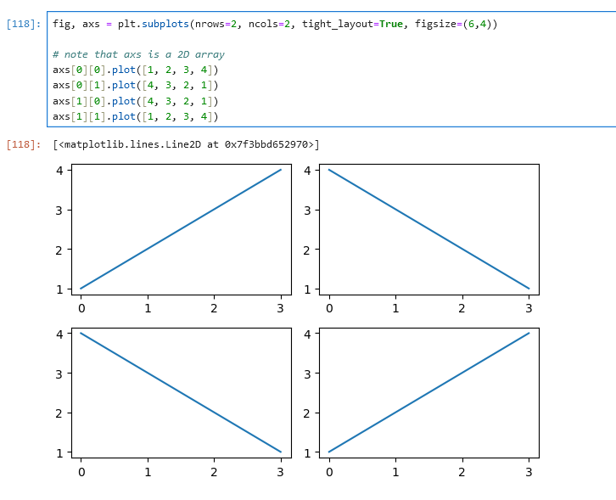
Alternatively, we can create an axis array

Slide 7
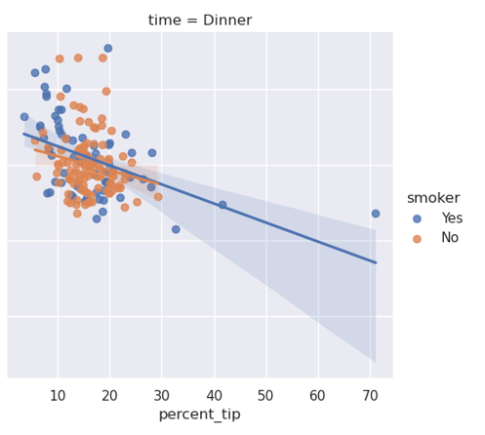
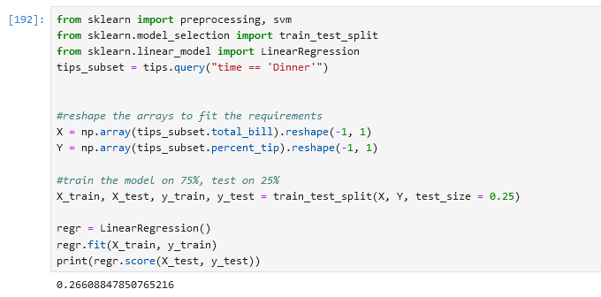
But how do we quantify how well the line fits?
R2 metric

Slide 8
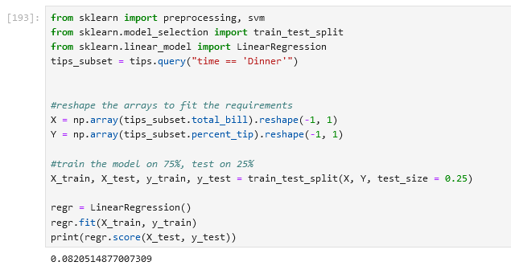
But what if we run it again and it chooses a different test set
R2 metric

Slide 9
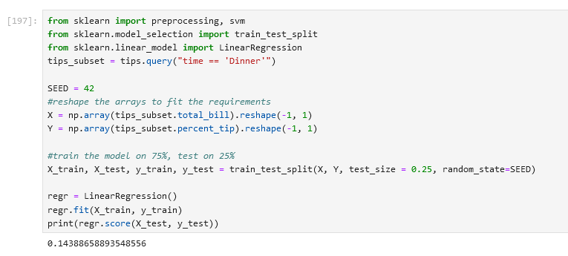
We could fix the SEED, but does that really give us scientific rigour?

Slide 10
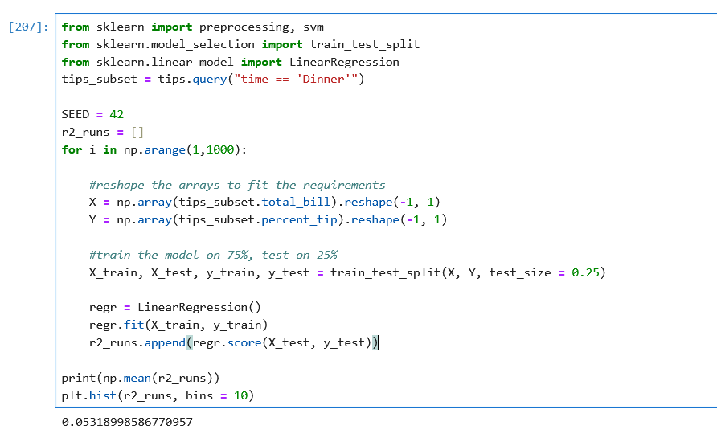
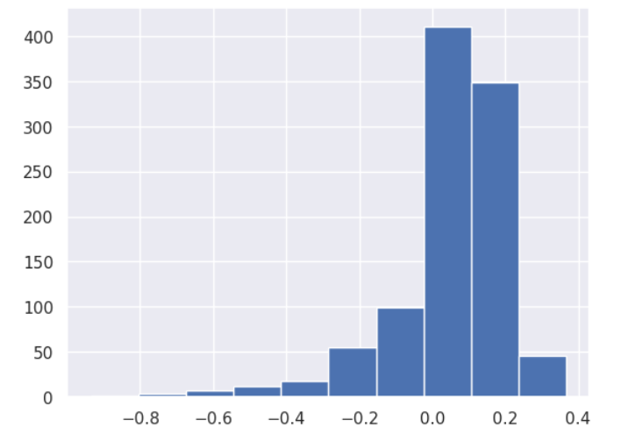
Instead, we can ‘bootstrap’

Slide 11
Instead, we can ‘bootstrap’

Slide 12
ILO’s for today
Basics of scikit learn in python for machine learning
This lecture follows the examples provided by Jake VanderPlas’ Python Handbook
https://jakevdp.github.io/PythonDataScienceHandbook/

Slide 13
We’ve already been using it, but now its time to explain whats happening ‘under the hood’

Slide 14
Why scikit learn
Machine learning is about creating models from data
There are several Python libraries which provide solid implementations of a range of machine learning algorithms. One of the best known is Scikit-Learn, a package that provides efficient versions of a large number of common algorithms. Scikit-Learn is characterized by a clean, uniform, and streamlined API, as well as by very useful and complete online documentation.

Slide 15
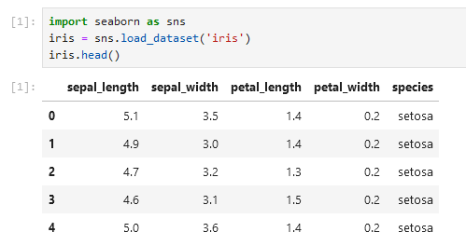
A simple example to start
Each row is a sample
Each column is a feature

Slide 16
Samples, Features and Targets
This table layout makes clear that information can be thought of as a two-dimensional numerical array or matrix, which we will call the features matrix. By convention, this features matrix is often stored in a variable named X. The features matrix is assumed to be two-dimensional, with shape [n_samples, n_features], and is most often contained in a NumPy array or a Pandas DataFrame
The samples (i.e., rows) always refer to the individual objects described by the dataset. For example, the sample might be a flower, a person, a document, an image, a sound file, a video, etc
The features (i.e., columns) always refer to the distinct observations that describe each sample in a quantitative manner. Features are generally real-valued, but may be Boolean or discrete-valued in some cases.
In addition to the feature matrix X, we also generally work with a label or target array, which by convention we will usually call y. The target array is usually one dimensional, with length n_samples. The distinguishing feature of the target array is that it is usually the quantity we want to predict from the data: in statistical terms, it is the dependent variable.

Slide 17
Samples, Features and Targets
Each row is a sample
Each column is a feature
Target

Slide 18
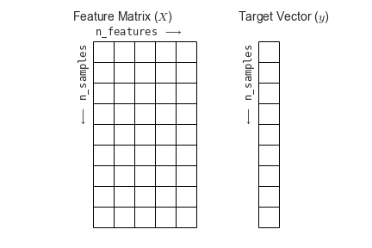
Samples, Features and Targets

Slide 19
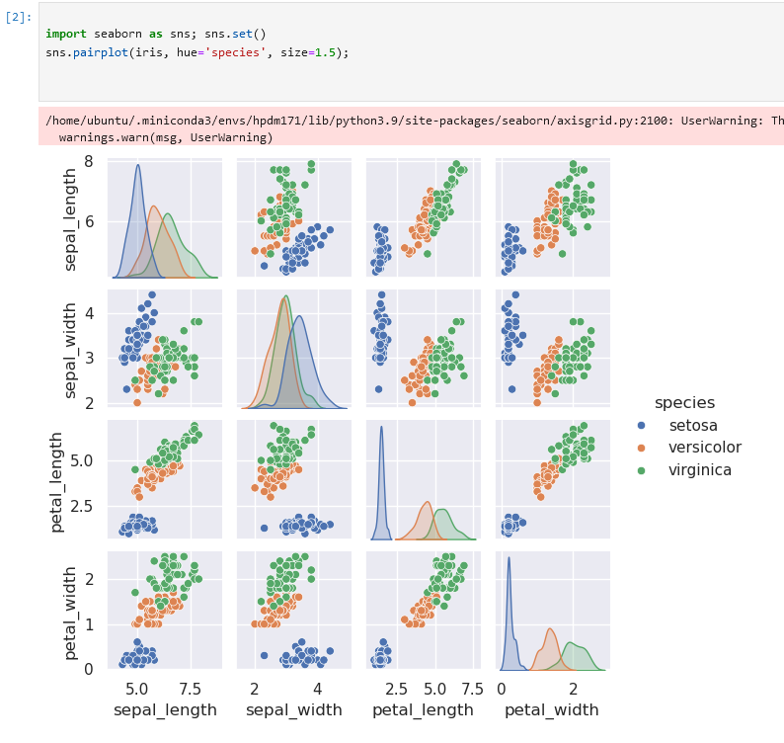
Plotting the data with ease using seaborn

Slide 20
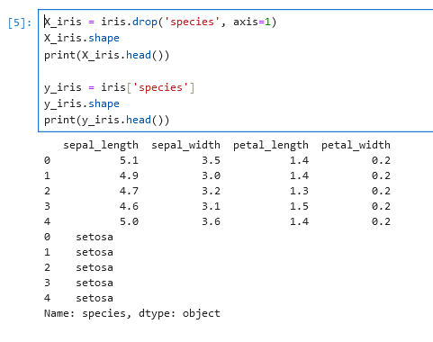
Split the targets and features

Slide 21
The Scikit model
Most commonly, the steps in using the Scikit-Learn estimator API are as follows
Choose a class of model by importing the appropriate estimator class from Scikit-Learn.
Choose model hyperparameters by instantiating this class with desired values.
Arrange data into a features matrix and target vector following the discussion above.
Fit the model to your data by calling the fit() method of the model instance.
Apply the Model to new data:
For supervised learning, often we predict labels for unknown data using the predict() method.
For unsupervised learning, we often transform or infer properties of the data using the transform() or predict() method.

Slide 22
Supervised vs. unsupervised learning
In supervised learning, we often have a goal (e.g. predicting species of a flower)
In un-supervised learning, we are trying to infer something about the structure of the data (e.g. clustering), but don’t have a pre-fixed output of interest

Slide 23
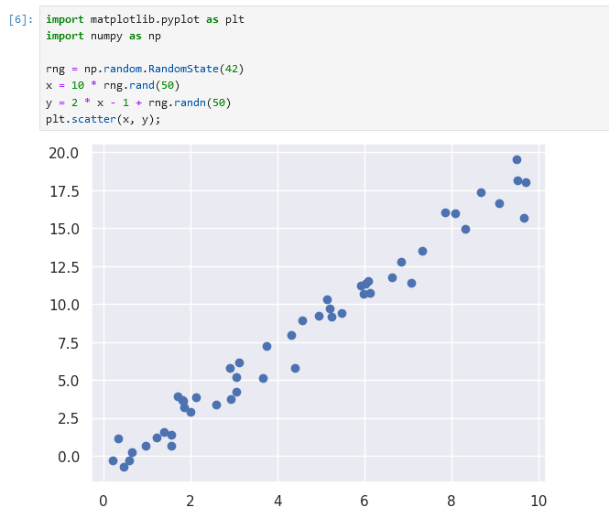

Picking your model
This data looks like it follows a linear trend
We therefore load the LinearRegression class from SciKit learn

Slide 24
Hyper-parameters
Once we have decided on our model class, there are still some options open to us. Depending on the model class we are working with, we might need to answer one or more questions like the following (e.g.):
Would we like to fit for the offset (i.e., y-intercept)?
Would we like the model to be normalized?
How many model components would we like to use?
These are examples of the important choices that must be made once the model class is selected. These choices are often represented as hyperparameters, or parameters that must be set before the model is fit to data. In Scikit-Learn, hyperparameters are chosen by passing values at model instantiation. We will explore how you can quantitatively motivate the choice of hyperparameters in Hyperparameters and Model Validation.

Slide 25
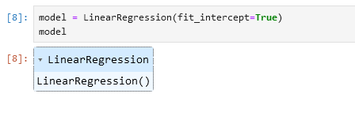
Instantiating a model instance
Note that when the model is instantiated, the only action is the storing of these hyperparameter values. In particular, we have not yet applied the model to any data: the Scikit-Learn API makes very clear the distinction between choice of model and application of model to data.

Slide 26
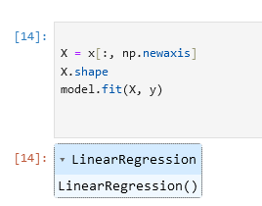
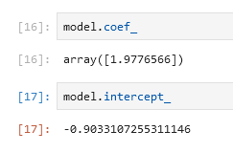

Model outputs
This fit() command causes a number of model-dependent internal computations to take place, and the results of these computations are stored in model-specific attributes that the user can explore. In Scikit-Learn, by convention all model parameters that were learned during the fit() process have trailing underscores

Slide 27
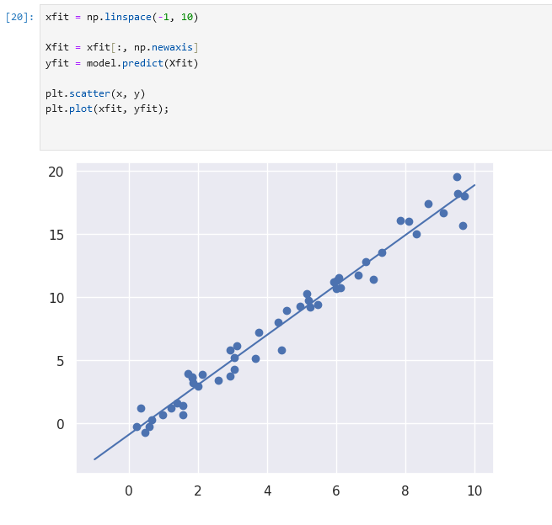
Predicting based on your model
Once the model is trained, the main task of supervised machine learning is to evaluate it based on what it says about new data that was not part of the training set. In Scikit-Learn, this can be done using the predict() method. For the sake of this example, our "new data" will be a grid of x values, and we will ask what y values the model predicts:

Slide 28
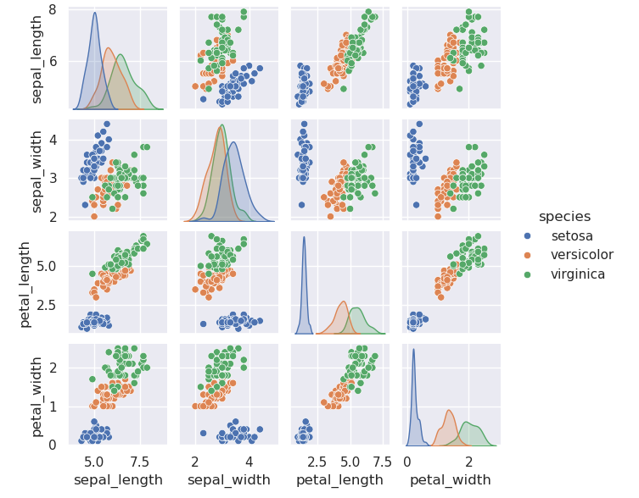
Returning to the Iris example
Given a model trained on a portion of the Iris data, how well can we predict the remaining labels?
We will use a simple generative model known as Gaussian naive Bayes. It is fast because has no hyperparameters to choose, Gaussian naive Bayes is often a good model to use as a baseline classification, before exploring whether improvements can be found through more sophisticated models.

Slide 29
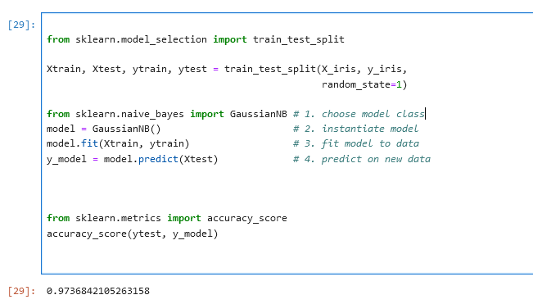

Returning to the Iris example

Slide 30
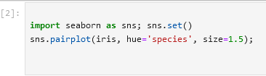
Un-supervised learning on the iris example

Slide 31
An example of un-supervised learning
Suppose we want to reduce the dimensionality of the Iris data to more easily visualize it. Recall that the Iris data is four dimensional: there are four features recorded for each sample.
The task of dimensionality reduction is to ask whether there is a suitable lower-dimensional representation that retains the essential features of the data. Often dimensionality reduction is used as an aid to visualizing data

Slide 32
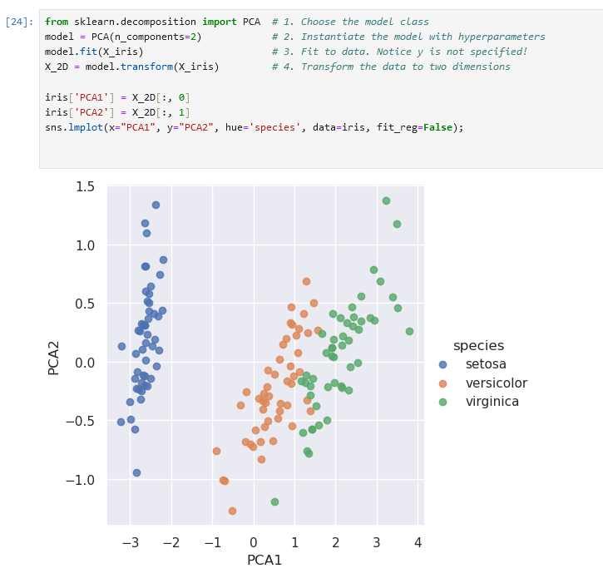
An example of un-supervised learning
We see that in the two-dimensional representation, the species are fairly well separated, even though the PCA algorithm had no knowledge of the species labels! This indicates to us that a relatively straightforward classification will probably be effective on the dataset

Slide 33
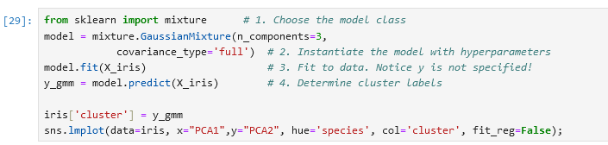
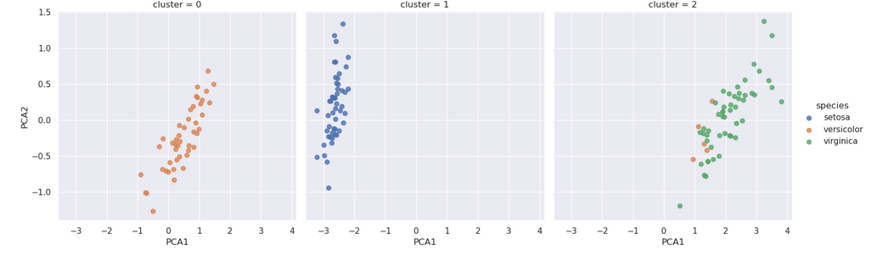
An example of un-supervised learning

Slide 34
Un-supervised clustering of the Iris data
K-means
The k-means algorithm searches for a pre-determined number of clusters within an unlabeled multidimensional dataset. It accomplishes this using a simple conception of what the optimal clustering looks like:
The "cluster centre" is the arithmetic mean of all the points belonging to the cluster.
Each point is closer to its own cluster centre than to other cluster centres.

Slide 35
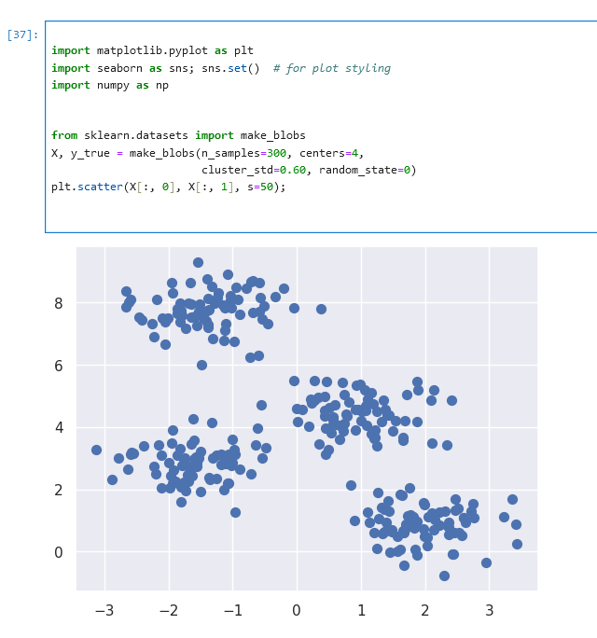
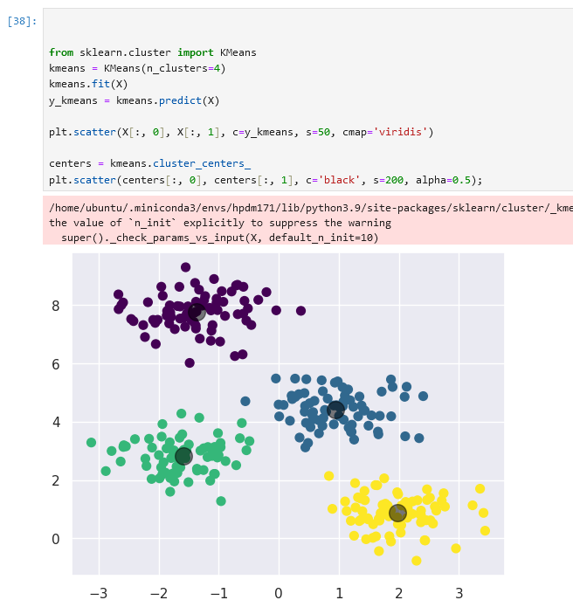
Un-supervised clustering of the Iris data
K-means

Slide 36
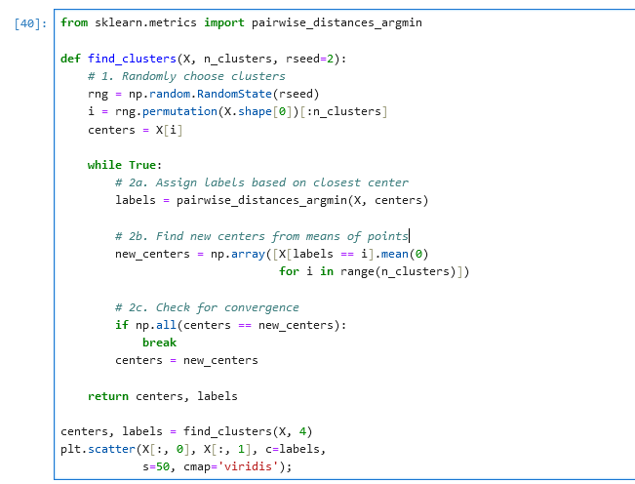
But how does k-means work?
By Chire - Own work, CC BY-SA 4.0, https://commons.wikimedia.org/w/index.php?curid=59409335

Slide 37
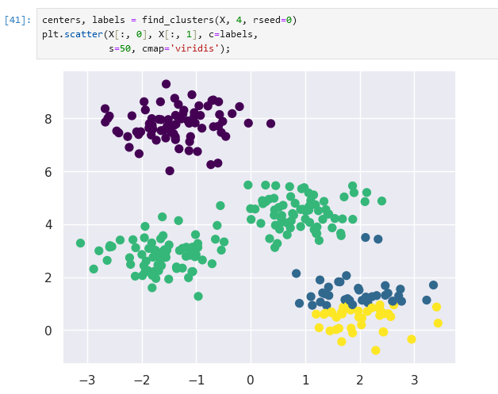
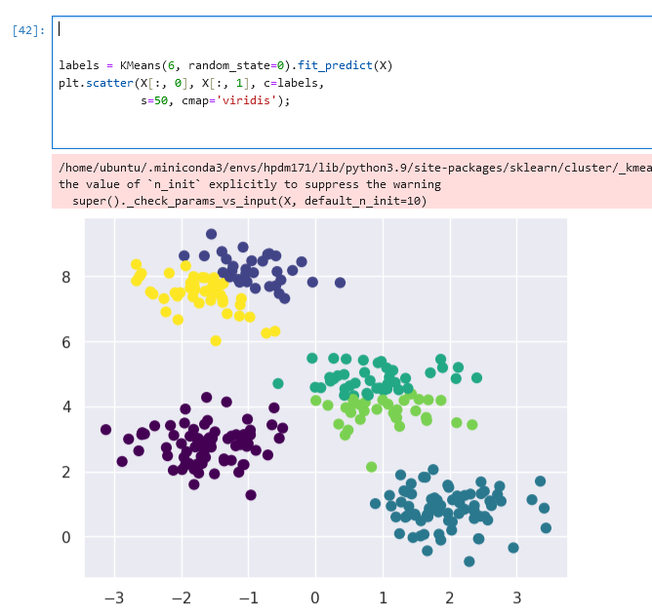
Problems with k-means
The Model doesn’t always converge
It depends on parameter choices

Slide 38
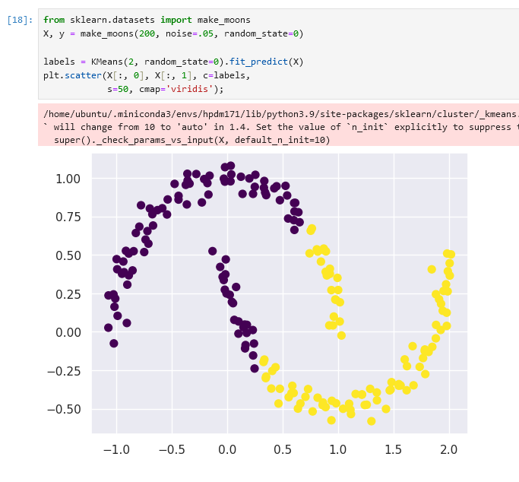
Problems with k-means
K-means is limited to linear cluster boundaries

Slide 39
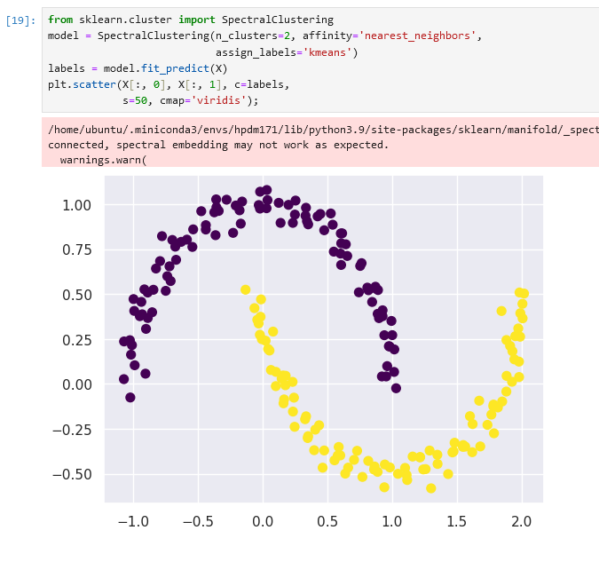
Solutions to problems with k-means
One way to avoid this is spectral clustering
Again – you don’t need to understand the ins and outs of what it's doing, just the right (typically one of many) method for the problem

Slide 40
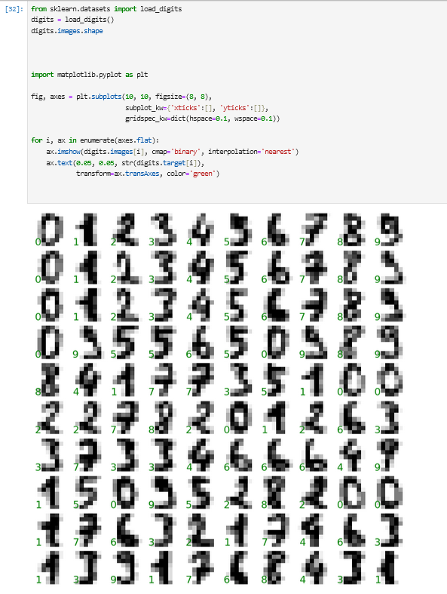
A more interesting example: digits and image recognition
1,797 samples each consisting of an 8 × 8 grid of pixels. First 100:
We need a two-dimensional, [n_samples, n_features] representation. We can accomplish this by treating each pixel in the image as a feature: that is, by flattening out the pixel arrays so that we have a length-64 array of pixel values representing each digit. Additionally, we need the target array, which gives the previously determined label for each digit.

Slide 41
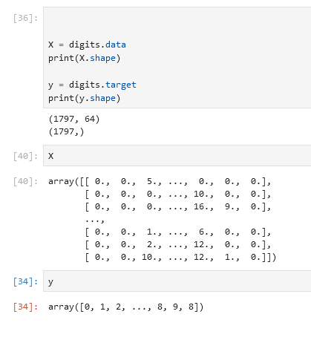
A more interesting example: digits and image recognition
1,797 samples each consisting of an 8 × 8 grid of pixels. First 100:

Slide 42
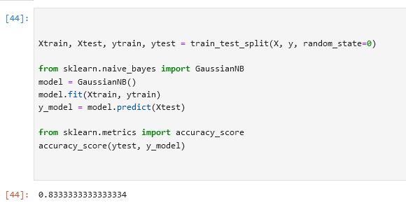
A more interesting example: digits and image recognition
Even with an extremely model, we get the correct digit 83.3% of the time!

Slide 43
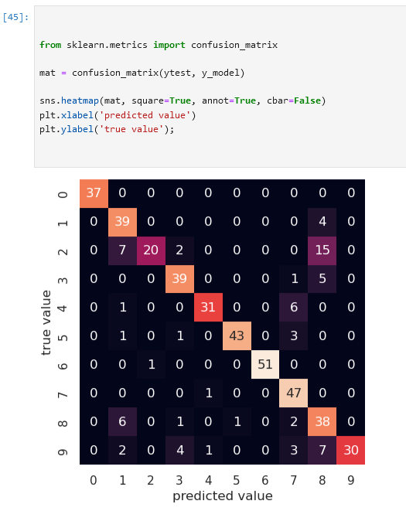
A more interesting example: digits and image recognition
A confusion matrix shows us where the mis-labeled points tend to be: for example, a large number of twos here are mis-classified as either ones or eight

Slide 44
What did we cover today?
Basics of scikit learn in python for machine learning, including:
Supervised vs. unsupervised learning
K-means
Basic clustering, prediction & quantification of fit

