Slide 1
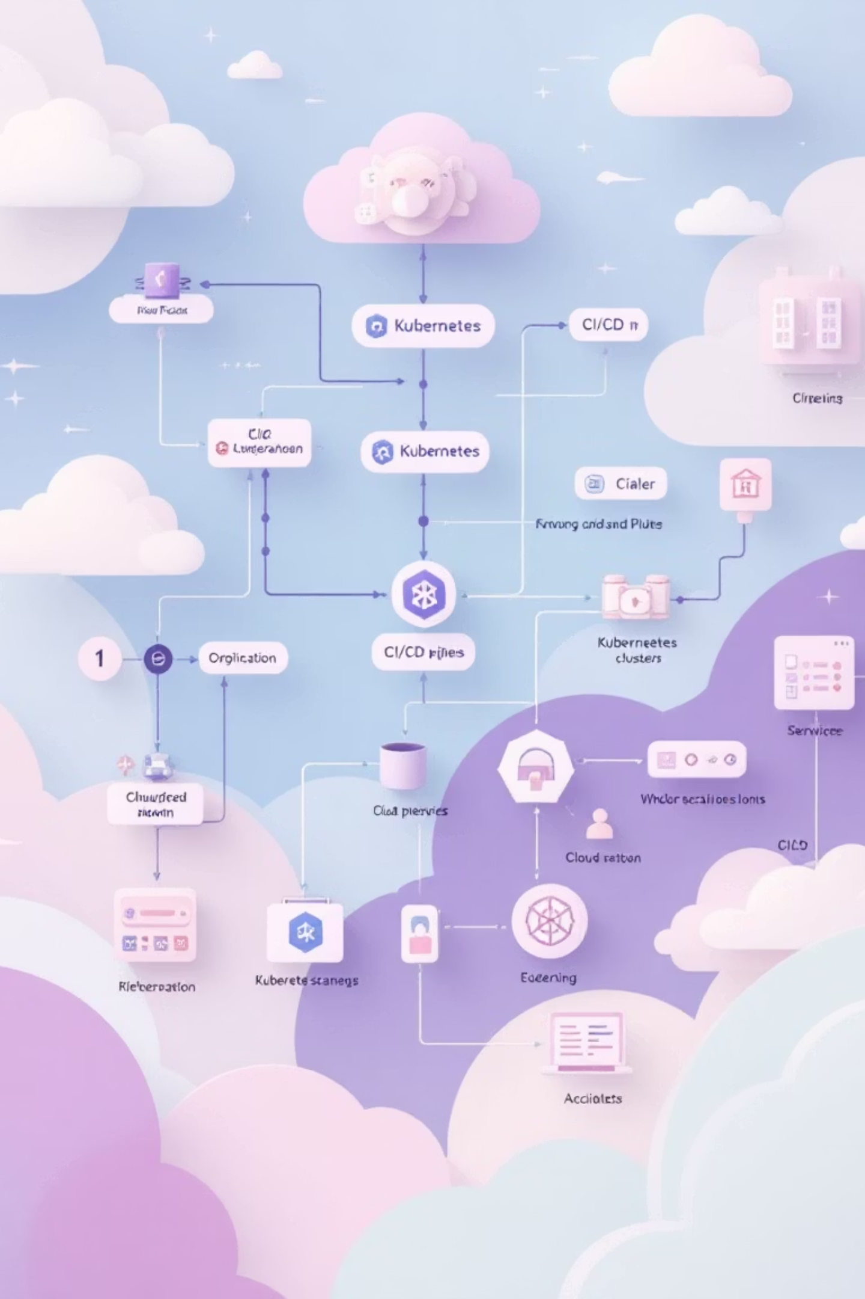
Final Project: Cloud-Native DevSecOps Pipeline with Kubernetes
Project Overview
Build a complete cloud-native DevSecOps infrastructure extending the microservices application (Flask + React) with:
Kubernetes orchestration using Helm & Kustomize
GitOps deployment with ArgoCD
Monitoring with Prometheus & Grafana
Centralized logging with ELK Stack
AWS cloud integration (ECS, EC2, S3, RDS)
Enhanced CI/CD pipeline

Slide 2
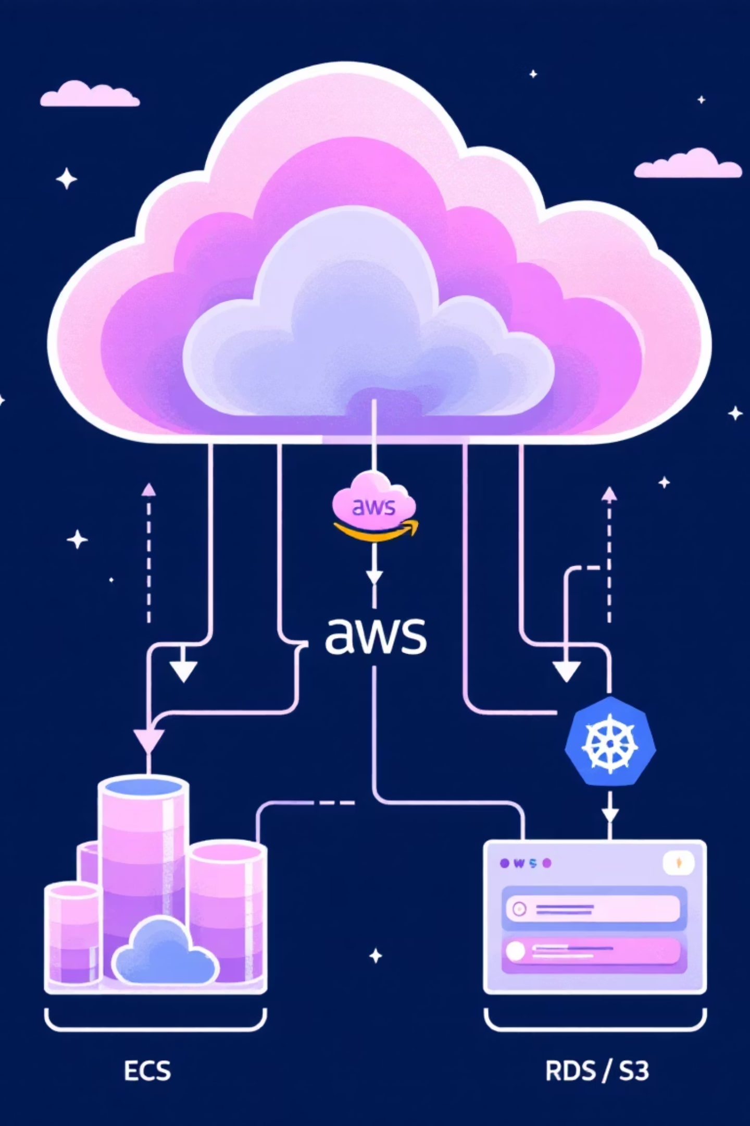
Architecture Overview
Kubernetes Stack
AWS Cloud Stack
Application Layer: Frontend (React), Backend (Flask), PostgreSQL
Compute: ECS Fargate + EC2 instances
Storage: S3 buckets (static assets, backups, logs)
Monitoring: Prometheus + Grafana + AlertManager
Database: RDS PostgreSQL (Multi-AZ)
Logging: Elasticsearch + Logstash + Kibana + Filebeat
Networking: VPC + ALB + Security Groups
GitOps: ArgoCD for automated deployments
Monitoring: CloudWatch integration

Slide 3
Technologies & Tools
Infrastructure & Orchestration
Monitoring & Logging
Cloud & IaC
Prometheus & Grafana | AlertManager | Elasticsearch | Logstash | Kibana | Filebeat
AWS (ECS, EC2, S3, RDS, ALB) | Terraform | Ansible
Kubernetes 1.28+ | Helm 3.12+ | Kustomize | ArgoCD | Docker 24.0+
CI/CD & Security
Application Stack
GitLab CI/CD | Trivy Security Scanning | SonarQube | Kubesec
Python 3.10 + Flask | React 18 | PostgreSQL 15 | Nginx

Slide 4
Project Structure
final-project/├── k8s/│ ├── base/ # Base Kubernetes manifests│ ├── overlays/ # Kustomize overlays (dev/staging/prod)│ ├── monitoring/ # Prometheus & Grafana│ ├── logging/ # ELK Stack│ └── argocd/ # ArgoCD applications├── helm/│ ├── microservices-app/ # Main application chart│ ├── monitoring-stack/ # Monitoring helm chart│ └── logging-stack/ # Logging helm chart├── terraform/│ └── aws/ # AWS infrastructure (VPC, ECS, RDS, S3)├── ansible/│ ├── playbooks/ # Automation playbooks│ └── roles/ # Ansible roles├── .gitlab-ci.yml # CI/CD pipeline└── docs/ # Documentation
The structure is designed for clear separation of concerns and environment-specific configurations.

Slide 5

Implementation Timeline
Week 2: GitOps & Monitoring
Week 1: Kubernetes Foundation
Install & configure ArgoCD
Set up K8s cluster (Minikube/Kind)
Deploy Prometheus & Grafana
Create base manifests & Kustomize overlays
Create custom dashboards
Build Helm charts for microservices
Set up alerting rules
Configure ingress and networking
Week 4: CI/CD & Testing
Week 3: Logging & Cloud
Enhance GitLab pipeline
Deploy ELK stack
Security scanning integration
Configure log collection & parsing
Testing & documentation
Set up AWS infrastructure with Terraform
Final presentation prep
Deploy to ECS + configure RDS & S3

Slide 6
Monitoring Strategy
Key Metrics to Track
Grafana Dashboards
Application: Request rate, error rate, response time (p50/p95/p99)
1
Kubernetes Cluster Overview
Infrastructure: CPU/Memory usage, pod restarts, node health
2
Application Performance Metrics
Database: Connection pool, query performance, transaction rate
3
PostgreSQL Database Monitoring
Alerting Rules
4
Node Exporter (Infrastructure)
High error rate (>5% for 5min)
Pod crash looping
High resource utilization (>80%)
5
Custom Business Metrics
Database connection issues
Service endpoint down

Slide 7
Logging Strategy
Log Sources
ELK Stack Configuration
Application logs (Flask API, React frontend)
Nginx access/error logs
Kubernetes system logs
Database query logs
Elasticsearch
Monitoring stack logs
3-node cluster for HA
Kibana Dashboards
Real-time log volume
Error tracking by service
API performance analysis
Logstash
User activity monitoring
Log processing & enrichment
Security audit logs
Filebeat
DaemonSet for pod log collection
Kibana
Visualization & search

Slide 8

CI/CD Pipeline Stages
Build & Test
Security & Quality
Lint code (Python/JavaScript)
Trivy container scanning
Run unit tests (pytest/Jest)
SonarQube code analysis
Build Docker images
Kubesec K8s manifest scanning
Tag with commit SHA
OWASP dependency check
Deploy Pipeline
Post-Deployment
Dev: Automatic deployment via Helm/ArgoCD
Smoke tests & health checks
Staging: Automated with integration tests
Performance validation
Production: Manual approval + blue-green deployment
Slack notifications

Slide 9
AWS Cloud Integration
Infrastructure Components
Compute: ECS Fargate tasks + EC2 bastion hosts Storage: S3 buckets (assets, backups, logs, Terraform state) Database: RDS PostgreSQL Multi-AZ with read replicas Networking: VPC with public/private subnets + ALB Security: IAM roles, Security Groups, WAF, CloudTrail
Terraform Modules
CloudWatch Integration
Networking: VPC, subnets, route tables, NAT gateways
Custom metrics from ECS tasks
Compute: ECS cluster, task definitions, EC2 instances
Log aggregation from all services
Storage: S3 buckets with encryption & versioning
Automated alarms & SNS notifications
Database: RDS with automated backups & monitoring

Slide 10

Deliverables & Evaluation
Code Repository ✓
Presentation ✓
All K8s manifests & Helm charts
Architecture diagrams
Terraform IaC for AWS
Live demos (K8s, ArgoCD, monitoring, logs, AWS)
Ansible automation playbooks
Security scanning results
Complete CI/CD pipeline
Challenges & lessons learned
Comprehensive documentation
Evaluation
Running Systems ✓
Technical (60%) | Code Quality (20%) | Documentation (10%) | Presentation (10%)
K8s cluster with deployed app
ArgoCD managing GitOps
Prometheus + Grafana monitoring
Bonus: Service mesh, distributed tracing, auto-scaling, chaos engineering, multi-cluster setup
ELK stack logging
AWS infrastructure (ECS/RDS/S3)

