Slide 1

Vodafone Project
2024 April 27
Automating Web Server Deployment with CI/CD Pipeline
Jenkins Pipeline – GitLab repo – Ansible playbook – Bash script
Nada Hussam Eldien Barakat

Slide 2
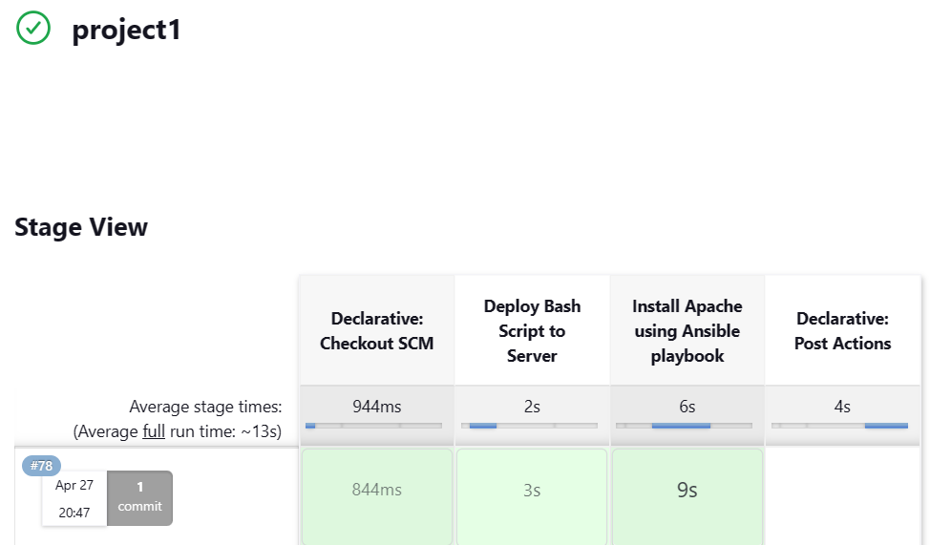
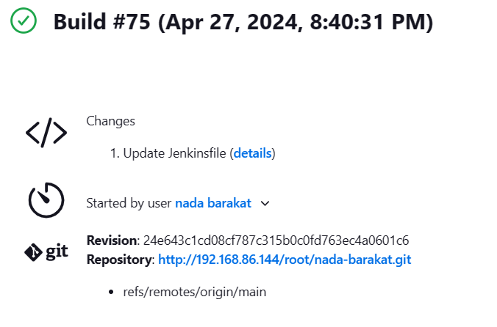
Overview
This project simulates an on-premise CI/CD pipeline for deploying a web server with Apache HTTP Server. It involves provisioning virtual machines, user management, GitLab and Jenkins integration, and automated deployment upon code changes and generating an email notification using Jenkins upon pipeline failure.
2
Nada Hussam Eldien Barakat

Slide 3
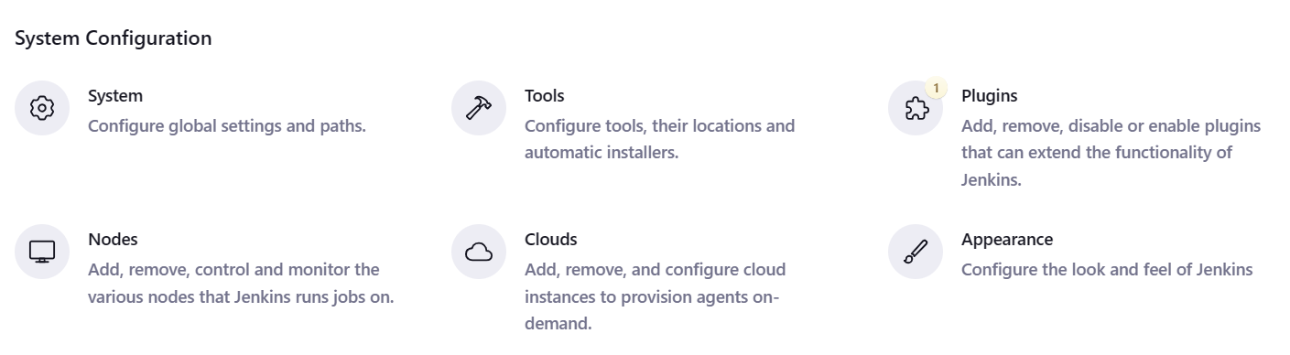
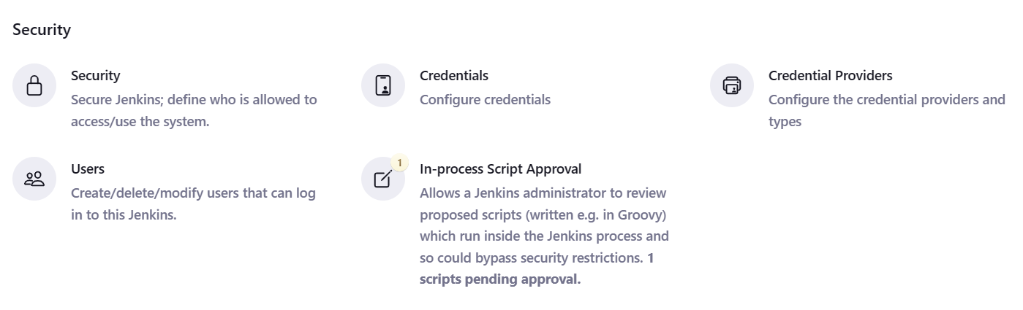
Prerequisites
Automating Deployment with Jenkins & GitLab/Gogs
Plugins (2 Needed):
Git Plugin: Connects Jenkins to GitLab/Gogs repository (fetch code, trigger builds).
SSH Plugin (with SSH Agent): Enables secure communication with remote servers (VM3) for tasks like script execution or playbook deployment.
Credentials (2 Needed):
Git Credential: Username/password (or access token) for GitLab/Gogs authentication.
SSH Key: Secure key pair for server access (private key managed by SSH Agent).
4
Nada Hussam Eldien Barakat
3

Slide 4
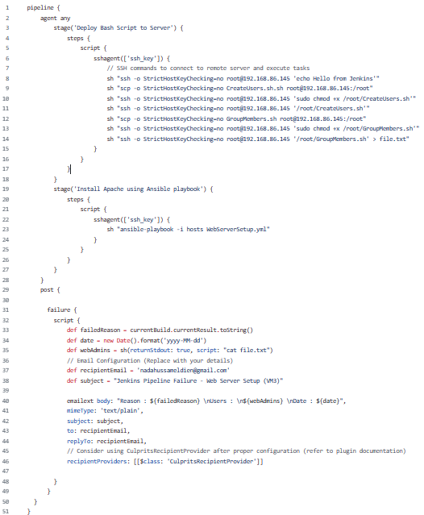
Pipeline
Stages of Jenkinsfile
The pipeline stages can be summarized as follows:
Deploy Script: Copies a script (GroupMembers.sh) to the target server for retrieving user information.
Install Apache: Executes an Ansible playbook (WebServerSetup.yml) to deploy and configure Apache HTTP Server on the server.
Post-Build (Failure):
Triggers only on pipeline failures.
Sends an email notification with details:
Failure reason
List of users in "webAdmins" group (obtained from GroupMembers.sh)
Current date
Nada Hussam Eldien Barakat
4

Slide 5
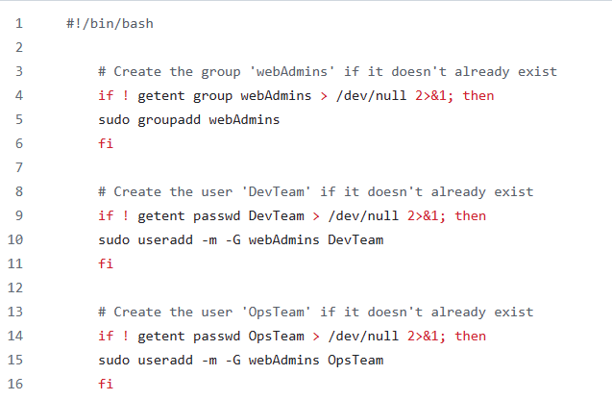
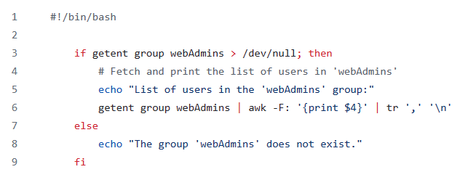
Bash Scripts
Bash script to create users named "DevTeam" and "OpsTeam" on VM3 and assign them to group named "webAdmins" for centralized access control.
Bash script named "GroupMembers.sh" to fetch a list of users from the "webAdmins" group.
Nada Hussam Eldien Barakat
5

Slide 6
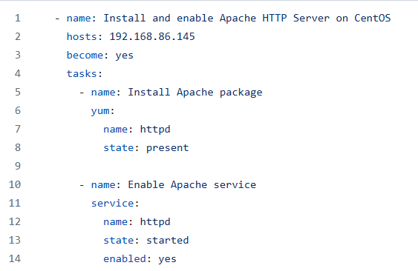
Ansible playbook
Ansible playbook to automate the installation and configuration of Apache HTTP Server on VM3 and its hosts file.
Nada Hussam Eldien Barakat
6

Slide 7
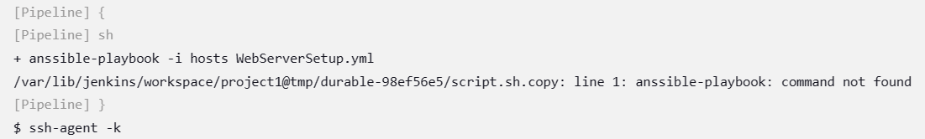
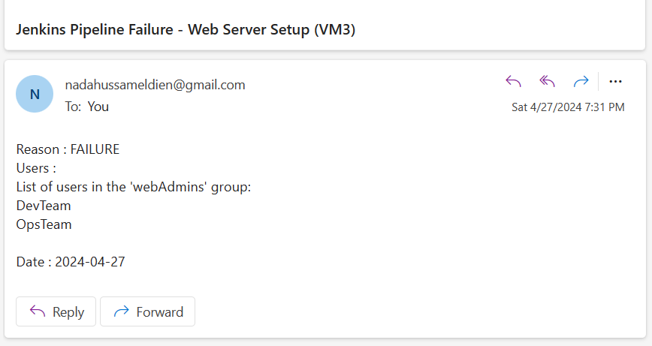
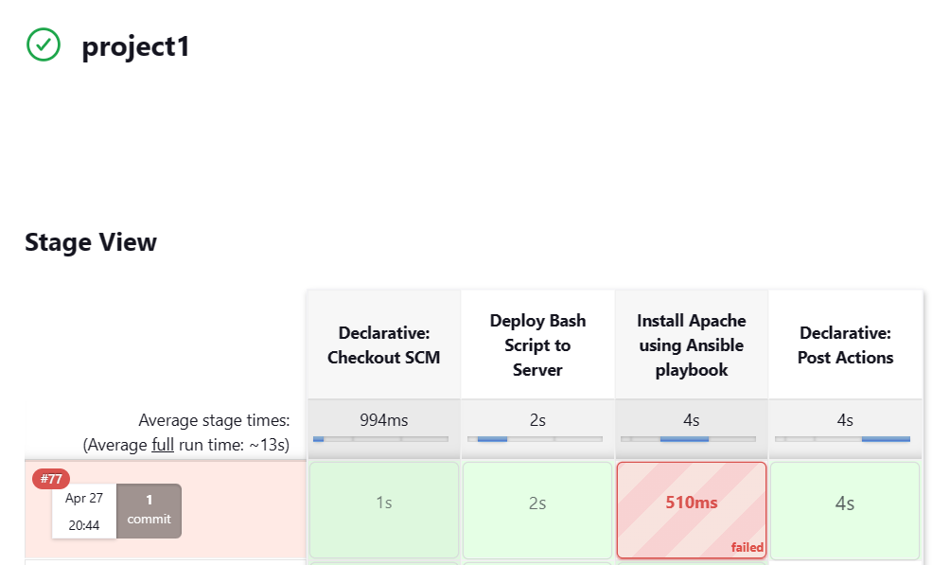
Email-Notification
Email Notification when pipeline Failed :
Pipeline failure (command not found)
Jenkins email notification using
“Extended E-mail Notification Plugin”
Nada Hussam Eldien Barakat
7

Slide 8
Vodafone Project
2024 April 27
THANK YOU
Nada Hussam Eldien Barakat

