Slide 1

Plant Disease BI System
EfficientNetB0 Transfer Learning | Power BI Analytics
Prepared by: Nada Ahmed Khattab
Supervisor: Husam Barham
University of Petra | Business Intelligence
Submission Date: 1 / 6 / 2026

Slide 2
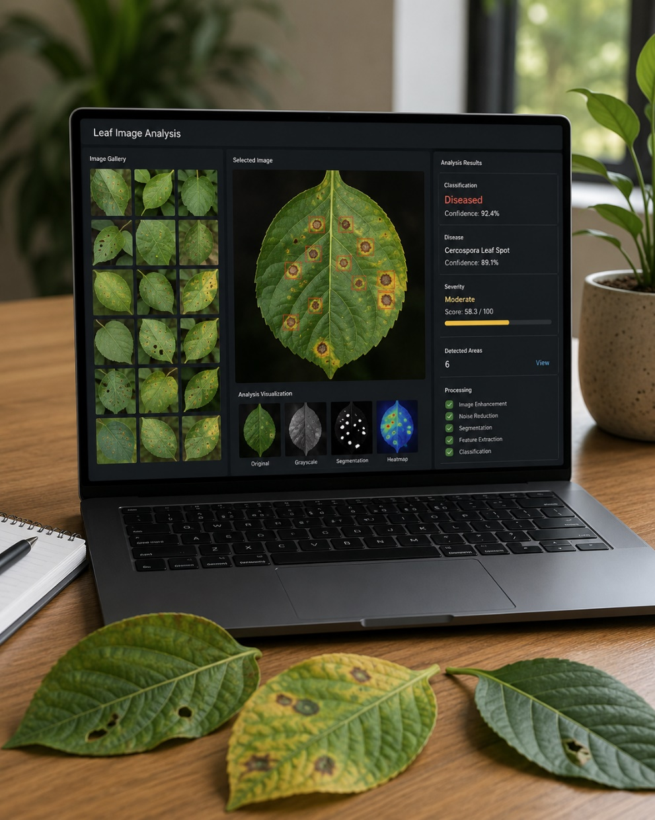
Introduction
Plants are essential for food security, agriculture, and human life.
Plant diseases can reduce crop quality and cause major losses if they are not detected early.
The idea of this project came from the need to analyze plant leaf images using AI.
The project focuses on image analysis, where plant leaf images are classified into healthy or diseased classes.
The results are then visualized using Power BI dashboards to make the analysis easier to understand.

Slide 3
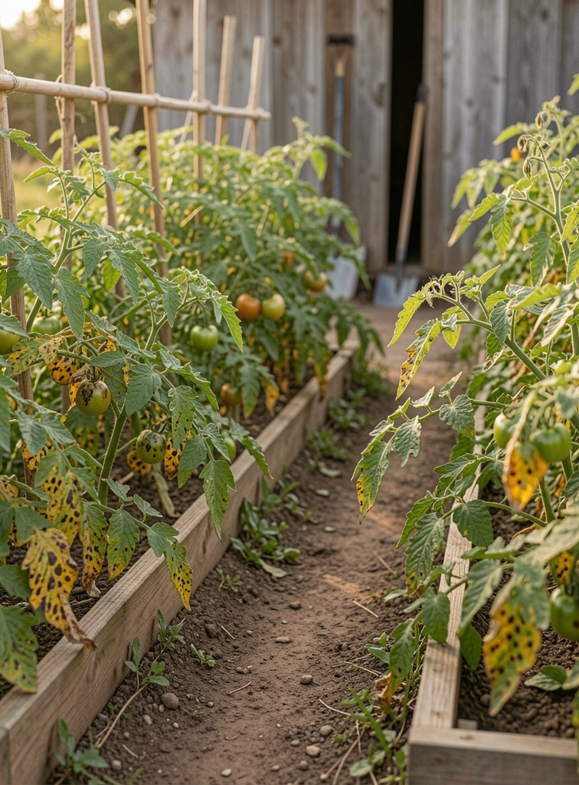
01
Project Overview

Slide 4
Problem Statement
Plant diseases can reduce crop quality and affect food security.
Manual diagnosis is slow, depends on expert knowledge, and may be error-prone.
This project supports faster plant disease analysis by using image classification and BI dashboards.

Slide 5
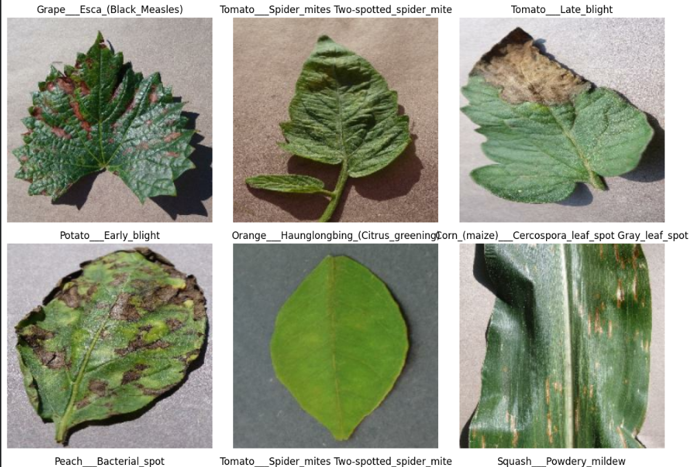
Dataset Samples
The dataset includes healthy and diseased plant leaf images from multiple plant types such as tomato, potato, apple, corn, grape, orange, and others.

Slide 6
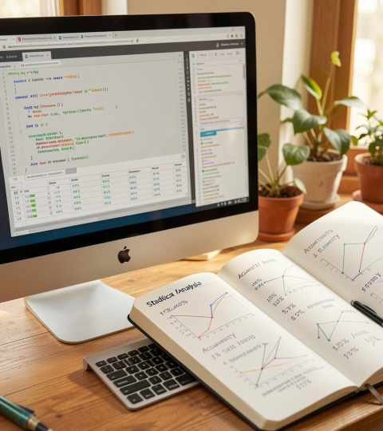
Objectives
• Classify plant leaf images into healthy or diseased classes.
• Predict the exact plant disease class.
• Evaluate the model using accuracy, precision, recall, and F1-score.
• Visualize model results using Power BI dashboards.
• Support decision-making through clear BI insights.

Slide 7
System Block Diagram
Dataset
↓
Preprocessing & Augmentation
↓
EfficientNetB0 AI Model
↓
Evaluation Results
↓
Power BI Dashboard
↓
Decision Support

Slide 8

02
Model & Results

Slide 9
Dataset & Quality
Dataset Source: Public online datasets + Al-Thara Company ((الثرى
Dataset contains 38 classes: 34,765 training images, 8,691 validation images, and 10,845 test images.
Data quality check showed 0 corrupted images. Four duplicate test images were found and removed, resulting in 0 final duplicates.
38 Classes
34,765 Training
8,691 Validation
10,845 Test
0 Corrupted
4 Duplicates Removed

Slide 10
Duplicate Check & Data Leakage Prevention
Duplicate Check & Data Leakage Prevention
Duplicate test images were checked against training images
using SHA-256 hashing.
Four duplicate test images were removed
to reduce the risk of data leakage
and make the evaluation more reliable.

Slide 11
EfficientNetB0 Model Architecture
Data Augmentation
→
EfficientNetB0 Feature Extractor
→
Global Average Pooling
→
Batch Normalization
→
Dropout
→
Dense Layers
→
Softmax Output
38 Classes
The model extracts visual features from plant leaf images and classifies them into 38 healthy or diseased classes.

Slide 12
Model Evaluation Results
Accuracy
95.81%
Macro F1-score
94.42%
Balanced Accuracy
93.96%
Weighted F1-score
95.70%
Disease Classes
38
Multiple metrics were used to evaluate performance because the dataset contains class imbalance.

Slide 13

Evaluation Summary
The model achieved strong overall performance across multiple evaluation metrics. Key Results: Accuracy: 95.81% Macro F1-score: 94.42% Balanced Accuracy: 93.96% Weighted F1-score: 95.70% These results were exported and visualized using Power BI for clearer analysis.

Slide 14
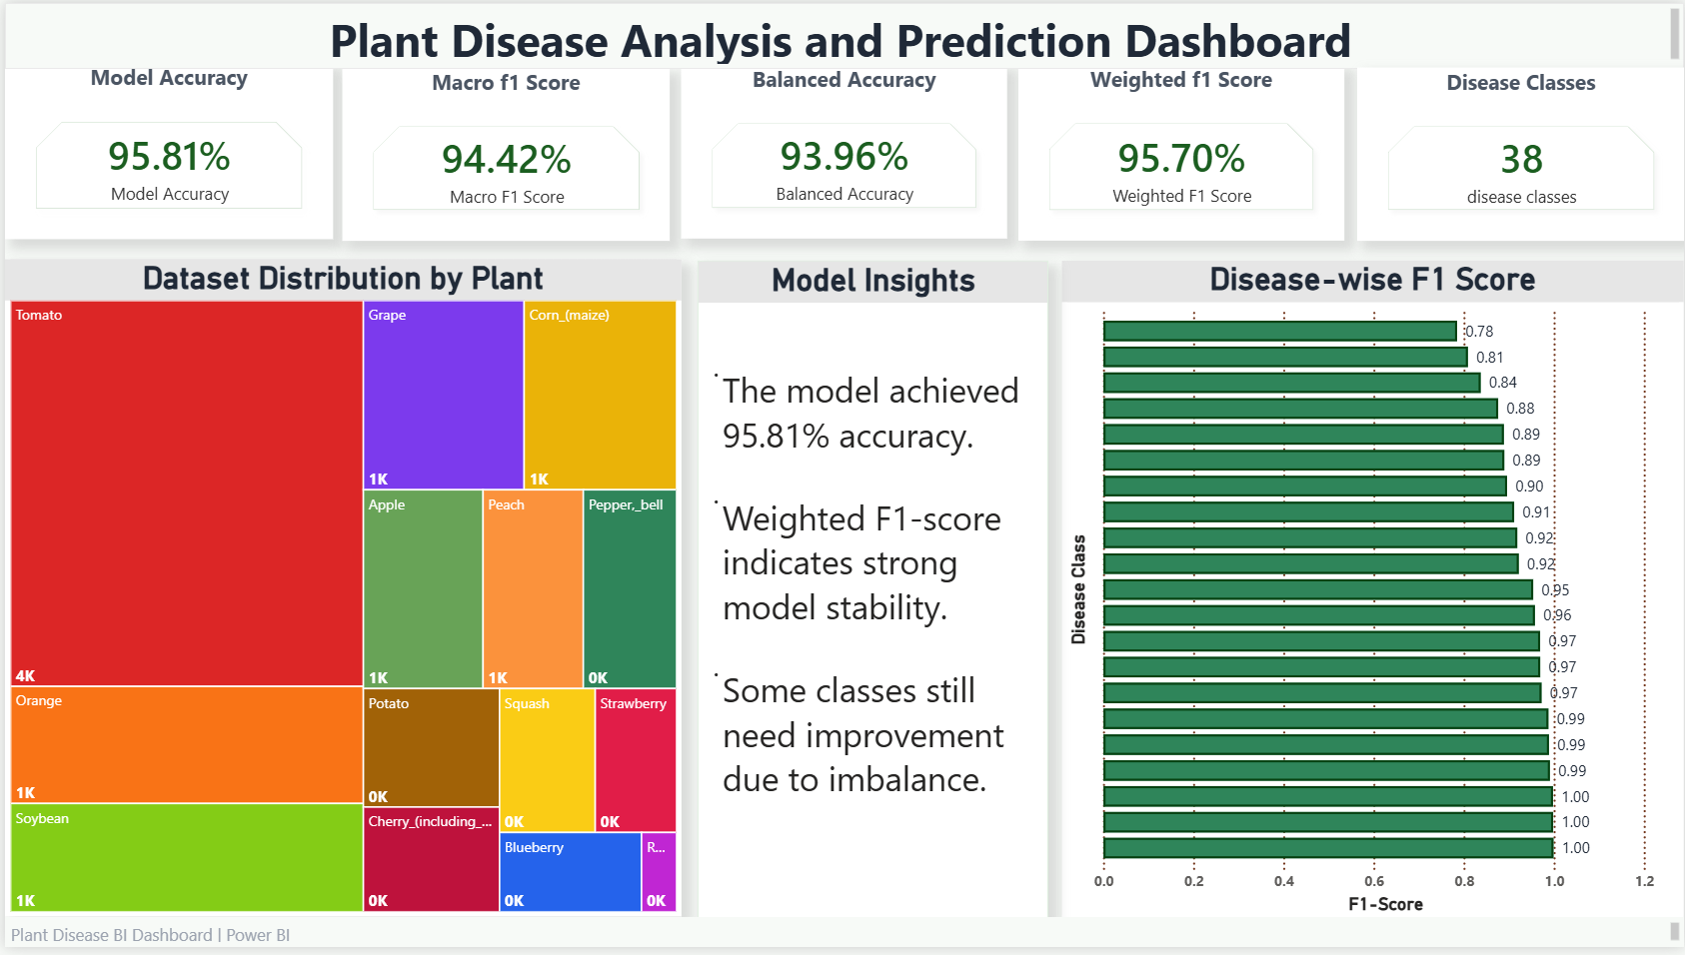
Power BI Dashboard Overview
Dashboard includes:
- Performance metrics
- Dataset distribution
- Class-level F1-score
- Model insights
Power BI transforms model outputs into clear visual insights.

Slide 15
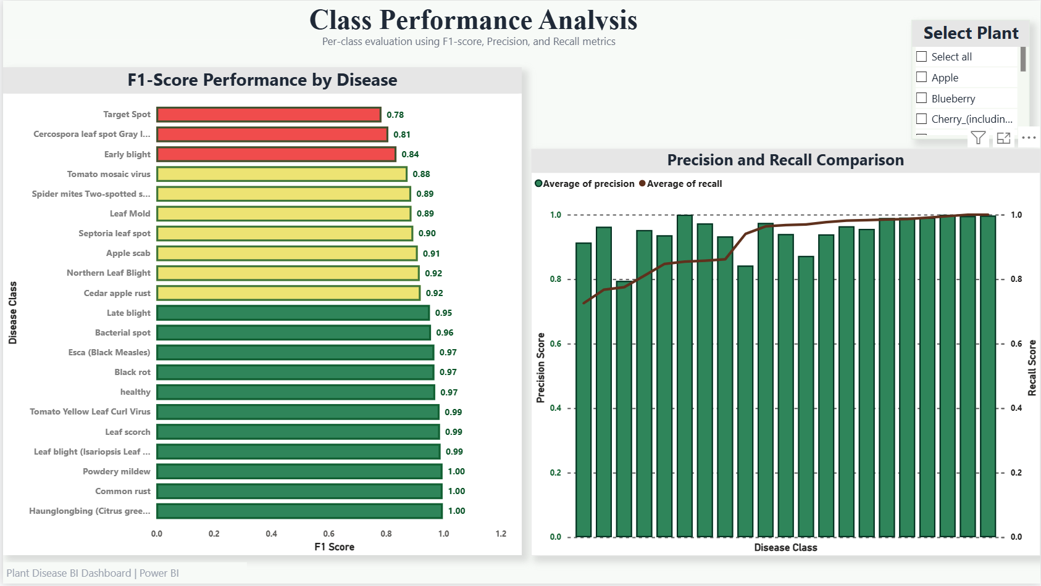
Class Performance Analysis
Class-level analysis identifies strong and weak disease classes using F1-score, precision, and recall.

Slide 16
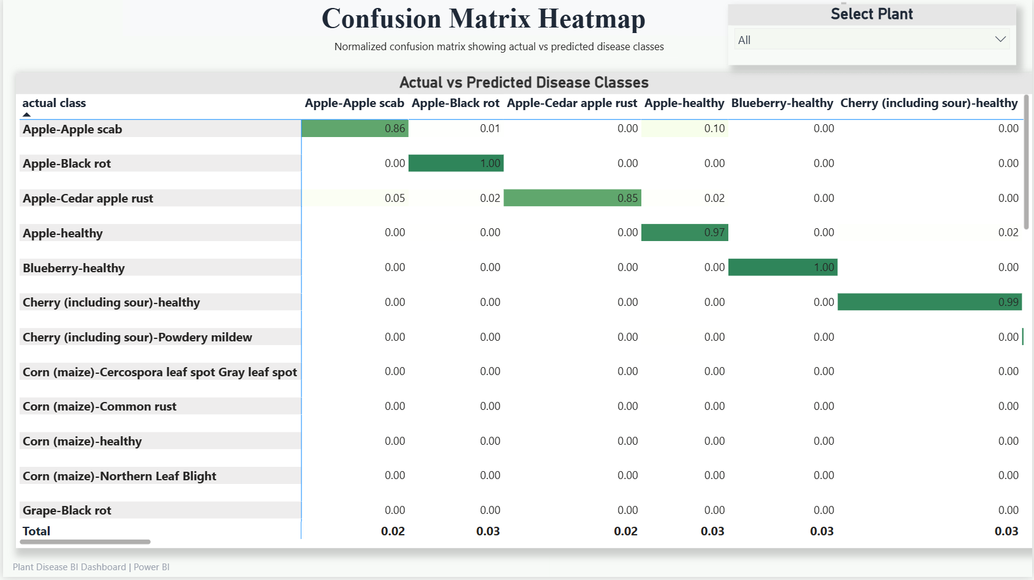
Confusion Matrix Heatmap
Shows actual vs predicted classes.
Highlights misclassification between similar diseases.

Slide 17
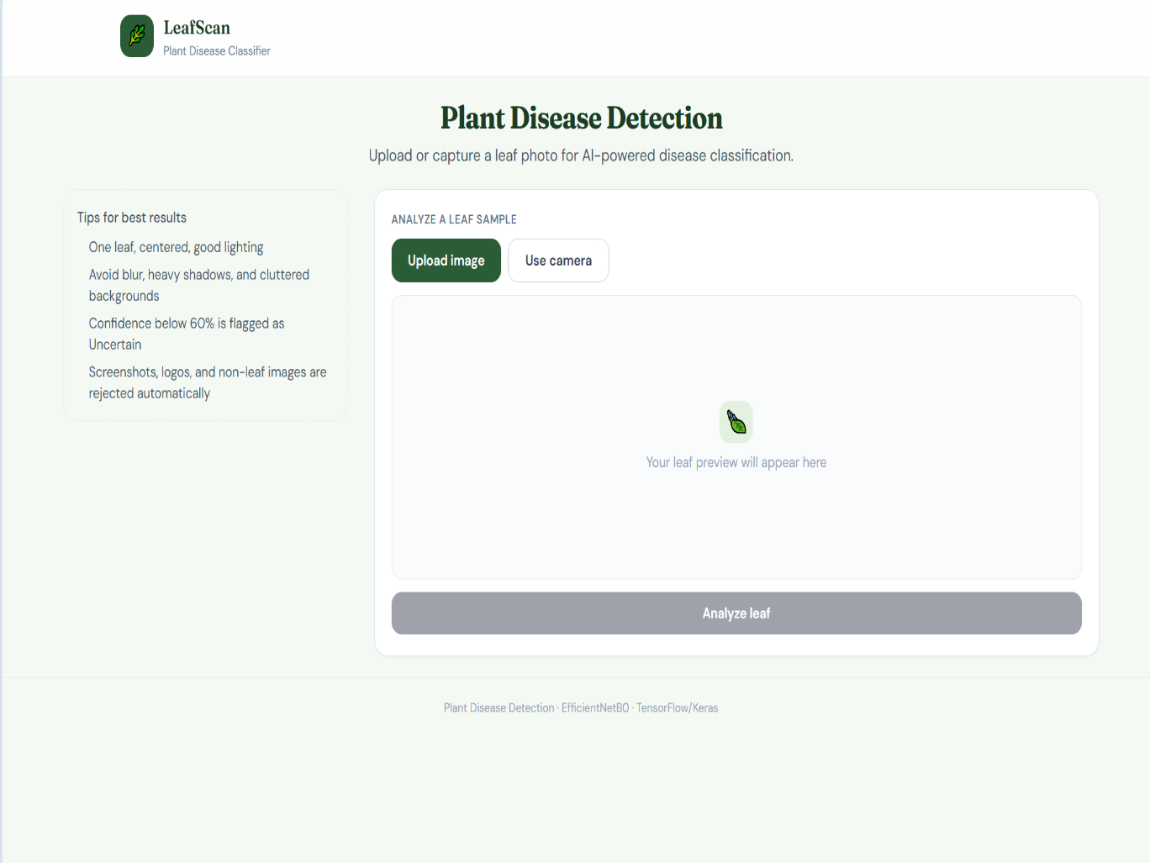
Web App: Plant Disease Detection
A web app was developed to test plant disease prediction.
Main features:
- Upload plant leaf image
- Use phone camera images
- Predict the disease class
- Simple interface for model testing
Web App Link:
Open Plant Disease Detection Web App

Slide 18
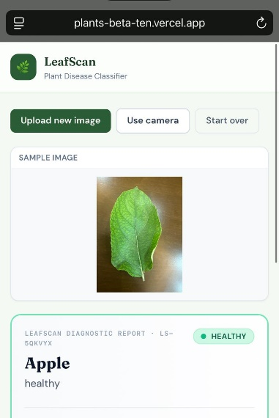
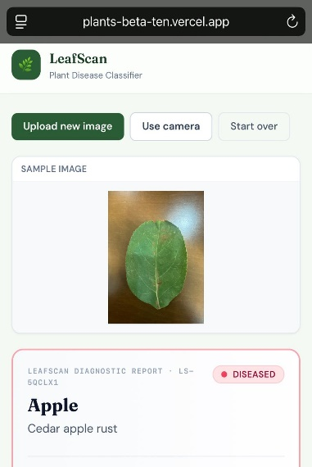
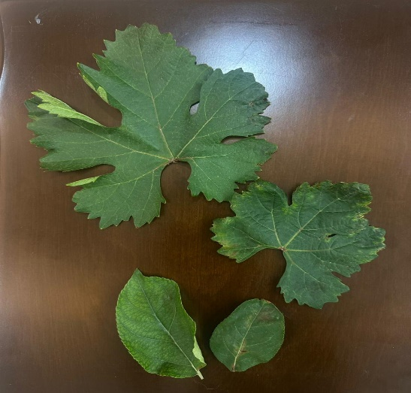
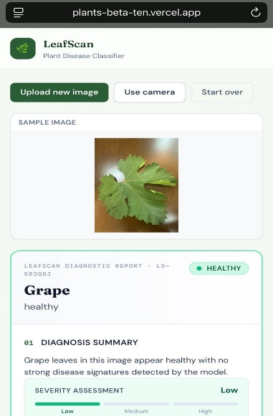
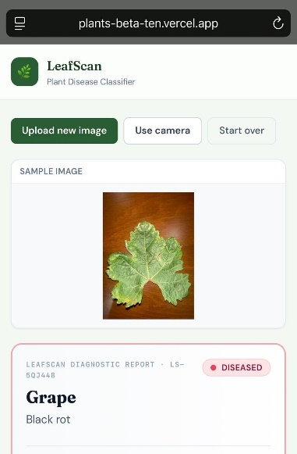
Web App Real Phone Testing
The web app was tested using real plant leaf images from a mobile phone camera
Testing workflow:
• Open the web app from mobile browser
• Upload or capture a leaf image
• Display image preview
• Predict plant type and disease class
• Show health status: Healthy / Diseased
Example results:
• Grape — Healthy
• Grape — Black rot
• Apple — Healthy
• Apple — Cedar apple rust
This test demonstrates practical mobile usability of the web app.

Slide 19
Challenges & Future Work
Challenges:
- Class imbalance
- Similar disease symptoms
- Large dataset size
- Google Colab runtime limits
Implemented Extension:
- Web app for plant disease prediction
- Image upload and phone camera testing
- Predicted disease class output
Future Work:
- Convert the system into a full mobile application
- Increase dataset diversity
- Add treatment recommendations
- Improve model performance on real-world images

Slide 20
Conclusions
The project combines deep learning image classification with Business Intelligence reporting. Key outcomes:
• EfficientNetB0 achieved strong classification performance.
• Power BI visualized model metrics and class-level results.
• A web app was developed for plant disease prediction testing.
• The system supports clearer plant disease analysis and decision-making. Project files are available in the GitHub repository.

Slide 21
GitHub Repository
Project Repository
The GitHub repository includes:
Project documentation
Notebook file
Power BI dashboard
Model evaluation results
Dashboard screenshots
Dataset link
Web app link
Presentation and submission links
Web App
https://plants-beta-ten.vercel.app/
GitHub
github.com/nadakhattab33-code/BI-Plant-Disease-Analysis-and-Prediction

Slide 22

Thanks!
Questions? Prepared by: Nada Ahmed Khattab

