Slide 1
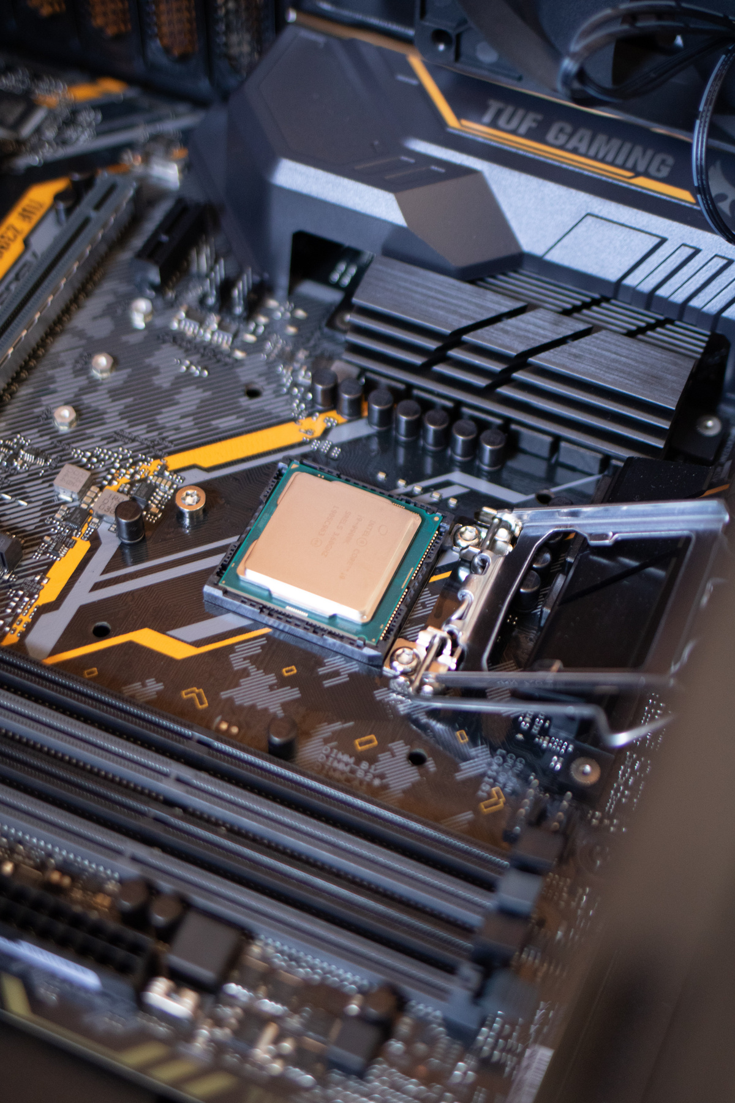
Forest Before Trees Cognition
The BIQC
Imagine combining the remarkable way our brains process vision with the unparalleled computational power of quantum computing—could this redefine how machines perceive reality?

Slide 2
The problem we ’re trying to solve
Decoding visual information is a key challenge in machine learning.
Early algorithms mainly relied on feature extraction and Bayesian-based matching methods but struggled with deformations and generalization.
The introduction of Deep Learning, particularly (CNNs), revolutionized the field by enabling the automatic learning of hierarchical feature representations, focusing on translation-invariant characteristics.
But recently the DL algorithms often struggle with accuracy when dealing with large, high-dimensional, and detail-rich images.
Moreover, high computational cost is another major challenge in the era of big data.

Slide 3
Follow problem analysis
So thinking of Quantum Computing for Computer Vision tasks, due to
Exponential state space for representing high-dimensional data.
Potential for faster optimization and feature extraction.
But it faces challenges like:
Limited qubit counts
Fidelity issues
Barren plateaus
Difficulties mapping large classical datasets to quantum states
So the introduce of
parametrized quantum circuit
hybrid quantum-classical algorithms
But it doesn’t stop here .... .
Parameterized Quantum Circuit (PQC):
A quantum-only model with trainable parameters.
Introduced so quantum circuits could learn like neural networks (optimized by classical algorithms).
Core idea: instead of fixed quantum gates, you allow tunable rotations → the circuit adapts to the data/task.
Hybrid Quantum–Classical Models:
Combine quantum modules (like PQCs) with classical neural networks.
Aim: exploit the strengths of both worlds — quantum for high-dimensional feature space, classical for scalability and optimization.

Slide 4
Follow problem analysis
After integrating Quantum components with classical architecture, a pragmatic solution to harness quantum capabilities while mitigating the limitations mentioned before.
Current hybrid approaches predominantly follow parallel or serial paradigms. While these models have demonstrated performance advantages and promise across various tasks, they often exhibit drawbacks.
Parallel architectures can suffer from inefficiencies and information loss during data conversion.
Serial architectures demand extensive quantum resources unsuitable for high-dimensional inputs.
Thus, developing a new hybrid architecture that enhances the synergy between quantum and classical components and overcomes these specific issues is crucial.

Slide 5
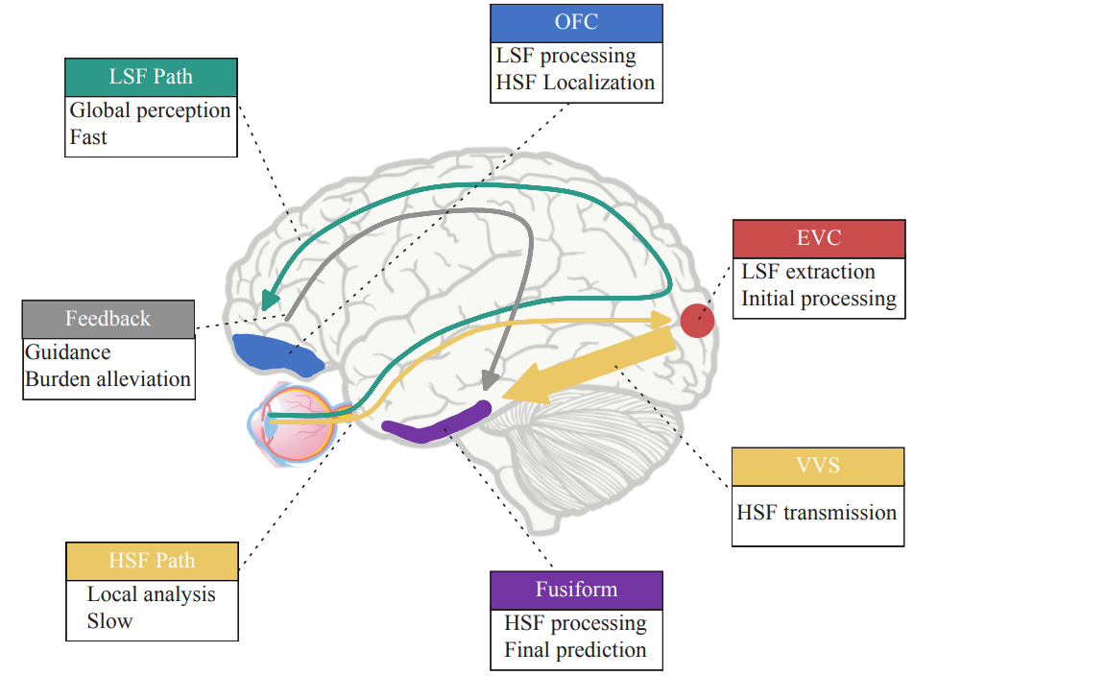
How the human Visual System work

Slide 6
The Solution: BIQC via Guiding paradigm
Inspired by the human visual system that is of dual channel , the BIQC “Brain-Inspired Quantum Classifier via the guiding paradigm is introduced solving all previous problem and outperforms some currently classical and quantum algorithms
The aim:
Mitigating qubit limitations ( preserving quantum resources).
Minimizes information loss from repeated data transformation
Computer vision task with high efficiency and generalization.

Slide 7
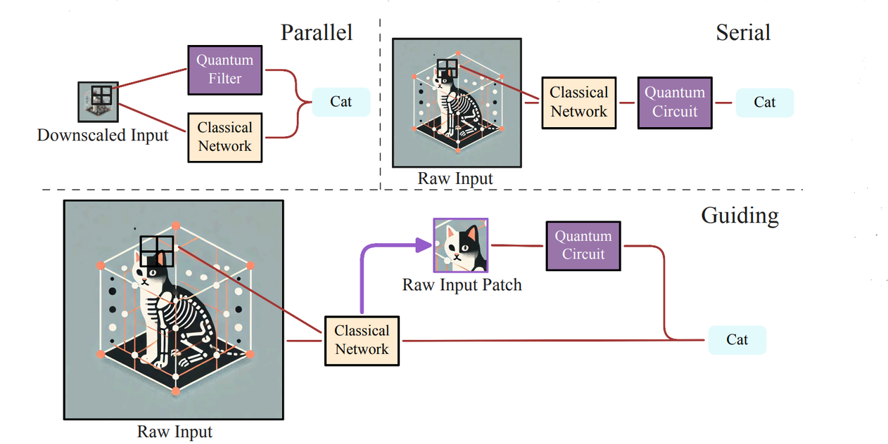
Guiding paradigm and the complementary application
The Guiding Paradigm effectively localizes a 32 × 32 HSF patch encompassing the bird’s rectrices (tail feathers). Detailed analysis of this patch reveals subtle textures, such as the organic texture of feathers compared to the metallic surface of an airplane rudder, which might be overlooked by traditional networks focusing solely on global features. This targeted approach allows for efficient allocation of quantum resources to the most discriminative local regions, thereby enhancing classification accuracy.
By confining quantum operations to HSF-rich patches, our paradigm capitalizes on quantum representational strengths without incurring the excessive resource demands.
Parallel (quantum and classical filters process raw input simultaneously)
Serial (quantum component processes hidden states from classical network)

Slide 8
Paper defaults in implementations
Images preprocessing and modeling defaults:
They all should be of grayscale (of 1 channel): to emphasize structural and frequency features
Applying Min-Max scalar to the range [− π 2 , + π 2 ]: to enhance training stability, ensures stable encoding into rotation angles for quantum circuits; keeps amplitudes balanced, avoids vanishing/exploding gradients.
Model parameters are optimized with the AdamW optimizer with a learning rate of 1 × 10−3 and a weight decay of 5 × 10−4 : stabilizes hybrid optimization while controlling overfitting
An early stopping strategy is employed, terminating training when the loss function plateaus, or after a maximum of 10,000 epochs: Early stopping avoids stagnation while allowing deep convergence up to 10k epochs.
Binary cross-entropy is used as the loss function for all experiments & Performance is evaluated using Accuracy and AUC metrics: BCE loss with Accuracy & AUC balances training stability and robust evaluation.
The HSF patch size is set by default to 4×4 pixels for input images with a resolution of 32 × 32 pixels or lower, and 32 × 32 pixels for higher-resolution inputs : Patch size scales with resolution: 4×4 captures fine HSF details, 32×32 captures global structure
To assess the robustness of BIQC to noise, we introduce noise into the quantum simulator by applying Rx(θ) to each qubit, where θ ∼ U(0, noise) : Uniform Rx noise injection mimics quantum decoherence, enhancing hardware-robustness.

Slide 9
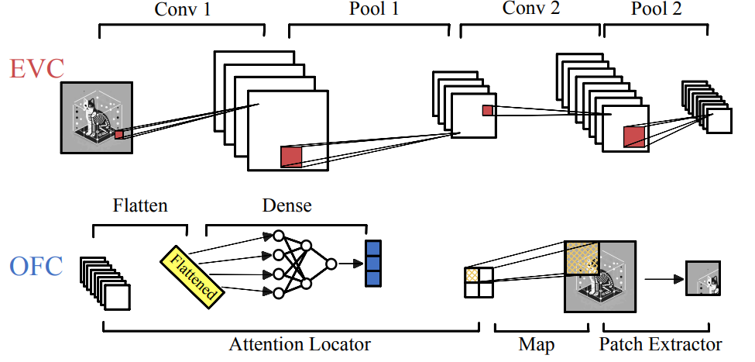
The classical pathway
Mimicking the EVC’s role in efficient initial processing to capture coarse structure, the classical pathway utilizes a CNN to extract global, LSF features.
This CNN comprises :
Two convolutional layers, followed by relu activation function
Max-pooling operations
Rapidly processing input images X to generate LSF features Z(LSF).
Analogous to the OFC’s guidance of attention, an attention map A(HS)F is then derived from Z(LSF) via a 1×1 convolutional layer to highlight potential HSF regions P(Human HSF) for targeted quantum processing.

Slide 10
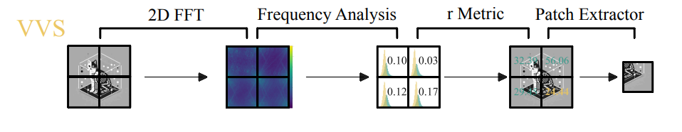
Quantum pathway’s
HSF regions are identified through two complementary strategies. One approach selects regions via the attention mechanism, P(Human HSF ). The second, critical for focusing on intricate details, draws inspiration from the VVS .
The VVS
Divide the image
Split the image into small patches (like 8×8 squares).
Check each patch
Ask: is this patch mostly smooth (background) or full of edges/details (like strokes of a digit)?
Transform patch with 2D-DFT
Convert the patch from pixel space into frequency space.
Low frequencies = smooth areas.
High frequencies = edges and fine details.
Measure energy
Compute the energy (strength) of low-frequency vs. high-frequency parts.
Compute r-metric
r=High-frequency energyLow-frequency energyr = \frac{\text{High-frequency energy}}{\text{Low-frequency energy}}r=Low-frequency energyHigh-frequency energy​If rrr is large → patch has strong details.
If rrr is small → patch is smooth/flat.
Choose the best patch
Rank all patches by their r-metric.
Select the one with the highest rrr.
This patch (rich in details) is sent into the quantum circuit.

Slide 11
Follow the quantum pathway’s, the fusiform re-uploading circuit
The re-uploading circuit:
It’s the quantum version of a neural network layer.
Called “reuploading” because the same input data is encoded into the quantum circuit multiple times across layers.
This allows a small number of qubits to represent richer, more complex functions.
In BIQC, the chosen HSF patch (from VVS) is flattened into a vector and encoded as rotation angles on qubits.
Why Reuploading?
A plain quantum circuit with few qubits is limited.
Reuploading = reuse input multiple times + learnable params each time → allows universal function approximation (proven in quantum ML theory).
It’s like adding more “hidden layers” in a neural network.
RZ(θ) → rotates qubit around Z-axis: Used for data encoding: pixel/feature value → angle.
RX(θ) → rotates qubit around X-axis: Used for trainable parameters (learnable weights).
Therefore Data enters via RZ rotations. & Learnable parameters adjust via RX rotations.
Reuploading Layers
Each layer has:
Encode data again: apply RZ(data).
Apply trainable weights: RX(params).
Add entanglement gates between qubits.

Slide 12
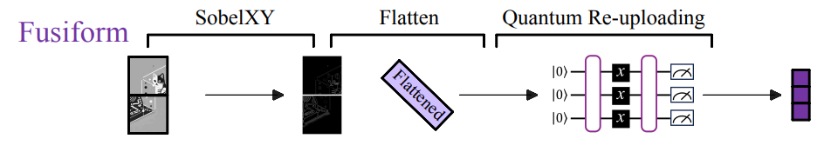
Follow the Fusiform and the algorithm final touch
Entangling Gates
Usually a Controlled-Z (CZ) between neighboring qubits.
Purpose: make qubits interact → allows the circuit to capture correlations between features (like edges + orientation).
Noise Injection (Rx(θ) with random θ)
During training, small random rotations are added.
Mimics real hardware noise (decoherence).
Makes the model more robust.
Measurement
At the end, qubits are measured in the Z-basis.
Expectation values ⟨Z⟩\langle Z \rangle⟨Z⟩ give classical feature vector (quantum embedding).
After the fusiform stage, the quantum circuit has transformed the selected high-frequency patch into a compact quantum feature vector. These features are then combined with the classical low-spatial-frequency (LSF) features coming from the early visual pathway. The two streams — classical and quantum — are fused together into a single representation that now carries both the global structure (from LSF) and the fine details (from quantum). This fused vector is passed into a classical classifier, a small neural network, which learns to separate the classes.

Slide 13
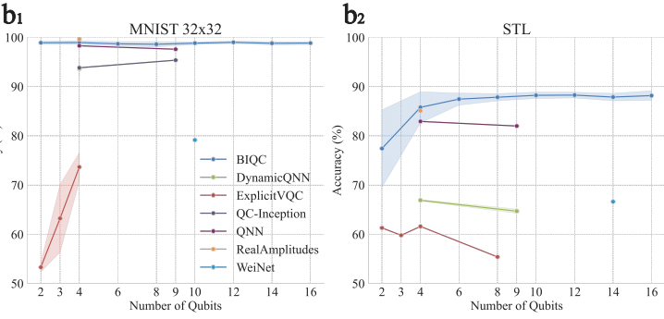
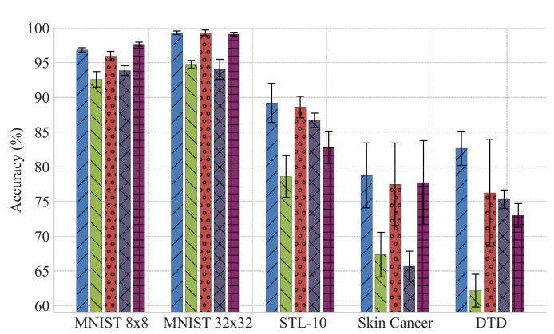
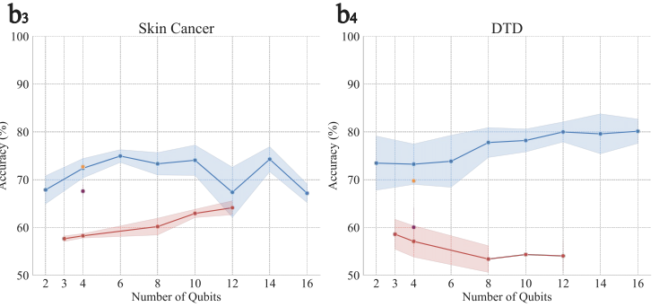
Benchmarking

Slide 14
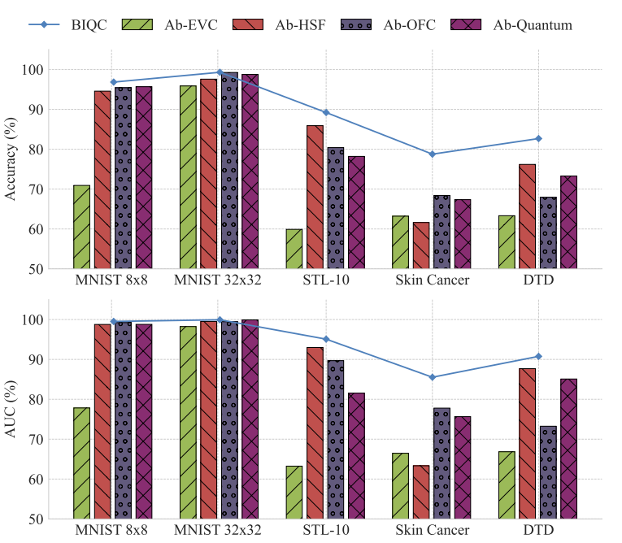
Ablation study of BIQC components
To investigate the contributions of each modules in BIQC and validate their correspondence to the high- and low-frequency mechanisms.
Removing the EVC module, which eliminates low-frequency feature extraction, significantly reduces accuracy on MNIST 8 × 8. This underscores the foundational role of global information.
Eliminating the HSF pathway, leaving only the LSF pathway, also lowers accuracy, confirming the benefit of integrating both coarse and fine-grained features.
Disabling OFC attention-based HSF localization reduces performance on high resolution datasets, emphasizing the need to accurately target HSF regions to utilize quantum benefits.
Finally, replacing the data re-uploading quantum circuit in the Fusiform module with a classical MLP results in a performance decline on DTD, indicating that quantum processing is crucial for capturing intricate high-frequency texture features, emulating the Fusiform’s detailed HSF analysis.
All pictures and charts are from the paper
A brain-inspired paradigm for quantum vision
[Submitted on 7 Sep 2025]

Slide 15
NEWS TIME
International investigation about the currently advancements in QC
Searching about the Egyptian advancements in QC
“Quantum Technologies: ”Opportunities and Challenges – Egypt Perspective” workshop
Held February 17-18, 2025 at Egypt University of Informatics (EUI), New Administrative Capital. Under the auspices of the Ministry of Communications & Information Technology; brings together experts to discuss quantum technology from Egypt’s perspective.
National Institute of Standards and Technology (NIST) Researchers Propose New Approach to Noise in Quantum Sensing
A team from NIST and collaborating institutions has outlined a method to make quantum sensors more resilient to environmental noise while still retaining enhanced sensitivity.
Uses partial quantum error correction on entangled qubits
Accepts some noise-related errors rather than correcting all of them
Still enables sensors to outperform unentangled systems
The work provides a theoretical framework for developing future high-precision sensors with potential applications in healthcare, navigation, and mineral exploration.
“Egyptian Air Quality Prediction Quantum Competition”
A competition in Egypt using quantum methods for predicting PM2.5 (air pollution).
Example of an applied problem where quantum / quantum + classical methods might be used in Egypt; aligns with environmental / societal needs.

Slide 16

FUTURE INVESTMENTS
While the industry is still relatively new, with a market size of around $1.16 billion in 2024, it's expected to grow to $12.62 billion in 2032.
Anzaetek (Seoul, South Korea)
QuBits / mQuBits (Cairo, Egypt)
First Quantum Computing Research Lab in Middle East & Africa. Founded ~2017. Focuses on education, research, and connecting researchers/advisors/investors.
Shows there is an entity specifically in Egypt focused on QML / quantum computing research and development. Might not yet be product-focused in CV but shows infrastructure.
They are developing scalable & privacy-preserving QML and Quantum Federated Learning (QFL) platforms. One achievement: high-fidelity image reconstructions from a 256×256 RGB ImageNet subset using QML-powered autoencoders (QLAE). They plan to release an emulator-based QML/QFL product suite by late 2025.

Slide 17
Lastly thanks a lot Dr: Ahmed
Looking forward to be part of the future projects u have mentioned that are going to be held, especially in QML and looking forward to be part of Alexandria Quantum Group

