Slide 1

Multi-Agent Orchestration
From Prompts to Autonomous AI Teams
A Complete Architectural Overview & Practical Implementation Frameworks

Slide 2
The Evolution of AI Interaction
How we shifted from static queries to autonomous multi-agent ecosystems.
2022 — Prompting
2024 — Single Agents
Single-turn Q&A and basic instructions.
Tool calling, web browsing, and simple execution loops.
1
2
3
4
2023 — RAG
2025/2026 — Multi-Agent Orchestration
Augmenting LLMs with external document retrieval.
Autonomous agent teams collaborating on complex workflows.

Slide 3
Why Single LLMs Fail at Complex Tasks
Context Rot & Drift
Lack of Specialization
Attention degrades significantly as long-context prompts increase in size.
Expecting one prompt to handle research, coding, testing, and writing leads to mediocrity.
Cascading Hallucinations
Infinite Loops
A single mistake early in a complex prompt compounds into severe output errors.
Single models struggle to self-correct when stuck in logical deadlocks without external critique.

Slide 4




The Anatomy of a Single AI Agent
The core building block of any orchestrated system.
Brain (Core LLM)
Memory
General reasoning, comprehension, and decision making.
Short-term (conversation thread) and Long-term (Vector DBs / RAG).
Tools & Interfaces
Planning Engine
APIs, web searchers, Python interpreters, and SQL connectors.
Task decomposition, reflection, and self-correction loops.

Slide 5
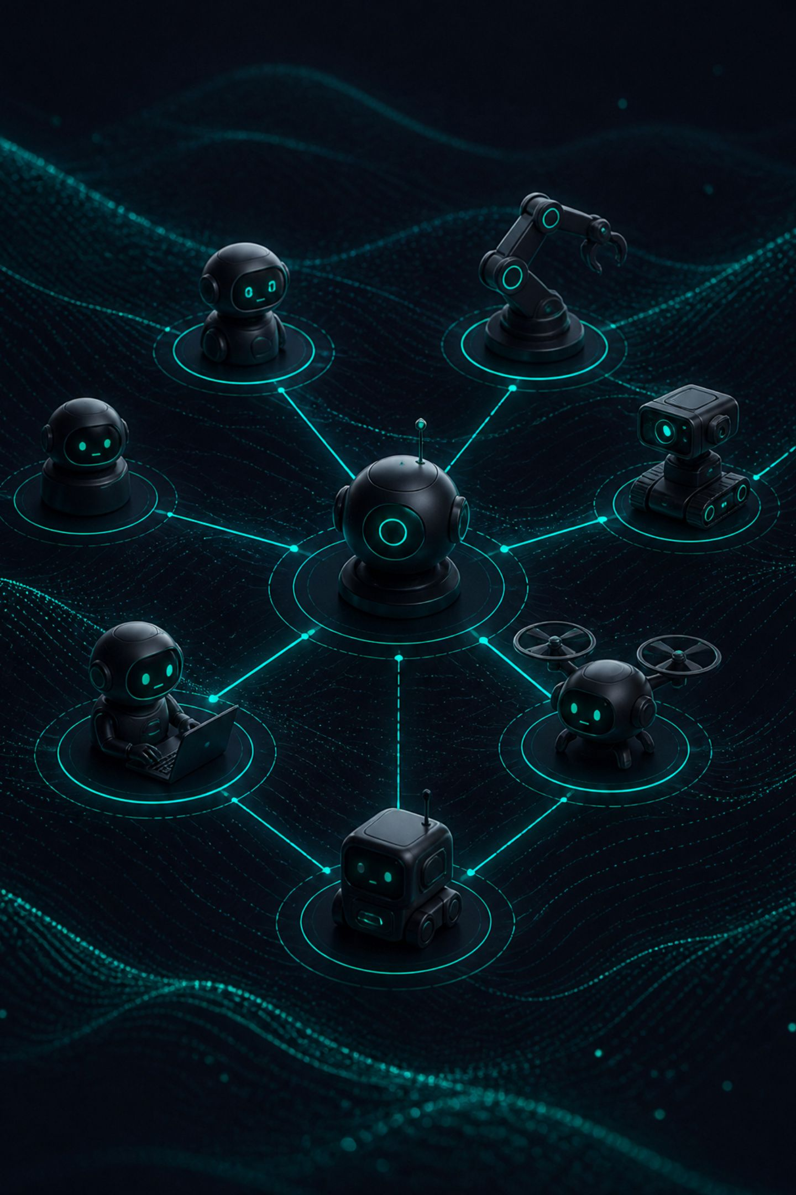
The Power of Multi-Agent Systems
From Individual Agents to Collaborative AI Teams

Slide 6
What is a Multi-Agent System (MAS)?
Shifting from a single overworked generalist to a team of specialized experts.
Role Specialization
Distributed Intelligence
Each agent operates with a hyper-focused persona and strict goal. Specialization eliminates the mediocrity that emerges when a single model is asked to do everything.
Complex problems are broken down into manageable atomic tasks. Each sub-task is routed to the agent best equipped to handle it.
Peer Verification
Agents critique and validate each other's work before finalizing outputs, dramatically reducing error propagation across the system.

Slide 7




Defining "Orchestration"
The Orchestrator: The Project Manager of AI
It doesn't execute every task itself—it understands the big picture, breaks down the goal, and assigns the right job to the right agent.
Goal Understanding
Task Planning
Translates complex user prompts into clear macro objectives
and core goals.
Draws a step-by-step roadmap and breaks down goals into actionable sub-tasks.
Smart Delegation
Quality & Delivery
Assigns each sub-task to the most specialized AI agent for optimal results.
Monitors execution, resolves conflicts, and merges output into the final response.

Slide 8




The 4 Pillars of Multi-Agent Systems
1
2
Roles & Personas
Task Decomposition
Explicit backstories, constraints, and operational domain boundaries assigned to each agent.
Breaking macro business goals into clear, executable atomic tasks that can be distributed across the system.
3
4
Communication Protocols
Shared State & Memory
Structured messaging schemas (JSON/Pydantic) governing how agents exchange information between steps.
Centralized memory registers accessible across the agent topology, ensuring coherent context throughout execution.

Slide 9



Human-in-the-Loop (HITL) Gates
Ensuring safety, alignment, and operational control.
Approval Gates
Steering & Intervention
Quality Control
Halting execution before high-risk actions (e.g., payments, email sending). No irreversible action proceeds without explicit human sign-off.
Injecting human guidance when an agent gets stuck in a loop or encounters an ambiguous decision boundary it cannot resolve autonomously.
Reviewing synthesized drafts prior to production deployment. Human review remains the final checkpoint before any output reaches end users.

Slide 10
Multi-Agent Collaboration
How Do Agents Work Together?

Slide 11



Orchestration Patterns
Multi-agent systems leverage various architectural patterns to coordinate agents effectively, moving beyond simple sequential flows.
Hierarchical Architecture
Pipeline Architecture
Collaborative Architecture
Manager-Worker structure. A central Manager agent plans, delegates tasks to specialized workers, and verifies quality.
Sequential step-by-step flow. The output of one agent becomes the direct input for the next agent.
Peer-to-peer review loop. Agents communicate, critique, and refine work iteratively until quality thresholds are reached.

Slide 12
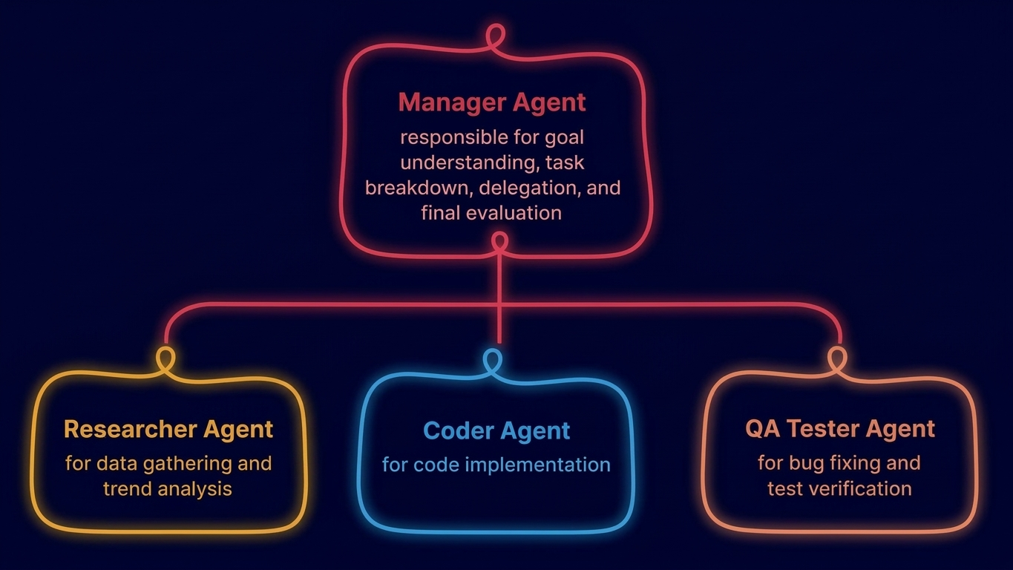
Orchestration Pattern 1: Hierarchical Architecture
Manager & Workers Pattern for Complex Workflows
When to Use
This pattern is best suited for complex, non-linear projects requiring central oversight and dynamic decision-making, such as software development, advanced research, or strategic planning initiatives.

Slide 13

Orchestration Pattern 2: Pipeline Architecture
Sequential Step-by-Step Execution
User Request
Researcher Agent
Writer Agent
Translator Agent
Final Output
Key Rule
When to Use
100% dependency chain. Each agent strictly waits for the completed output of the preceding step before beginning its own task.
Ideal for document creation, translation pipelines, automated content publishing, and any workflow where each stage has a clearly defined input and output contract.

Slide 14






Orchestration Pattern 3: Collaborative Architecture
Peer-to-Peer Review & Feedback Loop
Agent B (Critic)
Reviews content and identifies flaws/errors.
Agent A (Writer)
Drafts initial content or code.
Agent C (Editor)
Applies corrections and improves accuracy.
Execution Loop: Continues iterating between agents until a defined Quality Score is achieved (e.g., ≥ 9/10).
When to Use
Ideal for high-precision requirements, such as security code audits, strict fact-checking workflows, or any scenario demanding iterative refinement to meet stringent quality thresholds.

Slide 15



Memory Management in Orchestration
Short-Term Memory
Long-Term Memory
Active conversation thread context and immediate execution prompt.
Entity Memory
Vector DBs (ChromaDB, Pinecone) storing past user preferences and historical interactions.
Tracks specific names, concepts, and system-defined project variables.

Slide 16


Controlling Execution State & Loops
Establishing guardrails for reliable multi-agent operations.
Problem: Infinite Loop Risk
Architectural Solution: DAG & State Control
Agents can become trapped in self-reinforcing, endless correction cycles without reaching a satisfactory consensus or a terminal state. This leads to resource waste and system stagnation.
Max Recursion Limit: Implement a hard stop after a defined number of iterations (e.g., 5-10) to prevent runaway processes.
Conditional Edges: Utilize a State Evaluator to route logic safely, ensuring agents only proceed when specific conditions are met, thus breaking potential loops.

Slide 17



Popular Multi-Agent Frameworks
CrewAI: Role-Based & Intuitive
LangGraph: Production-Ready
Microsoft AutoGen: Conversational & Code-Driven
Best for beginner to intermediate developers building role-specialized agent teams.
Cyclical graph-based framework built for enterprise-grade control and state persistence.
Optimized for multi-agent dialogs and automated code execution pipelines.

Slide 18
Hands-on: CrewAI Implementation
Key Takeaways
from crewai import Agent, Task, Crew, Process
# 1. Define Specialized Agents
researcher = Agent(
role='Financial Researcher',
goal='Analyze market trends',
tools=[search_tool]
)
writer = Agent(
role='Content Strategist',
goal='Craft tech blogs'
)
# 2. Coordinate Crew Execution
crew = Crew(
agents=[researcher, writer],
tasks=[research_task, write_task],
process=Process.sequential
)
result = crew.kickoff()
Define specialized agents with clear roles, goals, and available tools.
Combine agents and tasks into a `Crew` to manage their interaction.
Specify the execution flow, such as `Process.sequential` for linear workflows.
Use `crew.kickoff()` to start the multi-agent system and achieve its objectives.

Slide 19
Hands-on: LangGraph Architecture
Graph Logic
from langgraph.graph import StateGraph, END
builder = StateGraph(AgentState)
builder.add_node("researcher", research_node)
builder.add_node("coder", code_node)
builder.add_edge("researcher", "coder")
builder.add_conditional_edges(
"coder",
should_continue,
{"continue": "researcher", "exit": END}
)
graph = builder.compile()
Nodes: Independent functions or agents that perform specific tasks.
Edges: Define direct communication pathways, dictating how information flows between nodes.
Conditional Edges: Provide state-based routing logic, enabling dynamic workflow decisions and preventing infinite execution loops.

Slide 20

Real-World Case Study: Automated Dev Team
Experience an end-to-end multi-agent system designed to automate a complete software development lifecycle.
Product Manager Agent
Architect Agent
Developer Agent
QA Agent
Parses user requirements into granular technical user stories.
Designs database schema and drafts OpenAPI endpoints.
Writes production Python/FastAPI code implementation.
Executes automated unit tests and sends bug reports back to Developer until pass.
This automated pipeline showcases how specialized agents can collaborate seamlessly, enabling rapid iteration and ensuring code quality from concept to completion.

Slide 21



Production Engineering Challenges
Token Cost
Execution Latency
System Observability
High token consumption caused by repetitive inter-agent dialogue.
Sequential multi-step reasoning adds noticeable latency compared to single queries.
Difficulty in debugging complex interaction chains without specialized tracing (e.g., LangSmith).

Slide 22




Security & Risk Mitigation
Ensuring Robust Multi-Agent Systems
Security Threats
Indirect Prompt Injection: Agents reading malicious payload from untrusted external files, leading to unintended actions or data breaches.
Cascading Failures: A minor hallucination or error in early steps can escalate downstream, corrupting subsequent agent outputs and the final result.
Prevention Strategy
Strict Guardrails: Implement robust input and output validation layers between graph nodes to sanitize data and prevent malicious instructions from propagating.
Human-in-the-Loop (HITL): Introduce mandatory human approval gates for high-risk executions, sensitive data access, or critical decision points within the workflow.

Slide 23



The Future of Agentic AI
As Multi-Agent Systems evolve, we anticipate several transformative shifts across industries and AI development.
Digital Workforce
Universal Protocols
Advanced Reasoning Models
Organizations shifting from traditional software to specialized "Agent Workforces" that autonomously handle complex, multi-step tasks.
Emergence of standardized Agent-to-Agent (A2A) communication protocols to enable seamless interaction and interoperability between diverse agent systems.
Integration with next-generation reasoning models for truly autonomous long-horizon planning, problem-solving, and decision-making capabilities.

Slide 24


Conclusion & Key Takeaways
Reflecting on the transformative power of Multi-Agent Systems.
Specialization Beats Scale
Strategic Orchestration
Framework Selection
Specialized agents outperform single LLMs for complex, multi-step tasks, reducing cognitive load and improving accuracy.
Effective orchestration is crucial, seamlessly coordinating state management, memory, and intelligent task routing among agents.
Choose CrewAI for rapid prototyping and simplified workflows; opt for LangGraph for fine-grained, state-controlled production systems.
Multi-Agent Systems represent the shift from static AI responses to dynamic, autonomous execution.

Slide 25
Interactive Discussion
What is the first workflow in your organization that you would convert into
a Multi-Agent system today?
Thank you for your time and attention!
Open for Q&A

