Slide 1

Revolutionize Your Parking

Slide 2

Our team
Junaid : Designer
Hachem : Frontend Developer
Vineeth : Market study
Nada : Backend Developer

Slide 3

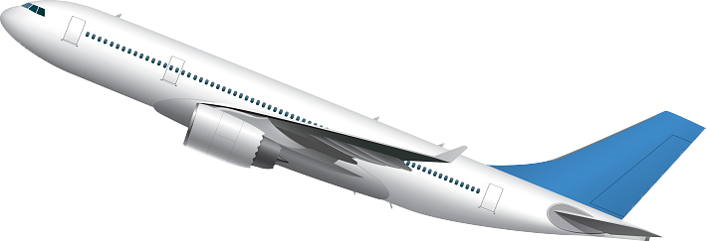

Our Personna

Slide 4
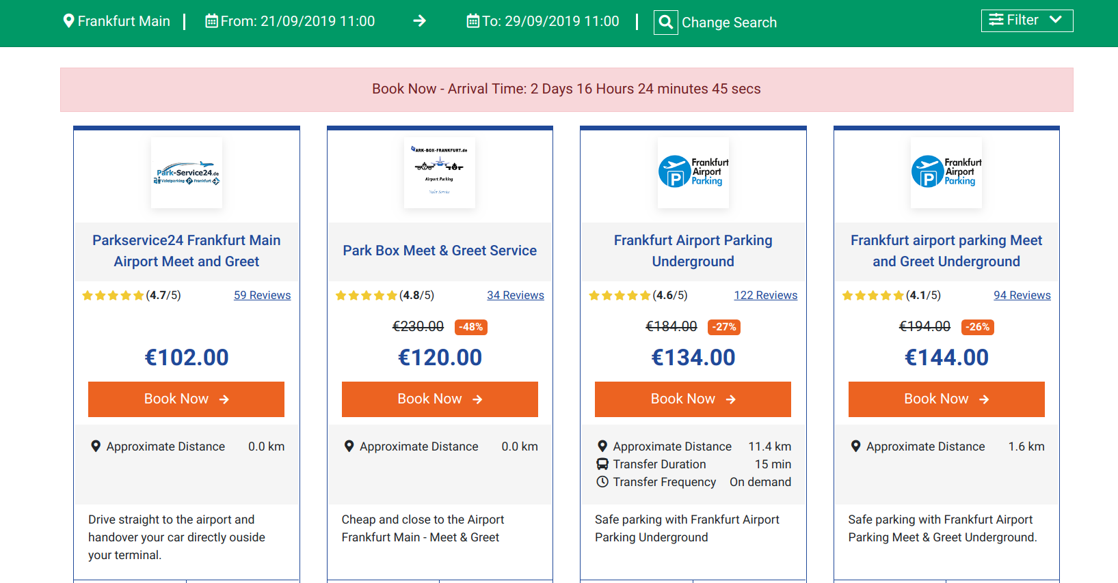
Basic problem : Airport Parking fees for a long stay

Slide 5

Save your time & your money

Slide 6
Save your time & your money

