Slide 1


Ice Cream Sales Analysis
Using R
A Data Science Project
Team Members: Nada Alnajjar, Khadijah Hzayen, Rawan Asqoul
Course Name: Data Science
University Name: Al-Zaytoonah University
Date: January 2025

Slide 2


Introduction
This project analyzes monthly ice cream sales data using R to explore trends, patterns, and insights that can help improve decision-making in business.
Project goals: To perform data preparation, visualization, and statistical analysis to uncover key business insights.

Slide 3

Dataset Overview
Name of the dataset: Ice Cream Sales Data
Number of records : 12
Variables: DATE, Monthly Units Sold.
Source of the data: Kaggle.com
DATE | monthly_units_sales
1/1/1972 | 59.9622
2/1/1972 | 67.0605
3/1/1972 | 74.235
4/1/1972 | 78.112
5/1/1972 | 84.7636
6/1/1972 | 100.596
7/1/1972 | 100.1263
8/1/1972 | 96.3607
9/1/1972 | 85.8007
10/1/1972 | 70.3934
11/1/1972 | 60.8072
12/1/1972 | 58.6598

Slide 4
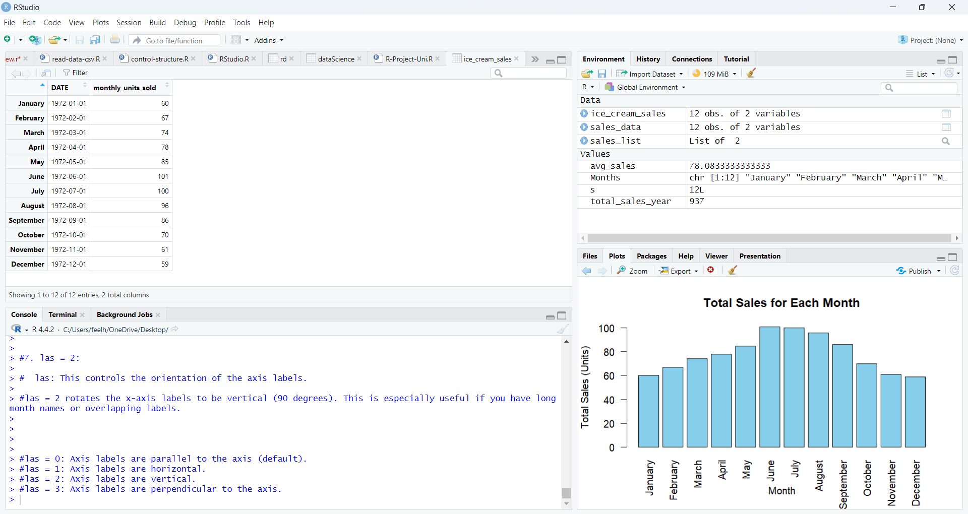

Tools and Methodology
Tools: R programming language, RStudio
Steps:
1. Reading the dataset from a CSV file
2. Data preparation (cleaning and transformation)
3. Statistical analysis (e.g., mean, sum)
4. Data visualization (charts and plots)

Slide 5

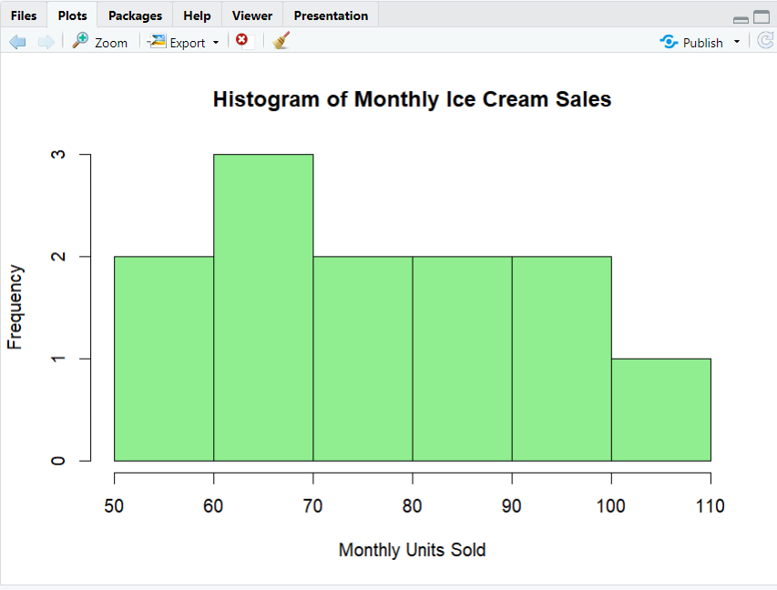
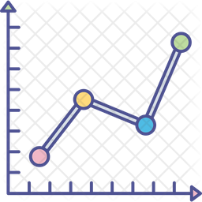
Data Preparation
Renamed columns for clarity (e.g., IPN31152N → Monthly Units Sold).
Converted date column to proper date format.
Rounded monthly sales values to integers.
Checked for missing values and outliers.

Slide 6
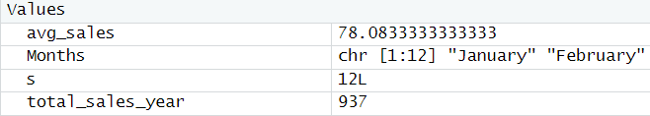


Variable and Vector Creation
Variables:
Created total_sales_year to store the total sales for the first year.
Calculated the total as <value>.
Vector:
Created Months vector to store month names.
Used it as row names for the dataset.

Slide 7
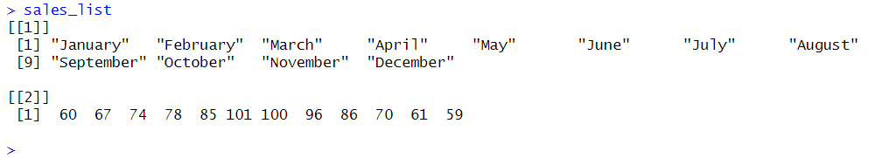
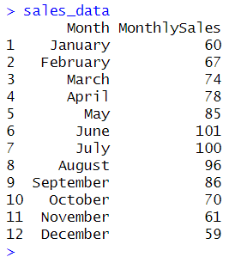
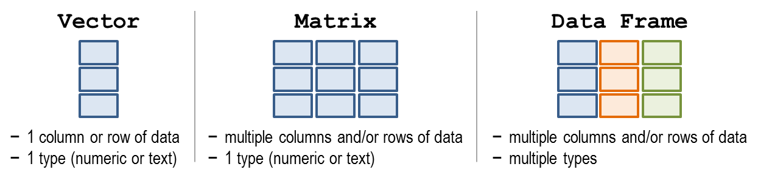
List and Data Frame
List Creation:
Combined Months and monthly_units_sold into a list.
Displayed total sales using the list.
Data Frame Creation:
Built sales_data data frame from the list.
Added month names and corresponding sales.

Slide 8
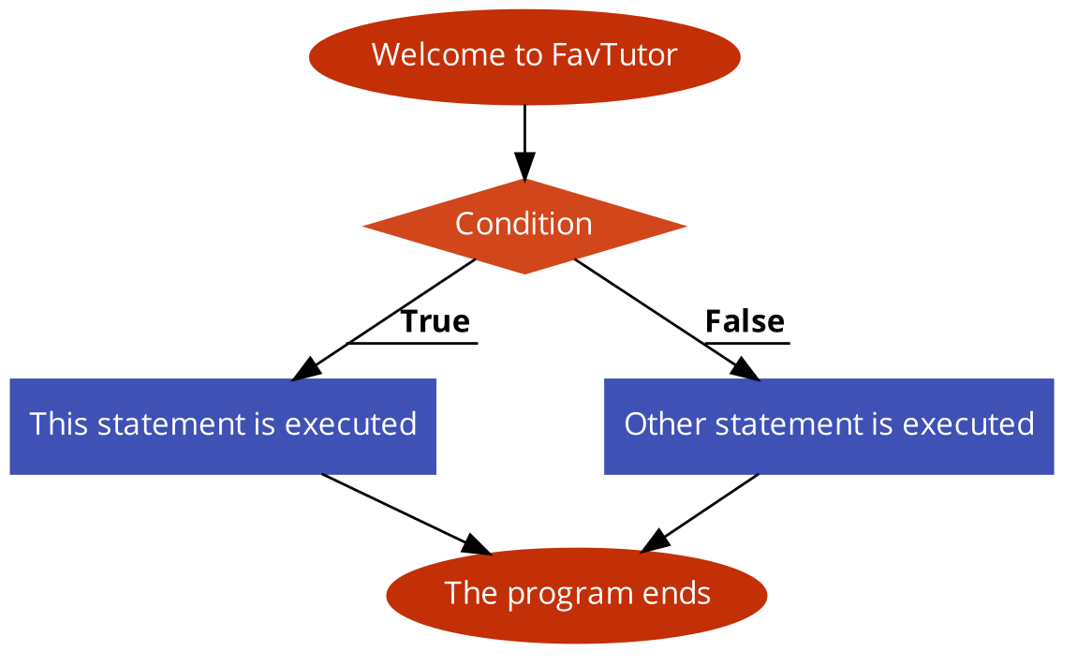

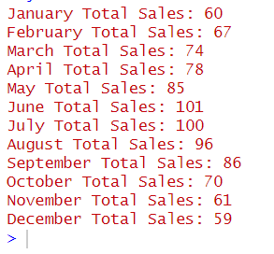
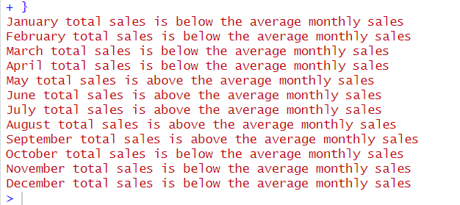
Control Structures
For Loop:
Printed total sales for each month.
If-Else Statement:
Checked if monthly sales were
above or below the average.
Key Findings:
Highlighted months with above-average sales

Slide 9
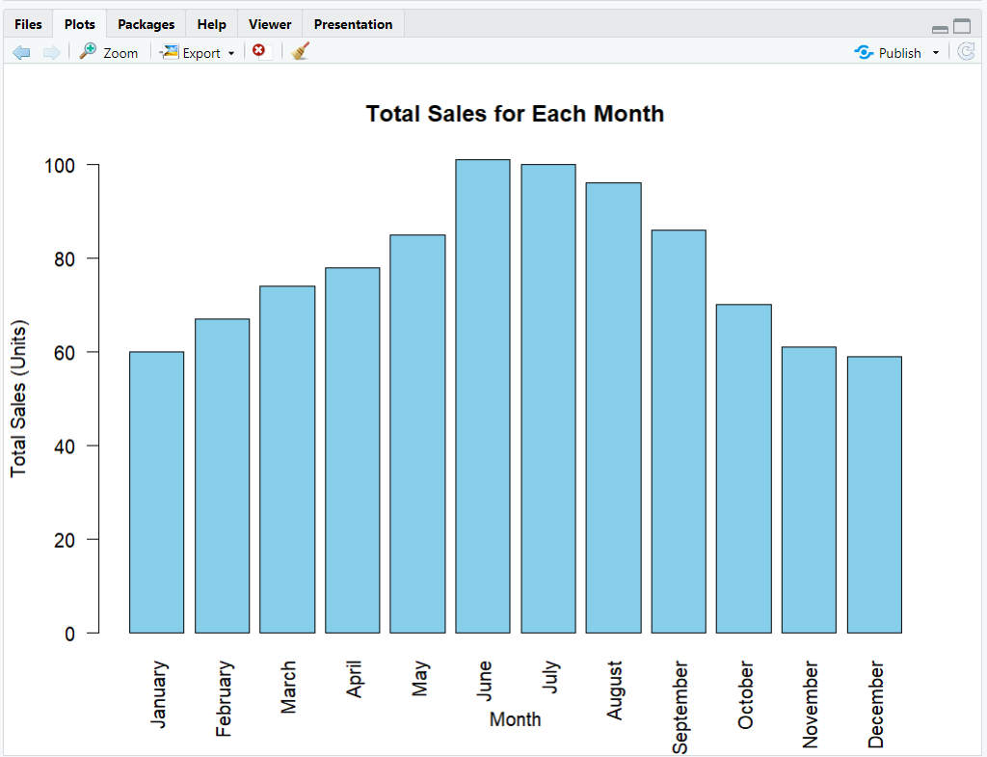
Data Visualization
Bar Plot:
Displayed total sales for each month
X-axis: Month names.
Y-axis: Total sales (units).
Key Insight:
Identified peak sales months from the chart.
R (barplot())

Slide 10

Summary
The analysis revealed monthly trends and the relationship between average and peak sales.
Data preparation and visualization highlighted actionable patterns.

Slide 11


Thank You
Thank you for your attention!

