Slide 1















FasTag Fraud Detection
Presented by Nada Sherif

Slide 2

01.
04.
Problem Statement &
Dataset
Model Development
Outline
02.
Exploratory Data Analysis
05.
Model Evaluation
03.
Data Preprocessing
06.
Conclusuion

Slide 3


Problem Statement
The goal is to create a robust model that can accurately identify instances of fraudulent activity, ensuring the integrity and security of Fastag transactions.

Slide 4
Dataset
1. Transaction_ID: Unique identifier for each transaction.
2. Timestamp: Date and time of the transaction.
3. Vehicle_Type: Type of vehicle involved in the transaction.
4. FastagID: Unique identifier for Fastag.
5. TollBoothID: Identifier for the toll booth.
6. Lane_Type: Type of lane used for the transaction.
7. Vehicle_Dimensions: Dimensions of the vehicle.
8. Transaction_Amount: Amount associated with the transaction.
9. Amount_paid: Amount paid for the transaction.
10. Geographical_Location: Location details of the transaction.
11. Vehicle_Speed: Speed of the vehicle during the transaction.
12. Vehicle_Plate_Number: License plate number of the vehicle.
13. Fraud_indicator: Binary indicator of fraudulent activity (target variable).

Slide 5
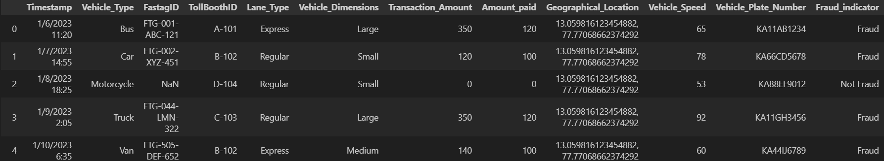
Dataset

Slide 6
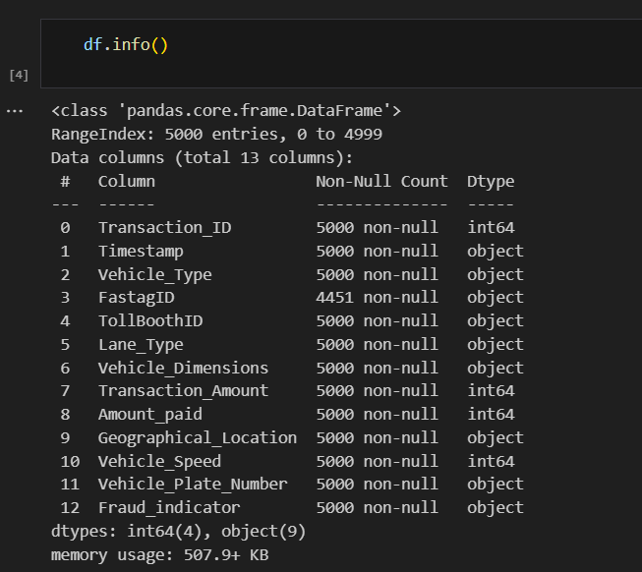
Dataset

Slide 7
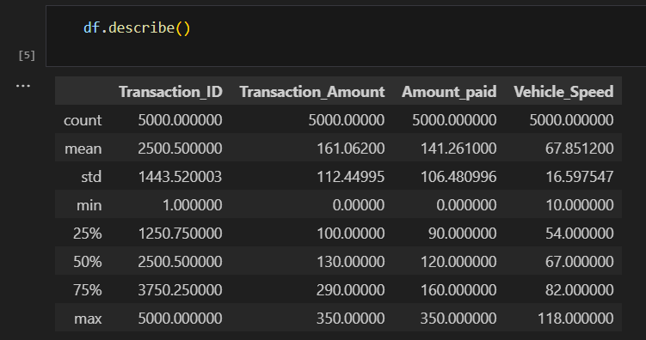
Exploratory Data Analysis

Slide 8
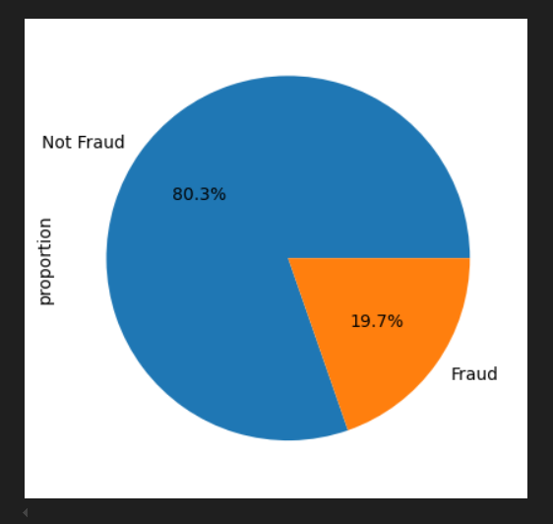
Exploratory Data Analysis
Pie chart representation of Fraud_indicator column

Slide 9
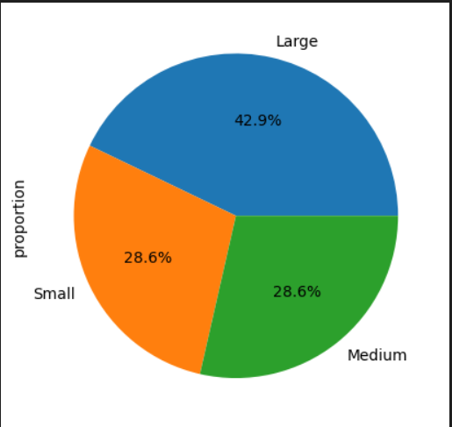
Exploratory Data Analysis
Pie chart representation of Vehicle_Dimensions column

Slide 10
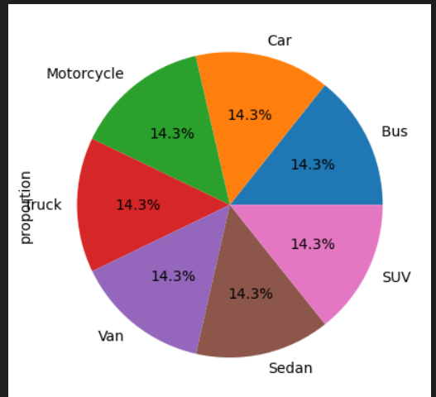
Exploratory Data Analysis
Pie chart representation of Vehicle_Type column

Slide 11
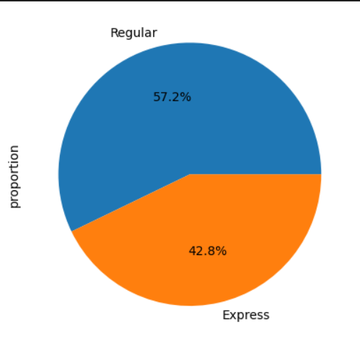
Exploratory Data Analysis
Pie chart representation of Lane_Type column

Slide 12
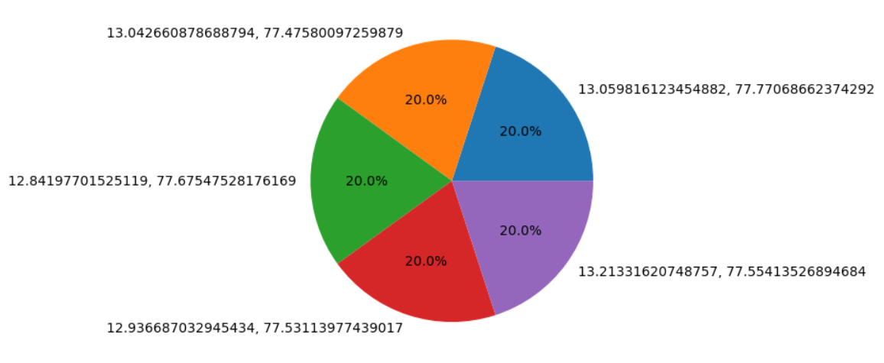
Exploratory Data Analysis
Pie chart representation of Geographical_Location column

Slide 13
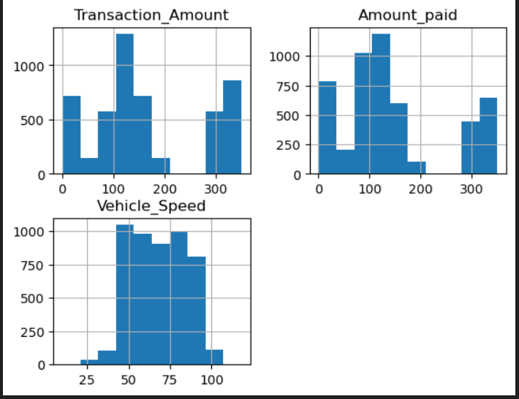
Exploratory Data Analysis

Slide 14
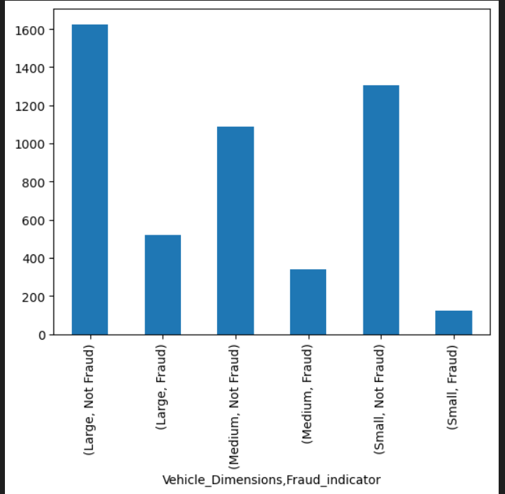
Exploratory Data Analysis
Fraud grouped by Vehicle_Dimensions

Slide 15
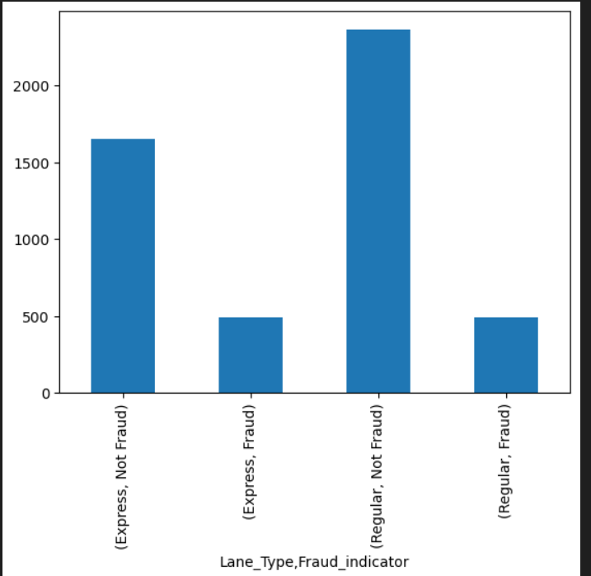
Exploratory Data Analysis
Fraud grouped by Lane_Type

Slide 16
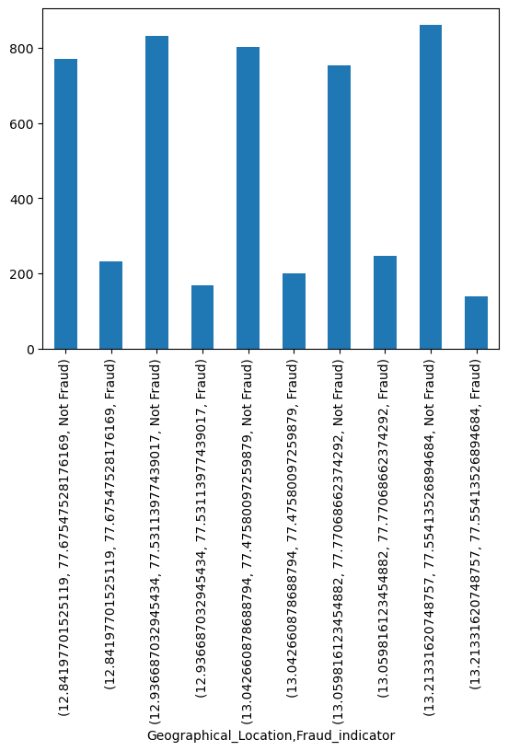
Exploratory Data Analysis
Fraud grouped by Geographical_Location

Slide 17
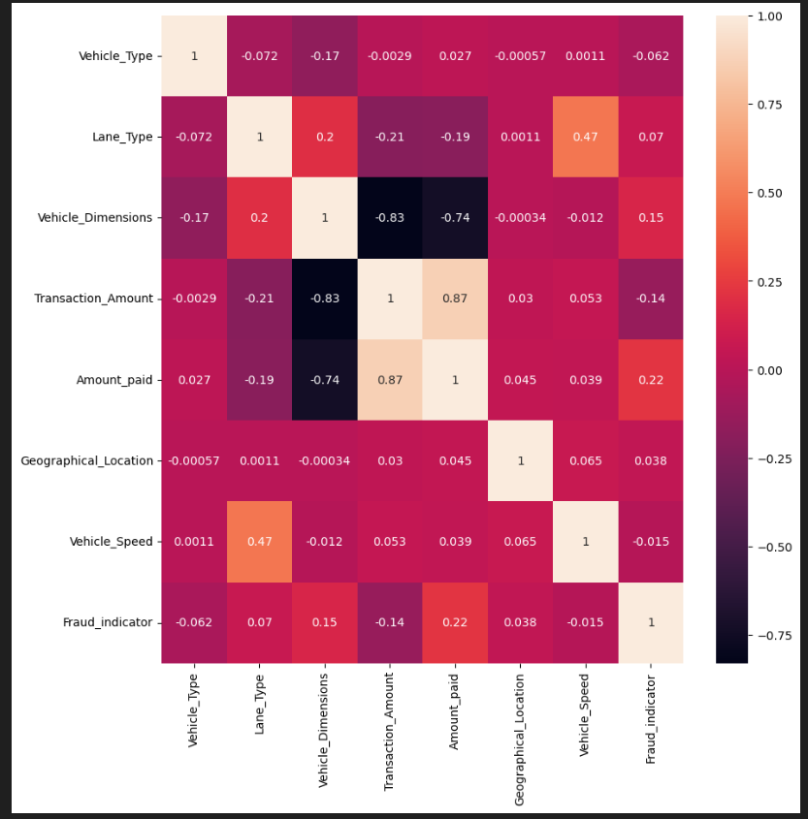
Exploratory Data Analysis
Correlation of all features with each other

Slide 18
Data Preprocessing
Dropping unnecessary columns
Encoding
Splitting
Resampling

Slide 19
Dropping Unnecessary Columns
Transaction_ID
TollBoothID
FastagID
Timestamp
Vehicle_Plate_Number

Slide 20
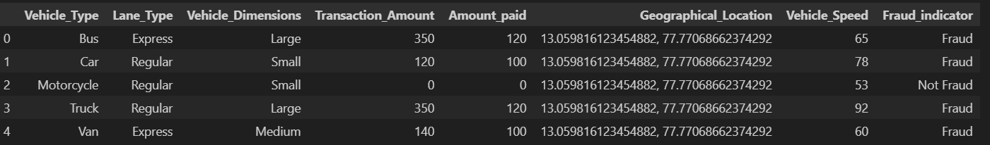

Dropping Unnecessary Columns

Slide 21
Encoding
Label Encoding for categorical data
Vehicle_Type
Lane_Type
Vehicle_Dimensions
Geographical_Location
Fraud_indicator

Slide 22
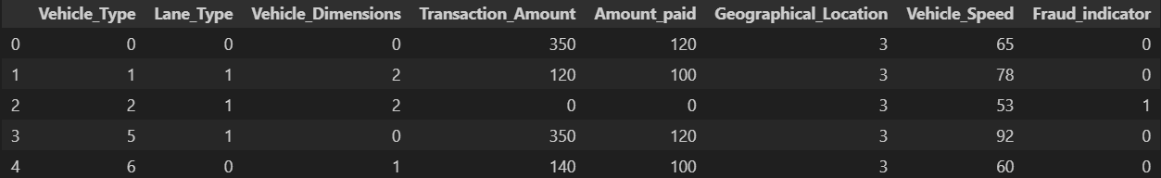
Encoding

Slide 23
Splitting
Training
75%
Dataset
Test
25%

Slide 24
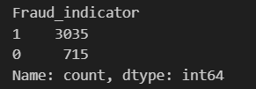

Resampling
SMOTE Oversampling

Slide 25
Model Development
Random Forest
Extreme
Gradient Boosting

Slide 26
Model Evaluation
Accuracy
Precision
Recall
F1-Score

Slide 27
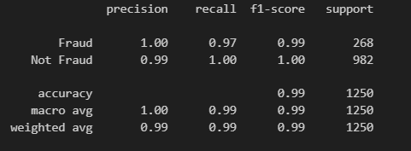
Random Forest
No Resampling

Slide 28
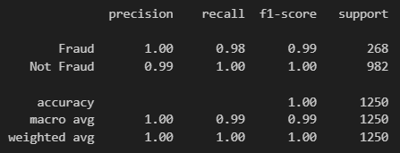
Random Forest
SMOTE Oversampling

Slide 29
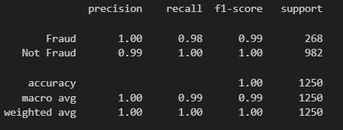
XGBoost
No Resampling

Slide 30
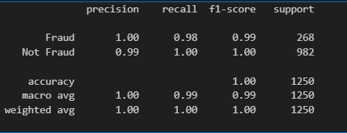
XGBoost
SMOTE Oversampling

Slide 31
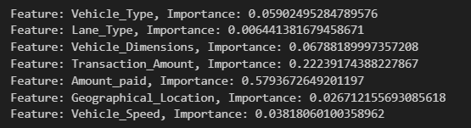
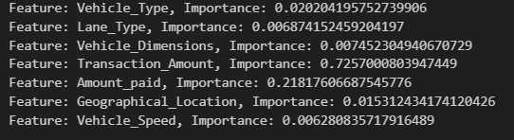
Features Importance
Random Forest
XGBoost

Slide 32
Conclusion
Transaction amount and amount paid have the highest impact on fraud.

Slide 33
Thank you very much!

