Slide 1
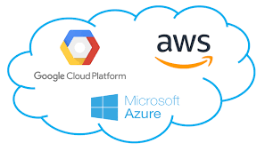
3. CLOUD COST OPTIMIZATION STRATEGIES
Presenter
NADAKUDITI TARUN BALAJI

Slide 2

CONTENTS
WHAT IS CLOUD ?
WHY TO USE CLOUD?
WHAT IS COST OPTIMIZATION IN CLOUD?
WHAT ARE THE MAIN COST OPTIMIZATION TECHNIQUES?

Slide 3
WHAT IS CLOUD
The word CLOUD means remote servers that are used to store, manage, run and deploy of applications over the internet is known as cloud
There are 3 main types of cloud models are there
PUBLIC CLOUD
PRIVATE CLOUD
HYBRID CLOUD
And there are also 3 main types of cloud service models
IAAS (storage, computing, networking)
PAAS (development, running, deployment of applications)
SAAS(end user applications like MS office 365)

Slide 4
WHY TO USE CLOUD PLATFORM?
The cloud platforms provide the computing resources over the internet like hardware, software, networking, storage.
The cloud platforms allows users to pay bills on pay as go model. Which means user has to pay the amount for the resources which he/she used.
Cloud computing also has scalability

Slide 5
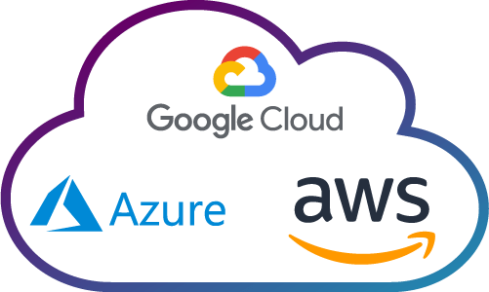

EXAMPLE
Startup / a small size company
Company local servers or data centre

Slide 6
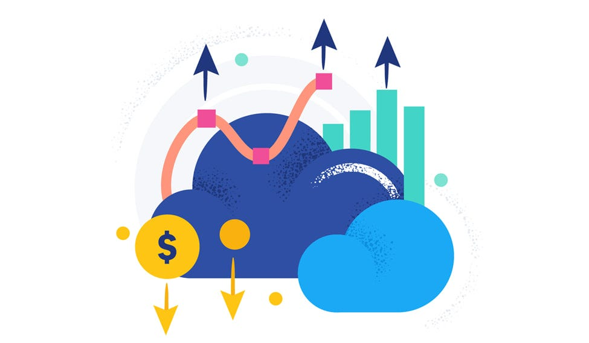
WHAT IS COST OPTIMIZATION IN CLOUD?
The cost optimization is process of managing the cloud resources.
In this process the computing power is maximized while reducing the cloud operating costs
The process involves selecting right resources for the applications.

Slide 7
WHAT ARE THE MAIN COST OPTIMIZATION TECHNIQUES?
Monitoring
Billing and cost management monitoring
Budgeting
Resource Allocation
Using of Cloud Cost Optimization Tools

Slide 8
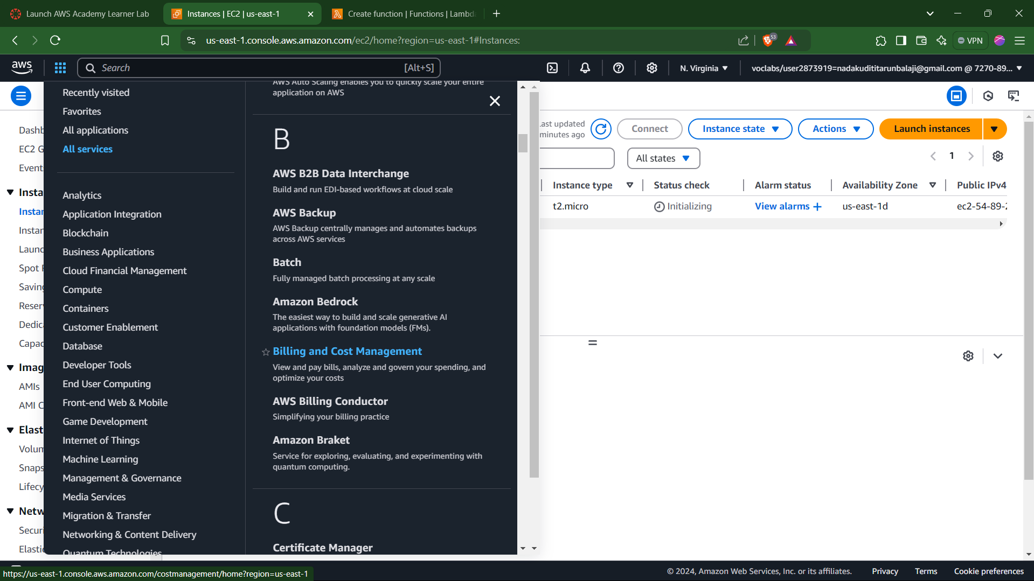

Slide 9
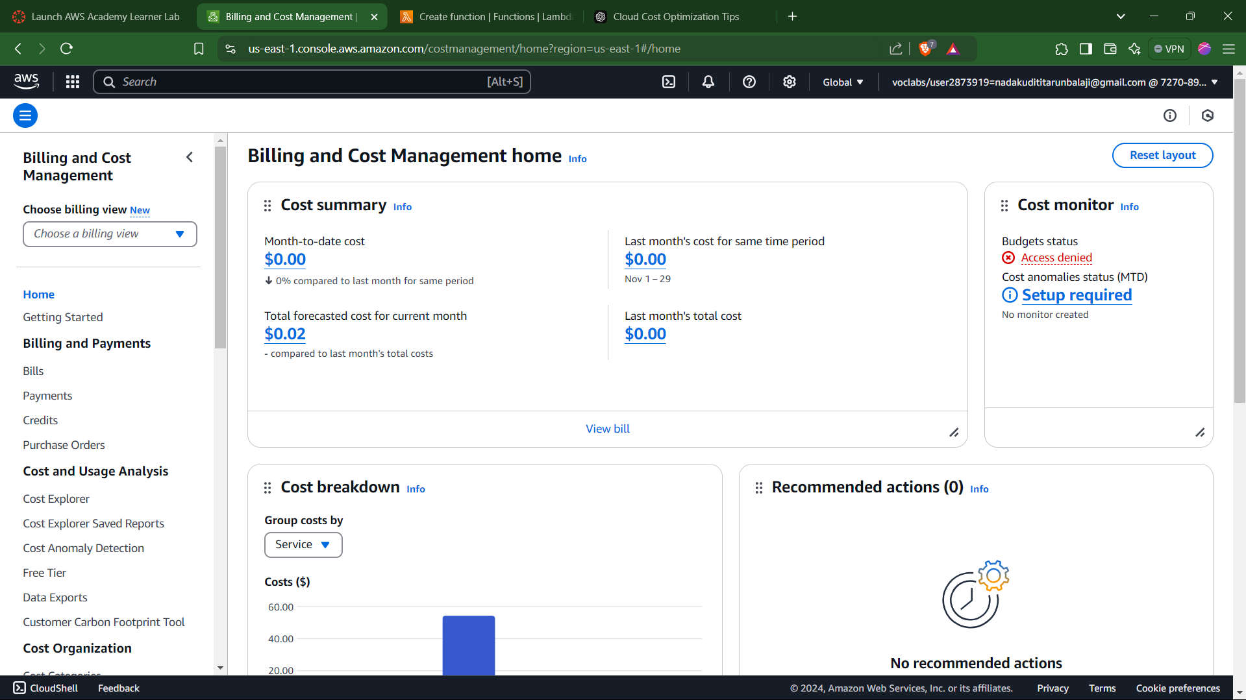

Slide 10
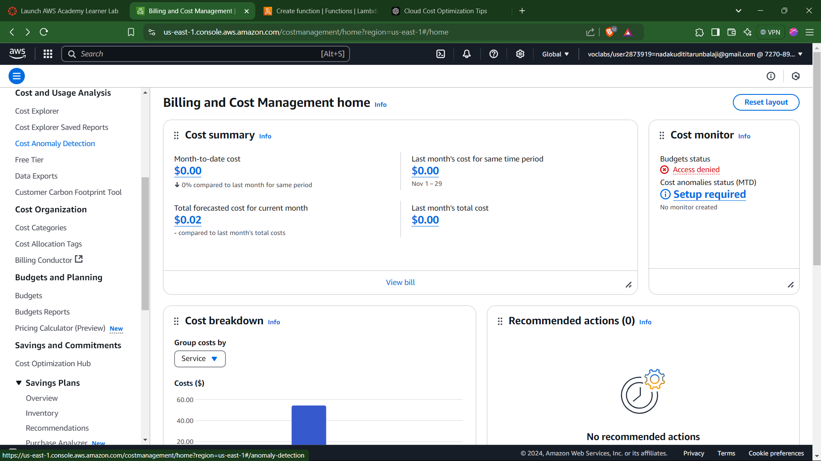

Slide 11
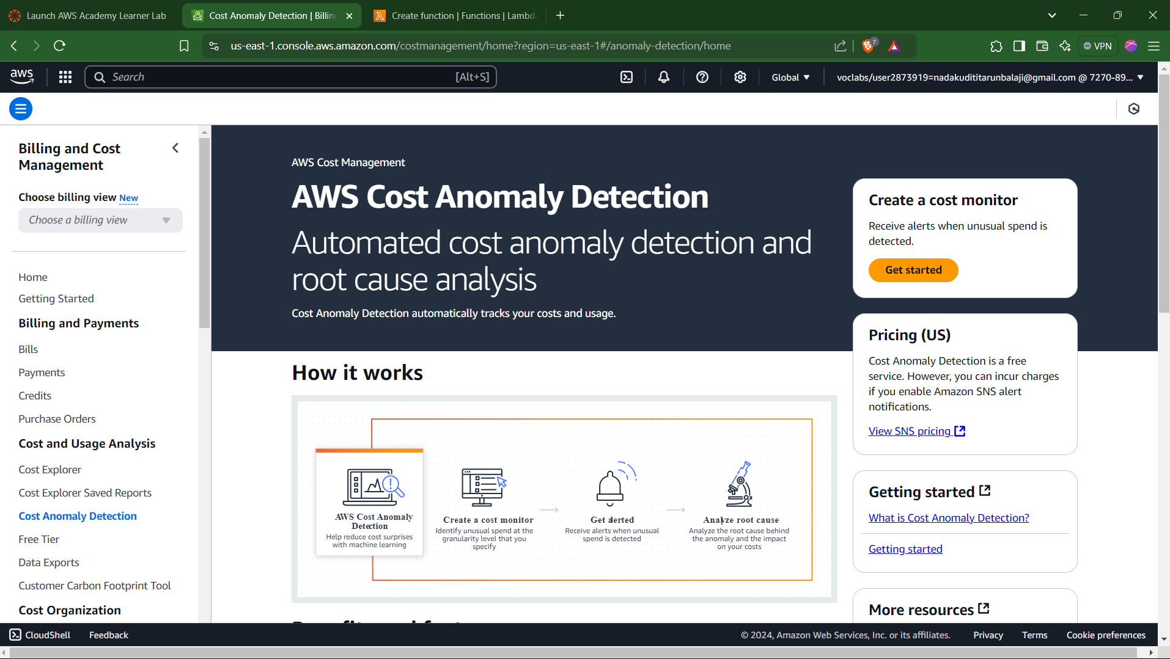

Slide 12
EXAMPLE

Slide 13
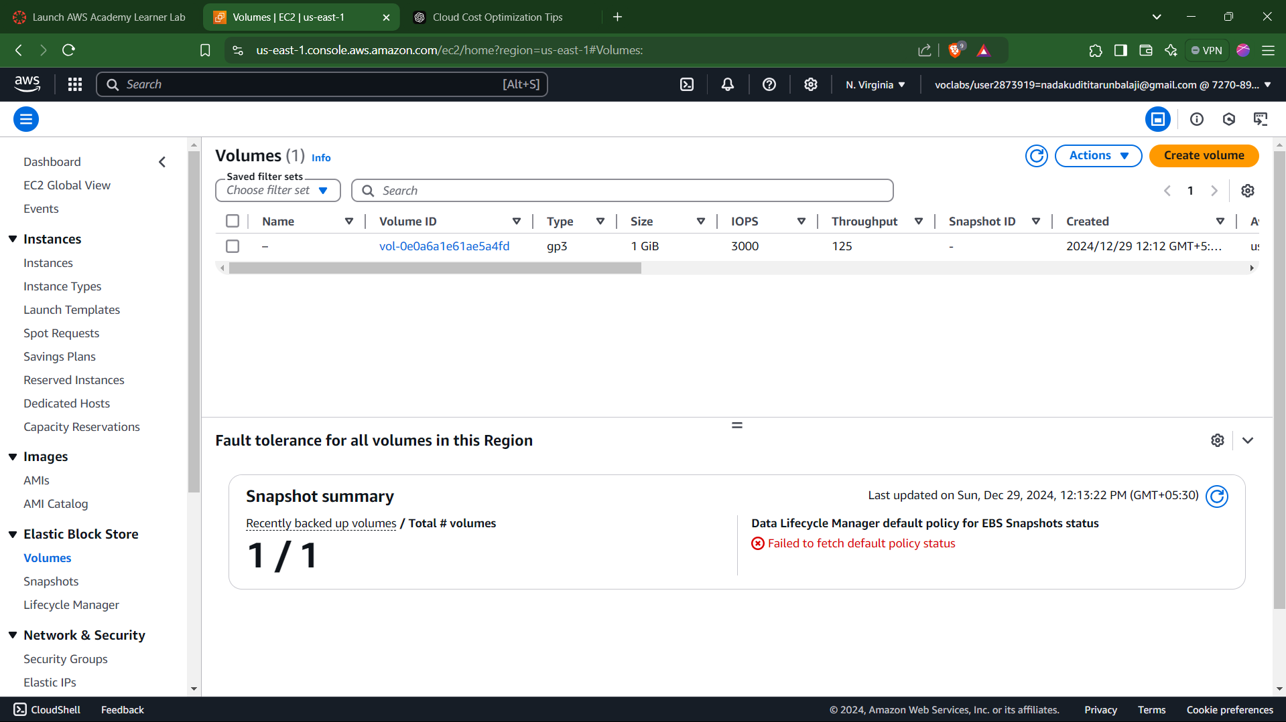

Slide 14
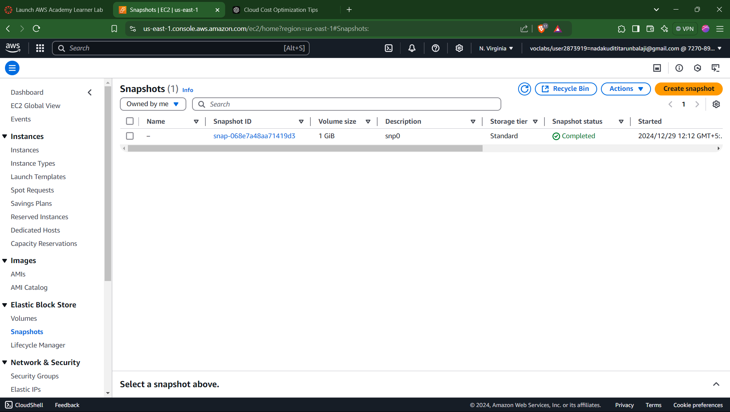

Slide 15
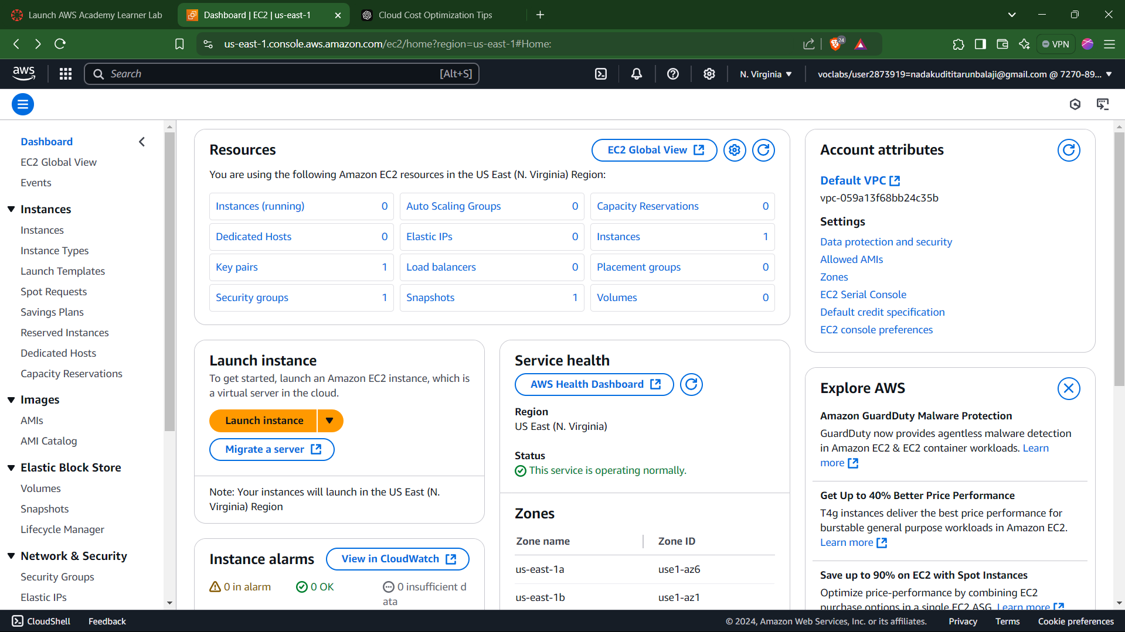

Slide 16


