Slide 1
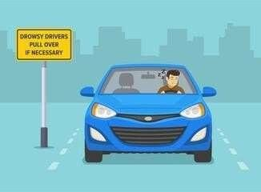
DRIVER DROWSINESS DETECTION FOR ACCIDENT PREVENTION
UNDER THE GUIDANCE O F MR.RAJESH SIR ASSISTANT PROFESSOR
TEAM MEMBERS
NADAKUDITI TARUN BALAJI SUSANI PRIYA CHANDRIKA PRANEETHA SINGH GAUTAM LANKA ANUHYASINI
21NG1A1234
21NG1A1253
21NG1A1246
21NG1A1228
DEPARTMENT OF INFORMATION TECHNOLOGY
USHA RAMA COLLEGE OF ENGINEERING AND TECHNOLOGY

Slide 2
TABLE CONTENTS
S.NO | CONTENTS
1.0 2.0 3.0 | DESIGN PHASE UML DIAGRAMS LITERATURE SURVEY

Slide 3

1.0 DESIGN PHASE
1.1-DATA COLLECTION
1.2-CREATING A CNN MODEL
1.3-EVALUATION OF MODEL
1.4-DEPLOYMENT

Slide 4



1.1-DATA COLLECTION
We are going to develop a code that uses OpenCV and Mediapipe to capture drowsiness data from the webcam by calculating EAR and MAR. Users label data as "Drowsy" or "Not Drowsy" with 'd' or 'n'. The data (EAR, MAR, label) is saved to a CSV file upon quitting with 'q'.

Slide 5
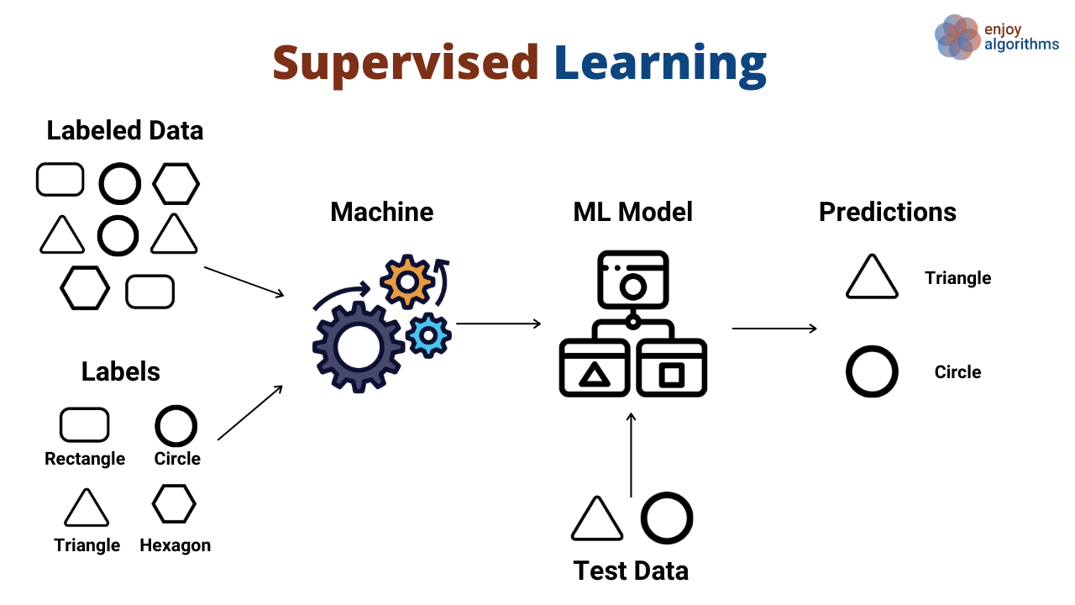
1.2-CREATING A CNN MODEL
The model uses the drowsiness dataset which is created previously and extracts EAR and MAR for classification. It splits the data, standardizes features, and builds a neural network. The model is trained for 50 epochs depends on the dataset. At last the trained model is saved.

Slide 6
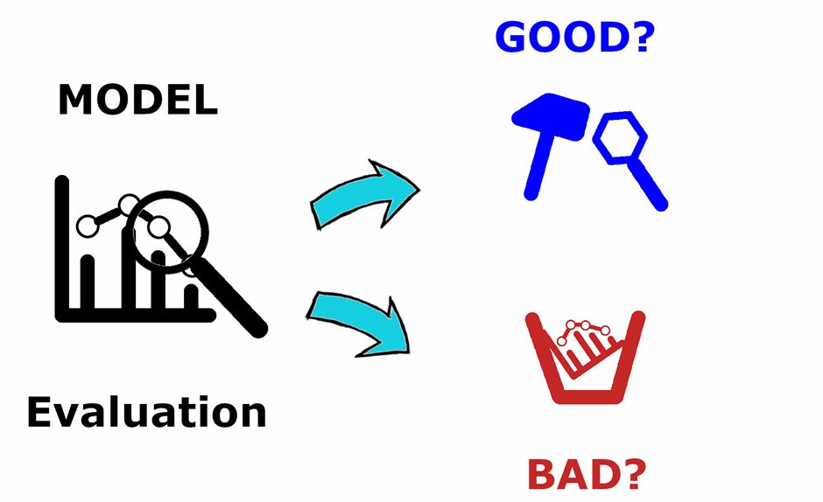
1.3-EVALUATION OF MODEL
In this phase, we are evaluating our saved model and makes predictions on the test data. It converts probabilities into binary predictions using a threshold of 0.5. The model's performance is assessed using a confusion matrix and a classification report. These metrics provide insights into accuracy, precision.

Slide 7
1.4-DEPLOYMENT
Developing a Flask app for real-time drowsiness detection using a webcam. The Flask app provides a web interface. It processes video frames with Mediapipe to extract EAR and MAR, Passes them to a pre-trained model. If drowsiness is detected, a Alarm is triggered.

Slide 8

2.0 UML DIAGRAMS
2.1 USE CASE DIAGRAM
2.2 SEQUENCE DIAGRAM
2.3 CLASS DIAGRAM
2.4 ACTIVITY DIAGRAM

Slide 9
2.1 USE CASE DIAGRAM

Slide 10
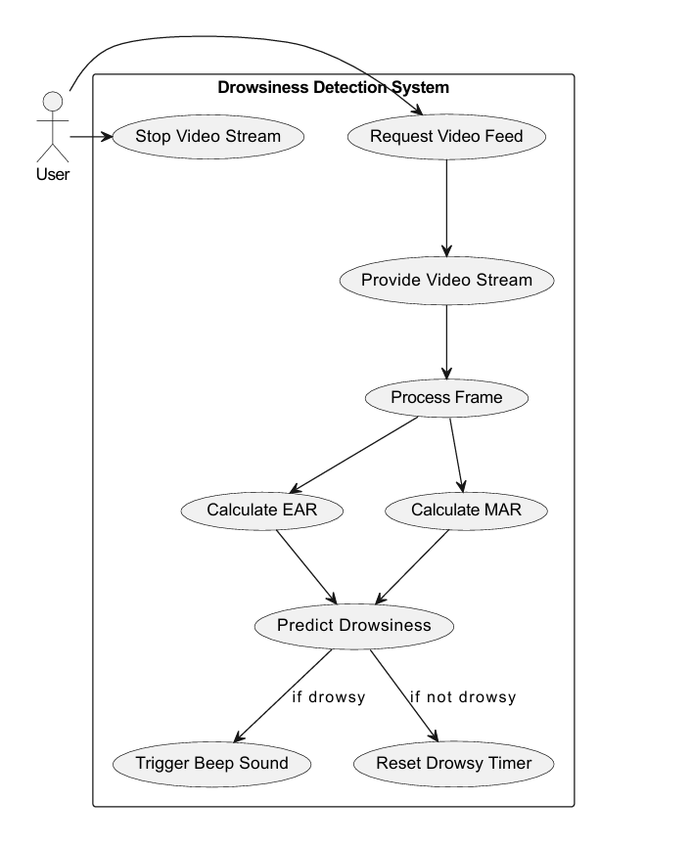
The use case diagram is used to show case the functionality of the system

Slide 11
2.2 SEQUENCE DIAGRAM
The sequence diagram shows the work flow of system

Slide 12
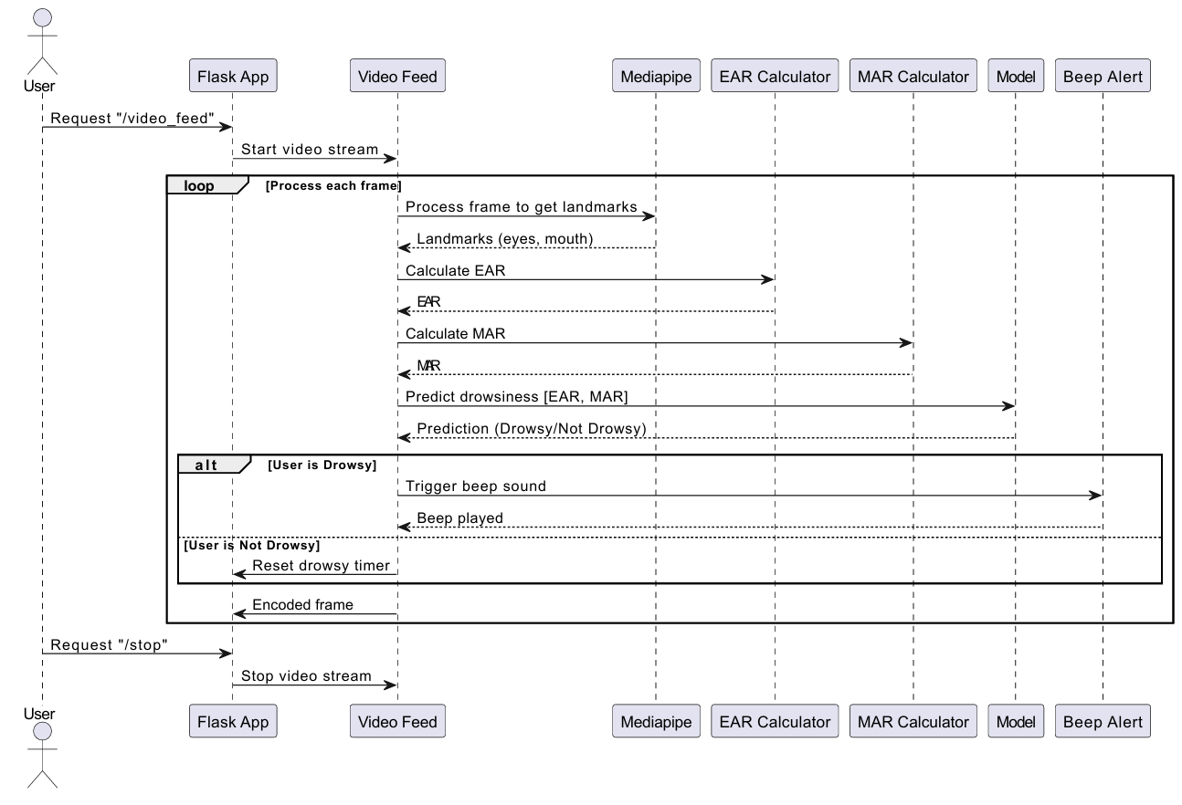

Slide 13
2.3 CLASS DIAGRAM

Slide 14
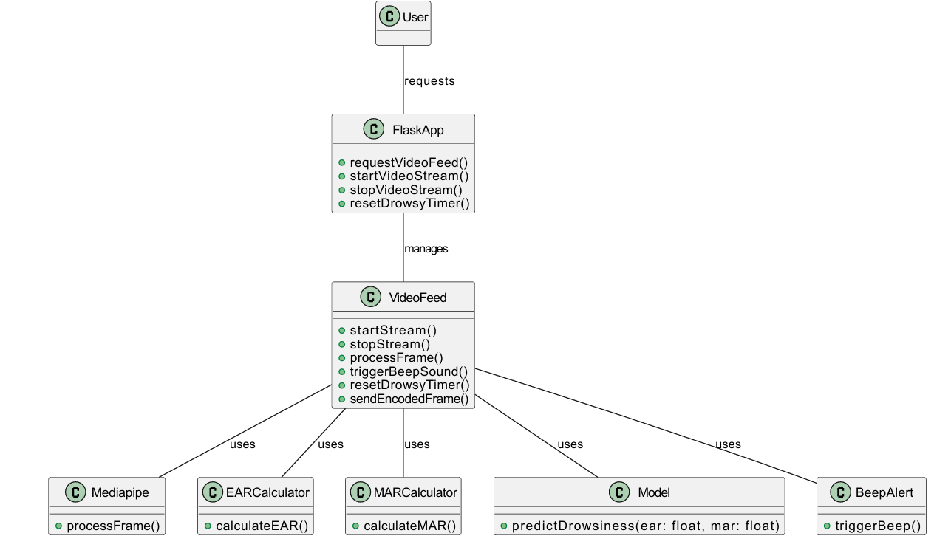
The class diagram shows the static structure of the project. And it is also used to identify the relationship between the classes and types of methods available in the classes

Slide 15
2.4 ACTIVITY DIAGRAM

Slide 16
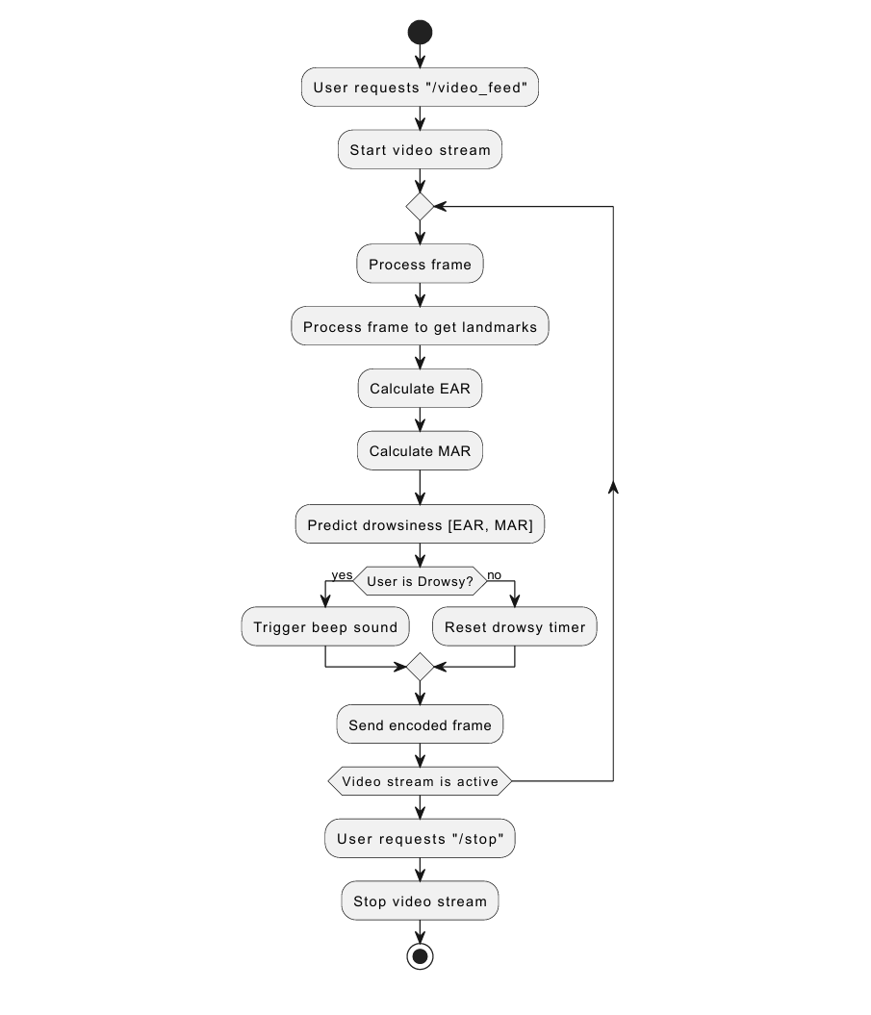
Activity Diagrams to illustrate the flow of control in a system

Slide 17

3.0 LITERATURE SURVEY

Slide 18
S.NO | TITLE | AUTHOR N A M E | YEAR | TECHNIQUES | DISADVANTAGES
1 | Driver Drowsiness Detection Using Deep Learning | Dhiren Ojha,Amit Pawar, Gaurav Kasliwal, Roshani Raut, Anita Devkar | 2023 | Physiological Measures Electroencephalogram Skin Conductance Facial Expressions | High Cost Complexity Data Sensitivity
2 | Raspberry Pi Based Driver Drowsiness Detection System Using Convolutional Neural Network (CNN) | Safie S. I, Rusmawarni Ramli, M. Amirul Azri, M. Aliff, Zulhaimi Mohammad | 2022 | Real-Time Detection on Raspberry Pi | Hardware Limitation High Cost Complex
3 | Driver Drowsiness Detection using AI Techniques | Tushar Singh Manchanda, Gurdit Singh | 2021 | Python Language | Training Data Reliability User Experience
4 | Learning based Driver Drowsiness Detection Model | Jagendra Singh | 2020 | Facial Point Detection Microsleep Detection | Accuracy Issues Processing Speed Latency

Slide 19


