Slide 1

Performance Analysis of Credit Card Fraud Detection Algorithms: An Overview
Presented by Nneoma Okoroafor
Lecturer: Dr. Kiran Bellam

Slide 2


1. Introduction
According to Fidelity National Information Services Inc. Volume in dollars of attempted fraudulent transactions rose by 35% during the pandemic, and this trend does seem to continue in May 2021.
Dependency on cards for online/offline shopping, the volume of fraudulent transactions through credit cards has skyrocketed.
ML algorithms have been in existence to curb this menace. However, no existing algorithm has proved completely efficient as the methods of these fraudsters tend to change with newer inventions.
Analyze optimized LightGBM independently against the other popular algorithms, including bagging Decision Tree, Random Forest XGBoost Algorithms, and categorize them based on accuracy and speed.
Overview of the research presentation

Slide 3
2. Related Studies
Fraud classification
Cloning and hacking of cards, imprints of cards at hotels, shoulder surfing, phishing among others [1][2].
Fraud Detection Systems[3][1].
Supervised and Unsupervised Algorithms[5][3]
Streaming Analytics
Bagging Decision Tree, Random Forest, XGBoost algorithms and OLightGBM
Challenges:[4][6]
Data Skewness
Change in behaviour of Fraudsters behavior to avoid getting caught,
Seasonal changes in users behavior,
Domain metrics, lack of truth labels,
real-time classification requirements .

Slide 4
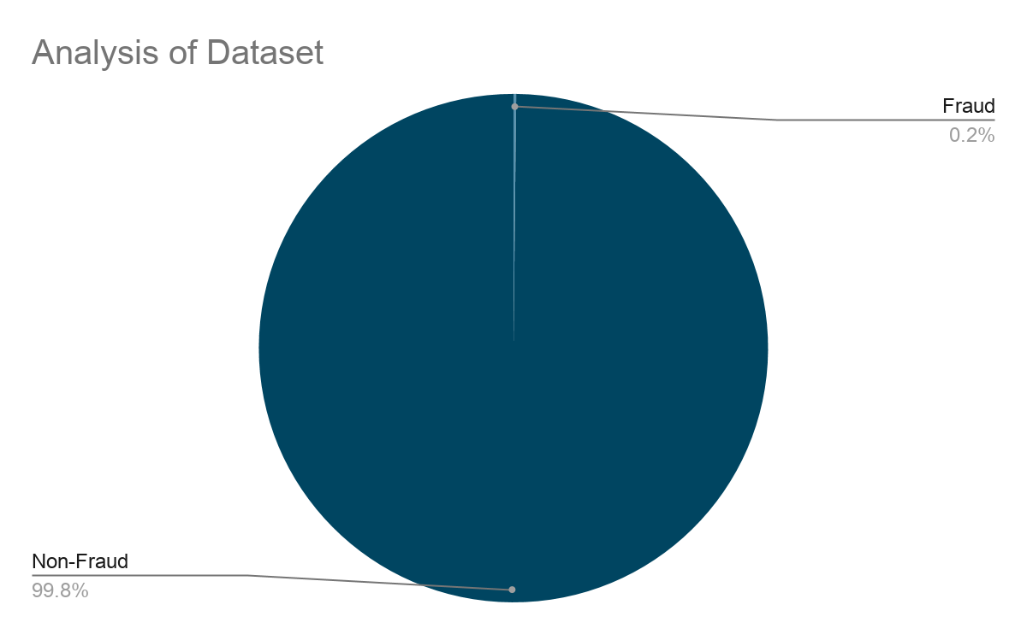
3. Research Methodology
Data : a publicly available real dataset with total of 282,809 transactions. Provided by Group of ULB(Université Libre de Bruxelles). It has 284,315 legitimate and 480 fraudulent transactions with 31 anonymized features using PCA.[3]
Model Design
Below steps are taken for each of the models
Parameters were initialized by importing appropriate python libraries and setting hyper-parameters.
Import the datasets and assign the x and y values.
Datasets were split into the Training set and Test set by 75% and 25% respectively.
Fit the training data to each model.
Model performance was evaluated on test data
K-fold Cross-validation was used against all models to ensure that a high-performing model was not randomly picked. This was used to calculate the accuracy mean and standard deviation.
Four models were designed: Bagging Decision Tree(BAG), Random Forest(RF), XGBoost and OLightGBM
Fig. 1 An overview of the dataset

Slide 5



3. Research Methodology Cont.
Metrics :
Predicted | Actual
 | Positive Prediction | Negative Prediction
Fraud(Class 1) | True Positive(TP) | False Negative(FN)
Non-Fraud(Class 0) | False Positive(FP) | True Negative(TN))
Table 1 Showing Confusion Matrix Definition
ML Performance measures used : Precision, Recall and F-1 score, Accuracy, K-fold Cross validation.

Slide 6
4. Result and Analysis
Algorithm/Model | PR | Pr | Rc | f1_score | K-fold Cross Validation(%) | Speed(s)
RF | 0.9995 | 0.93 | 0.79 | 0.85 | 99.95 | 18
Bagging | 0.9994 | 0.94 | 0.75 | 0.82 | 99.95 | 32
XGBoost | 0.9995 | 0.92 | 0.77 | 0.84 | 99.95 | 52
OLightGBM | 0.9999 | 0.95 | 0.80 | 0.86 | 99.96 | 197
Table 2 Performance Analysis of the different Machine Learning Models

Slide 7

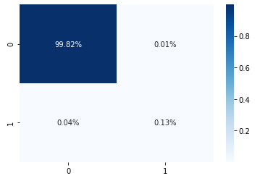
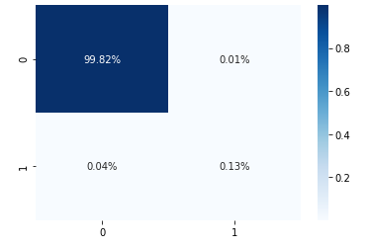
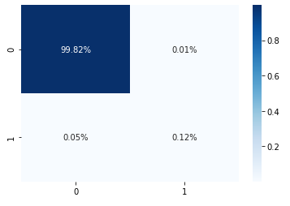
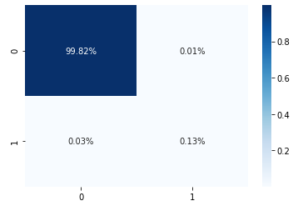
4. Result and Analysis Cont.
Fig 2. RF Confusion Matrix
Fig 3. XGBoost Confusion Matrix
Fig 4. Bagging DT Confusion Matrix
Fig 5. OLightGBM Confusion Matrix

Slide 8
5. Limitations
Lack of Datasets: Inability to check for oversampling
Variation in parameter tuning and algorithm implementation

Slide 9
6. Future Scope
Since credit card fraud would most likely increase, algorithm that would provide speed and accuracy would be preferred
Apply Bayesian optimization to RF to see how this works out.
Source for different dataset to work with.

Slide 10
7. References
S. Mittal and S. Tyagi, "Performance Evaluation of Machine Learning Algorithms for Credit Card Fraud Detection," 2019 9th International Conference on Cloud Computing, Data Science & Engineering (Confluence), Noida, India, 2019, pp. 320-324, doi: 10.1109/CONFLUENCE.2019.8776925.
U Rajeshwari and B. S. Babu, "Real-time credit card fraud detection using Streaming Analytics", 2016 2nd International Conference on Applied and Theoretical Computing and Communication Technology (iCATccT), pp. 439-444, 2016.
A. Dal Pozzolo, G. Boracchi, O. Caelen, C. Alippi and G. Bontempi, "Credit Card Fraud Detection: A Realistic Modeling and a Novel Learning Strategy", IEEE Transactions on Neural Networks and Learning Systems, vol. 29, no. 8, pp. 3784-3797, Aug. 2018.
Y. Sahin and E. Duman, "Detecting Credit Card Fraud by Decision Trees and Support Vector Machines", Int. Multiconference Eng. Comput. Sci., vol. I, pp. 442-447, 2011.
S. Dhankhad, E. Mohammed and B. Far, "Supervised Machine Learning Algorithms for Credit Card Fraudulent Transaction Detection: A Comparative Study," 2018 IEEE International Conference on Information Reuse and Integration (IRI), Salt Lake City, UT, USA, 2018, pp. 122-125, doi: 10.1109/IRI.2018.00025.
M. Kavitha and M. Suriakala, "Hybrid Multi-Level Credit Card Fraud Detection System by Bagging Multiple Boosted Trees (BMBT)", 2017 IEEE International Conference on Computational Intelligence and Computing Research (ICCIC), pp. 1-5, 2017.
E. W. T. Ngai, Y. Hu, Y. H. Wong, Y. Chen and X. Sun, "The application of data mining techniques in financial fraud detection: A classification framework and an academic review of literature", Decis. Support Syst., vol. 50, no. 3, pp. 559-569, 2011.
A. A. Taha and S. J. Malebary, "An Intelligent Approach to Credit Card Fraud Detection Using an Optimized Light Gradient Boosting Machine," in IEEE Access, vol. 8, pp. 25579-25587, 2020, doi: 10.1109/ACCESS.2020.2971354.

Slide 11
Thank You!
Q&A

