Slide 1
Email Header Analysis (Spoof Detection Tool)
-INTERN ID 230,366,286

Slide 2
Introduction
• Email header analysis helps in detecting phishing and spoofing attempts.
• Attackers forge headers to trick users into believing emails come from trusted sources.
• Automated tools can analyze headers quickly and highlight suspicious indicators.

Slide 3
WHAT ARE Email headers?
The header is like a passport for your email. Each time your email passes through a server, the header records details of that stop. The more servers an email is routed through, the longer the header becomes.
Email headers hold a lot of information. While the user usually only sees the subject, sender, and date, the full header contains routing paths, timestamps, and authentication results such as SPF, DKIM, and DMARC.
The visible parts of the header, like the sender’s name or subject, can be easily forged to mislead users.
Email headers are an important tool for identifying phishing, spoofing, and other malicious activities.

Slide 4
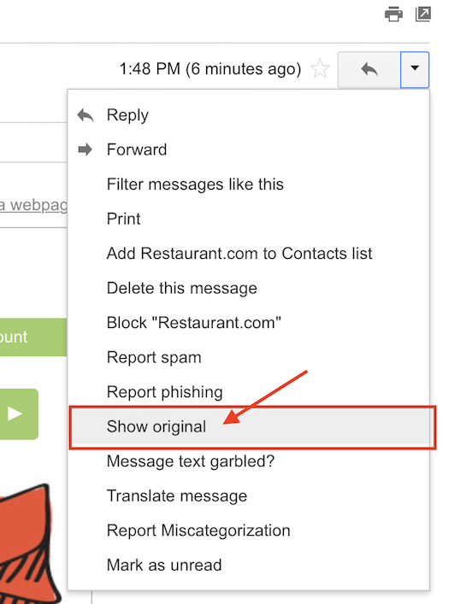
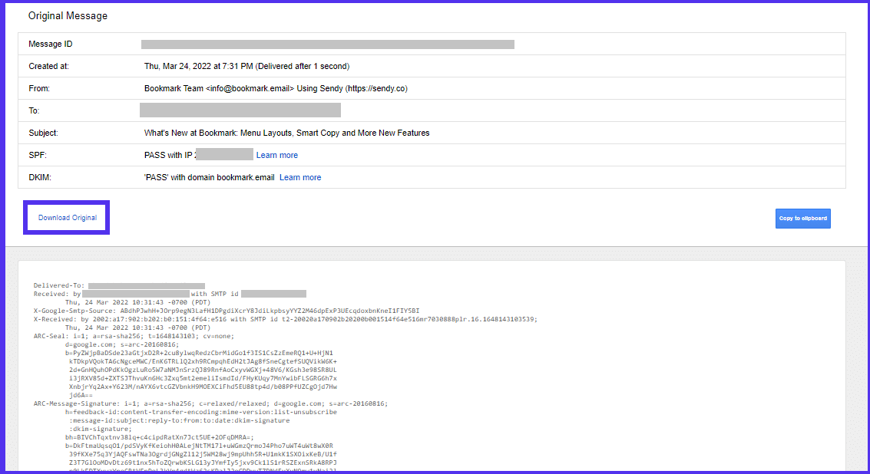
HOW TO CHECK EMAIL HEADERS?

Slide 5
EmAIL HEADER ANALYSIS: Important fields
SPF result – verifies if the sender’s server is allowed to send mail for that domain
DKIM result – checks if the email’s digital signature is valid
DMARC result – ensures policy alignment between SPF/DKIM and the “From” domain
Received headers – looks for private or loopback IP addresses that shouldn’t appear in real traffic
From/Return-Path domain – checks for mismatches between claimed sender and actual sending domain

Slide 6
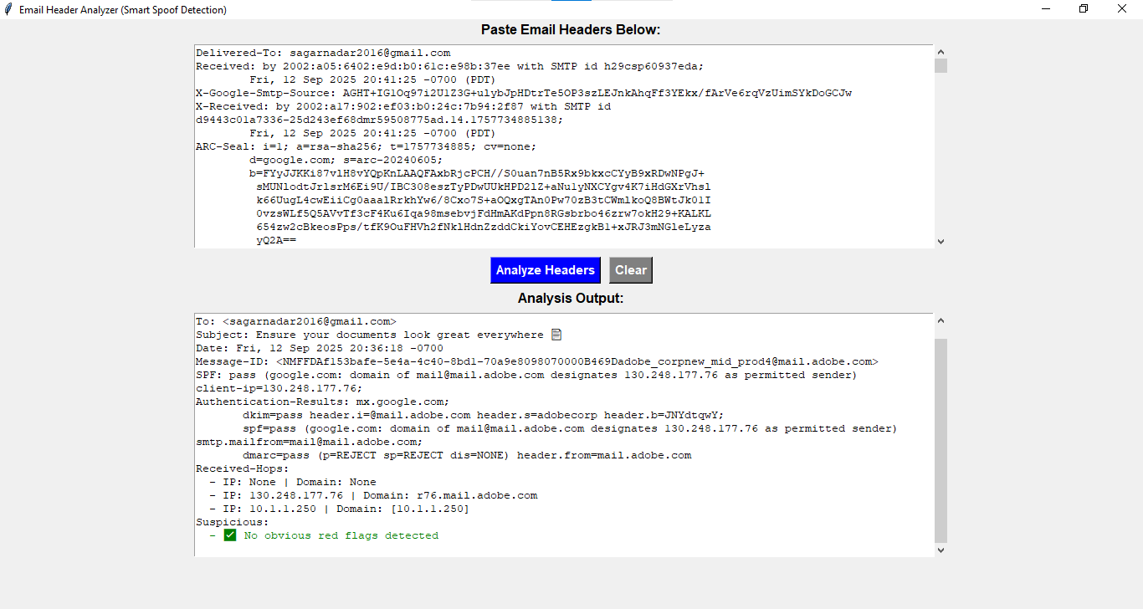
Example 1: Legitimate Email
• SPF, DKIM, and DMARC checks passed.
• Received IP addresses match the sending domain.
• No obvious red flags detected.

Slide 7
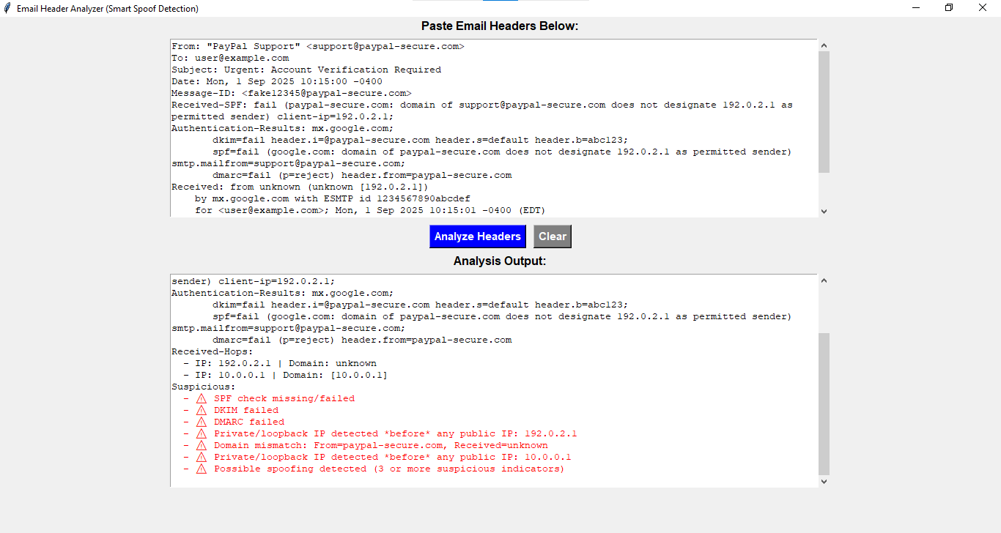
Example 2: Phishing Email
• SPF, DKIM, and DMARC checks failed.
• Private/loopback IPs detected in headers.
• Domain mismatch: Sender claims PayPal but fails authentication.
• Multiple suspicious indicators: Possible spoofing detected.

Slide 8
SAFE PRACTICES TO AVOID PHISHING
When in doubt, throw it out: Links in emails, social media posts, and online ads are common ways cybercriminals try to steal personal info. If something looks suspicious, delete it even if it looks like it’s from someone you know.
Think before you act: Be cautious of messages that urge immediate action, promise offers that seem too good to be true, or request personal information.

Slide 9
Conclusion
• Email header analysis is essential for Cybersecurity awareness.
• Legitimate emails typically pass SPF, DKIM, and DMARC checks.
• Phishing emails often fail these checks and include mismatched or private IP addresses.

