Slide 1

Mushroom Dataset Classification
Data Mining

Slide 2


Introduction
Classification is a fundamental task in data analysis and machine learning. It involves categorizing data items into predefined classes or categories based on their features or characteristics. A model is typically trained on a dataset where the classes or labels are already known, and then applied to make predictions on new data. There are various classification algorithms, such as Logistic Regression, Decision Trees, Random Forests, Support Vector Machines, and Neural Networks, each with its own strengths and weaknesses.

Slide 3

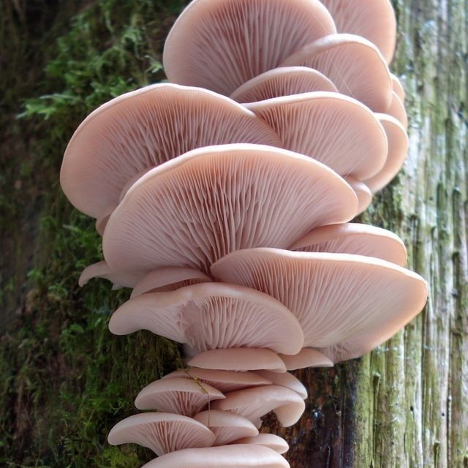
Define Task
The task in our dataset is to find out whether the type of mushroom is poisonous or not. By analyzing the input data, the output would be 1 which means “poisonous” or zero which means “edible”. We are going to use different type of classification algorithms to find which would provide the best results.

Slide 4

Dataset description
Dataset name: Mushroom classification dataset.
Source: Kaggle.
Dataset size: the dataset contains 9 attributes and 54035 records, its memory usage is 3.7MB.
Attributes: the 9 columns in the dataset describe various characteristics of the mushrooms as they are )cap diameter, cap shape, gill attachment, gill color, stem height, stem width, stem color, season, poisonous(
There are 2 float columns and 7 int columns.
Target Variable: The target variable is the "poisonous" column, which indicates whether the mushroom is "edible" (45.08% of the dataset) or "poisonous" (54.92% of the dataset).

Slide 5
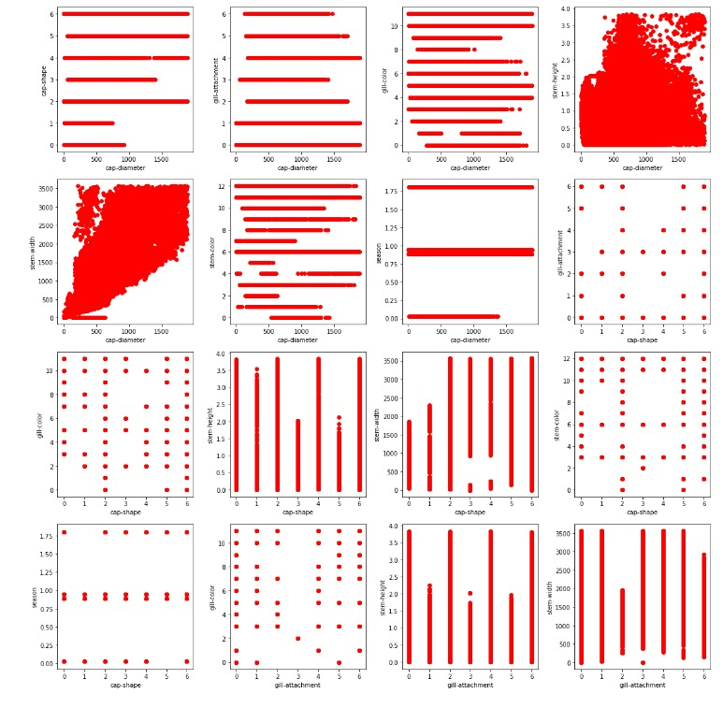

Relationship Between All Pairs Of Columns In The Dataset

Slide 6

Data Preprocessing

Slide 7

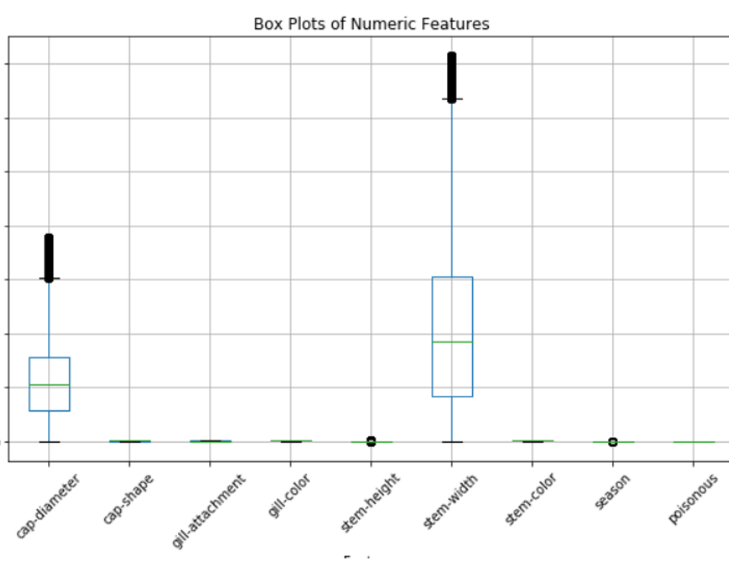
First Problem
There are some outliers specially in “Cap-diameter” and “stem-width”.
Solution
On applying Z-score way, it detected the outliers, so we dropped them. It was a total of “3827” outlier.

Slide 8


Second Problem
There are some duplicates in the dataset.
Solution
After detecting the duplicates, we dropped them from the data. It was a total of “250” duplicate.

Slide 9
Data splitting
We used "train-test-split" from "Sklearn.model selection" to split the data, "y" for "poisonous" class and "x" for the rest attributes. we applied "pd.crosstab" to examine the relationship between attributes with respect to "poisonous" class, it shows that its possible to predict if the mushroom is poisonous from the rest of the attributes.

Slide 10
Methods

Slide 11

Logistic regression (Baseline model)
By using SKlearn logistic regression lib. We applied the model on the dataset. First we applied the default parameters, the results is:
Logistic Regression model is making errors with an average squared difference of 0.3767 between the actual and predicted values and it correctly predicted the class label for 62.33% of the instances in the test set.
the confusion matrix shows that the model made 5680 true positive predictions, 3678 true negative predictions, 3195 false positive predictions, and 2492 false negative predictions.

Slide 12
Logistic regression (Baseline model)
After hyperparameter tuning:
The test accuracy become 0.6493851777999335 and the mean squared Error become 0.35061482220006646
The confusion matrix: 5928 true positive predictions, 3842 true negative predictions, 3031 false positive predictions, and 2244 false negative predictions.

Slide 13

Decision tree
We used entropy criterion with maxdepth = 3 (default) to create the decision tree model. First we applied the default parameters, the results are:
the mean is 0.3524759056164839, which means that, on average, the predicted target values are off by a squared difference of 0.352 from the actual target values.
the accuracy is 0.6475240943835161, which means that the Decision Tree Classifier correctly predicted the target variable 64.75% of the time.
The confusion matrix shows the number of true positive 4597, false positive 1728, false negative 3575, and true negative 5145 predictions made by the Decision Tree Classifier.

Slide 14
Decision tree
After hyperparameter tuning:
The test accuracy become 0.9054170820870722 and the mean squared Error become 0.09458291791292789
The confusion matrix: 7114 true positive predictions, 6508 true negative predictions, 365 false positive predictions, and 1058 false negative predictions.

Slide 15

Random forest
We used SKLearn.ensemble Random forest lib., using grid search.
The mean is 0.011365902293120638, which indicates that the Random Forest model is performing well on the dataset.
The accuracy score is 0.9886340977068794, which means that the Random Forest model correctly predicted the class label for 98.88% of the instances in the test set.
Confusion matrix shows the number of true positives 8086, false positives 85, false negatives 86, and true negatives 6788.

Slide 16
Random forest
After hyperparameter tuning:
The test accuracy become 0.9885676304420074 and mean squared error become 0.011432369557992688
The confusion matrix: 8085 true positive predictions, 6788 true negative predictions, 85 false positive predictions, and 87 false negative predictions.

Slide 17

Bagging
The MSE is 0.04971751412429379, which indicates that the model is performing reasonably well.
The accuracy score is 0.9502824858757062, which indicates that the model is performing well.
Confusion matrix shows the number of true positives 7647, false positives 223, false negatives 525, and true negatives 6650.

Slide 18
Bagging
After hyperparameter tuning:
The test accuracy become 0.9851777999335327 and the mean squared error become 0.014822200066467265
Confusion matrix: 8067 true positive predictions, 6755 true negative predictions, 118 false positive predictions, and 105 false negative predictions.

Slide 19

Boosting
We used SKLearn ensemble bagging classifier lib with maximum depth 10 and n-estimates 500.First we applied the default parameters, the results are:
The MSE is 0.012495845795945497, which is a relatively low value, indicating that the Boosting model has performed well in predicting the target variable for the test set.
The accuracy score is 0.9875041542040545, which is a relatively high value, indicating that the Boosting model has performed well in predicting the target variable for the test set.
Confusion matrix shows that the Boosting model correctly predicted 8079 instances where the true label is 1, but it incorrectly predicted 93 instances where the true label is 1 as 0. Similarly, the model correctly predicted 6778 instances where the true label is 0, but it incorrectly predicted 90 instances where the true label is 0 as 1.

Slide 20
Boosting
After hyperparameter tuning:
The test accuracy become 0.9871053506148222 and the mean squared error become 0.0128946493851778
Confusion matrix: 8072 true positive predictions, 6779 true negative predictions, 94 false positive predictions, and 100 false negative predictions.

Slide 21

Result analysis

Slide 22

Decision Tree
The decision tree model has an MSE of 0.35247590564839 and an accuracy of 0.64752409435161, which is lower than the logistic regression model but higher than the other models.
The F1-score for the "0" class is 0.66, and for the "1" class is 0.63, indicating that the model is not performing equally well for both classes.
Logistic Regression
The logistic regression model has the highest Mean Squared Error (MSE) of 0.377999335273513 and the lowest accuracy of is 0.6220006646726487 compared to the other models.
The F1-score for the "0" class is 0.56, and for the "1" class is 0.67, indicating that the model is not performing equally well for both classes.
Random Forest
It has the lowest MSE of 0.01136590222993120638 among all the models.
The accuracy is 0.98863409777068794, which is the highest among the models.
The F1-score for both the "0" and "1" classes is 0.99, indicating that the model is performing equally well for both classes.

Slide 23
Boosting
The boosting model has an MSE of 0.01249584542040545 and an accuracy of 0.98750415057955, which are very close to the random forest model.
The F1-score for both the "0" and "1" classes is 0.99, indicating that the model is performing equally well for both classes.
Bagging
The bagging model has an MSE of 0.049717514429379 and an accuracy of 0.950282485757062, which are better than the logistic regression and decision tree models but worse than the random forest and boosting models.
The F1-score for both the "0" and "1" classes is 0.95, indicating that the model is performing well for both classes.

Slide 24

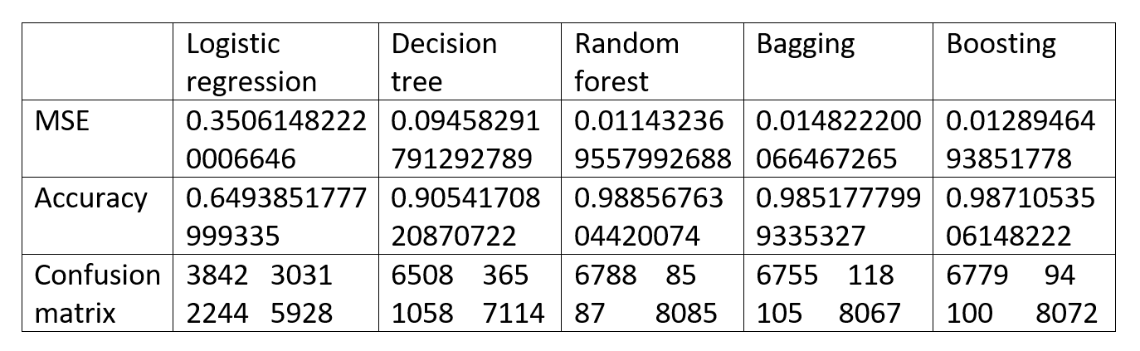
Results After Hyperparameter Tuning

Slide 25

Error Analysis
Logistic Regression
The logistic regression model has the highest error, as indicated by its high MSE and low accuracy.
The model is also not performing equally well for both classes, suggesting it may not be capturing the underlying patterns in the dataset effectively.
Logistic regression is not the best model for this classification task.
Decision Tree
The decision tree model has a higher error compared to the ensemble models, though the error has been significantly reduced after hyperparameter tuning.
The model still exhibits unequal performance across the two classes, indicating that it may not be the optimal choice.
Random Forest, Bagging, and Boosting
These ensemble models have the lowest errors, with very low MSE and high accuracy.
They also perform equally well on both classes, as shown by the equal F1-scores.
These ensemble models are the best choices for this classification task, with the random forest and boosting models being the top performers.

Slide 26
Conclusion
Through the experimental simulation and evaluation of various classification algorithms, we have observed the performance of each model in predicting whether a mushroom is edible or poisonous based on its features.
The ensemble models, particularly the random forest and boosting, are the recommended choices for this mushroom dataset classification problem, as they consistently outperform the logistic regression and decision tree models in terms of both performance and error analysis.
The results demonstrate the importance of hyperparameter tuning in improving the performance of the models. The decision tree model, in particular, showed significant improvement in accuracy after hyperparameter tuning. The results also highlight the potential impact of data preprocessing on model performance, as the removal of outliers and duplicates improved the accuracy of all models.

Slide 27
Future work
We could explore the use of other classification algorithms, such as Support Vector Machines (SVM) or k-Nearest Neighbors (k-NN), to determine if they perform better than the current models. We could also consider using dimensionality reduction techniques, such as Principal Component Analysis (PCA), to reduce the number of features and improve the computational efficiency of the models.
Finally, we could deploy the best-performing model in a real-world application, such as a mobile app or a web service, to help users determine whether a mushroom is safe to eat or not. This would require further testing and validation to ensure the model's accuracy and reliability in different environments and scenarios.

Slide 28



Team Members
Nada Salah El-Deen
Nourhan Amr
Eman Deyaa El-Deen

Slide 29
Thank You

