Slide 1
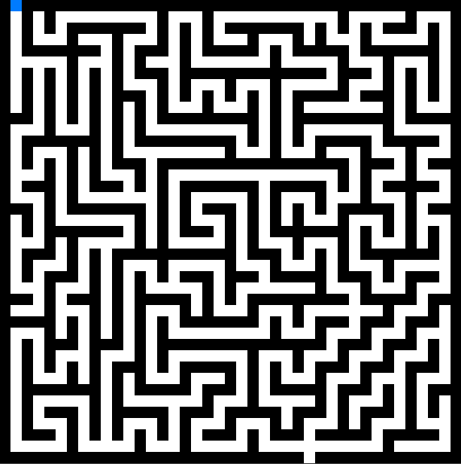
Infinity Maze
Made By:
Nadav Bitran Numa
Avichai Gal Or
Course:
Programming in the internet environment
Lecturer:
Nissim Brami

Slide 2
About The Project
Project Overview:
Embark on an exciting maze game where users can explore an endless array of generated perfect mazes.
Compete for top spots on the leaderboards as you navigate through mazes of various sizes and difficulties.

Slide 3
More In Depth…
What is Perfect Maze?
”A perfect maze is a maze where every point is reachable and where there is only one single path from one point in the maze to any other point” (Michael Krimgen, from Baeldung)
How the mazes are generated?
The mazes are generated with BFS and DFS shortest path algorithms inside our server

Slide 4
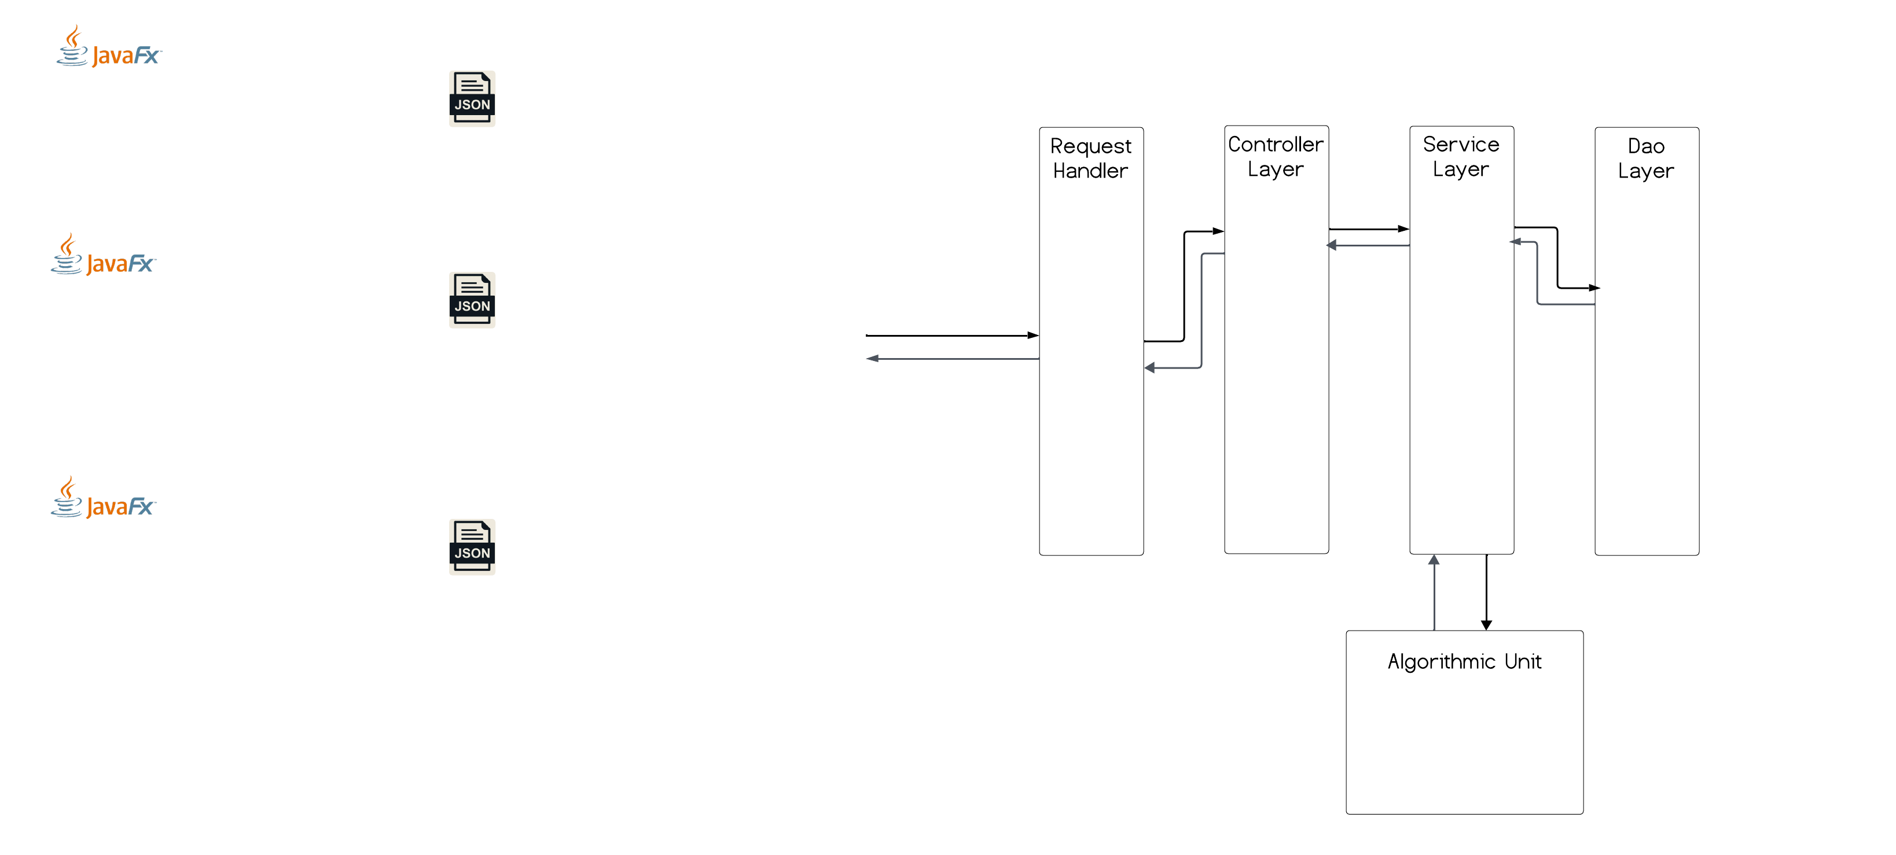
Project Architecture

