Slide 1
Methods
GRU (Neural network)
Displaying function distribution in sessions.
PCA
K-means with and without running PCA
Hierarchical Clustering with and without PCA
Displaying amount of sessions per user.
Searching for connections in the data.

Slide 2
Session-based Recommendations with Recurrent Neural Networks
Average number of sessions per user is 3.43
Therefore we wanted some way to predict the user’s activity while having small number of sessions
Session-based recommendations are good when we don’t have knowledge about the users. For example: new users or users who rarely return.

Slide 3
Session-based Recommendations with Recurrent Neural Networks
Used implementation of the algorithm of the "Session-based Recommendations with Recurrent Neural Networks" paper, published at ICLR 2016 (two month ago)
Real-life recommender systems often face the problem of having to base recommendations only on short session-based data instead of long user histories. In this situation matrix factorization approaches are not accurate.
In the session-based recommendation we can consider the first item a user clicks when entering a web-site as the initial input of the RNN, we then would like to query the model based on this initial input for a recommendation. Each consecutive click of the user will then produce an output (a recommendation) that depends on all the previous clicks.

Slide 4



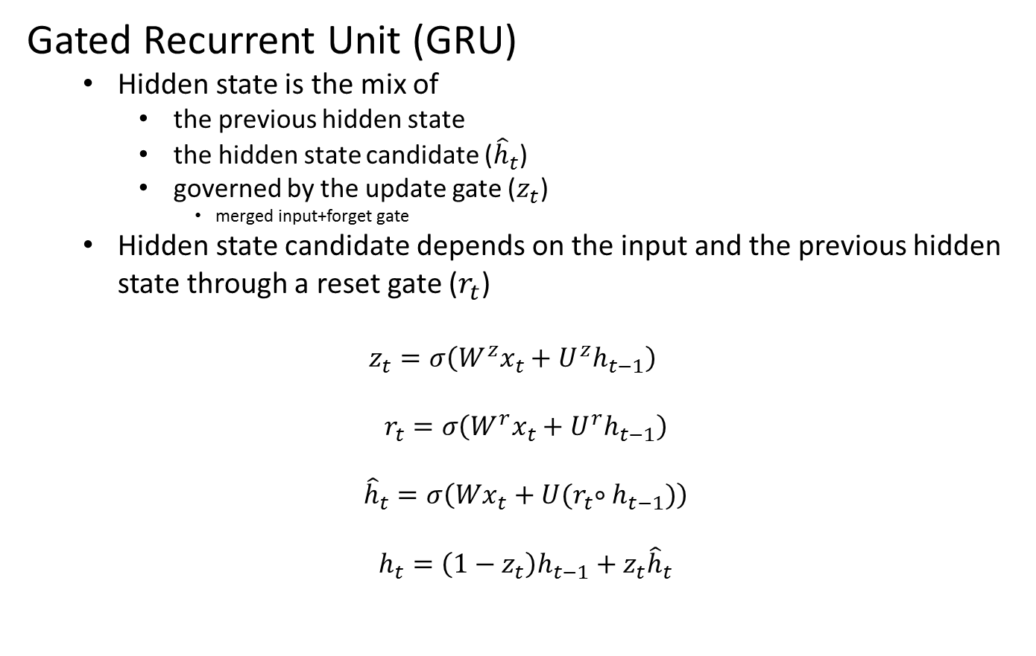



Session-based Recommendations with Recurrent Neural Networks
Gated Recurrent Unit (GRU)
Hidden state is the mix of
the previous hidden state
the hidden state candidate (${\hat{h}}_{t}$)
governed by the update gate ($z_{t}$)
merged input+forget gate
Hidden state candidate depends on the input and the previous hidden state through a reset gate ($r_{t}$)
$z_{t}=σ\left(W^{z}x_{t}+U^{z}h_{t−1}\right)$
$$r_{t}=σ\left(W^{r}x_{t}+U^{r}h_{t−1}\right)$$
$${\hat{h}}_{t}=σ\left(Wx_{t}+U{(r}_{t}∘h_{t−1})\right)$$
$$h_{t}=\left(1−z_{t}\right)h_{t−1}+z_{t}{\hat{h}}_{t}$$
$$z$$
$$x_{t}$$
$$h$$
$$r$$
$$\hat{h}$$
$$h_{t}$$

Slide 5
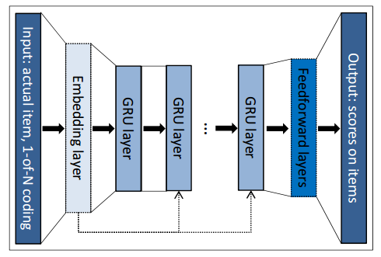
Session-based Recommendations with Recurrent Neural Networks
The input of the network is the actual state of the session while the output is the item of the next method in the session.
The input vector’s length equals to the number of methods and only the coordinate corresponding to the current method is one, the others are zeros (1-of-N encoding)
The output is the predicted preference of the methods, i.e. the likelihood of being the next in the session for each method

Slide 6
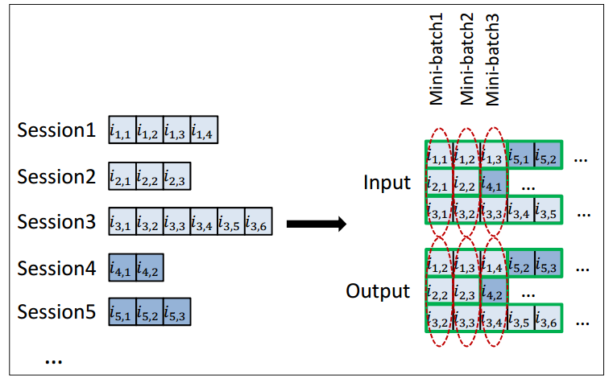
Session-based Recommendations with Recurrent Neural Networks
SESSION-PARALLEL MINI-BATCHES
Create an order for the sessions
The first event of the first X sessions form the input of the first mini-batch (the desired output is the second events of our active sessions). The second mini-batch is formed from the second events and so on. If any of the sessions end, the next available session is put in its place.

Slide 7
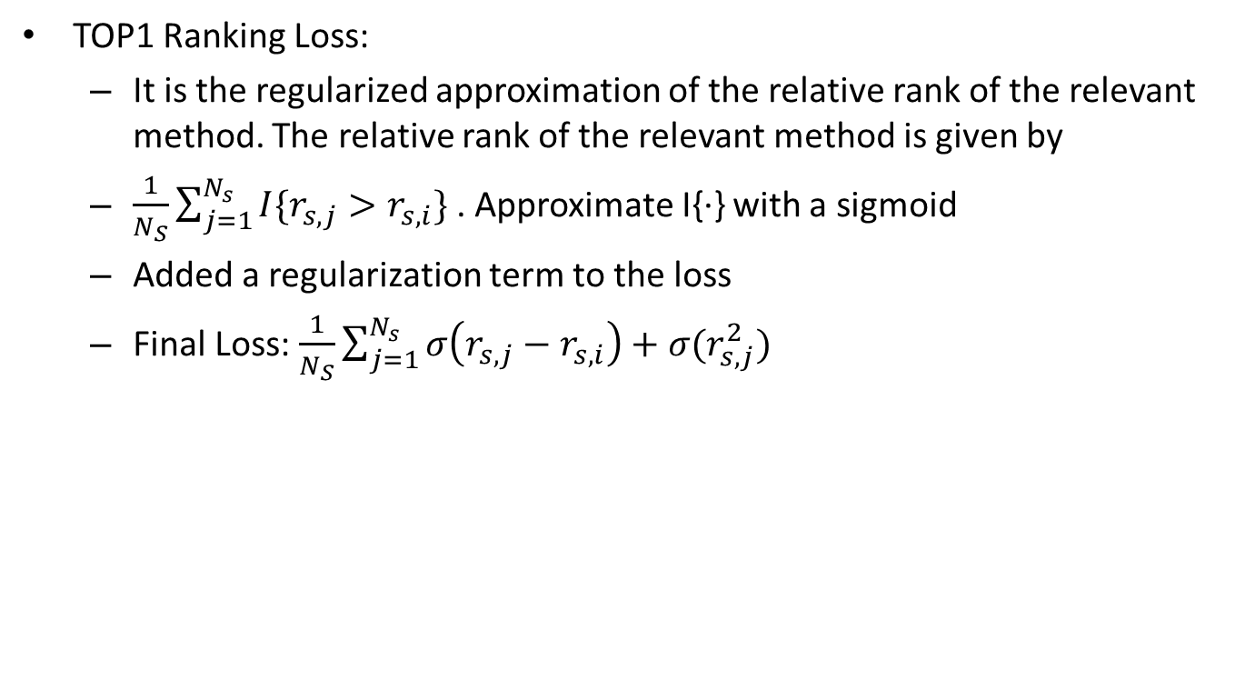
Session-based Recommendations with Recurrent Neural Networks
TOP1 Ranking Loss:
It is the regularized approximation of the relative rank of the relevant method. The relative rank of the relevant method is given by
$\frac{1}{N_{S}}\sum_{j=1}^{N_{s}}{I\{r_{s,j}>r_{s,i}\}}$ . Approximate I{·} with a sigmoid
Added a regularization term to the loss
Final Loss: $\frac{1}{N_{S}}\sum_{j=1}^{N_{s}}{σ\left(r_{s,j}−r_{s,i}\right)+σ(r_{s,j}^{2})}$

Slide 8
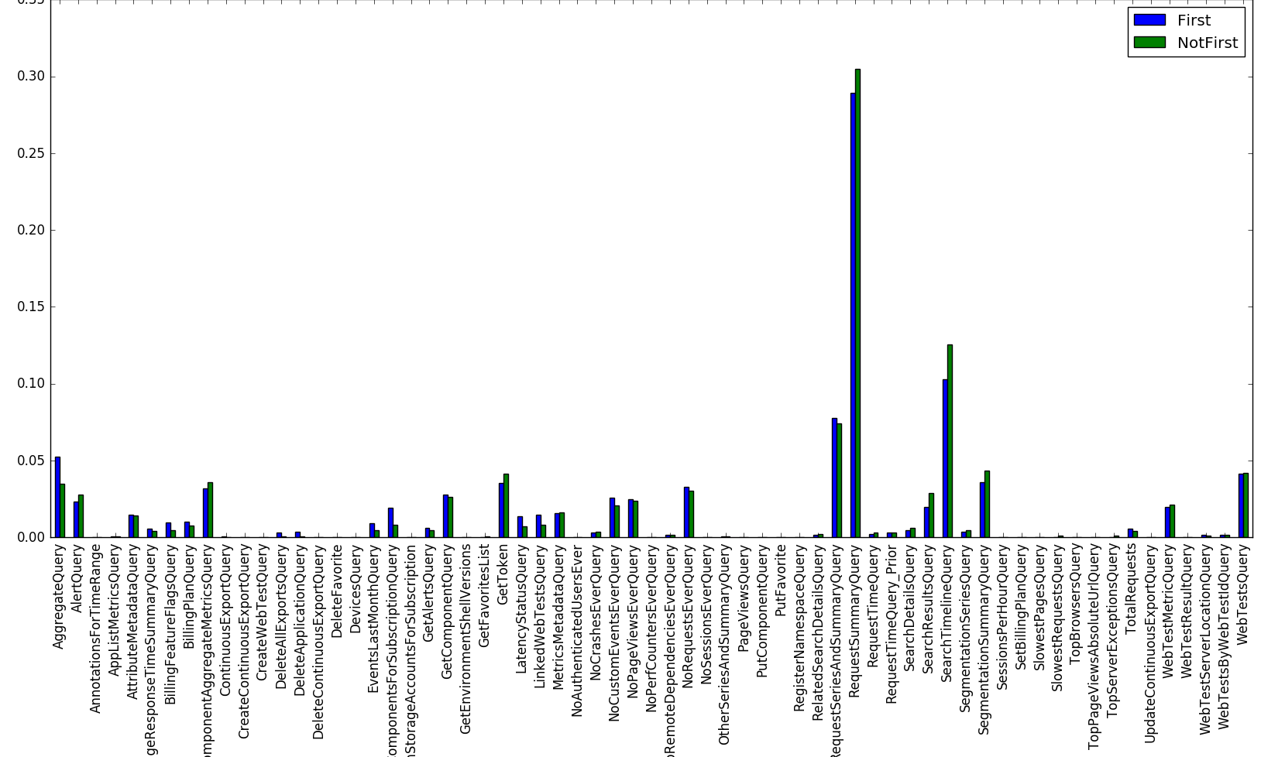
Comparing queries of new and experienced users
Using the tag “IsFirst” we have examined the types of queries made by experienced users compared to new users in the application:

Slide 9
Comparing queries of new and experienced users
It is visible that there are several dominant queries:
RequestSummaryQuery
SearchTimelineQuery
RequestSeriesAndSummaryQuery

Slide 10
Comparing queries of new and experienced users
New users don’t seem to send different queries than those who logged in before. The most visible differences between experienced and new users are:
New users send more AggregateQuery.
New users send more BillingFeatureFlagQuery, BillingPlanQuery and ComponenetsForSubscriptionquery.
Experienced users send more SearchTinelineQuery, SearchResultsQuert and SegmentationSeriesQuery.

Slide 11
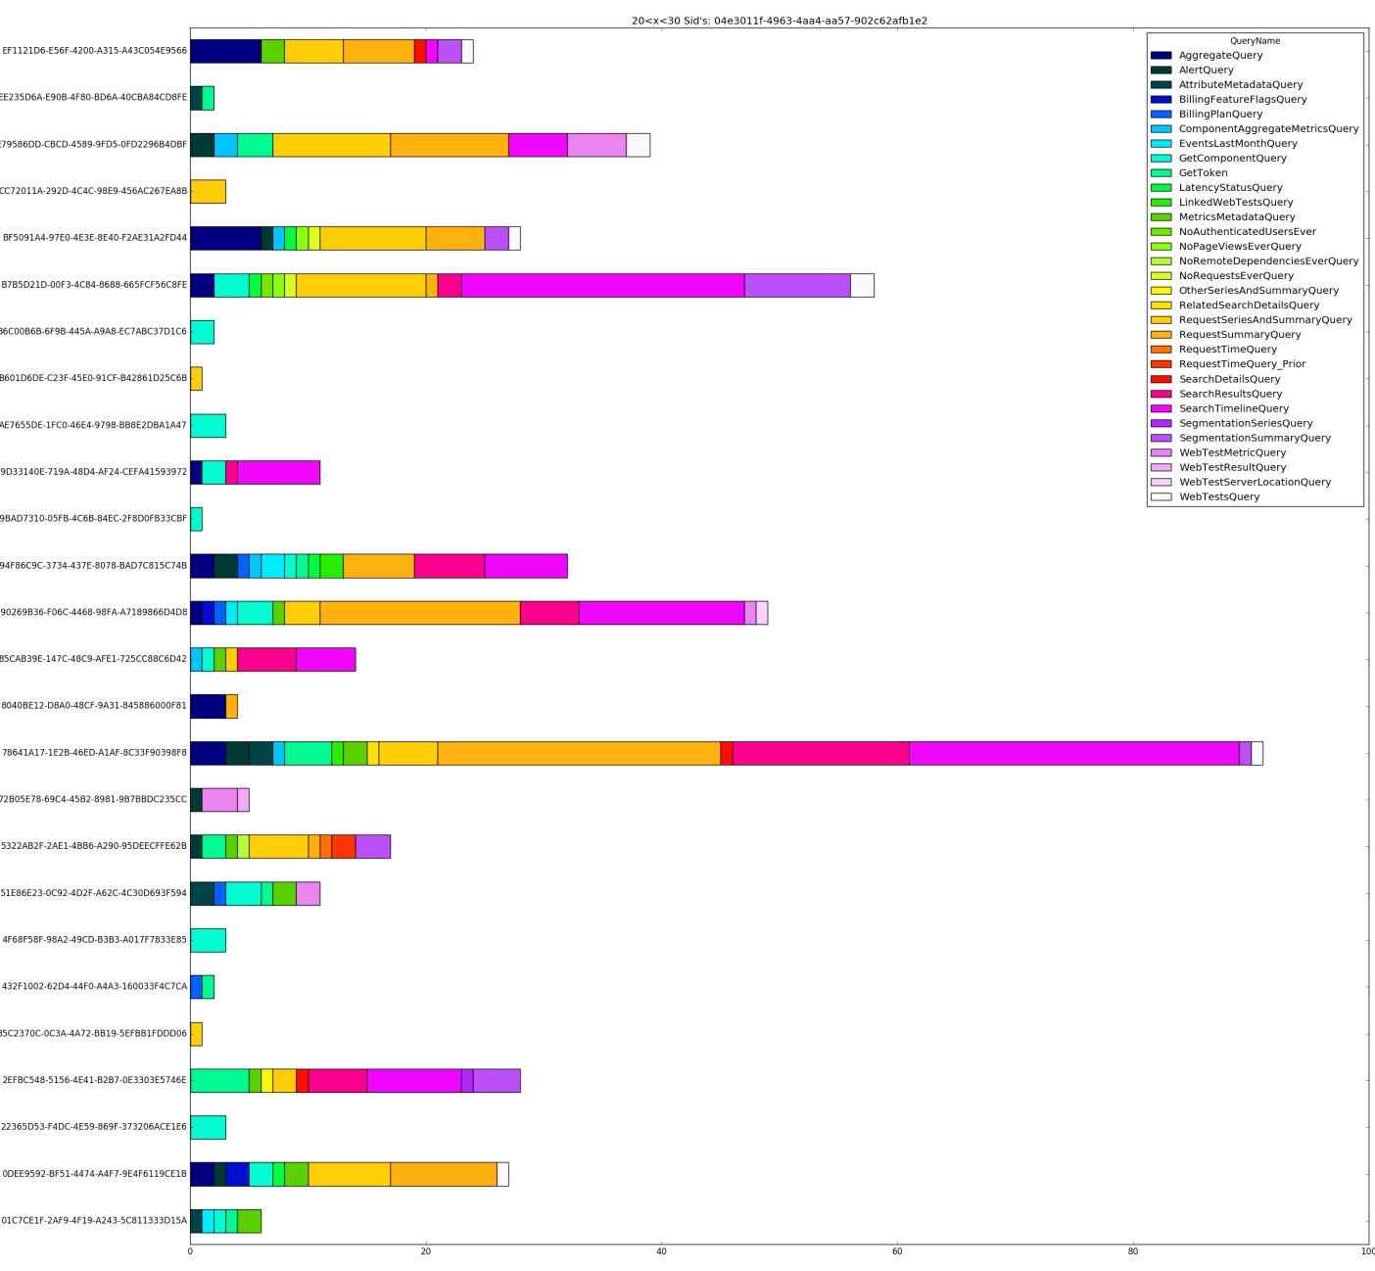
Displaying function distribution in sessions
Looking at a user with between 20 and 30 sessions.

Slide 12
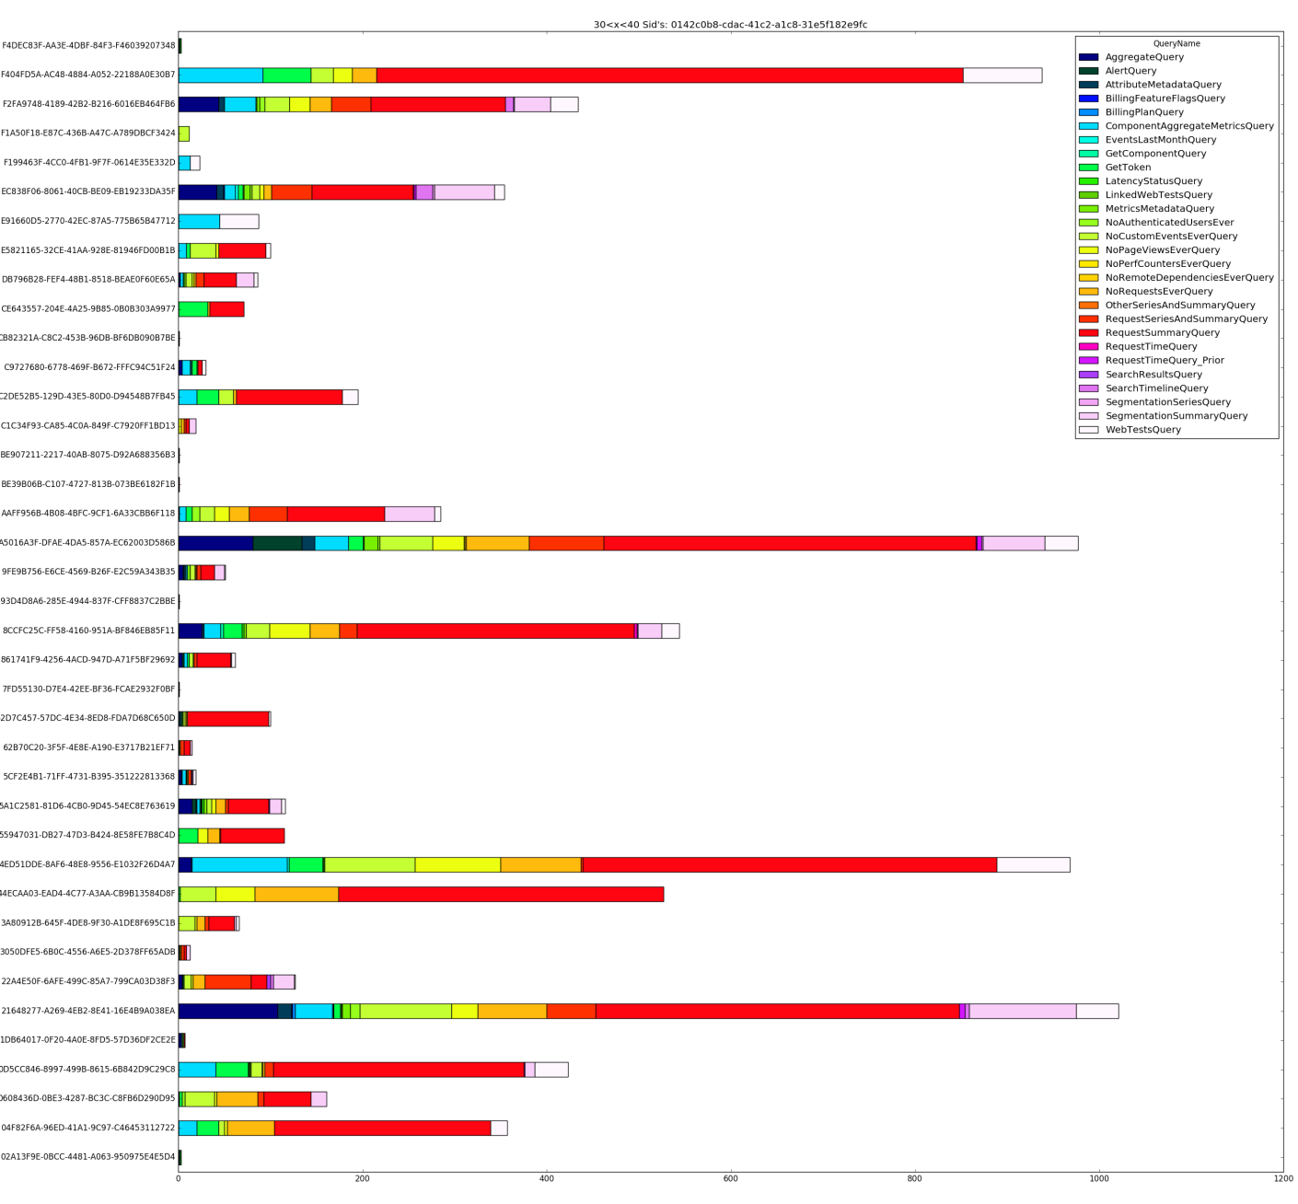
Displaying function distribution in sessions
Looking at a user with between 30 and 40 sessions.

Slide 13
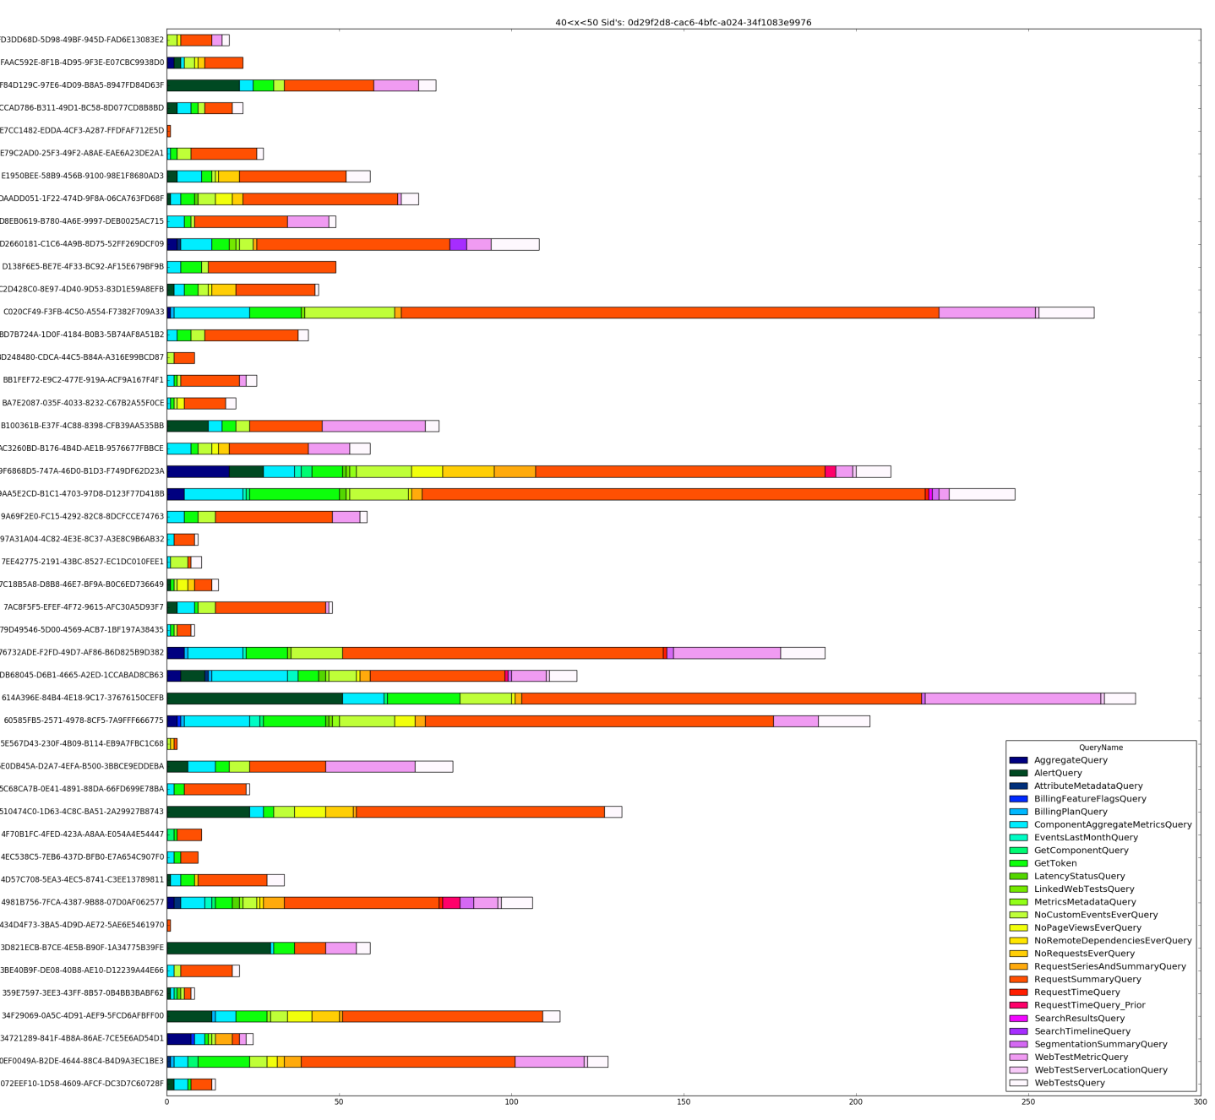
Displaying function distribution in sessions
Looking at a user with between 40 and 50 sessions.

Slide 14
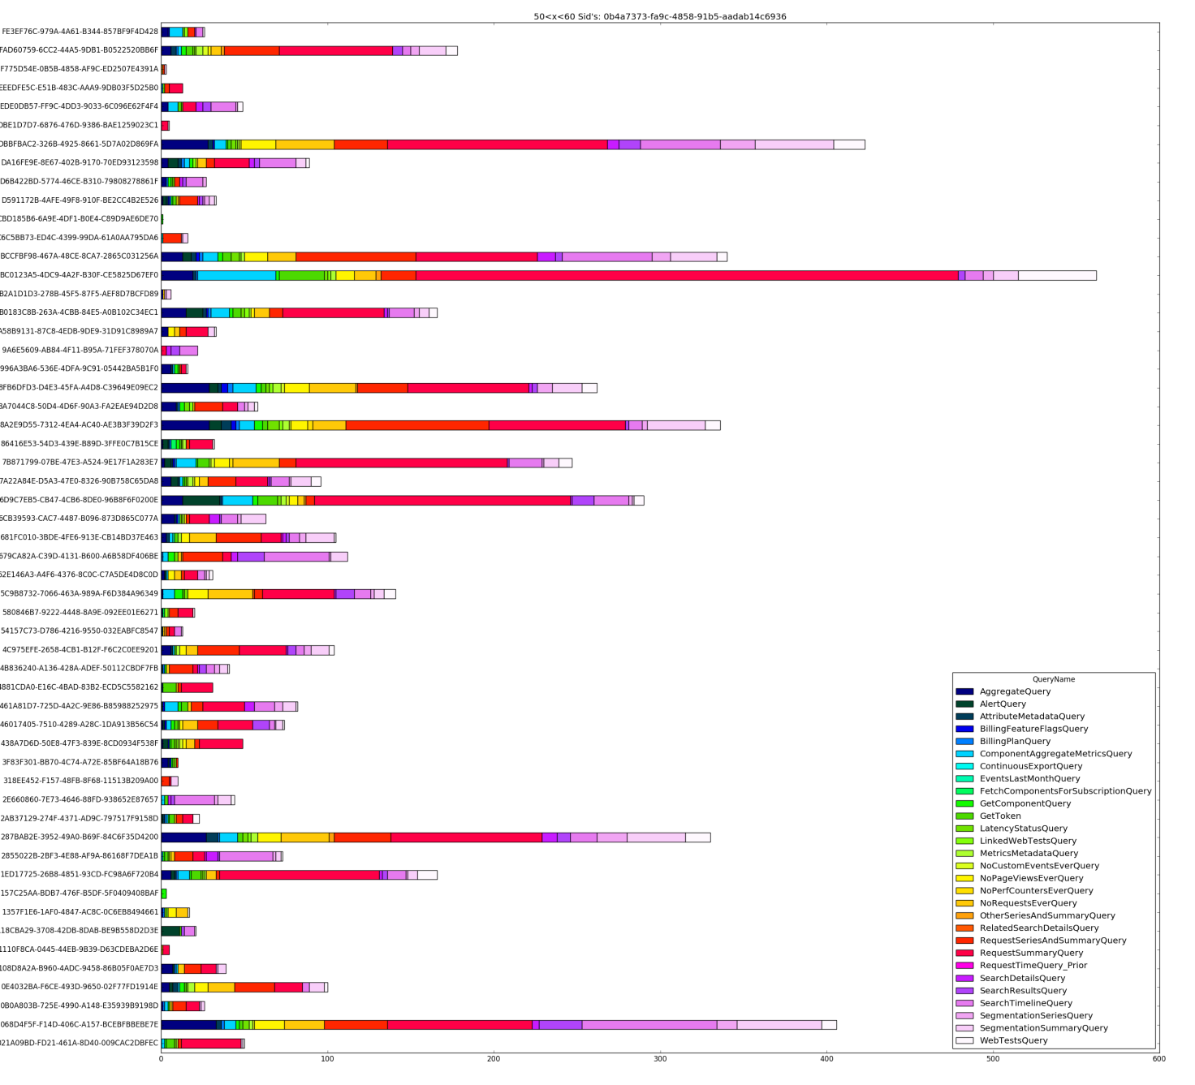
Displaying function distribution in sessions
Looking at a user with between 50 and 60 sessions.

Slide 15
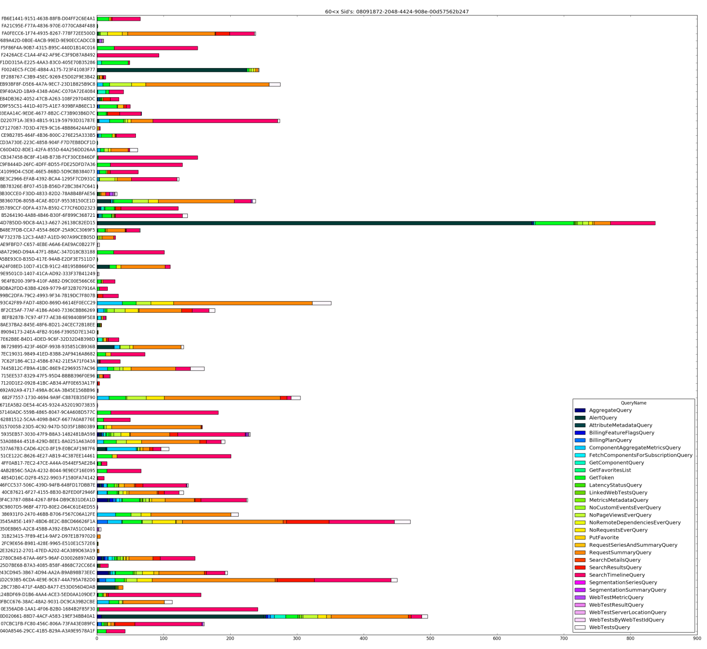
Displaying function distribution in sessions
Looking at a user with above 60 sessions.

Slide 16
Remarks - looking at specific users
For the users with above 30 sessions, about half of the sessions are considerably short, meaning that there are less than 100 queries per session, while some sessions may reach 1000 queries. However, the first user had only short sessions, most of length below 20.
Looking at the first user (20< queries <30), we can see that the most common queries are:
RequestSeriesandSummaryQuery
RequestSummaryQuery
SearchResultsQuery
SearchTimelineQuery
SegmentationSummaryQuery
GetTokenQuery

Slide 17
Remarks - looking at specific users
Examining the second user (30< queries <40), we can see that RequestSummaryQuery is the most common query in his sessions.
The longer sessions are similar, having the queries:
AggregateQuery
ComponentAggregateMetricsQuery
AlertQuery
GetToken
NoCustomEventsEverQuery
NoPageViewsEverQuery
NoRequestsEverQuery
RequestsSeriesandSummaryQuery
RequestSummaryQuery
SegmentationSummaryQuery
WebtestsQuery

Slide 18
Remarks - looking at specific users
The third user’s (40 < queries < 50) behavior is similar to the second user, but his sessions are shorter compared to the second user’s sessions.

Slide 19
Remarks - looking at specific users
The fourth user (50 < query < 60) behavior is very similar to the last two users, while adding the queries:
SearchResultsQuery
SearchTimelineQuery
SegmentationSeriesQuery
SegmentationSummaryQuery

Slide 20
Remarks - looking at specific users
The last user behavior (60 < queries) is similar to the previous users, while his rate of short sessions is higher (over 60% of his sessions are shorter than 100 queries). His common queries are:
ComponentAggregateMetricsQuery
GetTokenQuery
NoRequestsEverQuery
RequestsSummaryQuery
SearchResultsquery
WebTestQuery
NoPageViewsEverQuery

Slide 21
K-Means Clustering
First, we have tried to cluster users according to the Ajax queries they have invoked in the application.
The vectors were created using a “One of K” vector (aka “hot-one” vector) decoding.
The clusters were tested for k ranging from 2 to 24, using the Euclidian matric.
The clustering was performed over normalized and non normalized vectors. The normalized vectors were multiplied by 100 for better readability of the outcomes.
The clustering was performed over Sids and Aids.

Slide 22
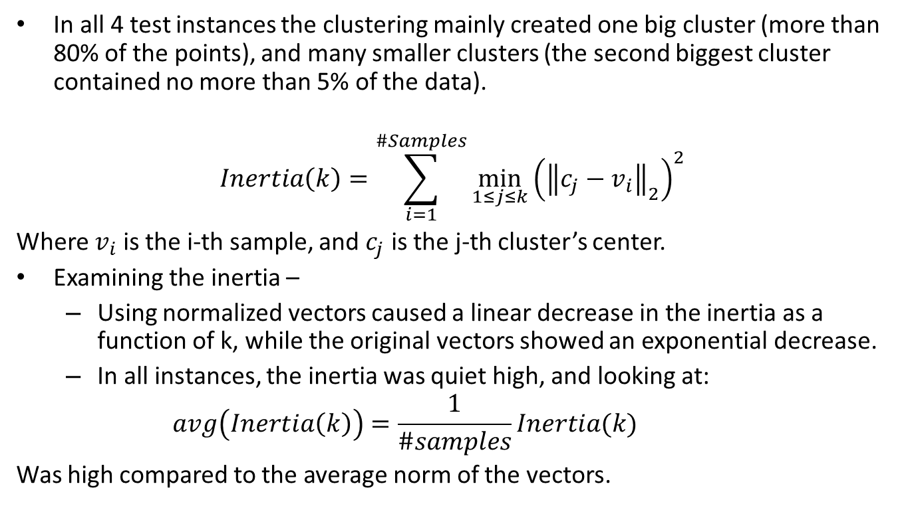
Results of K-Means
In all 4 test instances the clustering mainly created one big cluster (more than 80% of the points), and many smaller clusters (the second biggest cluster contained no more than 5% of the data).
$$Inertia\left(k\right)=\sum_{i=1}^{\#Samples}{\min_{1≤j≤k}{{\left({\left\|c_{j}−v_{i}\right\|}_{2}\right)}^{2}} }$$
Where $v_{i}$ is the i-th sample, and $c_{j}$ is the j-th cluster’s center.
Examining the inertia –
Using normalized vectors caused a linear decrease in the inertia as a function of k, while the original vectors showed an exponential decrease.
In all instances, the inertia was quiet high, and looking at:
$$avg\left(Inertia\left(k\right)\right)=\frac{1}{\#samples}Inertia(k)$$
Was high compared to the average norm of the vectors.

Slide 23
Results of K-Means
Inertia value by Aid without normalization
Inertia value by Aid with normalization

Slide 24
Results of K-Means
Inertia value by Sid without normalization
Inertia value by Sid with normalization

Slide 25
The Size of Clusters created for k=5
Cluster sizes for sid pivot
Cluster sizes for Aid pivot
Percentage of the data | Cluster size | Cluster number
92.3% | 89301 | 1
6.35% | 6148 | 2
0.1% | 97 | 3
0.03% | 32 | 4
1.22% | 1178 | 5
Percentage of the data | Cluster size | Cluster number
97.35% | 27869 | 1
0% | 1 | 2
0% | 1 | 3
2.45% | 702 | 4
0.2% | 56 | 5

Slide 26
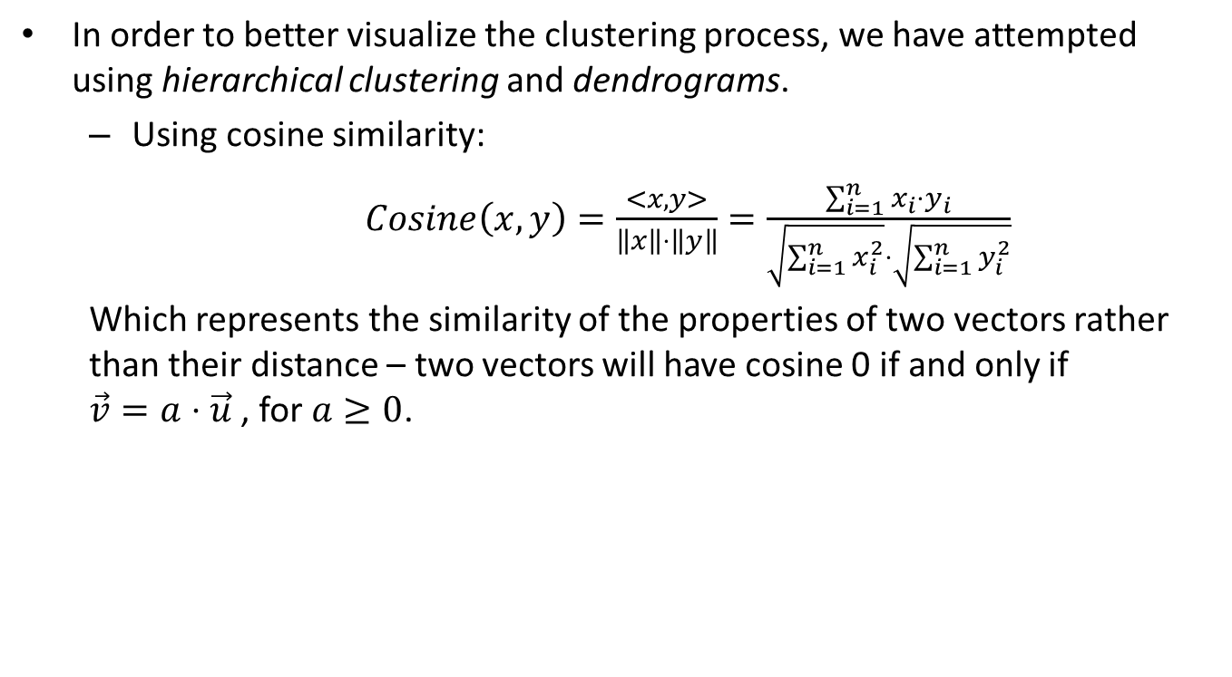
Hierarchical Clustering
In order to better visualize the clustering process, we have attempted using hierarchical clustering and dendrograms.
Using cosine similarity:
$Cosine\left(x,y\right)=\frac{<x,y>}{\left\|x\right\|⋅\left\|y\right\|}=\frac{\sum_{i=1}^{n}{x_{i}⋅y_{i}}}{\sqrt{\sum_{i=1}^{n}{x_{i}^{2}}}⋅\sqrt{\sum_{i=1}^{n}{y_{i}^{2}}}}$
Which represents the similarity of the properties of two vectors rather than their distance – two vectors will have cosine 0 if and only if $\vec{v}=a⋅\vec{u}$ , for $a≥0$.

Slide 27
Principal Component Analysis
After acquiring the previous results, we have attempted lowering the problem’s dimensionality using PCA.
We have applied PCA on the matrix we have obtained by one-hot encoding the vectors by Sids and Aids.
After acquiring the optimal number of components, we have reconstructed the matrix by looking at the projection of the original vectors to the linear sub-space spanned by the most significant singular vectors.
Looking at the singular values, we have deduced that there are only 5 relevant singular vectors, therefore, we have reduced the matrix to the projection to the matching sub-space.

Slide 28
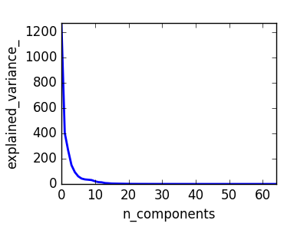
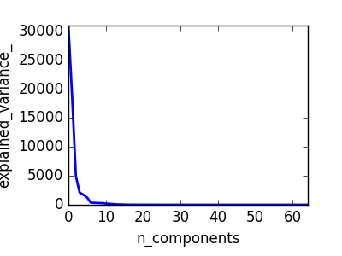
Principal Component Analysis
PCA results for pivot Sid
PCA results for pivot Aid

Slide 29
Hierarchical Clustering after PCA

Slide 30
Retention rate is very low
28,629 unique users used application insights in October, 2015
Average number of sessions per user is 3.43
79.5% of the unique users are using the site 3 times or less

Slide 31
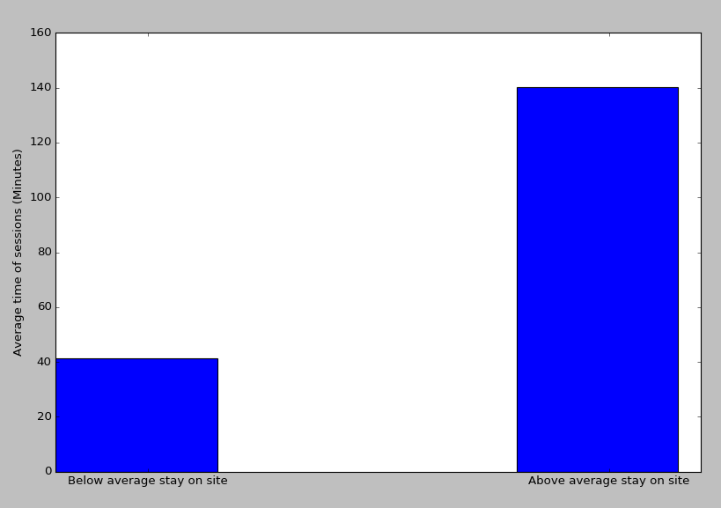
Session duration for users that visited the site more than 3 times is significantly higher than those who visited 3 times or less
Average duration per session
Calculated using Welch's t-test (p-value below 0.001)

Slide 32
Comparing amount of logins of “new” and “experienced” users
Overall, there are 28629 unique users (counted by Aid).
19211 users logged in for the first time during October, these are 67.1% of the users.
9418 users logged in prior to October, and we consider these as “experienced” users.
Overall, 22759 haven’t logged in more than 3 times during October.
15451 of the “new” users logged less than 3 times, which is 80.4% of the users.
7308 of the “experienced” users logged less than 3 times, which is 77.6% of the users.
The ratio of new users out of those who haven’t logged in more than 3 times is 67.9% .

