Slide 2
Retention rate is very low
28,629 unique users used application insights in October, 2015
Average number of sessions per user is 3.43
79.5% of the unique users are using the site 3 times or less

Slide 3
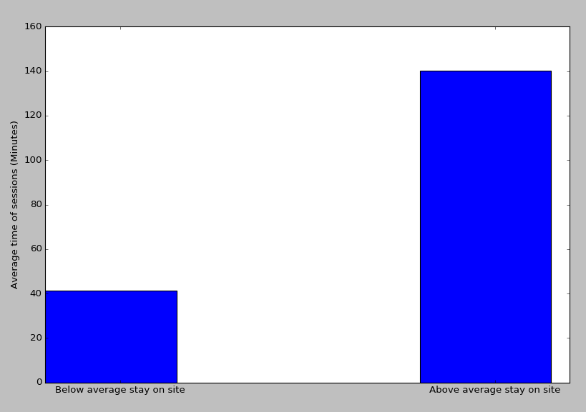
Session duration for users that visited the site more then 3 times is significantly higher than those who visited 3 times or less
Average duration per session
Calculated using Welch's t-test (p-value below 0.001)

