Slide 1


Proofs of Retrievability
(PoR)
Nadav Shaked
Hagar Aloni
Yuval Terry
Applied Cryptography

Slide 2


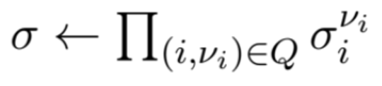





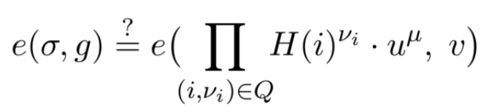
Proofs of Retrievability
(PoR)
Applied Cryptography

Slide 3
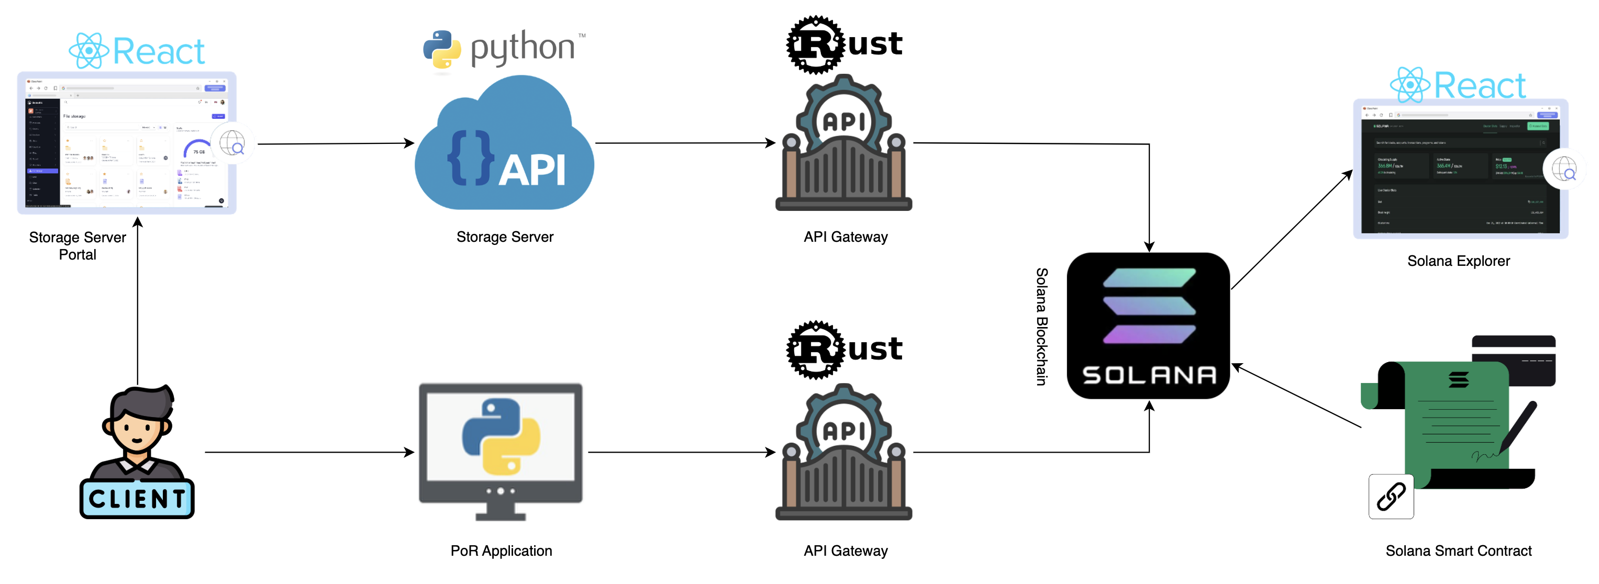
System Architecture
Notes:
תחתון – הגר
עליון - נדב

Slide 4

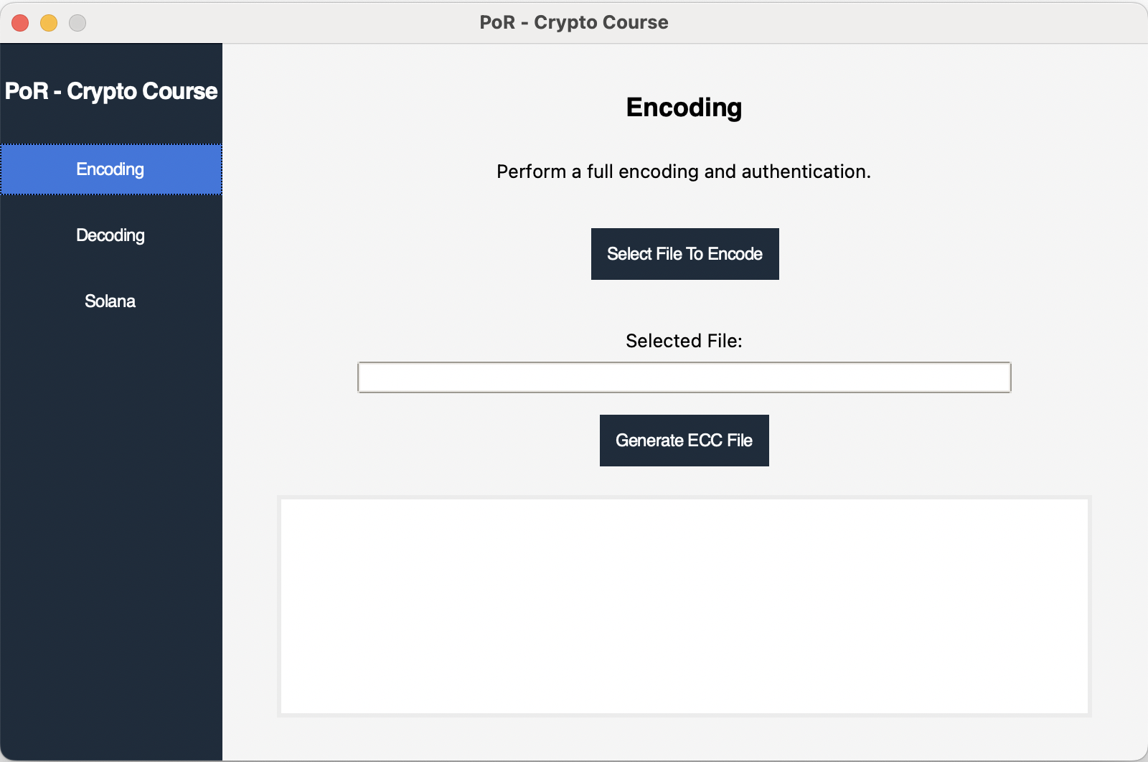

Notes:
הגר

Slide 5


Original File
Encoded File
by Reed Solomon
Encoded File
Separated to Blocks
Encoded File
with Authenticators
Notes:
הגר

Slide 6
Encoded File
Separated to Blocks
Encoded File
with Authenticators
Notes:
הגר

Slide 7

Original File
Encoded File
by Reed Solomon
Encoded File
Separated to Blocks
Encoded File
with Authenticators
Notes:
הגר

Slide 8

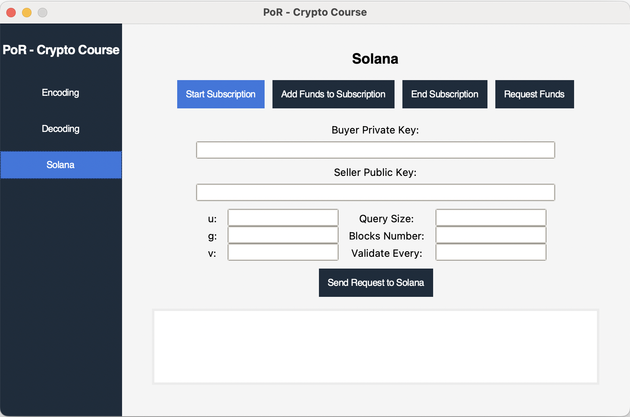
Notes:
נדב

Slide 9
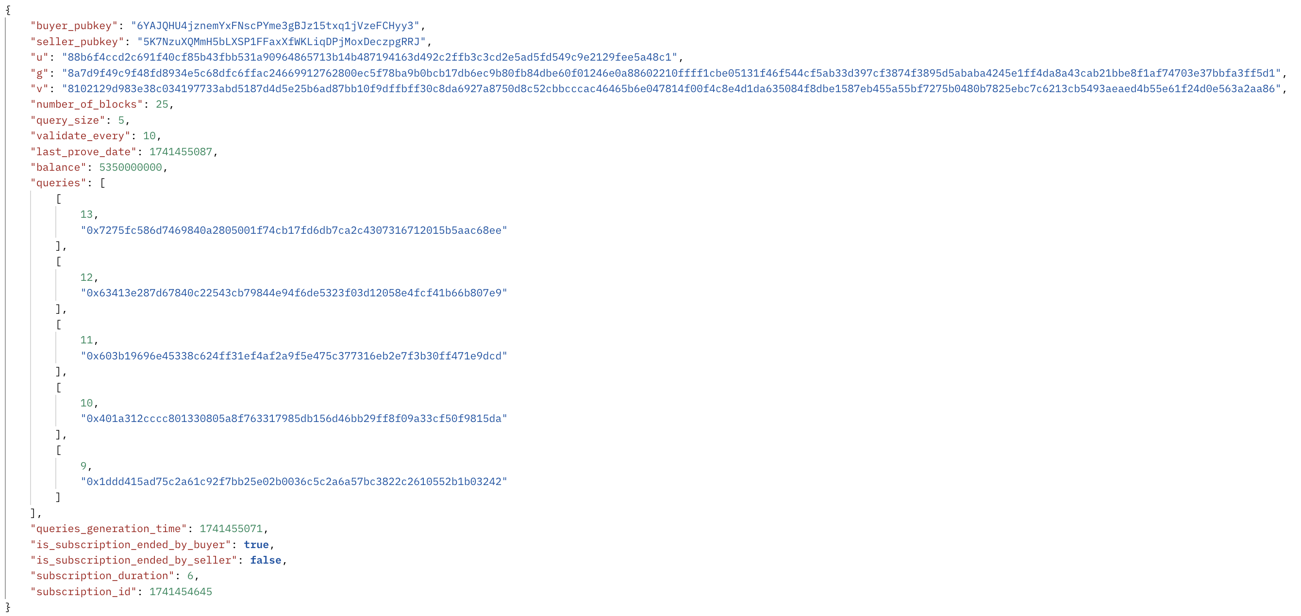
Notes:
נדב

Slide 10

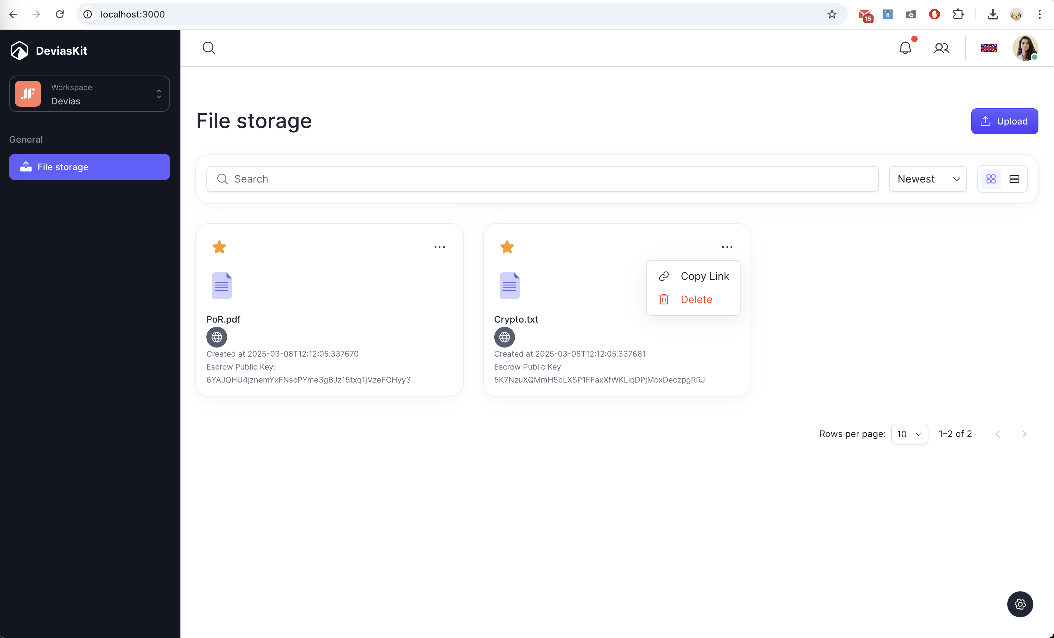
Notes:
נדב

Slide 11
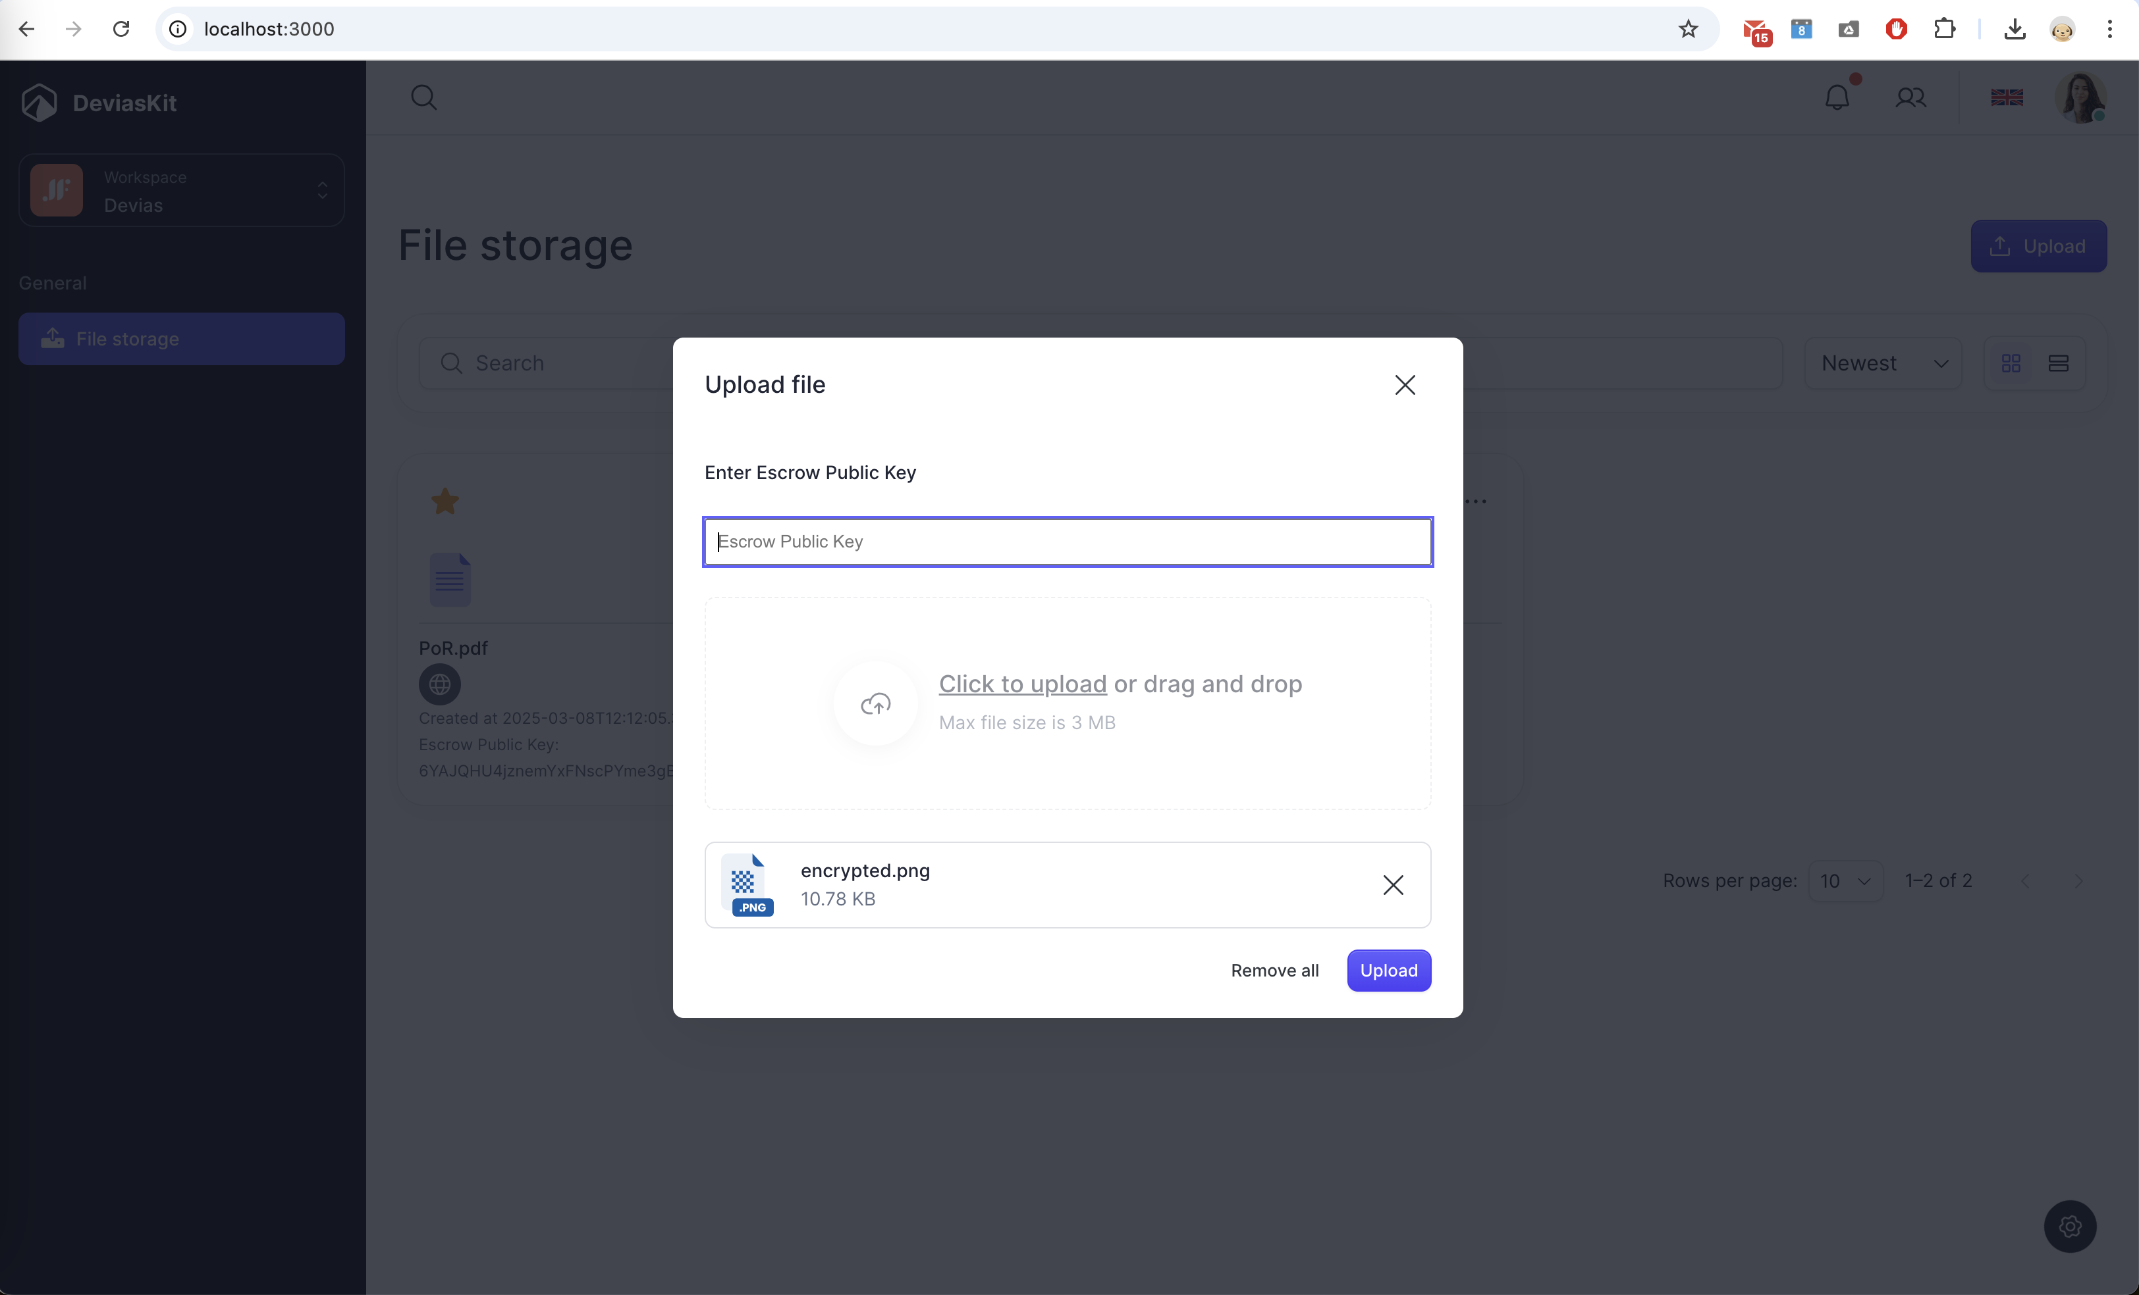
Notes:
נדב

Slide 12




Storage Server
API for
File Storage System
Management
Scheduled Job for
Stored files proving
Upload File
Every 30 seconds
go over the files
and send a prove if needed
Download File
Get Files
Prove For File
Delete File
Corrupt File
Notes:
הגר

Slide 13




Storage Server
Set Q = {(i, v_i)}
Calculate
sigma and mu
Notes:
נדב

Slide 14
Storage Server
Set Q = {(i, v_i)}
Calculate
sigma and mu
Notes:
נדב

Slide 15
Demo
Applied Cryptography

Slide 16
Thank you!
Applied Cryptography

