Slide 1
HTTP 2 The Next Gen of the Web
Version 0.7, dd 12/03/2017
Dr. Robert Iakobashvili, robert@Ghotit.com

Slide 2
HTTP 1.1 Deficiencies
Lack of Server Updates. Lack of Partial Page Updates.
HTTP was born by:
Inheriting SMTP headers
Trying to keep it simple with Stateless Request-Response Model (RRM)
Stateless RRM was challenged by the Internet Stores, Banking and other stateful requirements and:
Progressed to Stateful RRM (cookies, etc.)
Still, HTTP 1.1 Web-Server cannot send updates. Thus, web-client app should either:
Make polling for updates
Use websockets package
Still, there’s no option for a partial web-page update. To cope with, applications are doing:
Minification: defining resources, iFrames, script-loaded logic, etc.
AJAX development

Slide 3
HTTP 1.1 Deficiencies
Clear Text. Head-of-Line Blocking
Headers are sent as a clear text
It could be many headers and some be lengthy
It occupies some bandwidth and sometimes could be slow due to TCP slow-start algorithm
It can disclose too much info about the server/client
Parsing is not simple with white-space options
Error-prone parsing translates to errors which in their turn are translatable to security vulnerabilities.
HTTP/1.1 allows only one outstanding (not answered) request at a connection
It leads to a “head-of-line blocking” and attempts to address it via pipelining
HTTP/1.1 pipelining could be also stalled, difficult to implement and not so effective

Slide 4
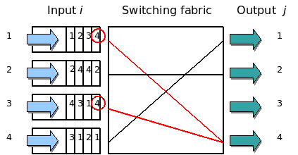
HTTP 1.1 Deficiencies
Head-of-Line-Blocking
Thanks to Wikipedia:
HTTP/1.1 pipelining stalls when a large or slow response blocks others
One of the best solutions is to allow fully parallel processing with unlimited outstanding requests allowed.

Slide 5
HTTP 1.1 Deficiencies
Multiple TCP/IP Connections
How many connections does your browser open?
Open the Wireshark and count.
Why do we need multiple connections with HTTP/1.1?
Why do all browsers prefer multiple TCP/IP connections to HTTP-pipelining over a single one?
What means a single connection for a web-server? How much resources does it take?
Which impact multiple connections do have on network and on TCP congestion control?
Which advantages could have a single connection with full multiplexing?

Slide 6
HTTP 2 - Introduction
Who created it? Known implementations.
IETF’s HTTP Working Group
RFC 7540: https://tools.ietf.org/html/rfc7540
Originally, it was based of Google’s SPDY/2 (Mike Belshe and Roberto Peon) but further changed
Fully compatible with HTTP/1.1
Includes HTTP Version Negotiation Mechanism to ensure seamless inter-operability with 1.1 (Header – Upgrade)
Supported at the client side: Chrome, Safari, IE-11, Edge, Firefox
Supported by the servers:
Apache – full support since 2.4.27, module mod_http2
Microsoft IIS – since Win-10 and Win-Server-2016
Ngnix – from 1.9.5
Supported by CDNs: Akamai, CDN77, Claudflare, AWS CloudFront

Slide 7
The Big Server Push
The Big White Shark 1
HTTP/1.1 Browser gets a page
The browser parses it and detects the links and the resources (images, iframes, CSS) required
The browsers opens several TCP connections to get the resources in parallel
All that suffers of RTTs and opening of multiple connections
Instead, HTTP 2 browser gets a page with all dependent resources ready to use – thanks to the Server Push of the resources

Slide 8
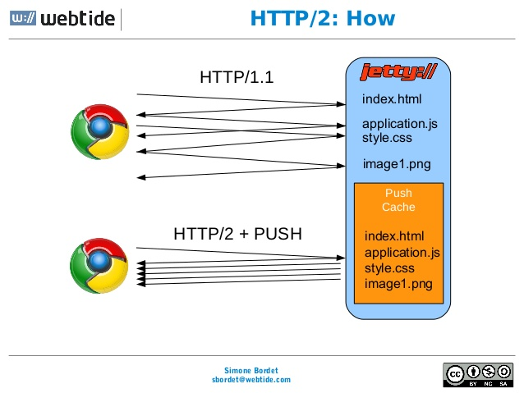
The Big Server Push
The Big White Shark 2

Slide 9
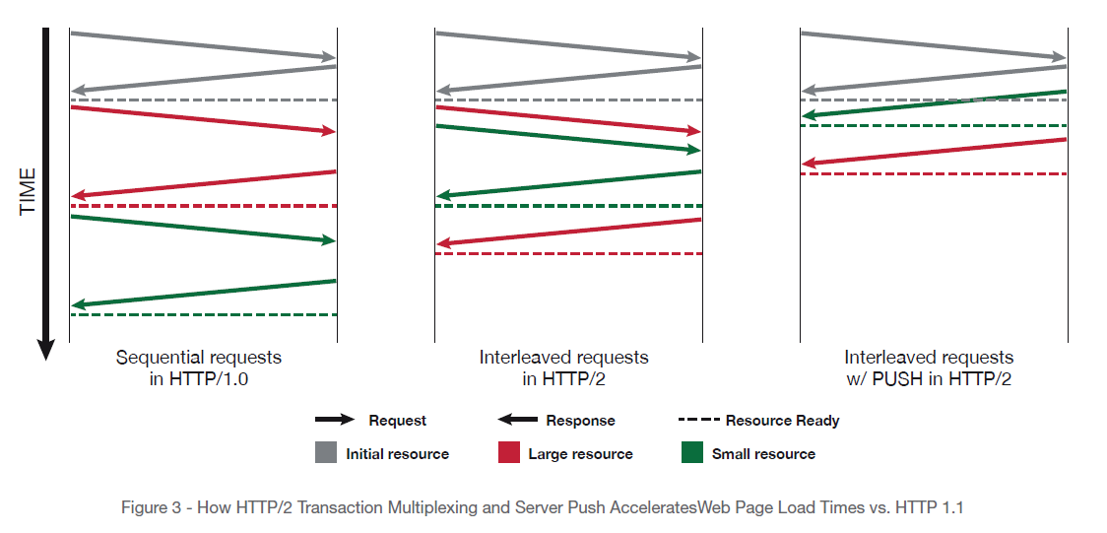
The Big Server Push
The Big White Shark 3

Slide 10
A Single Server Connection
… but with Multiplexing
HTTP 2 browser is using a single connection with multiplexing, any number of outstanding (not answered) requests:
Saves server-side resources
Not stalls with “head-of-line blocking”
More fairly loads potentially congested networks making CA to work properly
Enables “true pipelining” with multiple request and response messages to be in flight at the same time

Slide 11
Binary and Headers Compression
Déjà Vu – Back to 70s-80s
Binary means robust and reliable
For example 4-ways to parse in HTTP 1.1 (https://www.w3.org/Protocols/rfc2616/rfc2616-sec4.html#sec4.4) versus a single way for HTTP 2 (https://tools.ietf.org/html/rfc7540#section-4.1)
But binary is less flexible and debugging requires in-depth understanding of the protocol
Wireshark plugin is the expert: https://bugs.wireshark.org/bugzilla/show_bug.cgi?id=9042
HTTP Headers are passed compressed
It was demonstrated that long (uncompressed) headers can impact TCP Slow Start and make the transfer much longer.

Slide 12
Compression Under Attack
Security Driven Protocol Design
SPDY/2 had a single gzip context
CRIME schema is effective to break it and leak sensitive info: https://en.wikipedia.org/wiki/CRIME_(security_exploit)
Attacker observes the size of the cipher-text sent by browser and directs the browser to the target web-site
The attacker then observes the change in size of the compressed request payload containing both the secret cookie/message and the variable content created by the attacker
Making the variable content smaller and smaller the secret message could be extracted
Prevention: don’t use compression or use HPACK (HTTP 2)
BREACH is a general exploit for compressed HTTP https://en.wikipedia.org/wiki/BREACH_(security_exploit)

Slide 13
Compression Under Attack
Security Driven Protocol Design
HTTP 2 uses HPACK, RFC-7541
https://tools.ietf.org/html/rfc7541
HPACK is Huffman based
HPACK is more robust without known vulnerabilities

Slide 14
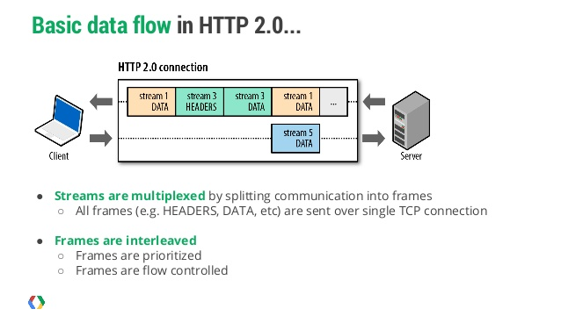
Basic Data Flow
Streams of Headers and Data

Slide 15
Encryption
To encrypt, or not to encrypt
Encryption is NOT a MUST
No support for Opportunistic Encryption / STARTTLS
But the discussion continues
Browsers do require encryption and that makes it de-facto requirement
HTTP/2 defines a profile of TLS that is required:
The minimum version – TLS 1.2
A cipher-suite blacklist
Extensions: Server Name Indication is a MUST
Target domain name MUST be stated upon TLS negotiation
More details like TLS 1.2 MUST disable compression, etc.
See at: https://tools.ietf.org/html/rfc7540#section-9.2

