Slide 1

Advanced Computer Architectures Project
Nadav Yosef Zada 208825257
Chen Kruphman 323101311

Slide 2

Our Project
We would like to use existing CNN that are trained on image and numeric classification, to classify our genomic data to its different lineages.
We will check several CNNs and compare their results, seeing which one fits our data the best, and classify with the best accuracy. The networks we will work with:
CNN with 1D convolution layers
CNN with Embedding layer
Image Classification Using Forward-Forward Algorithm

Slide 3
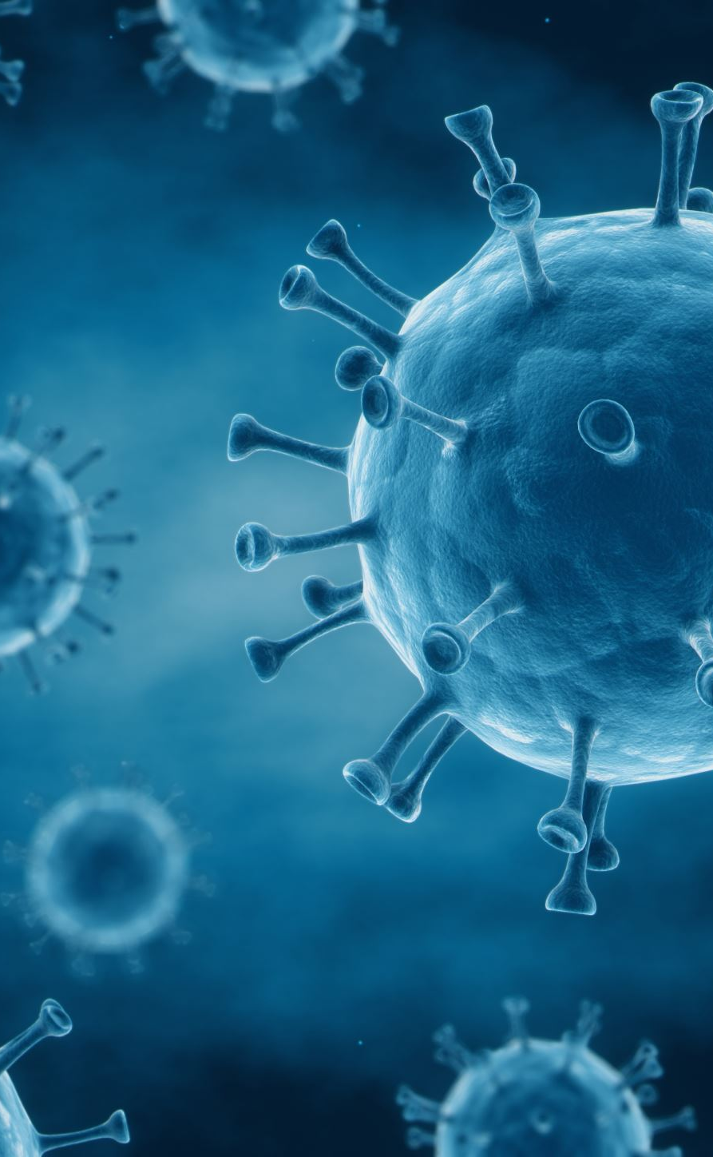
Our Data
Our data is comprised of Covid-19 genomic sequences of different lineages, from distinct evolutional stages of the virus (Beta, Eta, Zeta, Lambda, Mu).
Each lineage contains thousands of accessions (uniquely identified FASTA files), and the accessions of each lineage will be separated to train and test data.
This results in enough data for training, but not too much data so we could save them all on the memory for the training and testing.
After the training with the known labels of each accession (knowing his original lineage) we will try to classify the test accessions to their correct lineage.

Slide 4
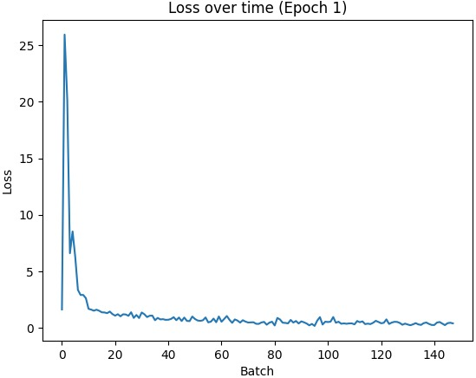
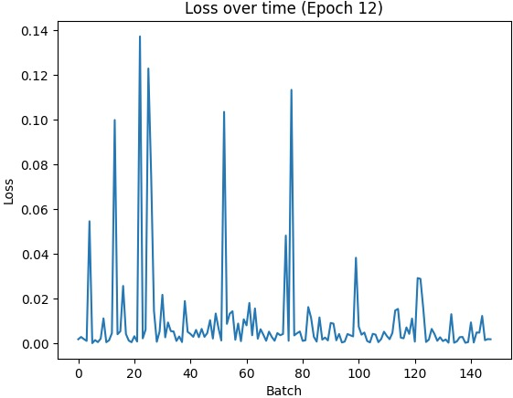
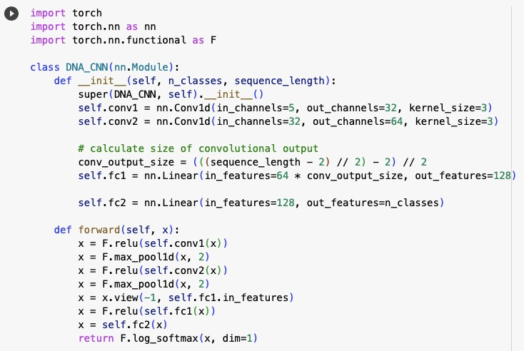
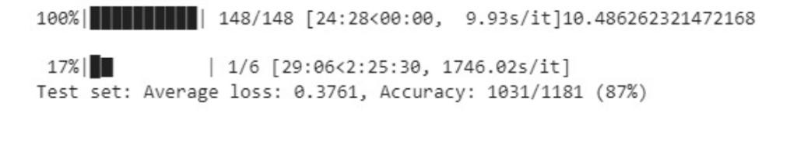
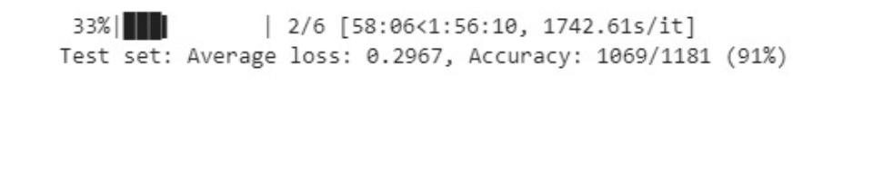

CNN with 1D convolution Layers

Slide 5
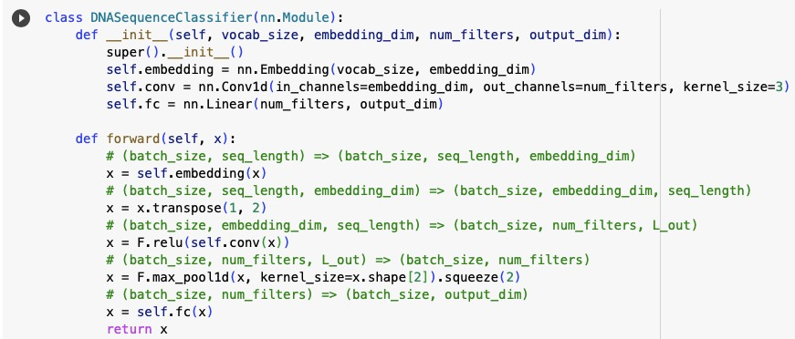
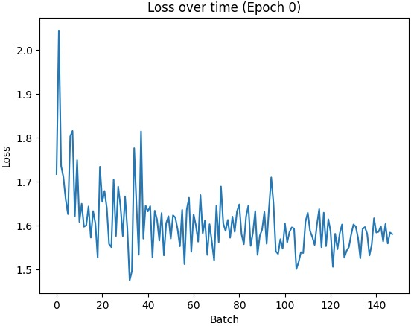
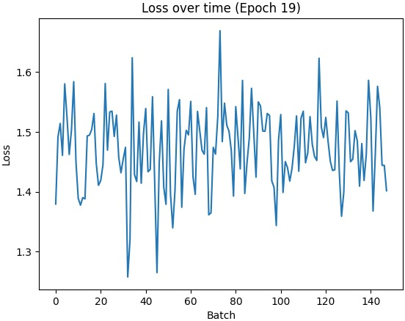
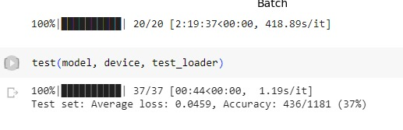
CNN with Embedding Layer

Slide 6
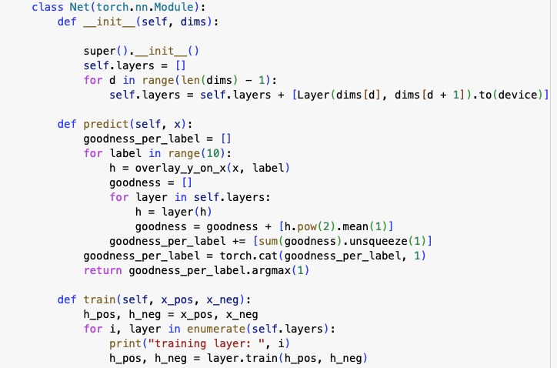
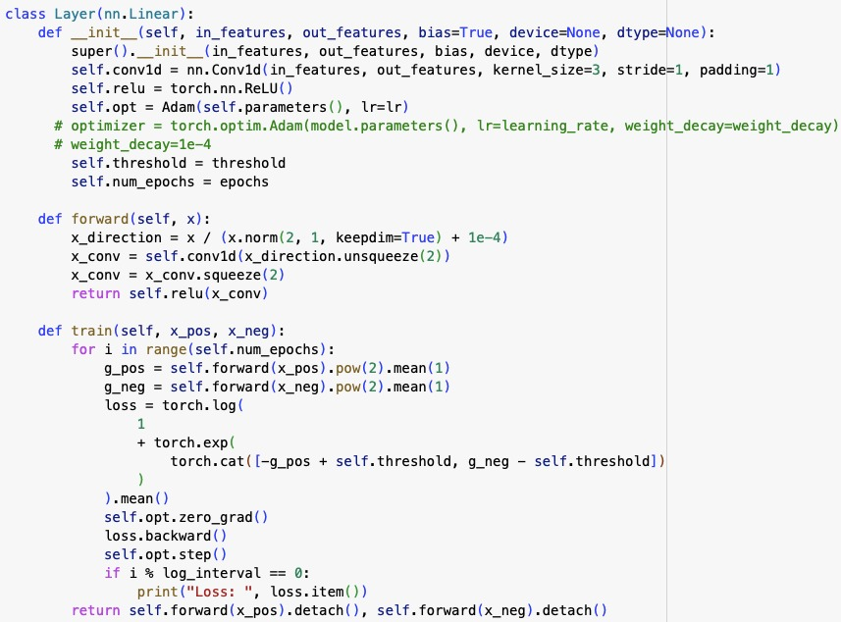

CNN with Forward-Forward Algorithm

