Slide 1

Project by:
Ayesha Aleena(22361A0516)
Ayesha Anjum (22361A0517)
Mohammed Abdullah Adnan(22361A0565)
Mohammed Nadeemullah Khan(22361A0568)
Supervised by:
-Dr. Guru Raghavendra Reddy Sir.
HOD(CSE).

Slide 2

BRAIN BATTLE
Enhancing Learning through Interactive Quiz Applications

Slide 3
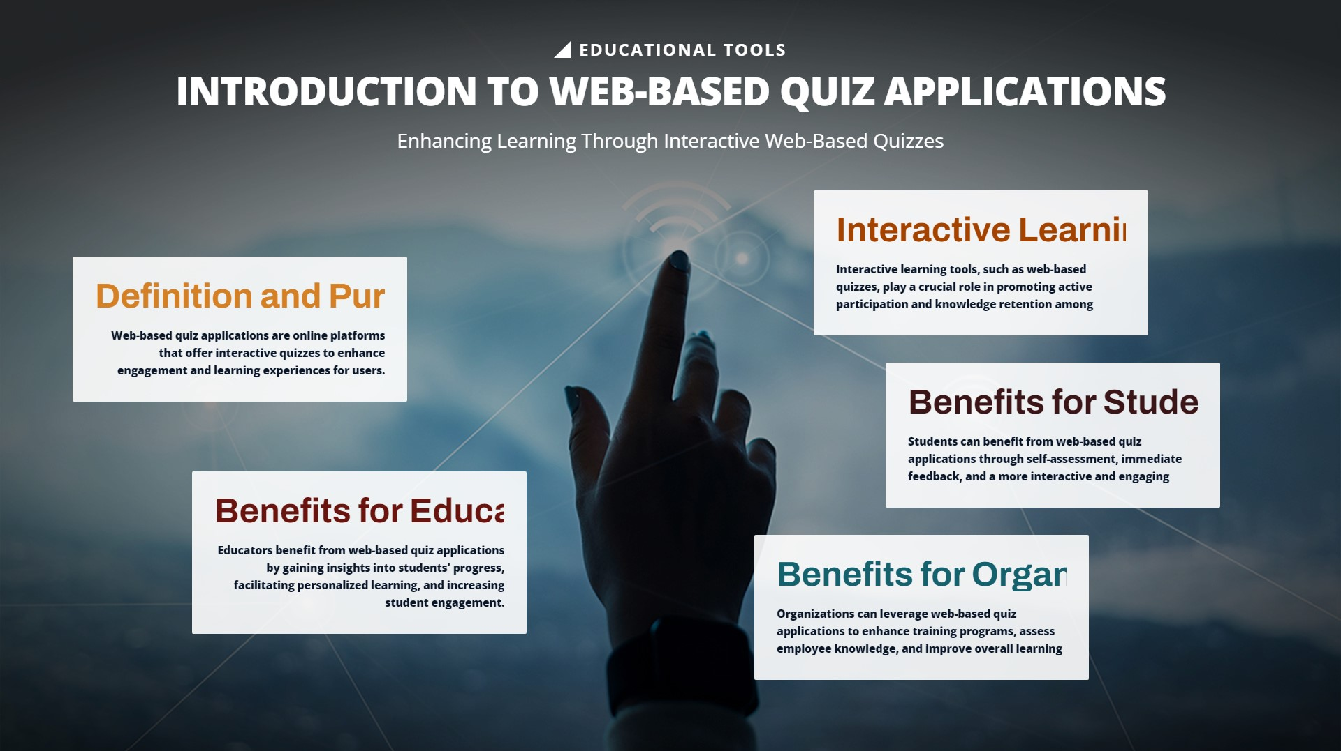
Username Input:
Users can enter their username to personalize their quiz experience. This feature allows for tracking individual performance over time.
User friendly interface:
Our application is designed with a simple and intuitive interface, making it easy for users of all ages to navigate and use.
High Scores Display:
Keep track of your progress and strive to beat your personal best with our high scores feature. Users can view their highest scores and compare them with others.
Submit Button and Popup on Time Completion:
When the time is up, or when the user finishes the quiz, they can submit their answers. A popup will notify users that their time is up or that they have successfully submitted their answers.
Time Limit:
Each quiz comes with a time limit to add an extra layer of challenge. The countdown timer ensures that users stay engaged and focused.

Slide 4

Interactive quizzes promote active participation and critical thinking.
They offer immediate feedback, which allows students to identify areas for improvement. Moreover, these quizzes can be tailored to individual learning needs, making them an effective tool for personalized learning.
The use of multimedia in quizzes also enhances engagement and knowledge retention.

Slide 5
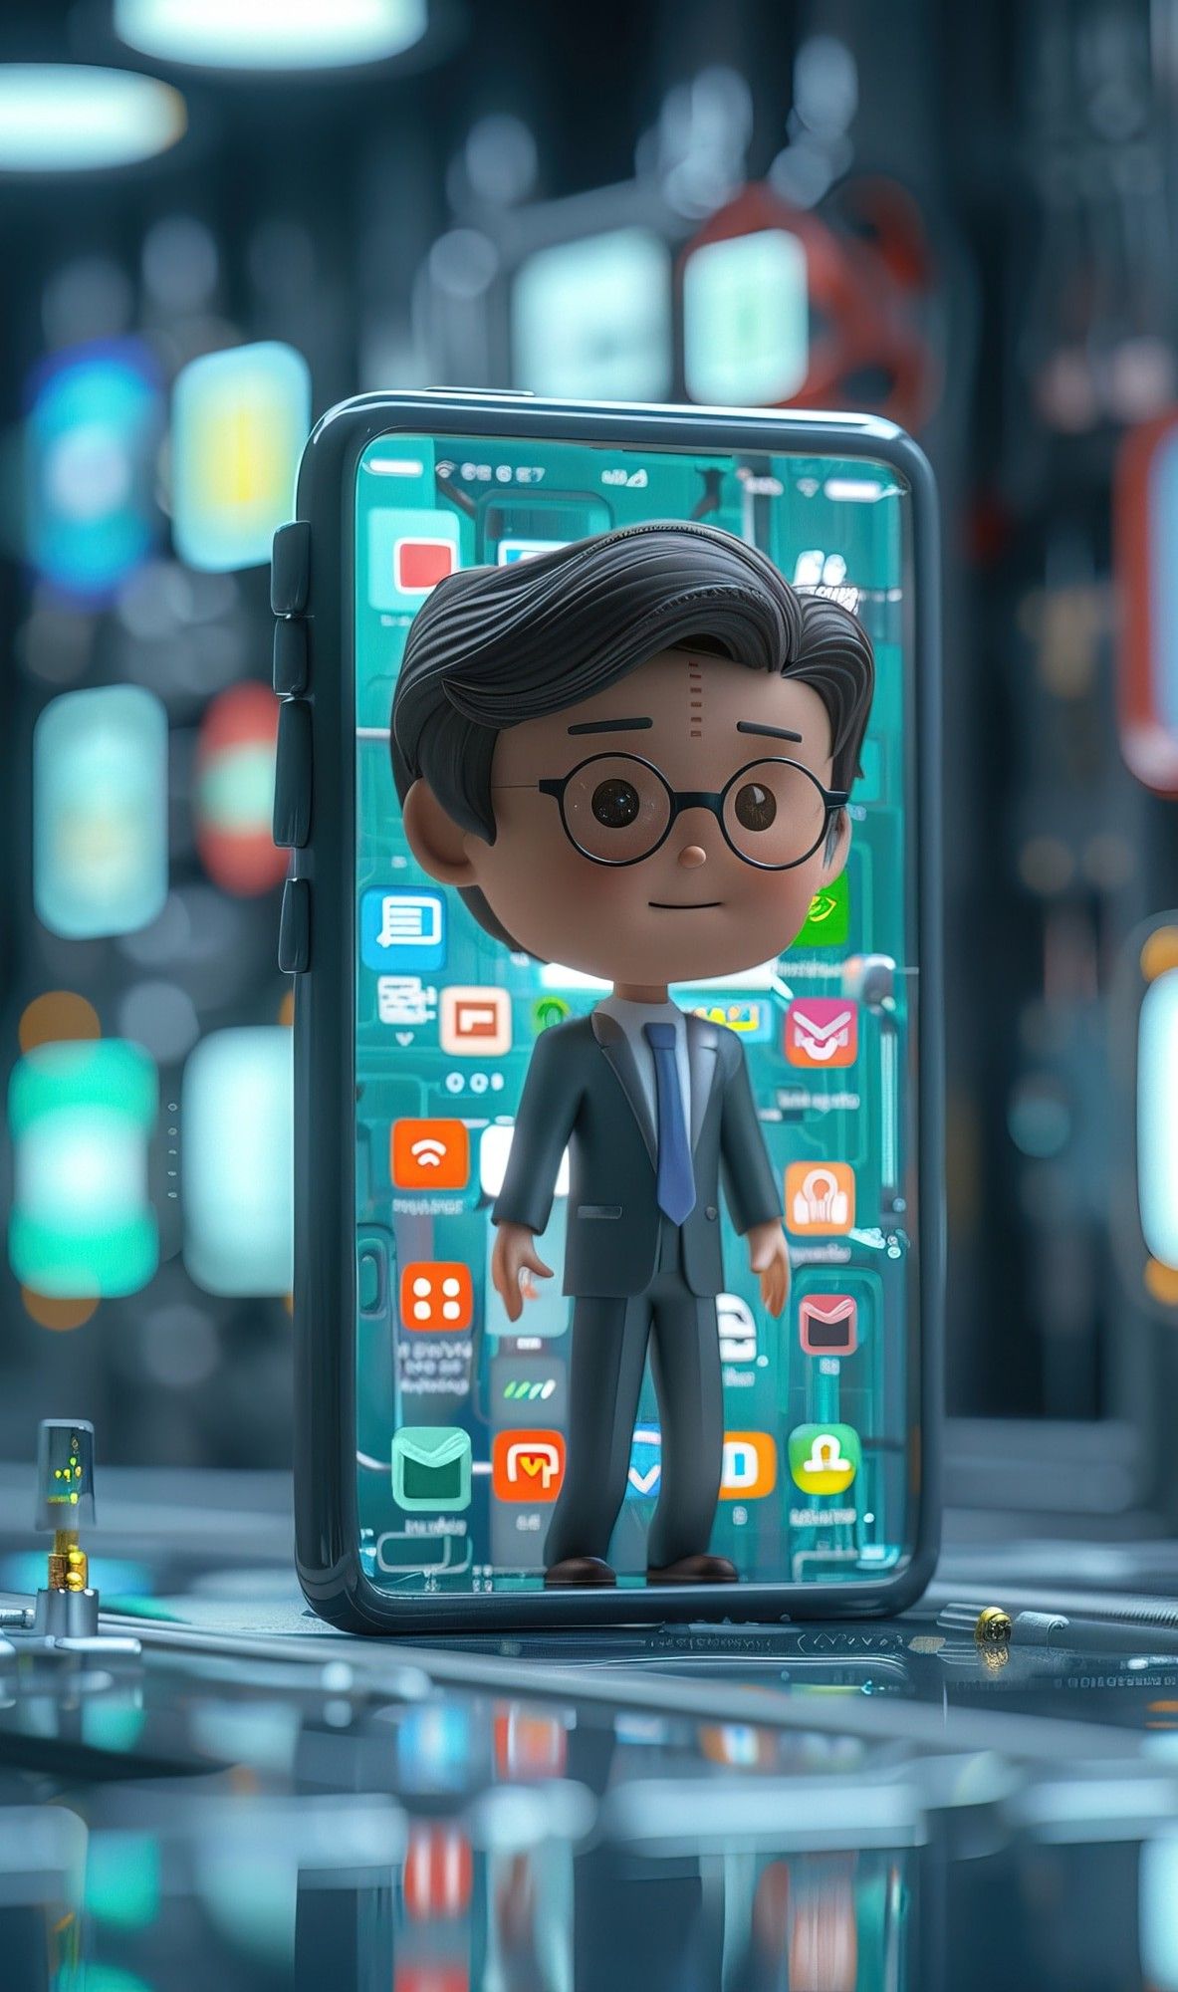

There are various types of interactive quiz applications, including multiple-choice, true/false, and short answer formats.
Some applications also feature gamification elements, such as leaderboards and rewards, to further enhance student motivation.
Additionally, there are platforms that allow for real-time collaboration among students, fostering a sense of community and engagement.

Slide 6




Engaging students through interactive quizzes involves incorporating to make
the learning experience and .
such as images, videos, and audio clips can cater to diverse learning styles.
Additionally, integrating and
into quizzes can make the content more for students.
and

Slide 7
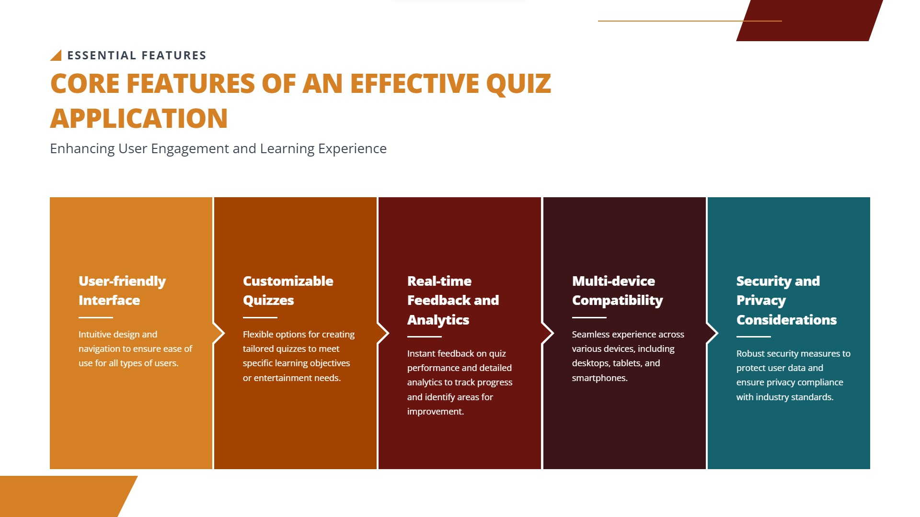

Slide 8








When implementing interactive quizzes, it is essential to align them with and
. and are crucial for a positive learning experience. Furthermore,
in question types and ensure that all students can participate effectively. Lastly,
considerations are paramount when using online platforms.

Slide 9





Conclusion
Interactive quiz applications offer a powerful means of enhancing learning through
, , and . By leveraging these tools, educators can create that cater to diverse learning styles and promote
. As technology continues to evolve, interactive quizzes will remain a valuable asset in the .

Slide 10
Thank you!

