Slide 1


Deforestation(Fire Classification)
Nadeem Khan
BU22CSEN0300262
STU64d72c792c88a1691823225

Slide 2

Learning Objectives
Understand the importance of satellite-based fire detection in environmental monitoring.
Explore and preprocess real-world geospatial datasets from the MODIS satellite.
Perform feature selection and scaling to prepare data for machine learning.
Apply multiple classification algorithms (Logistic Regression, Random Forest, KNN, XGBoost) to label fire types.
Evaluate models using standard metrics like accuracy, confusion matrix, and classification report.
Interpret geographic and statistical patterns from visualizations to derive actionable insights.
Build a deployable ML solution for real-time fire type classification.
GOAL
Source :
www.freepik.com/

Slide 3
Tools and Technology used
Programming Language
Python – for data processing, visualization, and model building
Data Handling & Analysis
Pandas – for data manipulation and cleaning
NumPy – for numerical computations
Matplotlib, Seaborn – for visualizations
Machine Learning
Scikit-learn – for model training, evaluation, and preprocessing
XGBoost – for gradient boosting classifier
SelectKBest – for feature selection
Geospatial Visualization
Folium – for plotting fire locations on interactive maps
Deployment (Optional/Advanced)
Streamlit – to create an interactive web app interface
Development Environment
Jupyter Notebook – for experimentation and step-by-step development
Google Colab / VS Code – for executing notebooks or scripts

Slide 4
Methodology
1. Data Collection
MODIS satellite fire data from 2021, 2022, and 2023 was collected and combined for analysis.
2. Data Preprocessing
Handled missing values and removed duplicates
Encoded categorical variables using Label Encoding and One-Hot Encoding
Normalized continuous features using StandardScaler
Selected top features using SelectKBest with f_classif and mutual_info_classif
3. Exploratory Data Analysis (EDA)
Analyzed distribution of fire types and confidence scores
Visualized fire occurrences by latitude, longitude, satellite, and day/night
Plotted spatial fire patterns using Folium
4. Model Building
Split data into training and testing sets using train_test_split
Trained multiple classification models:
Logistic Regression
Random Forest
K-Nearest Neighbors (KNN)
XGBoost
5. Model Evaluation
Evaluated performance using accuracy score, classification report, and confusion matrix
Compared models to identify the best performing classifier
6. Interpretation and Insights
Analyzed fire type patterns and model predictions
Identified geographic and statistical trends in the data

Slide 5
Problem Statement:
India experiences numerous fire incidents every year, which pose serious risks to forests, agriculture, human life, and property. Timely identification and classification of these fires are critical for effective response and resource management.
Despite the availability of satellite data, there is a lack of automated systems to accurately classify fire types based on relevant features like location, time, and detection confidence.
This project aims to develop a machine learning-based classification system using MODIS satellite data to:
Identify and classify fire types across India
Analyze spatial and temporal patterns of fire incidents
Support authorities in making faster, data-driven decisions

Slide 6
Solution:
To address the problem of timely and accurate fire type classification in India, a machine learning-based solution was developed using MODIS satellite data.
The solution involves the following steps:
Collection and merging of MODIS fire data from 2021, 2022, and 2023
Preprocessing the data by handling missing values, encoding categorical variables, and normalizing features
Performing exploratory data analysis to understand patterns in fire types and confidence levels
Selecting the most relevant features using statistical methods
Training multiple classification models (Logistic Regression, Random Forest, KNN, XGBoost) to predict fire types
Evaluating model performance using accuracy, confusion matrix, and classification report
Visualizing geographic distribution of fires to identify high-risk zones
The final model provides a reliable and automated way to classify fire types, which can be integrated into early-warning and disaster management systems.

Slide 7
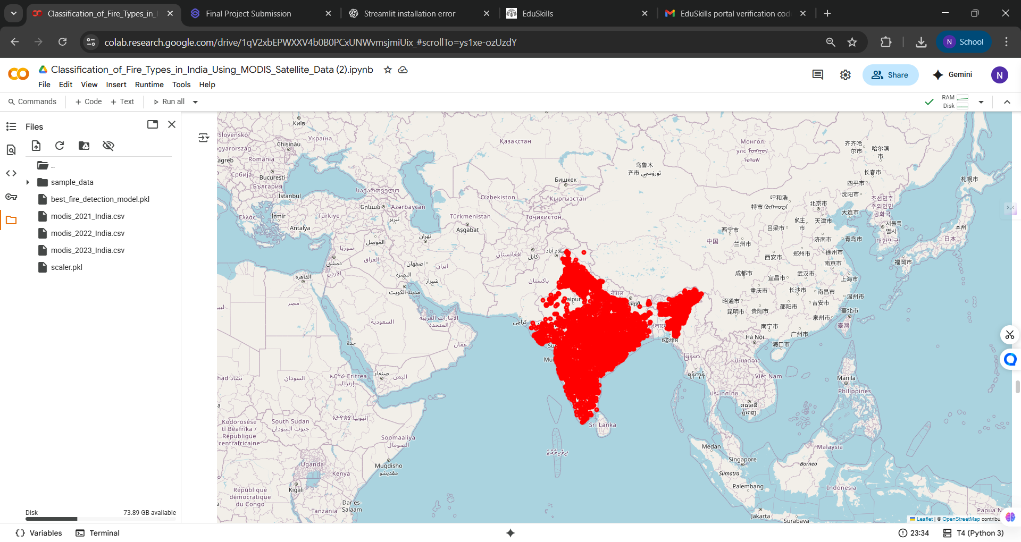
Screenshot of Output:

Slide 8
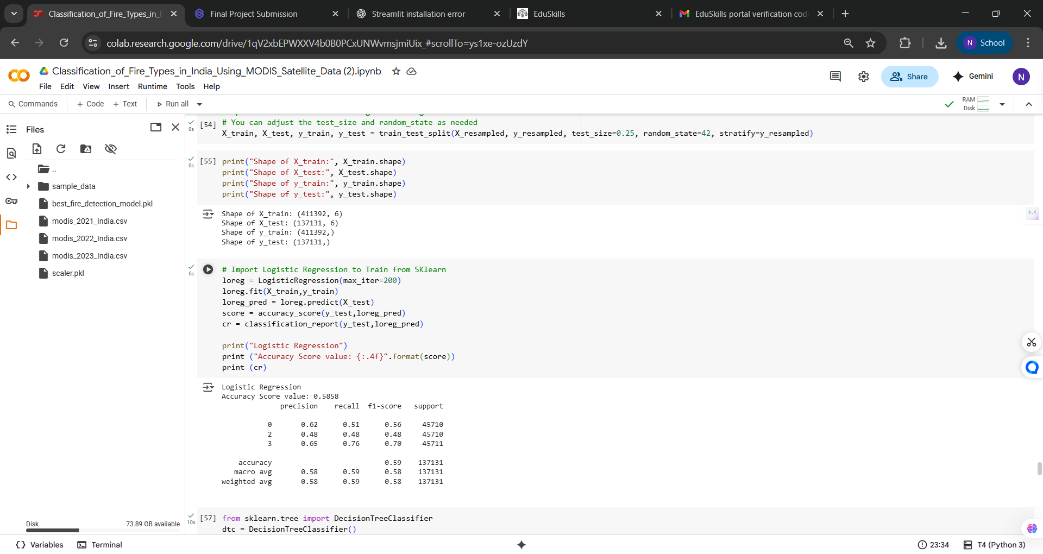
Screenshot of Output:

Slide 9
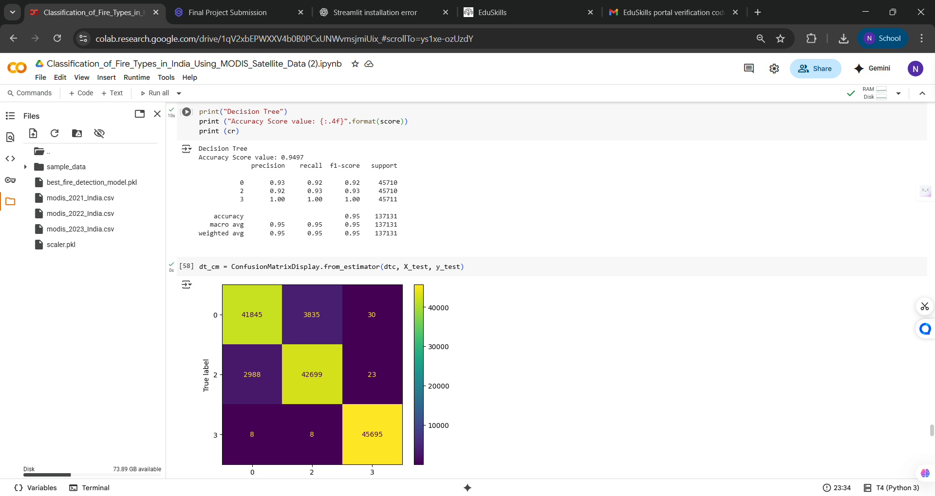
Screenshot of Output:

Slide 10
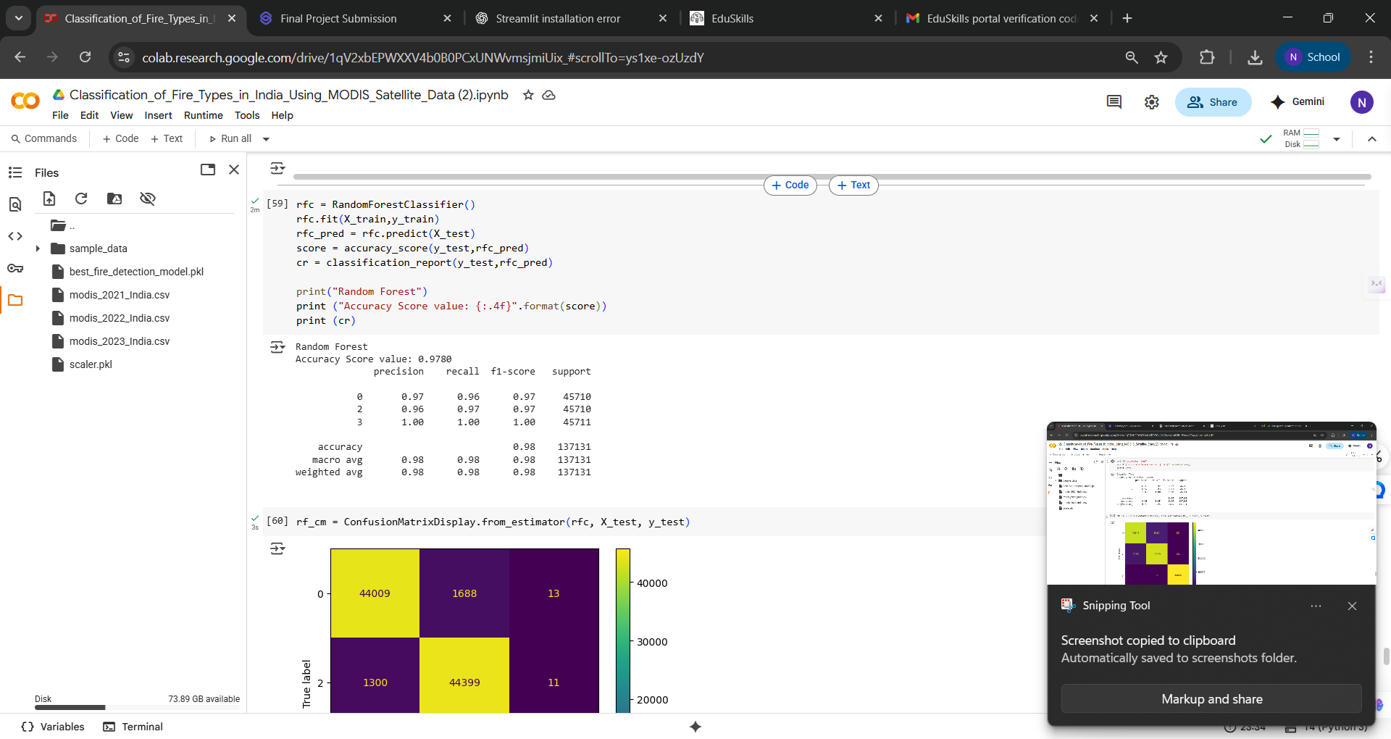
Screenshot of Output:

Slide 11
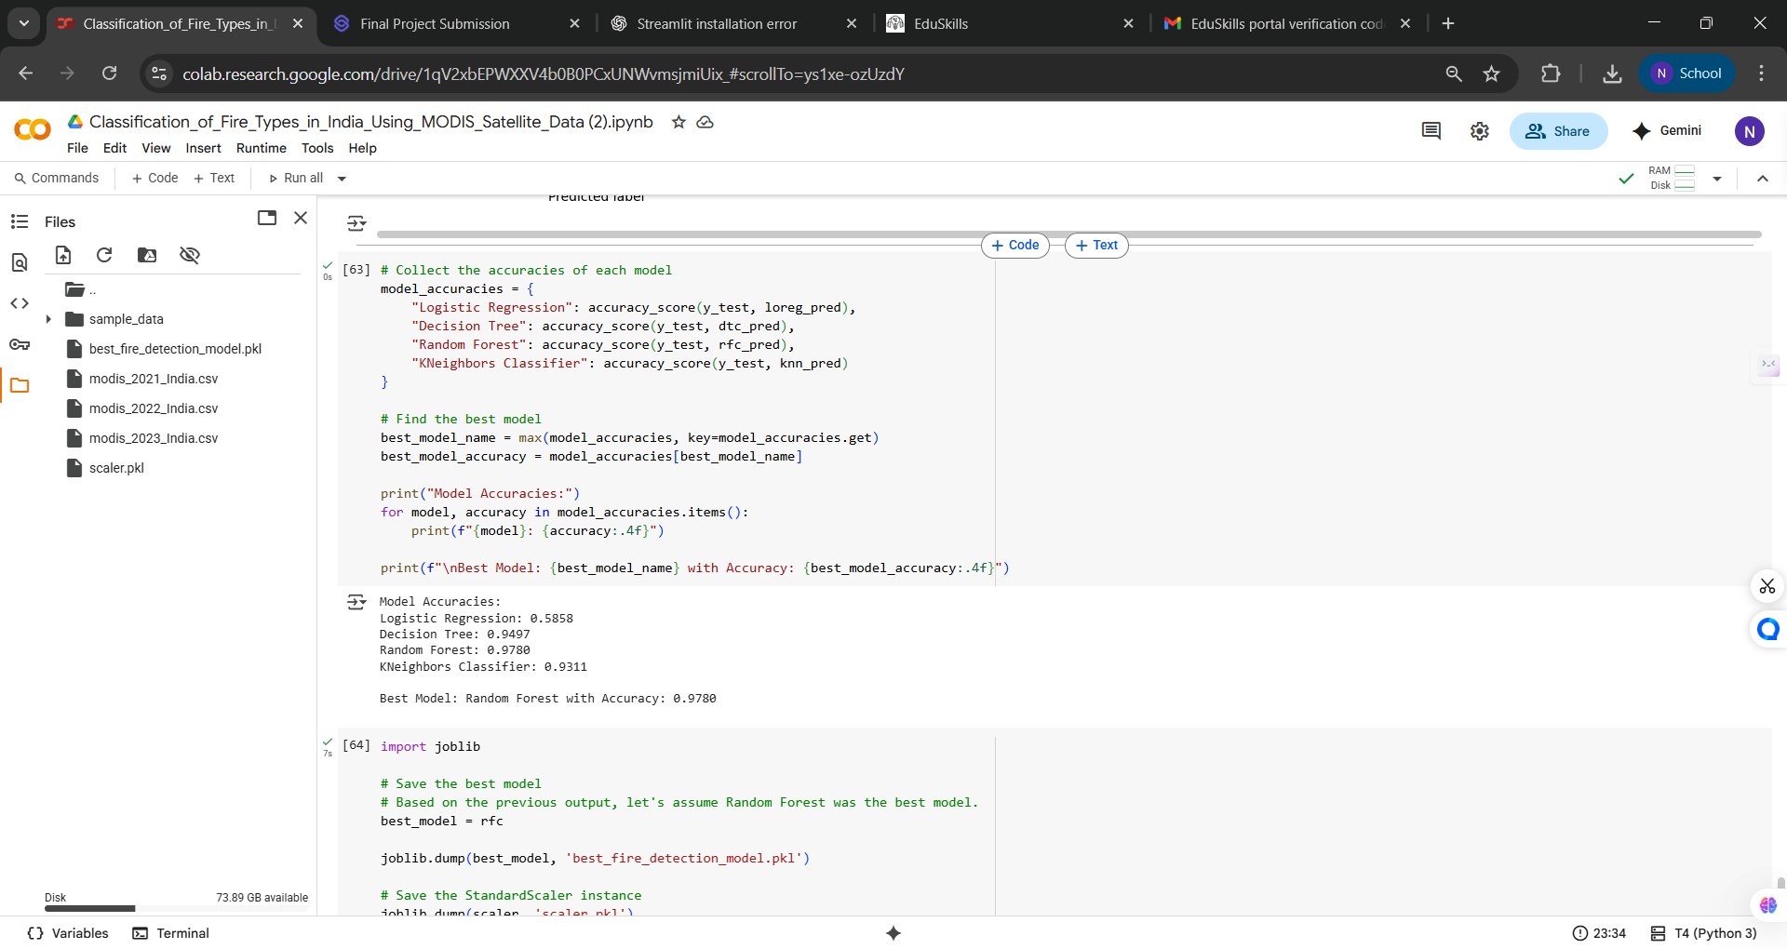
Screenshot of Output:

Slide 12
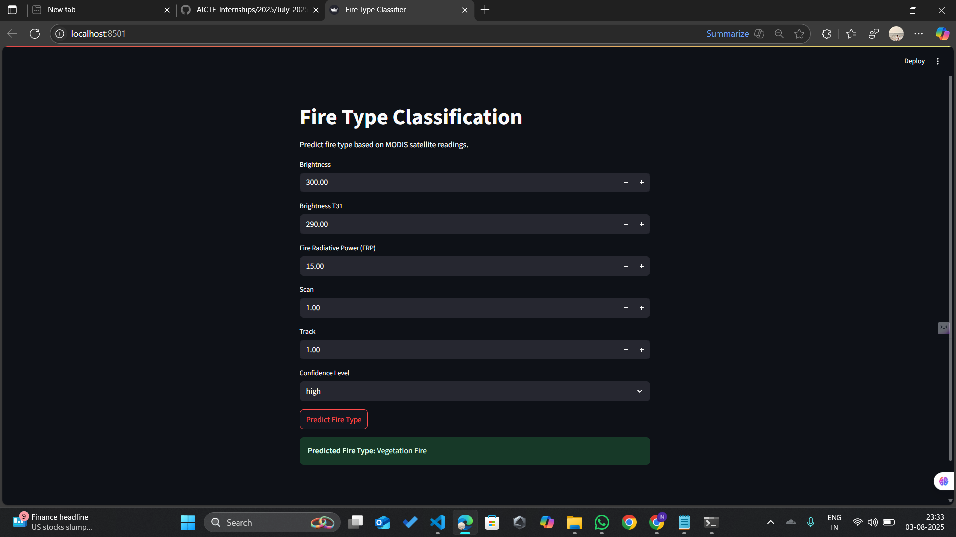
Screenshot of Output:

Slide 13
Conclusion:
This project highlights the effectiveness of using machine learning for environmental monitoring, specifically for the classification of fire types across India using MODIS satellite data.
Key conclusions are:
Data-Driven Decision Making: The system enables timely and informed decision-making by accurately identifying different types of fires using satellite data.
Model Performance: Among the tested models, Random Forest and XGBoost classifiers showed superior performance in terms of accuracy and generalization, making them suitable for real-world deployment.
Feature Importance: Features like latitude, longitude, satellite source, confidence score, and day/night detection were found to be highly significant in predicting fire types.
Geospatial Insights: Spatial visualization using Folium maps helped uncover regional fire patterns, identifying zones with higher fire occurrence for preventive measures.
Scalability: The pipeline can be adapted and scaled for other regions and datasets, making it a reusable and extensible solution.
Real-World Impact: This approach can serve as a valuable tool for forest departments, disaster management teams, and policy-makers for early detection and classification of fires, potentially minimizing damage and saving lives.

