Slide 1

Lending Club Case Study
Prepared by : Nadeem Akhtar

Slide 2

Problem Statement
Lending Club is a consumer finance company which specialises in lending various types of loans to urban customers. When the company receives a loan application, the company has to make a decision for loan approval based on the applicant’s profile in order to avoid financial loss.

Slide 3

Objectives
The aim is to identify patterns which indicate if a person is likely to default, which may be used for taking actions such as denying the loan,reducing the amount of loan, lending (to risky applicants) at a higher interest rate, etc.

Slide 4
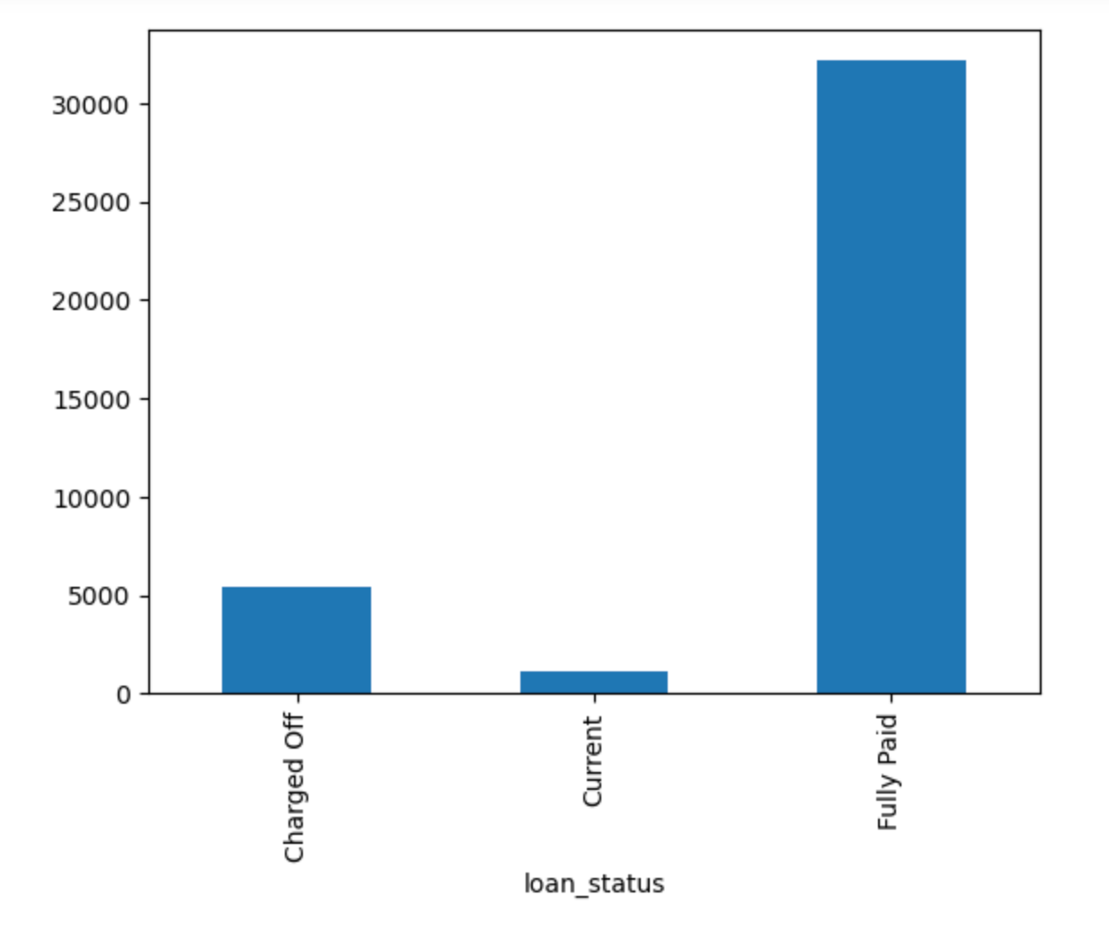
Loan Status

Slide 5
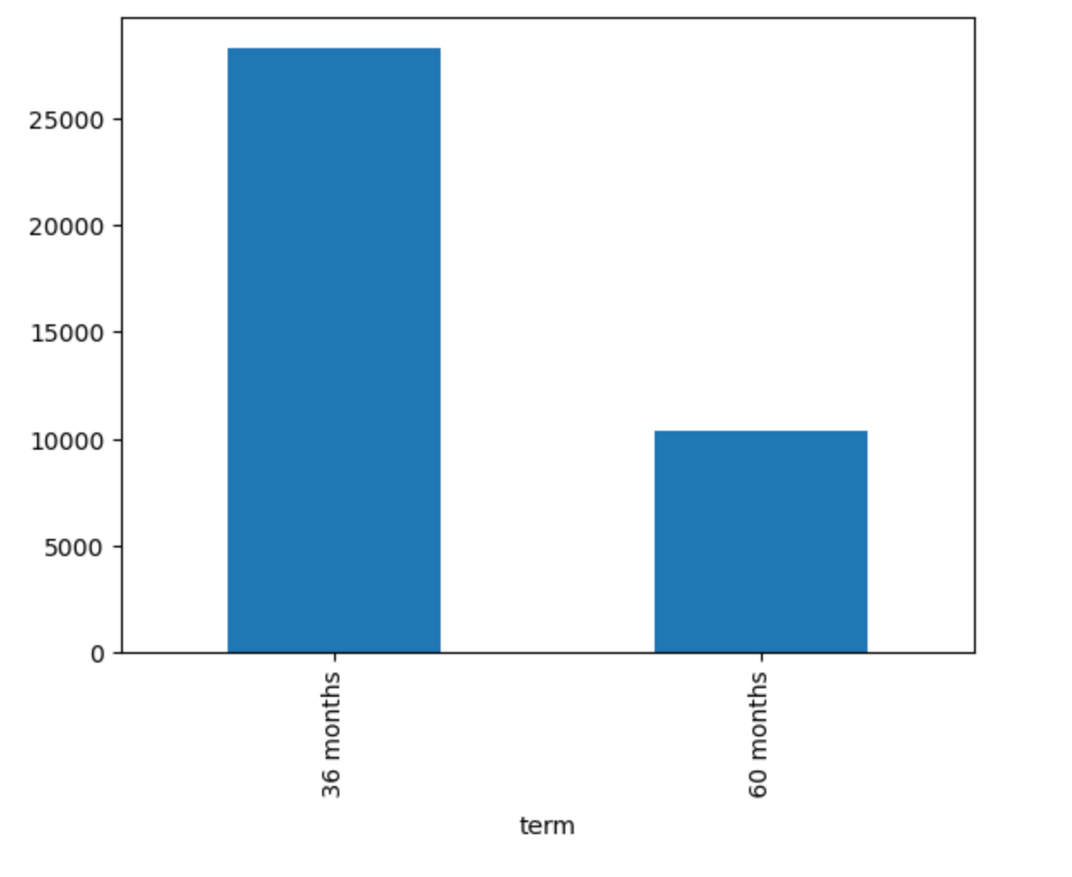
Term Loan

Slide 6
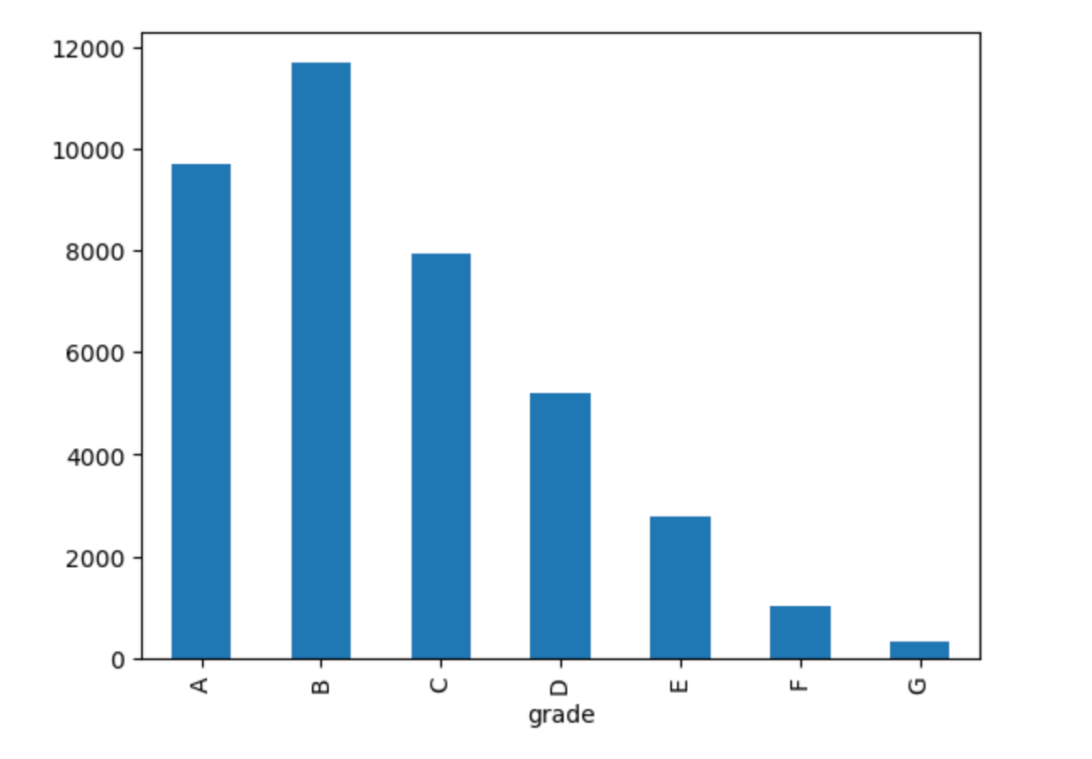
Grade Wise

Slide 7
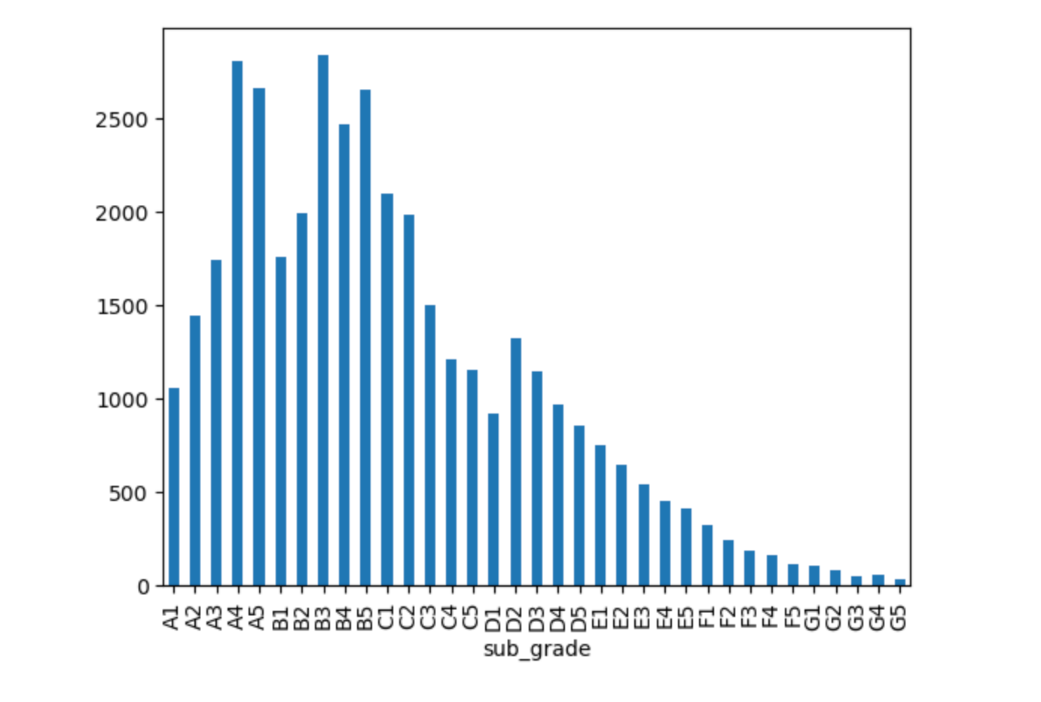
Sub Grade Wise

Slide 8
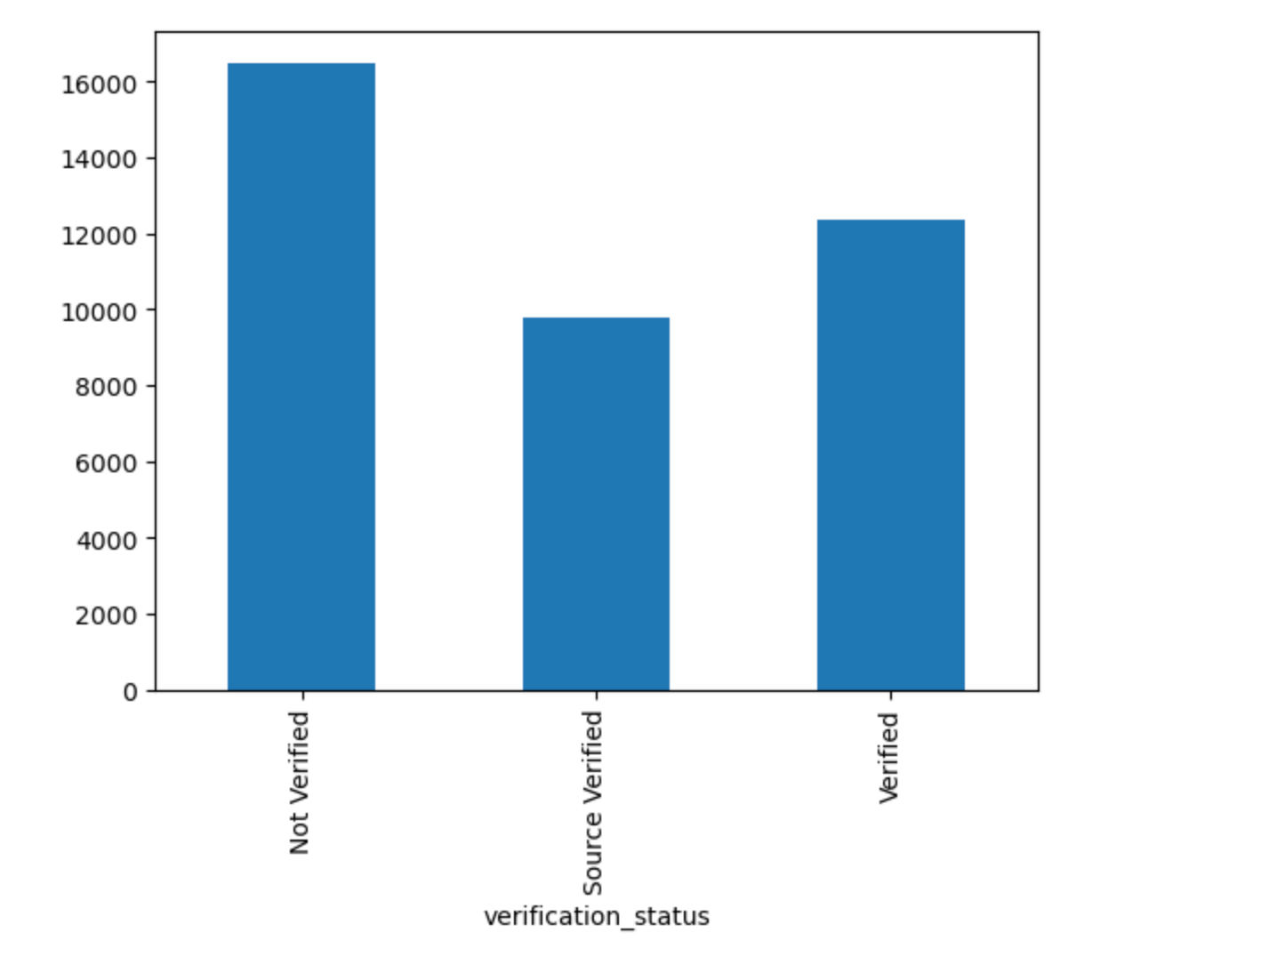
Verification Status

Slide 9
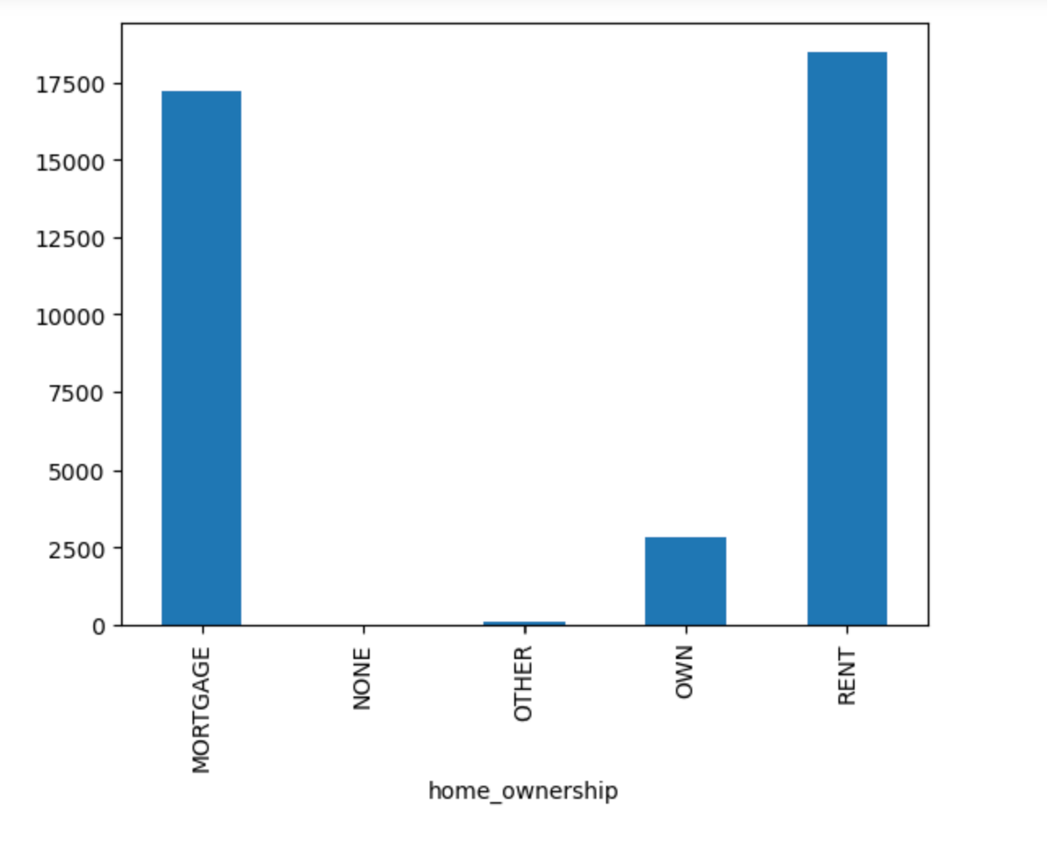
Home Ownership

Slide 10
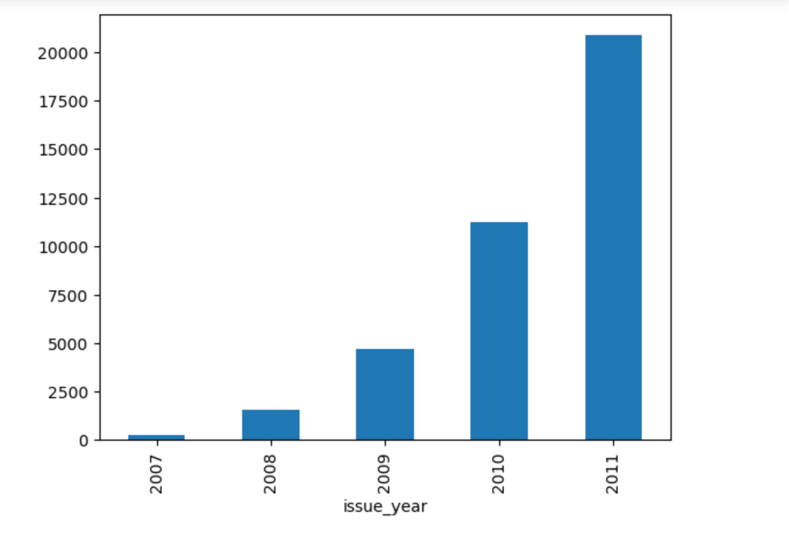
Year Wise Loan

Slide 11
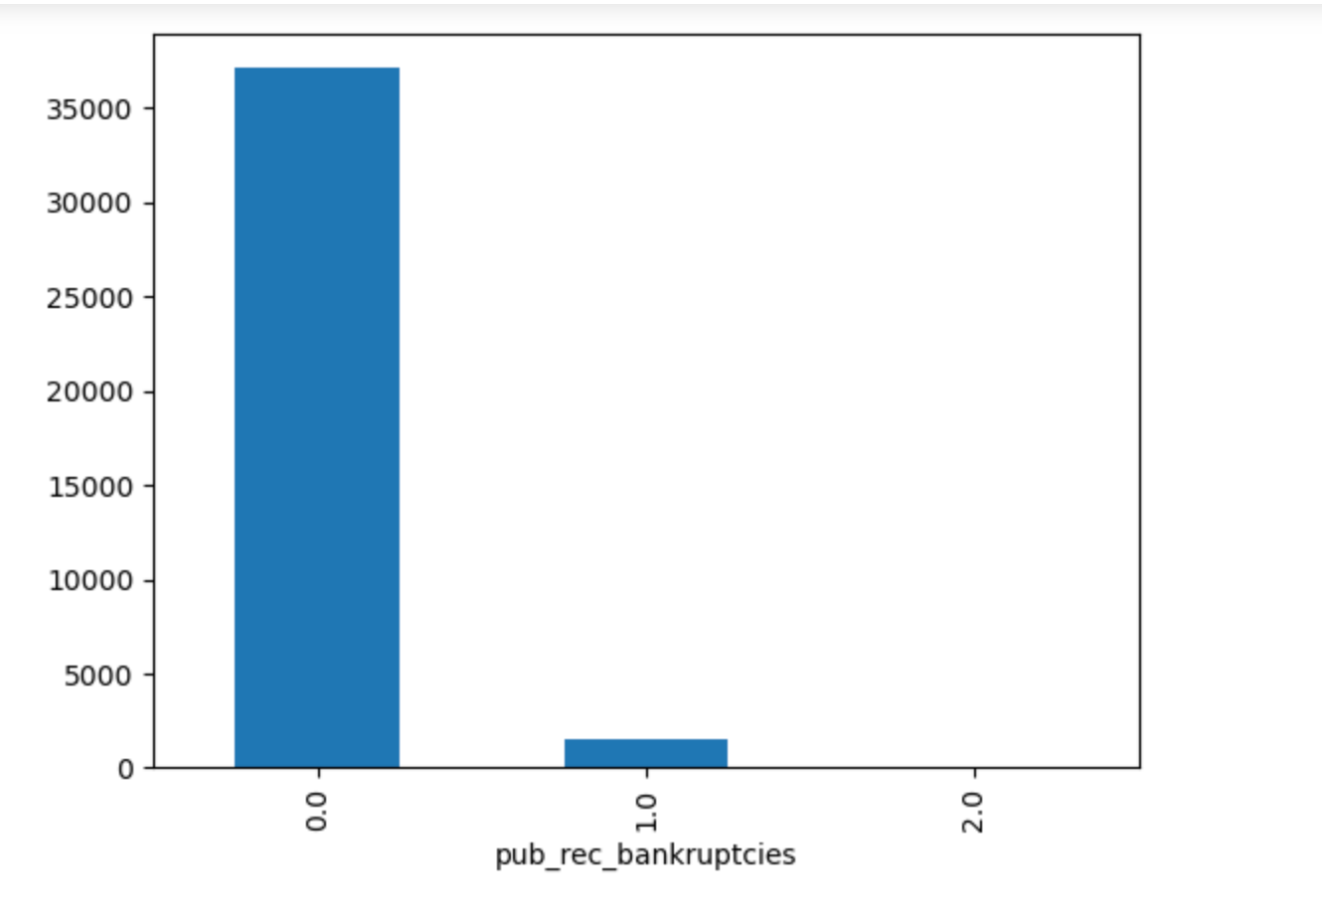
Public Bankruptcy

Slide 12
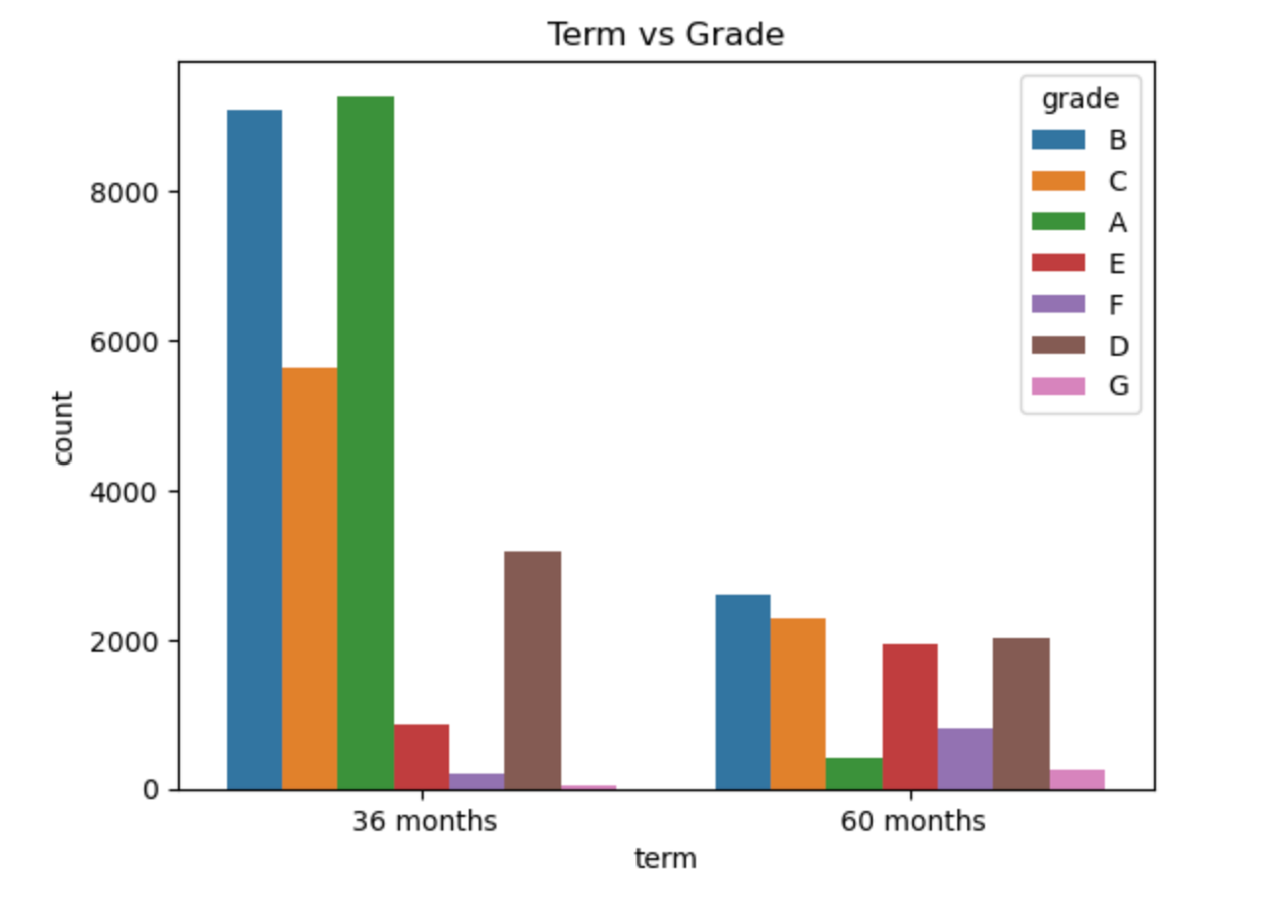
Term vs Grade

Slide 13
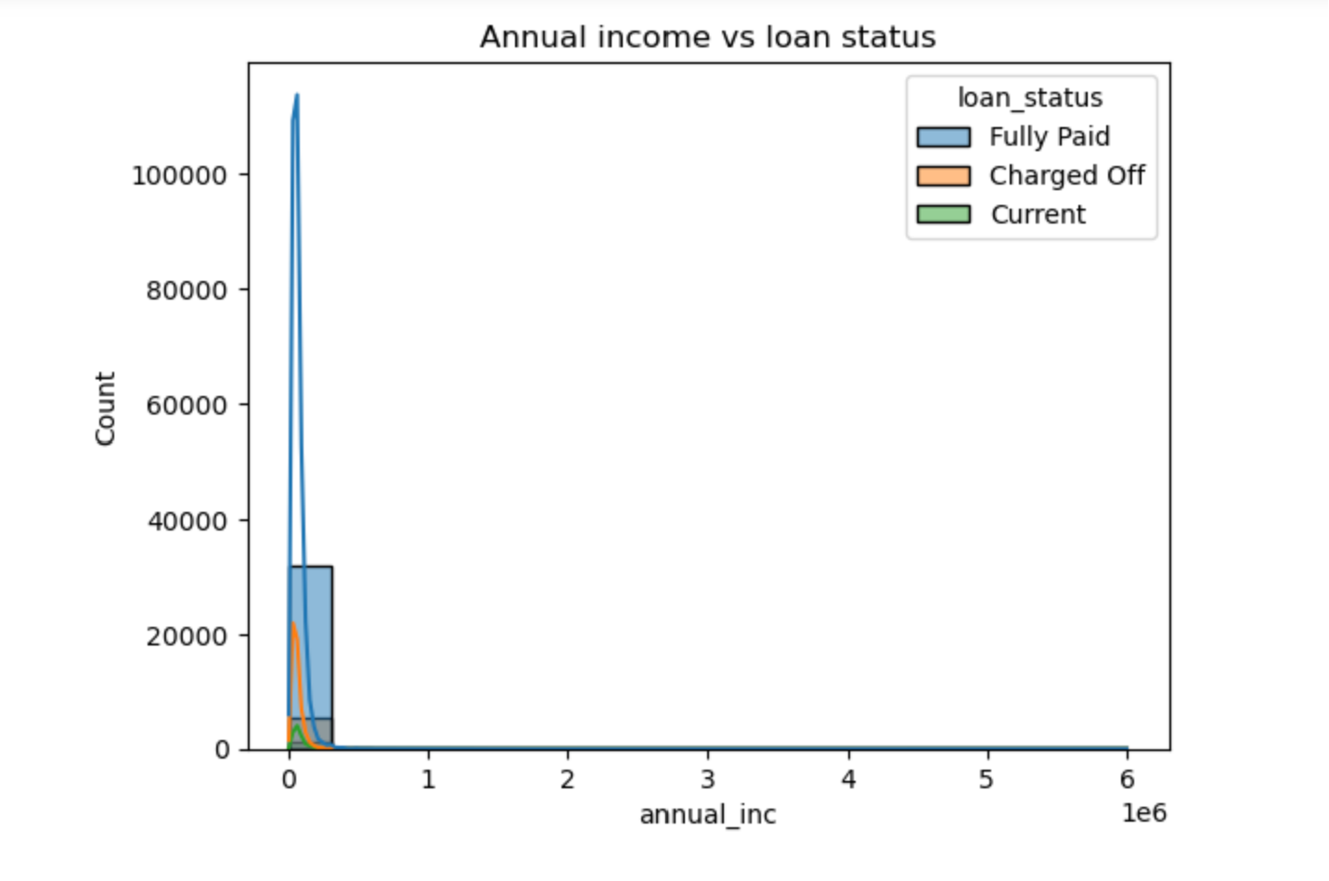
Annual income vs Loan Staus

Slide 14
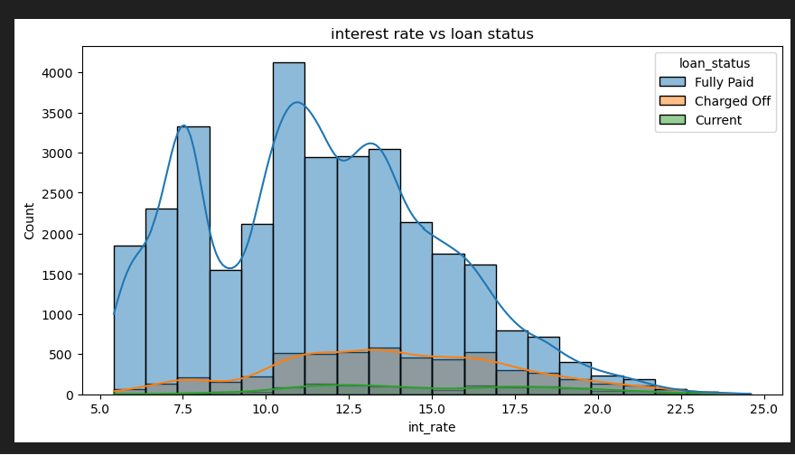
Interest Rate vs Loan Status

Slide 15
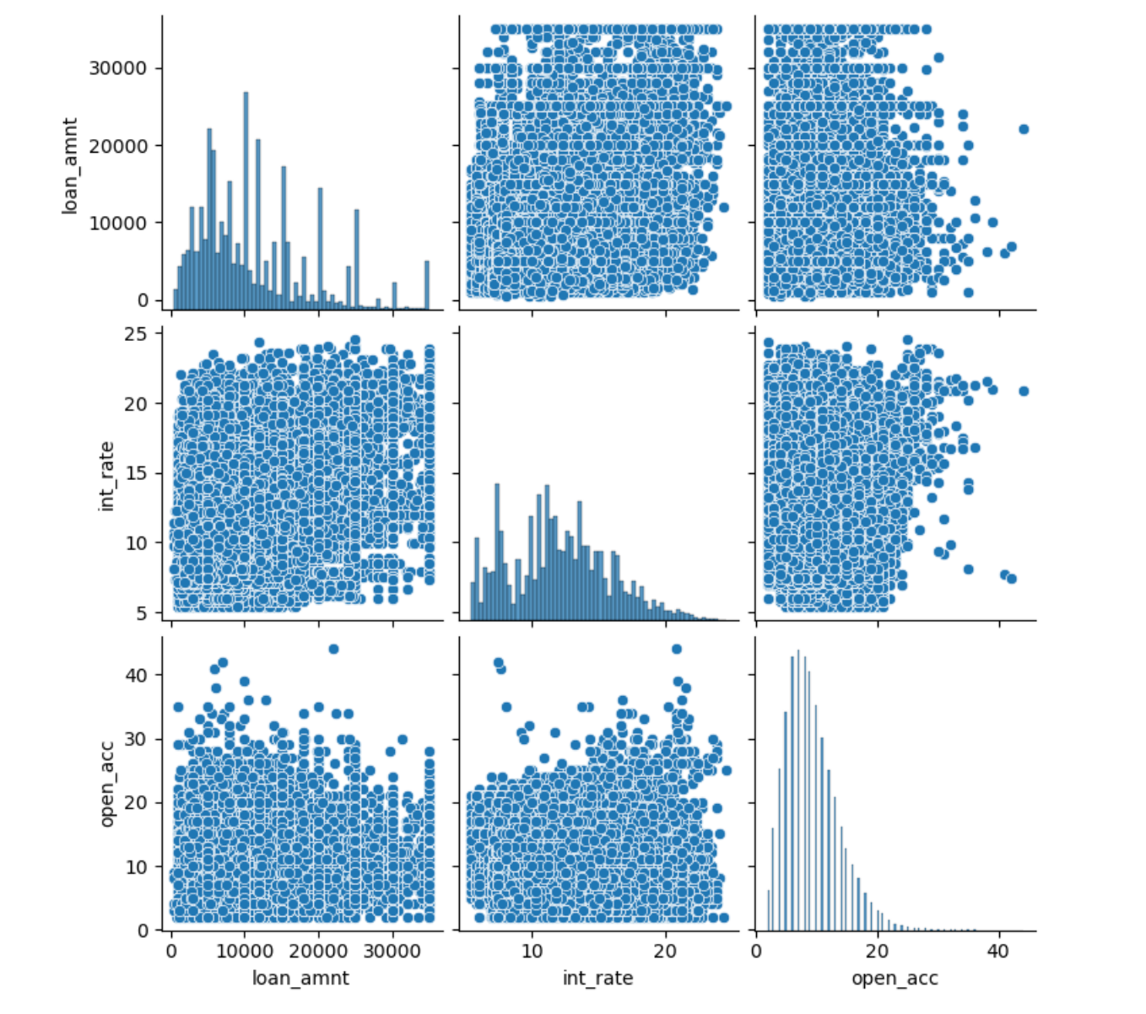
Pair Plot

Slide 16
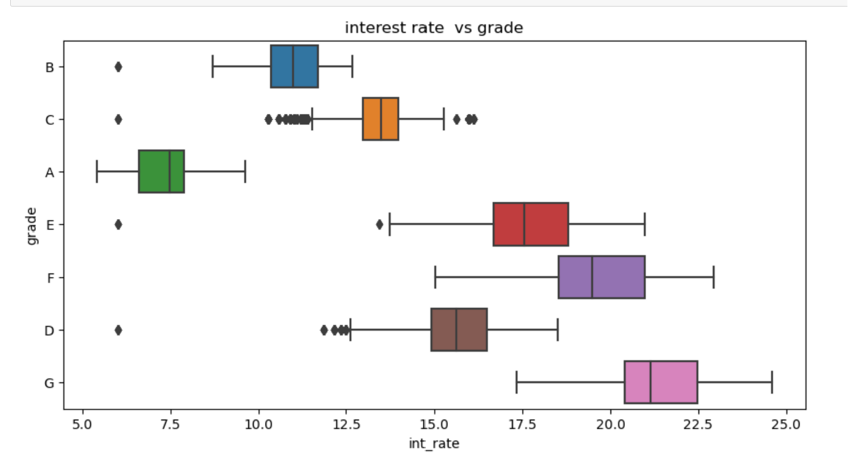
Interest Rate vs Grade

Slide 17
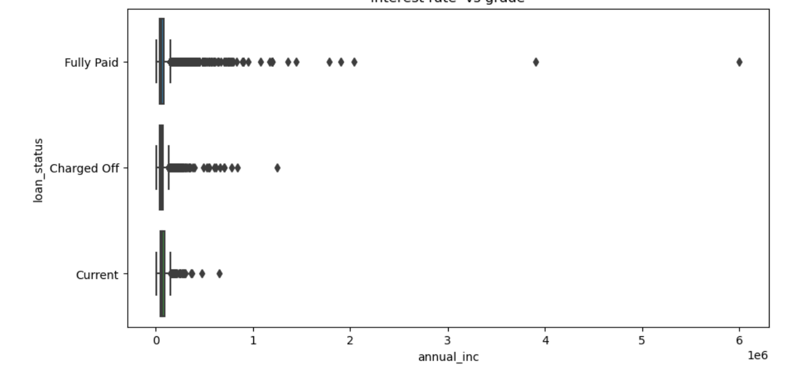
Loan Status vs Annual Income

Slide 18
Data Analysis Conclusion
Fully paid loan are approx 6 time higher than current and charged off loan.
36 Month Tenure loan are approx 1.5 times higher than the 60 Months loan.
A and B grade loans are higher than any other graded loans.
A and B sub grade loans are more than any other graded loans.
Majority of loan borrower are not verified.
Rented and Mortage customer borrow more loans as compared to the customer having their own property.
Loan borrowing are gradually increasing year by year.Highest number of loan approve in the year of 2011.
Majority of borrower doesnt have any bankruptcies.
Number of Charged off loan are more in the range of interest rate 10% to 20%.
Borrower having less salary are likely to default.

Slide 19

Potential Loan Default Risk Attributes
Majority of loan borrower are not verified which are potential risk for loan default in future.
The higher the interest rate ,the higher the chance of default.
Borrower having less salary are likely to default.
Borrower with rented and Mortage are having risk to default.

Slide 20

Thank You

