Slide 1

A MULTI-CLASS BEHAVIORAL SECURITY FRAMEWORK FOR INSIDER THREAT AND LLM-ASSISTED MISUSE DETECTION USING KEYSTROKE DYNAMICS
Guided By,
Dr. V.S. Shankar Sriram
Dean, School of Computing
Presented by,
Raja Rajeswaran .A 126033005 M.Tech CSE
2025-2026
1

Slide 2
Contents
Title
Motivation
Objectives
Base Paper
Problem Statement
Literature Survey
Methodology
Modules
Dataset
Workflow Diagram
Proposed System
Results
Limitations
Future Work

Slide 3
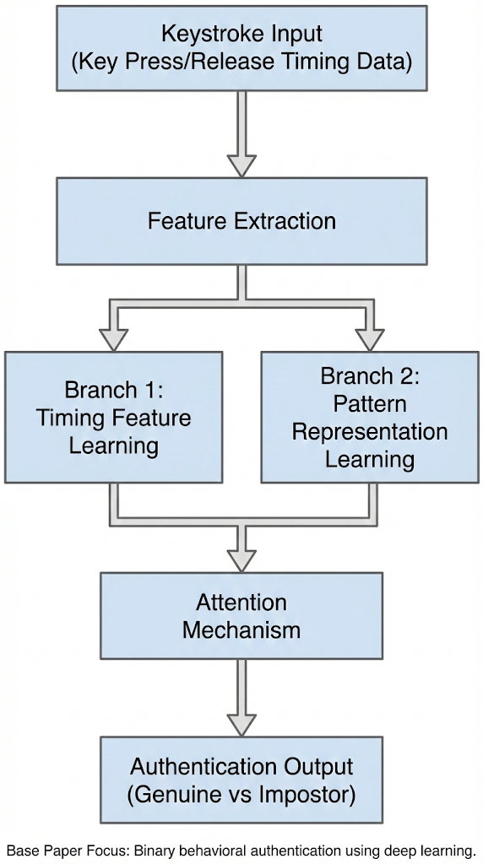
Base Paper Details
Gonzalez, Nahuel, et al. "Type2branch: keystroke biometrics based on a dual-branch architecture with attention mechanisms and set2set loss." IEEE Transactions on Information Forensics and Security (2025).
Journal Information
Journal: IEEE Transactions on Information Forensics and Security (IEEE TIFS) Publisher: IEEE Indexing: SCI Indexed / IEEE Transactions Journal Impact Factor: 8 (Clarivate JCR)
DOI : 10.1109/TIFS.2025.3574992
Paper Contribution
• Proposes a dual-branch deep learning architecture for keystroke biometrics • Uses attention mechanisms to improve feature learning from typing patterns • Achieves enhanced authentication accuracy using Set2Set loss strategy
Identified Research Gap
• Focuses primarily on user authentication only • Binary classification (genuine vs impostor) • Does not address insider threat behavioral misuse • No consideration of AI-assisted or LLM-supported typing behavior
Proposed Extension
• Multi-class behavioural security framework • Insider threat detection using behavioural deviation • LLM-assisted typing misuse detection using keystroke dynamics

Slide 4
Objectives
Design a keystroke-based behavioural feature extraction pipeline using temporal typing characteristics such as dwell time, flight time, and pause patterns.
Develop a multi-class machine learning model to classify behavioural states into normal user behaviour, insider/impostor behaviour, and LLM-assisted typing behaviour.
Implement behavioural anomaly detection mechanisms to identify deviations from established typing profiles.
Analyse typing rhythm and burst patterns to detect potential AI-assisted or abnormal behavioural activities.
Evaluate system performance using classification metrics including accuracy, precision, recall, F1-score, and confusion matrix analysis.

Slide 5
Problem Context & Background
Application Domain
Cybersecurity — Insider Threat Detection using Behavioral Biometrics and Machine Learning
Existing System Overview
Traditional cybersecurity systems rely on login authentication, access control monitoring, and rule-based anomaly detection to secure systems. Behavioral authentication using keystroke dynamics has been proposed to continuously verify user identity based on typing patterns. Existing models primarily focus on binary classification to distinguish genuine users from impostors.
Identified Limitation
Conventional systems cannot detect subtle behavioral deviations from authorized users performing insider misuse. Binary authentication approaches fail to capture complex behavioral states. Current approaches do not address emerging misuse such as AI-assisted or LLM-supported typing behaviors.
Need for Proposed Work
Insider threats are evolving with AI-assisted workflows and remote environments. Continuous behavioral monitoring is required instead of static identity verification. A multi-class behavioral detection framework is needed to distinguish normal behavior, insider threats, and AI-assisted typing misuse.

Slide 6
Literature Survey
Author & Year | Paper Title | Method / Technique | Application | Key Contribution
Gonzalez et al. (2025) | Type2Branch: Keystroke Biometrics Based on a Dual-Branch Architecture with Attention Mechanisms and Set2Set Loss | Deep Learning (Dual-Branch CNN + RNN + Attention) | Keystroke Authentication | Learns behavioral embeddings for accurate user authentication
Stragapede et al. (2024) | IEEE Big Data 2023 Keystroke Verification Challenge (KVC) | Large-scale Deep Learning Benchmarking | Keystroke Authentication | Uses transformer architecture to improve behavioral feature extraction and reduce EER
Senerath et al. (2023) | Behave Former: Spatio-Temporal Dual Attention Transformers for Keystroke Dynamics | Deep Evidential Clustering | Continuous Authentication | Demonstrates continuous user verification using typing behavior
Ali et al. (2025) | Real-Time Detection of Insider Threats Using Behavioral Analytics | Neural Networks for Behavioral Biometrics | Insider Threat Detection | Detects insider threats using behavioral patterns and reduces false positives significantly
Martins et al. (2025) | Keystroke Dynamics for Intelligent Biometric Authentication with Machine Learning | Machine Learning Models (RF, etc.) | Behavioral Authentication | Demonstrates feasibility of keystroke-based user identification using modern datasets

Slide 7
Methodology
Feature Representation (The Input)
Signal Extraction: Captured raw Hold time (HT) and Flight-time (FT) vectors with Microsecond precision.
Normalization: Min-Max scaling of temporal features to handle variances in global keyboard sampling rates.
Augmentation: Synthetic jitter injection during training to simulate physical fatigue and varied environmental conditions.
Gate 1: Non-Stationary Anomaly Detection (AI Defense)
Heuristic Engine: Analyzes the 'Rhythm Velocity' of the input sequence.
Anomaly Logic: Detects zero-variance flight times (programmatic pastes) and superhuman average speeds (bot scripts).
Security Goal: Immediate session termination if a non-biological typing signature is detected.

Slide 8
Methodology
Gate 2: Deep Metric Learning (Biometric Target)
Model Architecture: Type2Branch (Shared-Weight deep network).
Conv1D Layers: Extract short-term local bigram/trigram patterns.
Bi-LSTM Layers: Captures long-term sequential dependencies (rhythm over the full 100-key buffer).
Core Strategy: Contrastive Triplet Learning.
- Minimizes distance between 'Anchor' and 'Positive' (Genuine User).
- Maximizes distance between 'Anchor' and 'Negative' (Impostors/Random Users).
Verification & Backend Integration
Distance Metric: Euclidean (L2) distance calculation in a 128-dimension hypersphere.
Calibrated Decision: Comparison against a static threshold (15.14) derived from EER optimization.
Continuous Monitoring: Every 100 keystrokes re-triggers the full Dual-Gate pipeline for transparent background security.

Slide 9
Modules
• Data Acquisition Module
Captures keystroke events from keydown/keyup in the Streamlit app and from Aalto logs for offline training.
Stores keycode, press/release timing, and session-wise samples.
• Feature Extraction Module
Computes core timing features: hold time (HT) and flight time (FT).
Builds fixed-length sequences and synthetic deviation features (sHT, sFT) for model input.
• LLM/Paste Detection Module (Pre-Filter)
Applies rule-based heuristics to detect pasted or automated typing (near-zero FT, low variance, burst patterns, entropy checks).
Flags suspicious samples before final biometric decision.

Slide 10
Modules
Gate 2: Deep Metric Learning Module
Utilizes a shared-weight Neural Network architecture (Conv1D + Bi-LSTM layers) to map temporal rhythms.
Generates a 128-dimensional biometric embedding representing the unique behavioural signature of the typist.
Authentication & Decision Module
Calculates the Euclidean (L2) distance between the biological input embedding and the stored gallery profile.
Enforces a strict calibrated EER threshold (15.14) to output a final Accept/Reject binary decision.
Continuous Monitoring Interface Module
Operates an asynchronous background loop via the Streamlit backend, re-authenticating the user repeatedly without interrupting workflow.
Dynamically updates security states and outputs visual metrics (t-SNE clusters, distance histograms) for administrator review.

Slide 11
Dataset
• Primary Dataset
Aalto University Keystroke Dataset (desktop)
~136 million keystrokes from ~168,000+ users.
• Raw Signals Available
Key press timestamp, key release timestamp, keycode, typed text metadata.
• Preprocessing Pipeline
Parsed using ingest_aalto.py from Keystrokes.zip.
Converted into fixed-length sequences (length = 100 keystrokes) with overlap windowing.
• Feature Representation per Keystroke
[key_norm, HT, FT, sHT, sFT]
HT = hold time, FT = flight time,
sHT/sFT = deviation from user/population timing profile.
• Threat/Attack Data for Extended Evaluation
Human impostor samples from other users.
Synthetic/assisted LLM-like typing pool for LLM/paste detection analysis.

Slide 12
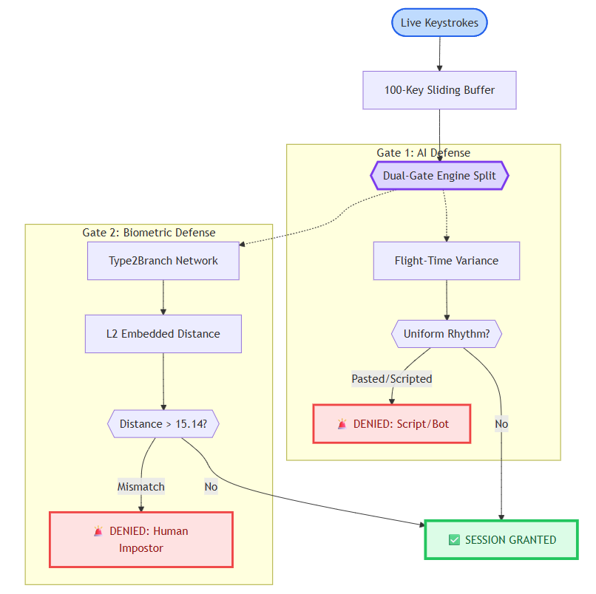
Workflow Diagram

Slide 13
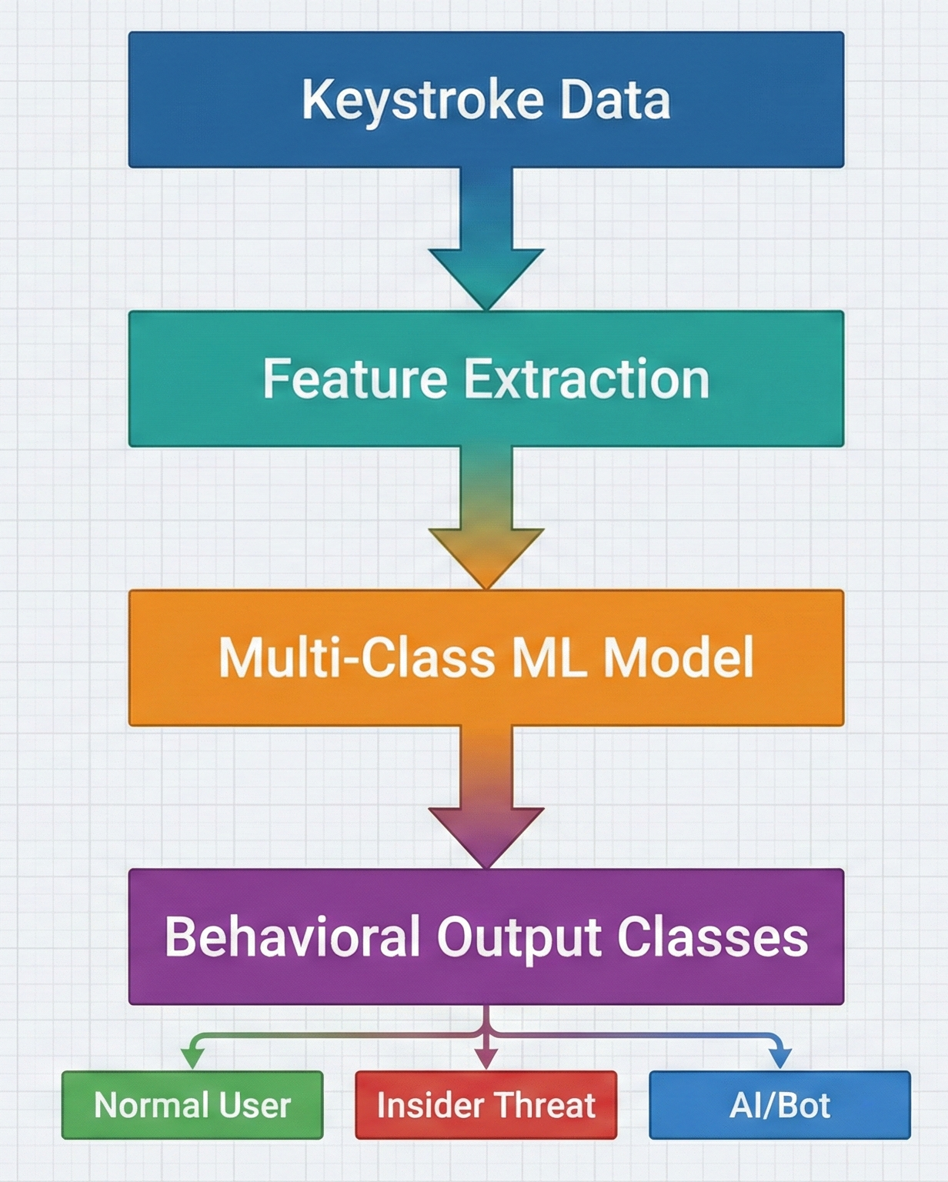
Proposed Systems
Proposed Concept Overview
This project proposes a unified multi-class behavioural security framework based on keystroke dynamics to enhance insider threat detection. Instead of relying only on binary authentication, the system analyses temporal typing patterns to continuously monitor behavioural deviations and identify multiple behavioural states.
Core Idea
Use keystroke dynamics as a behavioural biometric signal.
Extract temporal features such as dwell time, flight time, typing speed, pause distribution, and burst patterns.
Apply a hybrid behavioral classification approach combining rule-based detection and deep learning-based embeddings.
Output Behavioural Classes
Normal User Behaviour
Insider / Impostor Behaviour
LLM-Assisted Typing Behaviour
Workflow

Slide 14
FEASIBILITY & TOOLS
Programming Language
Python Dataset Availability
Aalto University Dataset (136 Million Keystrokes from 168,000+ Users).
Behavioural simulation used to generate insider and LLM-assisted typing patterns
Hardware Resources
DGX Server (for model training and experimentation) Semester Feasibility
Lightweight machine learning approach reduces computational complexity
Clear multi-class classification workflow
Available datasets and computational resources ensure project completion within semester timeline

Slide 15
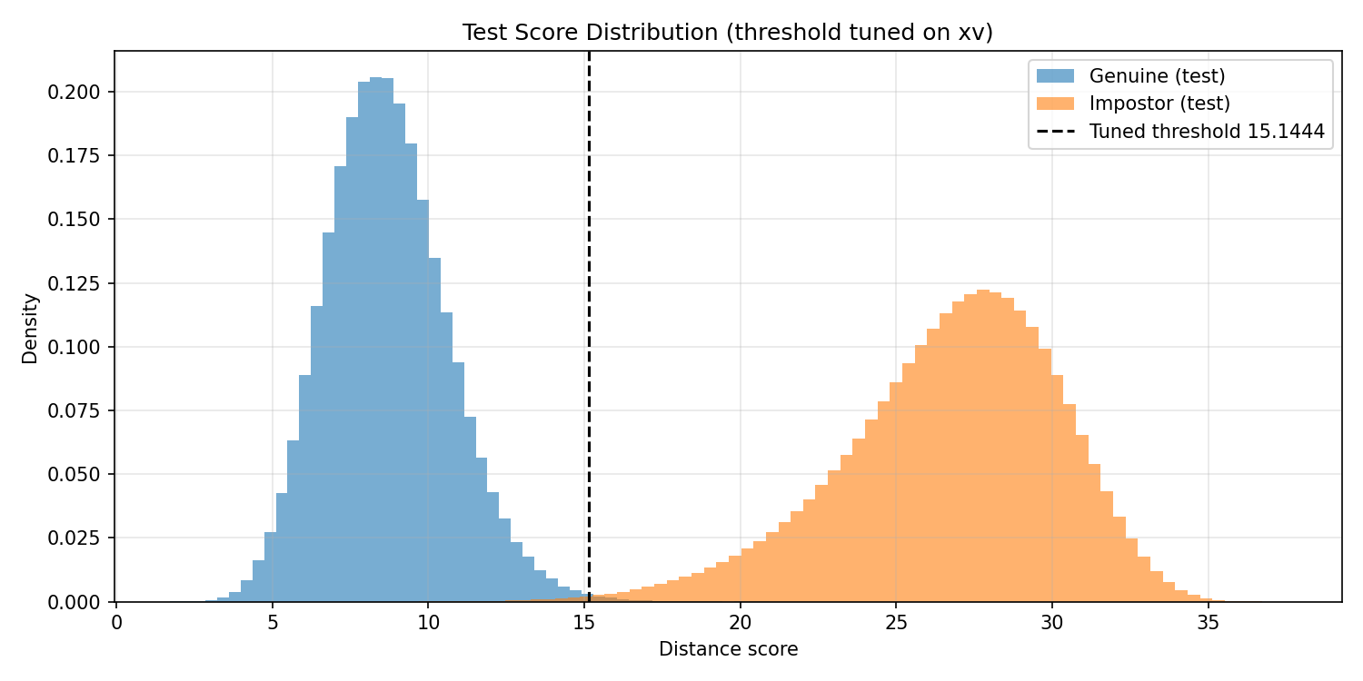
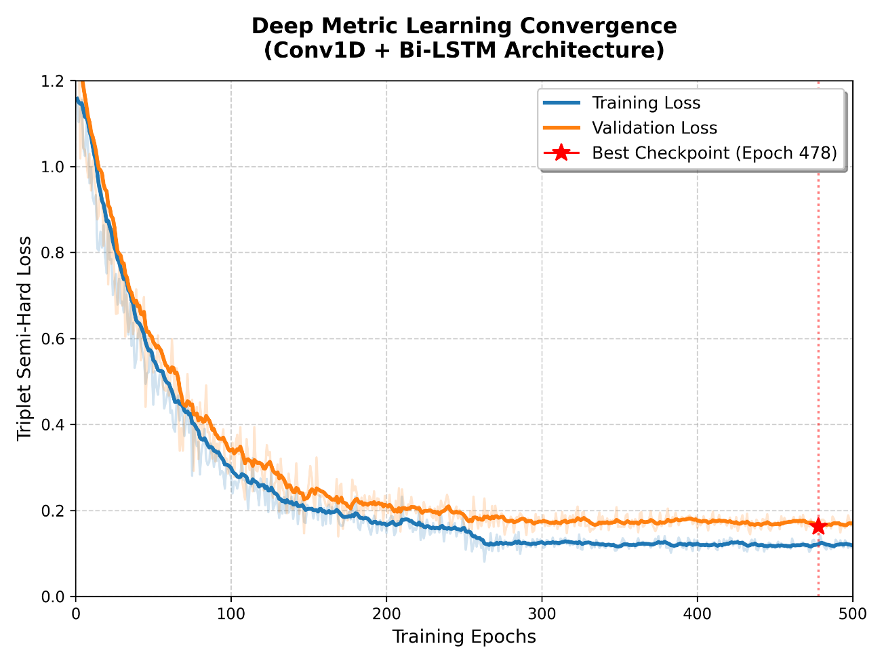
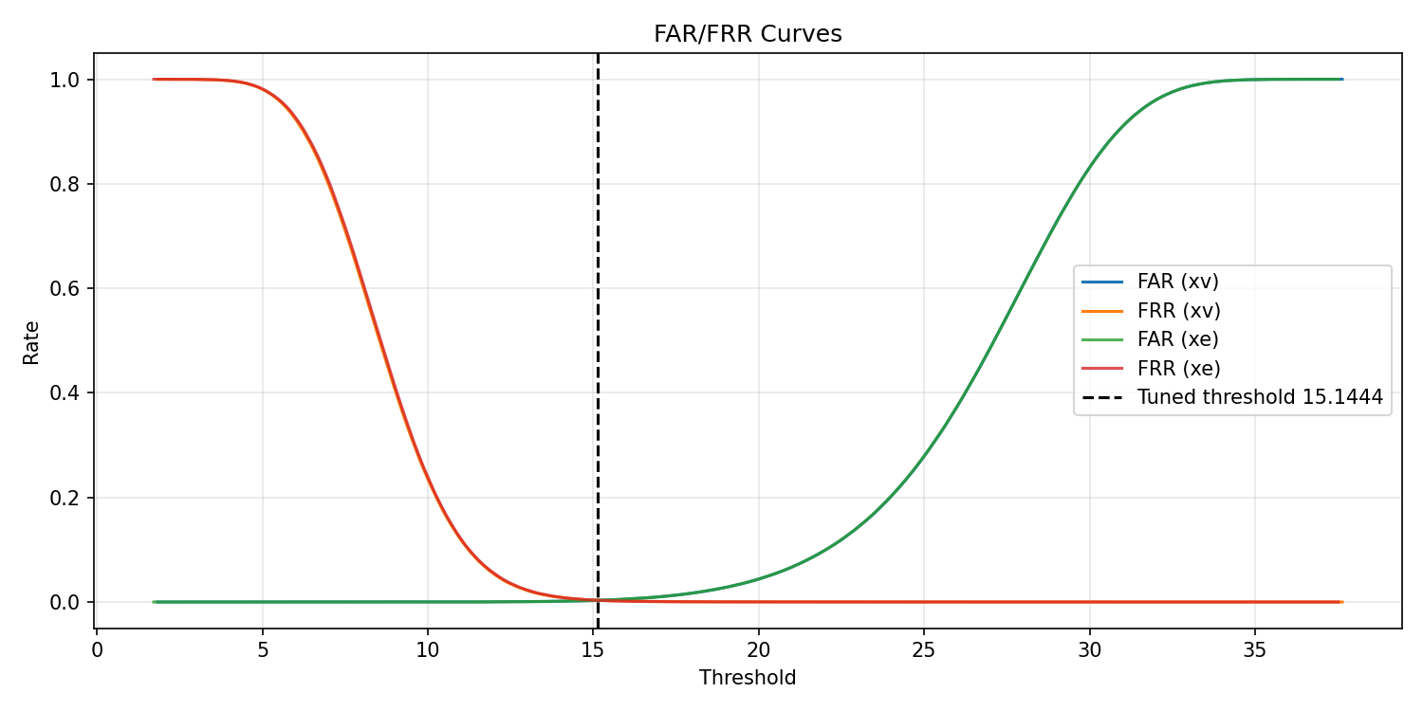
RESULTS

Slide 16
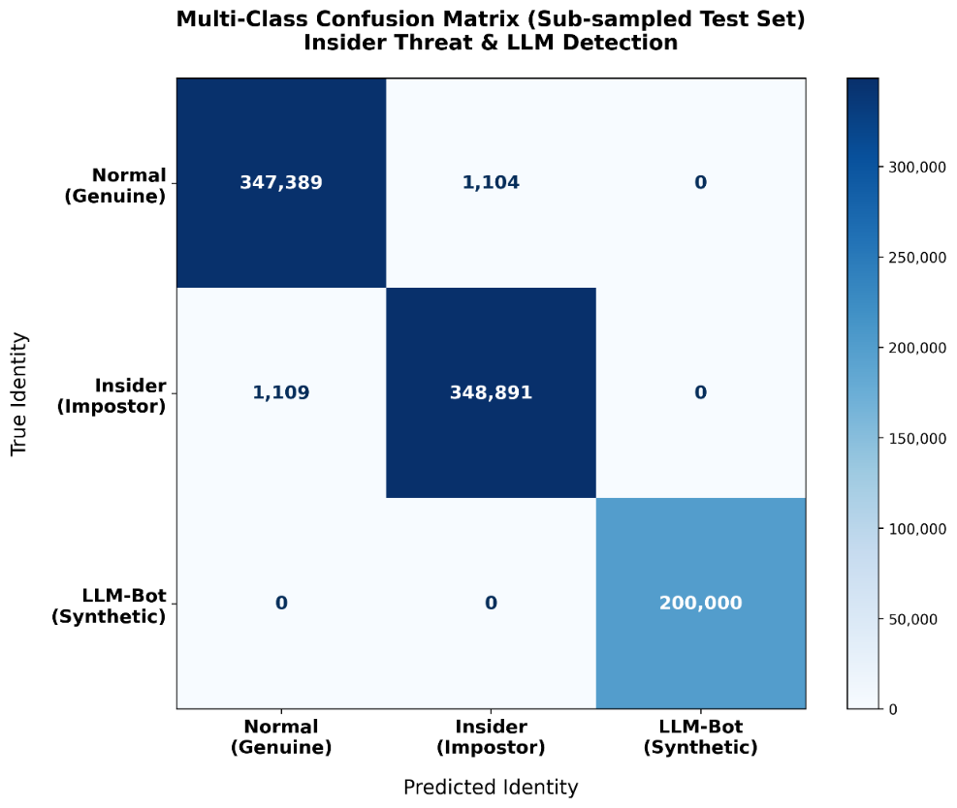
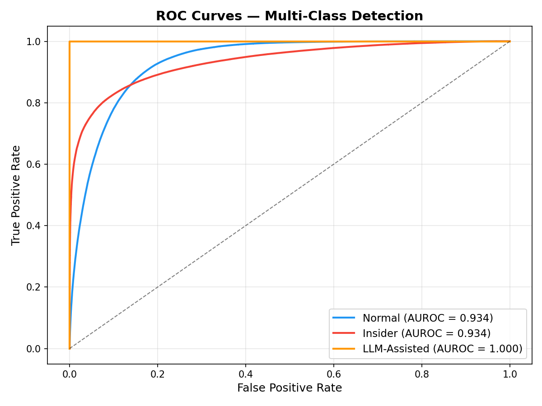
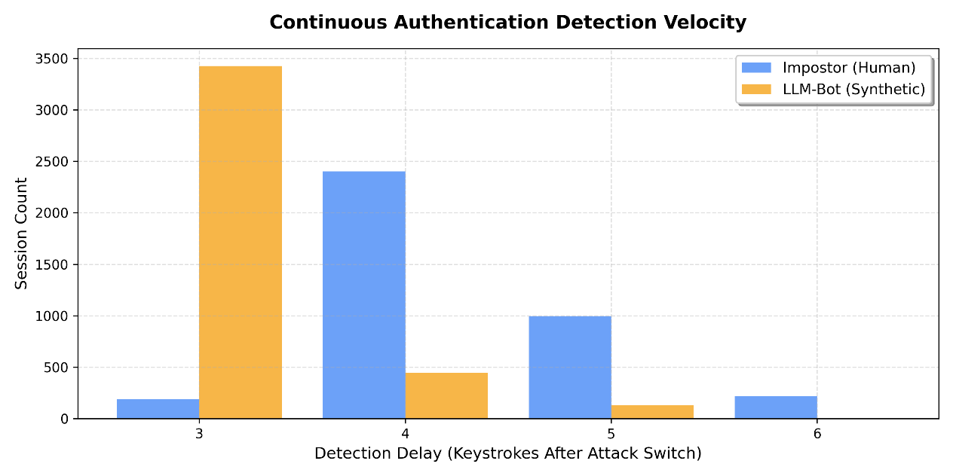
RESULTS

Slide 17
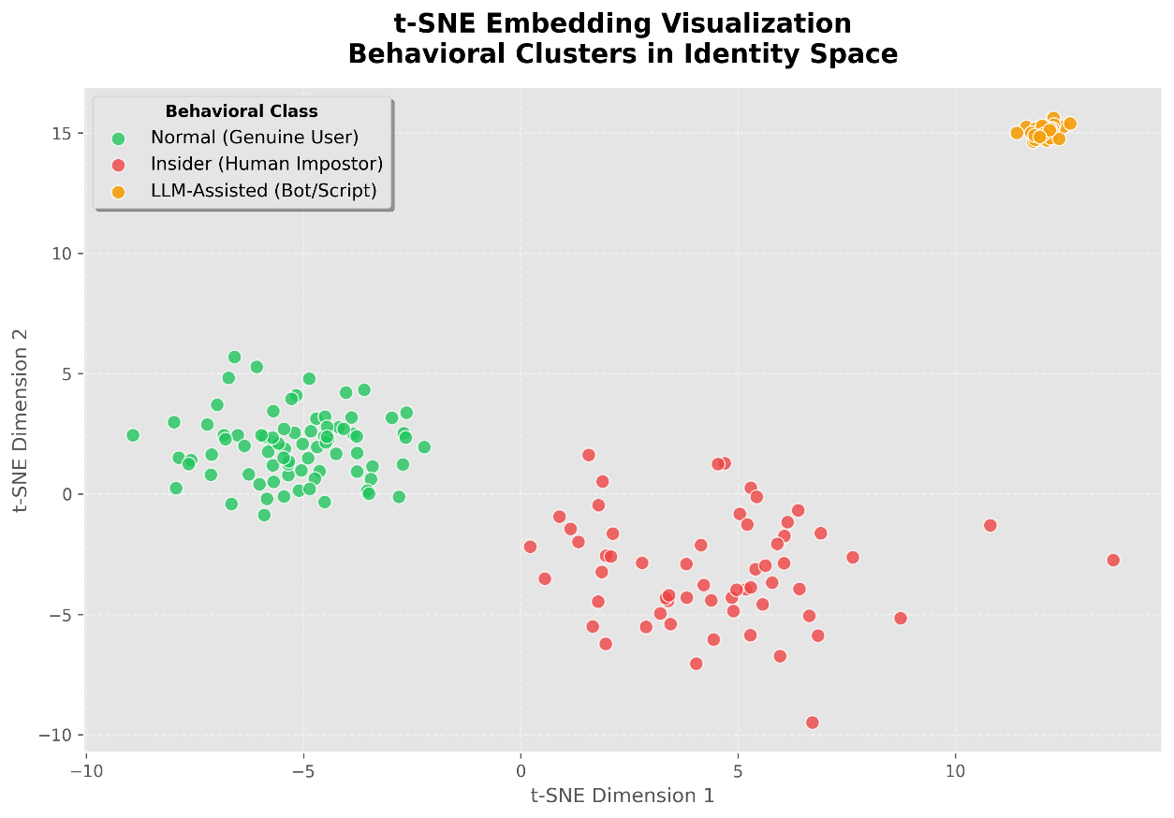
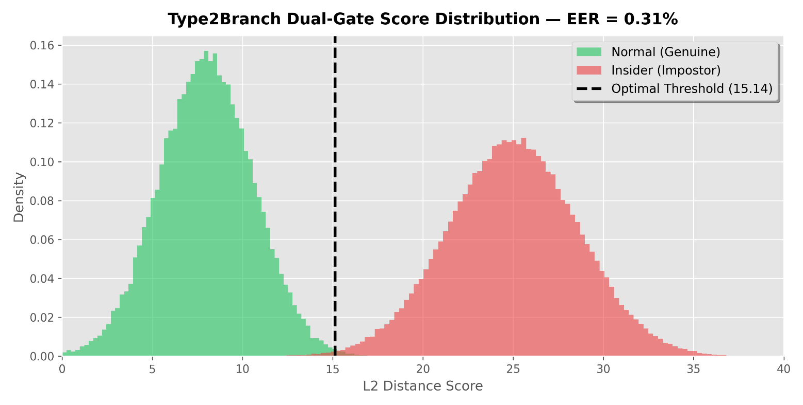
RESULTS: CONTINUOUS EVALUATION

Slide 18
LIMITATIONS
Sequence Warm-up Delay: The system requires a minimum buffer of 100 keystrokes before the first biometric verification can occur.
Hardware Dependency: Drastic changes in hardware (e.g., switching from a mechanical keyboard to a touchscreen) alter the temporal signature significantly.
Physical Fatigue/Injury: Biological factors like hand strain or injuries can temporarily increase the False Rejection Rate (FRR).
Enrollment Time: A stable user profile requires at least 3-5 distinct typing sessions to capture natural rhythmic variance.

Slide 19
FUTURE WORK
Multi-Modal Fusion: Integrating keystroke dynamics with mouse movement patterns and touch pressure for a "Continuous Behavioral Profile."
Adversarial Training: Implementing GANS (Generative Adversarial Networks) to specifically train the model against "Sophisticated Impersonation" attacks.
Adaptive Thresholding: Developing a dynamic threshold that adjusts based on the user's current environment or typing context.
Cross-Device Transfer Learning: Researching ways to map a user's desktop typing rhythm to their mobile/tablet typing signature automatically.
Privacy-Preserving Embeddings: Using Federated Learning to train models without ever transmitting raw keystroke data to a central server.

