Slide 1



SOFTWARE ENGINEERING
Presentation by:
Mehar Hamid Ishfaq 201980038
Muhammad Nadeem 201980050
Abdullah Shahid 201370234
Software Engineering| 2023
Gift University

Slide 2
INTRODUCTION
"Today, we'll explore three fundamental concepts in software engineering:
'Realization' and the 'Association' and Visibility of class members. While these four types of association are essential for defining relationships between classes or objects in a system. Together, they form the backbone of effective software design and development. Let's dive in."
Software Engineering | 2023 | Gift University

Slide 3
SDLC
The SDLC typically consists of several well-defined phases, which may vary slightly depending on the specific SDLC model or methodology being used. These phases typically include:
Requirements Gathering and Analysis.
System Design.
Detailed Design.
Realization (Implementation).
Testing.
Deployment.
Maintenance and Support.
Software Engineering | 2023 | Gift University

Slide 4
REALIZATION
Realization is a fundamental part of the Software Development Life Cycle (SDLC). In the context of SDLC, realization refers to the phase where the actual software system is constructed or developed based on the specifications, designs, and requirements defined in earlier phases of the SDLC.
Software Engineering | 2023 | Gift University

Slide 5
EXAPMLES
Software Development:
Creating a Website: Imagine a web developer who has designed a website for an online store. The realization phase involves writing the HTML, CSS, and JavaScript code, creating the database for product information.
Engineering:
Building a Bridge: In civil engineering, realization refers to the actual construction of a bridge based on the architectural and engineering plans.
Software Engineering | 2023 | Gift University

Slide 6

ASSOCIATION TYPES
ASSOCIATION
AGGREGATION
Aggregation is a special type of association that represents a "whole-part" relationship between classes(Week Relation)
Example:
Car <> Audio Player
An association represents a basic relationship between classes or objects
Example:
Customer(1) <> Account(M)
Software Engineering | 2023 | Gift University

Slide 7
ASSOCIATION TYPES
COMPOSITION
DEPENDENCY
Composition is a stronger form of aggregation.(Tightly couple Relationship.)
Example:
Document <> Shapes
Dependency represents a relationship in which one class relies on or is dependent on another class.
Example:
Client <> Server
Software Engineering | 2023 | Gift University

Slide 8

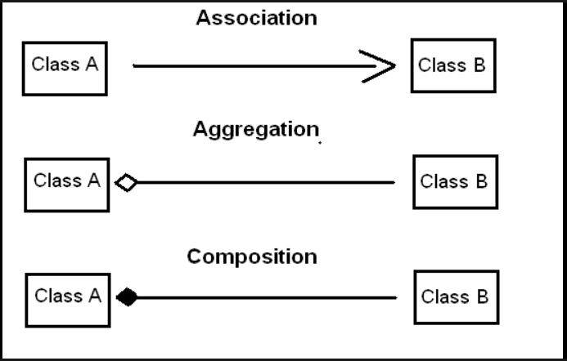

REPRSENTAIONS
Software Engineering | 2023 | Gift University

Slide 9
VISIBILITY OF CLASS MEMBERS
PUBLIC( + )
PRIVATE( − )
PROTECTED( # )
PACKAGE (~)
Accessible from anywhere, no restrictions, open to all code.
Only within class, highest encapsulation, hidden from outsiders.
In class and subclasses, not from outside class hierarchy.
Access within package/module, restricted outside
a package/module.
Software Engineering | 2023 | Gift University

Slide 10
CONCLUSION
The world of software engineering thrives on the principles of access control, association types, and the realization phase. These concepts serve as our guiding lights in crafting efficient, secure, and maintainable software.
Access control modifiers grant us the power to manage the visibility of our class members, ensuring data integrity and controlled access. Meanwhile, the four types of association empower us to model complex relationships, providing a structural framework that makes our code comprehensible and scalable.
Software Engineering | 2023 | Gift University

Slide 11
REFERENCES
SLIDES
Material Provided by instructor.
GOOGLE
Images for representations
OPEN AI
For knowledge enhancement and paraphrasing.
Software Engineering | 2023 | Gift University

Slide 12
THANK YOU
Software Engineering | 2023
GIFT University

