Slide 1
Introduction
Mental health disorders are global health issues.
Barriers to care include social bias, lack of awareness , and high cost.
Digital transformation offers accessible and cost-effective solutions.
The project aims to fill the gap in mental health care with a comprehensive digital solution.

Slide 2
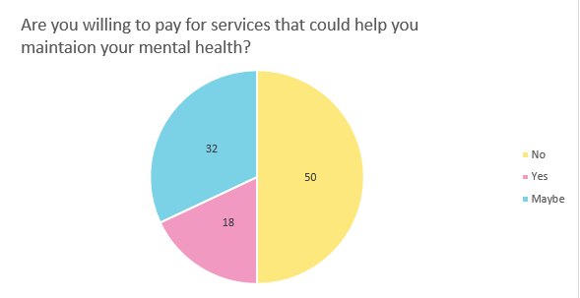
Problem statement
Limited Access to Mental Health Care: high Cost, availability, and social bias.
Traditional Systems: They often fail to meet diverse needs of mental health .

Slide 3
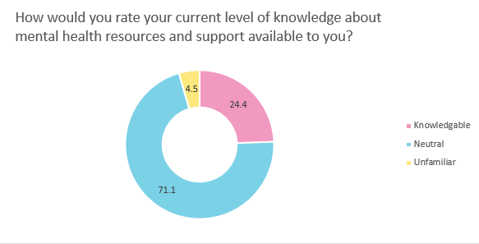
Problem statement
Lack of Personalized and Accessible Resources: Critical barrier to improving well-being.
Lack of knowledge : This project seeks to address the urgent need for an innovative solution that bridges the gap in mental health care, providing users with an integrated approach to managing their mental health

Slide 4
Objective
Secure and Accessible Authentication System: Ensure high levels of data privacy and security for user accounts.
Personalized mental health care plans are created to align with user preferences.
Advanced Mental Health Management Features: Include mood tracking, CBT modules, stress and depression detection, and meditation exercises.
Educational Resources: Provide information to increase awareness and self-management skills.
User-Friendly Interface Design: Ensure ease of use for diverse users, enhancing engagement and satisfaction.

Slide 5

Related works
Pros
Very useful and educational content about well-being
Have a science based activities to overcome negative thoughts
Cons
Focused on Gamified approach which is not suitable for everyone
The content is too generic and there is no much variety for each user
Too many features are locked with premium subscription

Slide 6

Related works
Pros
Very good meditation content
Friendly user interface and easy to navigate
Cons
Lack of tracking features
Lack of user personalized content
High subscription cost
Less focus on other mental health approaches besides meditation

