Slide 1


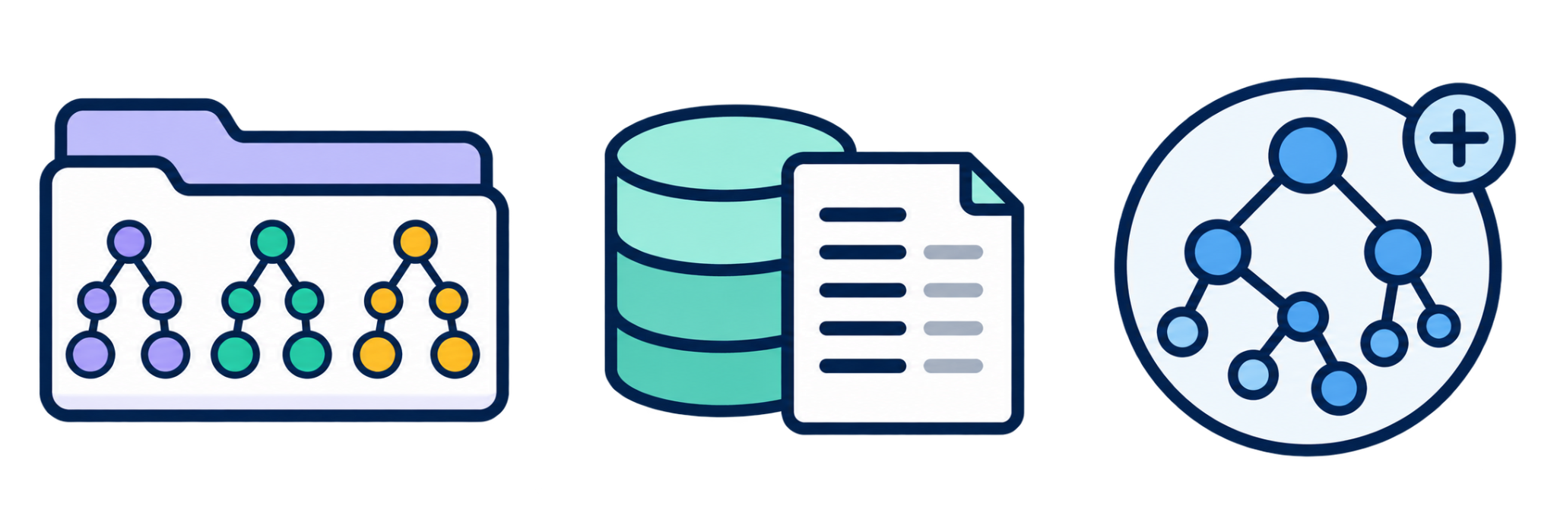

RIGOR / REASSEMBLING THE ARCHITECTURE
1. Follow the foreign keys
Start where the foreign-key dependencies begin.
(a)
Iterate
Schema S
FK-BFS
1 / 6
Notes:
[7:19–7:29] SPOKEN SCRIPT (18 words)
Let me put the pieces together, as in the paper's Figure 1. First, the schema decides the order.
PRESENTER / POINTER: Quick click. Reconnect, do not re-explain.
AUDIENCE TAKEAWAY: Order.
SOURCE AND SCOPE: Paper Fig. 1(a).

Slide 2
RIGOR / REASSEMBLING THE ARCHITECTURE
2. Anchor generation in the schema
The schema-grounded branch feeds the generation step.
(b)
Direct mapping
OWL seed DMᵣ
(a)
Iterate
Schema S
FK-BFS
2 / 6
Notes:
[7:29–7:37] SPOKEN SCRIPT (14 words)
Each table then gets its deterministic seed: the structural anchor for everything that follows.
PRESENTER / POINTER: Quick click.
AUDIENCE TAKEAWAY: Seed.
SOURCE AND SCOPE: Paper Fig. 1(b).

Slide 3
RIGOR / REASSEMBLING THE ARCHITECTURE
3. Retrieve the missing semantics
Context is retrieved independently from three sources.
(b)
Direct mapping
OWL seed DMᵣ
(a)
RETRIEVAL • top-k per source
(c)
External ontologies
Iterate
Domain alignments
Schema S
FK-BFS
(d)
Documentation
Cryptic fields and codes
(e)
Growing core ontology
Reuse validated IRIs
3 / 6
Notes:
[7:37–7:46] SPOKEN SCRIPT (15 words)
Three retrieval channels add meaning: external ontologies, documentation, and the core ontology built so far.
PRESENTER / POINTER: Quick click.
AUDIENCE TAKEAWAY: Retrieve.
SOURCE AND SCOPE: Paper Fig. 1(c-e).

Slide 4
RIGOR / REASSEMBLING THE ARCHITECTURE
4. Generate a delta ontology
The Gen-LLM receives the direct mapping and the retrieved context.
(b)
Direct mapping
OWL seed DMᵣ
(a)
RETRIEVAL • top-k per source
(c)
External ontologies
(f)
Iterate
Domain alignments
(g) ΔOᵣ
Schema S
FK-BFS
Gen-LLM
(d)
Documentation
creates ΔOᵣ
Cryptic fields and codes
(e)
Growing core ontology
Reuse validated IRIs
4 / 6
Notes:
[7:46–7:51] SPOKEN SCRIPT (10 words)
The Gen-LLM combines seed and context into a delta ontology.
PRESENTER / POINTER: Quick click.
AUDIENCE TAKEAWAY: Generate.
SOURCE AND SCOPE: Paper Fig. 1(f-g).

Slide 5
RIGOR / REASSEMBLING THE ARCHITECTURE
5. Validate before integration
Validate and refine each delta before it joins the core.
(b)
Direct mapping
OWL seed DMᵣ
(a)
RETRIEVAL • top-k per source
(c)
External ontologies
(h)
Iterate
(f)
Validate + refine
Domain alignments
(g) ΔOᵣ
Schema S
FK-BFS
Gen-LLM
Judge-LLM + rules
(d)
Documentation
creates ΔOᵣ
Cryptic fields and codes
(e)
Growing core ontology
Reuse validated IRIs
5 / 6
Notes:
[7:51–7:58] SPOKEN SCRIPT (12 words)
A Judge-LLM and rule-based checks validate the delta before it can join.
PRESENTER / POINTER: Quick click.
AUDIENCE TAKEAWAY: Validate.
SOURCE AND SCOPE: Paper Fig. 1(h).

Slide 6
RIGOR / REASSEMBLING THE ARCHITECTURE
6. Integrate and reuse the growing core
The growing core feeds the next generation iteration.
(b)
Direct mapping
OWL seed DMᵣ
(a)
RETRIEVAL • top-k per source
(c)
External ontologies
(h)
Iterate
(f)
Validate + refine
Domain alignments
(g) ΔOᵣ
Schema S
FK-BFS
Gen-LLM
Judge-LLM + rules
(d)
Documentation
creates ΔOᵣ
Cryptic fields and codes
(e)
Growing core ontology
(i)
Reuse validated IRIs
Integrate ΔOᵣ
Core Oₜ
Oₜ
6 / 6
Notes:
[7:33–7:44] SPOKEN SCRIPT (20 words)
And the validated delta is merged into the core, which feeds retrieval for the next table. That loop is RIGOR.
PRESENTER / POINTER: Trace the green return arrow from (i) back to (e).
AUDIENCE TAKEAWAY: Merge, and loop.
SOURCE AND SCOPE: Paper Fig. 1(i).

