Slide 1
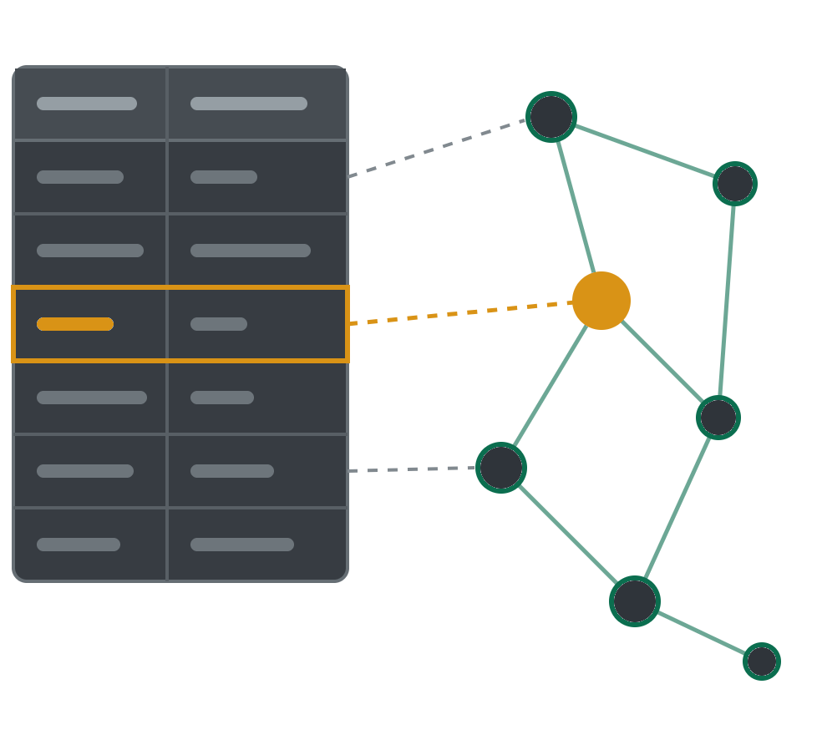
RESEARCH PAPER
RIGOR
Retrieval-Augmented
Generation of Ontologies
from Relational Databases
RIGOR
Nadeen Fathallah¹ · Mojtaba Nayyeri¹ · Athish A Yogi¹
Ratan Bahadur Thapa¹ · Hans-Michael Tautenhahn³
Anton Schnurpel³ · Steffen Staab^{1,2}
relational database
ontology
¹ Institute for Artificial Intelligence, University of Stuttgart, Germany
² University of Southampton, United Kingdom
³ Universitätsklinikum Leipzig, Germany
ISWC 2026
Bari, Italy
PAPER arXiv:2506.01232 CODE github.com/NadeenAhmad/RIGOR
Notes:
[0:00–0:25] SPOKEN SCRIPT (43 words)
Good morning. I'm Nadeen Fathallah, from the University of Stuttgart. Relational databases run hospitals, banks and governments. But their schemas tell us how data is stored, not what it means. This talk is about RIGOR: turning those schemas into rich OWL ontologies, automatically.
PRESENTER / POINTER: Calm, slow start. Do not read the author list.
AUDIENCE TAKEAWAY: Schemas store data, not meaning.
SOURCE AND SCOPE: Paper Section 1.

Slide 2
MOTIVATION / ILLUSTRATIVE CLINICAL EXAMPLE
A database can tell us how data is stored.
Can it tell us what the data means?
RELATIONAL SCHEMA · EXCERPT
WHAT WE STILL NEED TO UNDERSTAND
admission
How do we represent the link
from an admission to its patient?
01
patient_id
PatientData
admission_id
PK
patient_id
PK
patient_id
FK
Which clinical concept
does this abbreviation mean?
BM_DEP
INT
02
BM_DEP
age
INT
gender
TEXT
ecog_stage
INT
What do the encoded
score values mean?
03
ecog_stage
The FK links an admission to a patient.
Those meanings matter for ontology-based access, knowledge graphs and integration.
Notes:
[0:25–1:07] SPOKEN SCRIPT (74 words)
Imagine you inherit this clinical database. Admission points to PatientData through a foreign key. That link is clear. But look at the columns. What is BM_DEP? What does an ECOG stage of three mean? The schema cannot tell you. Yet these meanings are exactly what ontology-based access, knowledge graphs and data integration need. So our problem is not reading the SQL. It is recovering the domain meaning, while keeping the structure we can trust.
PRESENTER / POINTER: Point at the FK arrow, then BM_DEP, then ecog_stage. Let the questions hang for a second.
AUDIENCE TAKEAWAY: The schema knows storage and links, not clinical meaning.
SOURCE AND SCOPE: Illustrative table assembled from examples in paper Sections 3.2 and 3.4.

Slide 3
WHAT WE WANT TO BUILD
Not just a cleaner schema.
A usable semantic model.
INPUT
TARGET
admission
admission_id
PK
patient_id
FK
BM_DEP
INT
ecog_stage
INT
Notes:
[1:07–1:59] SPOKEN SCRIPT (91 words)
Here is what we want. [click] First, what the schema alone gives us: Admission becomes a class with a real relation to PatientData, and every property points back to its source column. [click] The documentation adds human-readable labels: Bone Marrow Depression, ECOG Performance Status. [click] A standard vocabulary adds a link to the Disease Ontology. [click] And the LLM's own knowledge adds what the ECOG codes mean, and that an admission is not a patient. [click] That is a usable semantic model. The challenge is to add all this without losing a single column or link.
PRESENTER / POINTER: Five clicks, one per knowledge source: schema, documentation, Disease Ontology, LLM knowledge, then 'What this enables'. The gloss colours match the sources.
AUDIENCE TAKEAWAY: A usable model combines schema, documentation, standard vocabularies and LLM knowledge.
SOURCE AND SCOPE: Illustrative fragment, verified with the OWL API at every reveal step (presentation/excerpts/slide03_*.omn). obo:DOID_4961 = Disease Ontology 'bone marrow disease'; skos:relatedMatch, not exactMatch, because BM_DEP is a yes/no column, not the disease. Provenance is column-level, as defined in paper Section 3.2.

Slide 4
WHAT WE WANT TO BUILD
Not just a cleaner schema.
A usable semantic model.
INPUT
TARGET
hasPatientData
admission
Admission
PatientData
admission_id
PK
Class: Admission
SubClassOf:
patient_id
FK
admission_id some xsd:integer,
hasPatientData some PatientData,
← schema (foreign key)
BM_DEP
INT
BM_DEP only xsd:integer,
ecog_stage only xsd:integer
ecog_stage
INT
DataProperty: admission_id
ObjectProperty: hasPatientData
← schema (foreign key)
DataProperty: BM_DEP
Annotations:
prov:wasDerivedFrom admission:BM_DEP
← source column
DataProperty: ecog_stage
Annotations:
prov:wasDerivedFrom admission:ecog_stage
← source column
Notes:
[1:07–1:59] SPOKEN SCRIPT (91 words)
Here is what we want. [click] First, what the schema alone gives us: Admission becomes a class with a real relation to PatientData, and every property points back to its source column. [click] The documentation adds human-readable labels: Bone Marrow Depression, ECOG Performance Status. [click] A standard vocabulary adds a link to the Disease Ontology. [click] And the LLM's own knowledge adds what the ECOG codes mean, and that an admission is not a patient. [click] That is a usable semantic model. The challenge is to add all this without losing a single column or link.
PRESENTER / POINTER: Five clicks, one per knowledge source: schema, documentation, Disease Ontology, LLM knowledge, then 'What this enables'. The gloss colours match the sources.
AUDIENCE TAKEAWAY: A usable model combines schema, documentation, standard vocabularies and LLM knowledge.
SOURCE AND SCOPE: Illustrative fragment, verified with the OWL API at every reveal step (presentation/excerpts/slide03_*.omn). obo:DOID_4961 = Disease Ontology 'bone marrow disease'; skos:relatedMatch, not exactMatch, because BM_DEP is a yes/no column, not the disease. Provenance is column-level, as defined in paper Section 3.2.

Slide 5
WHAT WE WANT TO BUILD
Not just a cleaner schema.
A usable semantic model.
INPUT
TARGET
hasPatientData
admission
Admission
PatientData
admission_id
PK
Class: Admission
SubClassOf:
patient_id
FK
admission_id some xsd:integer,
hasPatientData some PatientData,
← schema (foreign key)
BM_DEP
INT
BM_DEP only xsd:integer,
ecog_stage only xsd:integer
ecog_stage
INT
DataProperty: admission_id
ObjectProperty: hasPatientData
← schema (foreign key)
DataProperty: BM_DEP
Annotations:
rdfs:label "Bone Marrow Depression"@en,
← documentation
prov:wasDerivedFrom admission:BM_DEP
← source column
DataProperty: ecog_stage
Annotations:
rdfs:label "ECOG Performance Status"@en,
← documentation
prov:wasDerivedFrom admission:ecog_stage
← source column
Notes:
[1:07–1:59] SPOKEN SCRIPT (91 words)
Here is what we want. [click] First, what the schema alone gives us: Admission becomes a class with a real relation to PatientData, and every property points back to its source column. [click] The documentation adds human-readable labels: Bone Marrow Depression, ECOG Performance Status. [click] A standard vocabulary adds a link to the Disease Ontology. [click] And the LLM's own knowledge adds what the ECOG codes mean, and that an admission is not a patient. [click] That is a usable semantic model. The challenge is to add all this without losing a single column or link.
PRESENTER / POINTER: Five clicks, one per knowledge source: schema, documentation, Disease Ontology, LLM knowledge, then 'What this enables'. The gloss colours match the sources.
AUDIENCE TAKEAWAY: A usable model combines schema, documentation, standard vocabularies and LLM knowledge.
SOURCE AND SCOPE: Illustrative fragment, verified with the OWL API at every reveal step (presentation/excerpts/slide03_*.omn). obo:DOID_4961 = Disease Ontology 'bone marrow disease'; skos:relatedMatch, not exactMatch, because BM_DEP is a yes/no column, not the disease. Provenance is column-level, as defined in paper Section 3.2.

Slide 6
WHAT WE WANT TO BUILD
Not just a cleaner schema.
A usable semantic model.
INPUT
TARGET
hasPatientData
admission
Admission
PatientData
admission_id
PK
Class: Admission
SubClassOf:
patient_id
FK
admission_id some xsd:integer,
hasPatientData some PatientData,
← schema (foreign key)
BM_DEP
INT
BM_DEP only xsd:integer,
ecog_stage only xsd:integer
ecog_stage
INT
DataProperty: admission_id
ObjectProperty: hasPatientData
← schema (foreign key)
DataProperty: BM_DEP
Annotations:
rdfs:label "Bone Marrow Depression"@en,
← documentation
skos:relatedMatch obo:DOID_4961,
← Disease Ontology
prov:wasDerivedFrom admission:BM_DEP
← source column
DataProperty: ecog_stage
Annotations:
rdfs:label "ECOG Performance Status"@en,
← documentation
prov:wasDerivedFrom admission:ecog_stage
← source column
Notes:
[1:07–1:59] SPOKEN SCRIPT (91 words)
Here is what we want. [click] First, what the schema alone gives us: Admission becomes a class with a real relation to PatientData, and every property points back to its source column. [click] The documentation adds human-readable labels: Bone Marrow Depression, ECOG Performance Status. [click] A standard vocabulary adds a link to the Disease Ontology. [click] And the LLM's own knowledge adds what the ECOG codes mean, and that an admission is not a patient. [click] That is a usable semantic model. The challenge is to add all this without losing a single column or link.
PRESENTER / POINTER: Five clicks, one per knowledge source: schema, documentation, Disease Ontology, LLM knowledge, then 'What this enables'. The gloss colours match the sources.
AUDIENCE TAKEAWAY: A usable model combines schema, documentation, standard vocabularies and LLM knowledge.
SOURCE AND SCOPE: Illustrative fragment, verified with the OWL API at every reveal step (presentation/excerpts/slide03_*.omn). obo:DOID_4961 = Disease Ontology 'bone marrow disease'; skos:relatedMatch, not exactMatch, because BM_DEP is a yes/no column, not the disease. Provenance is column-level, as defined in paper Section 3.2.

Slide 7
WHAT WE WANT TO BUILD
Not just a cleaner schema.
A usable semantic model.
INPUT
TARGET
hasPatientData
admission
Admission
PatientData
admission_id
PK
Class: Admission
SubClassOf:
patient_id
FK
admission_id some xsd:integer,
hasPatientData some PatientData,
← schema (foreign key)
BM_DEP
INT
BM_DEP only xsd:integer,
ecog_stage only xsd:integer
ecog_stage
INT
DataProperty: admission_id
ObjectProperty: hasPatientData
← schema (foreign key)
DataProperty: BM_DEP
Annotations:
rdfs:label "Bone Marrow Depression"@en,
← documentation
skos:relatedMatch obo:DOID_4961,
← Disease Ontology
prov:wasDerivedFrom admission:BM_DEP
← source column
DataProperty: ecog_stage
Annotations:
rdfs:label "ECOG Performance Status"@en,
← documentation
rdfs:comment "0 = fully active … 5 = dead"@en,
prov:wasDerivedFrom admission:ecog_stage
← source column
Notes:
[1:07–1:59] SPOKEN SCRIPT (91 words)
Here is what we want. [click] First, what the schema alone gives us: Admission becomes a class with a real relation to PatientData, and every property points back to its source column. [click] The documentation adds human-readable labels: Bone Marrow Depression, ECOG Performance Status. [click] A standard vocabulary adds a link to the Disease Ontology. [click] And the LLM's own knowledge adds what the ECOG codes mean, and that an admission is not a patient. [click] That is a usable semantic model. The challenge is to add all this without losing a single column or link.
PRESENTER / POINTER: Five clicks, one per knowledge source: schema, documentation, Disease Ontology, LLM knowledge, then 'What this enables'. The gloss colours match the sources.
AUDIENCE TAKEAWAY: A usable model combines schema, documentation, standard vocabularies and LLM knowledge.
SOURCE AND SCOPE: Illustrative fragment, verified with the OWL API at every reveal step (presentation/excerpts/slide03_*.omn). obo:DOID_4961 = Disease Ontology 'bone marrow disease'; skos:relatedMatch, not exactMatch, because BM_DEP is a yes/no column, not the disease. Provenance is column-level, as defined in paper Section 3.2.

Slide 8
WHAT WE WANT TO BUILD
Not just a cleaner schema.
A usable semantic model.
INPUT
TARGET
hasPatientData
admission
Admission
PatientData
admission_id
PK
Class: Admission
SubClassOf:
patient_id
FK
admission_id some xsd:integer,
hasPatientData some PatientData,
← schema (foreign key)
BM_DEP
INT
BM_DEP only xsd:integer,
ecog_stage only xsd:integer
ecog_stage
INT
DataProperty: admission_id
ObjectProperty: hasPatientData
← schema (foreign key)
DataProperty: BM_DEP
Annotations:
rdfs:label "Bone Marrow Depression"@en,
← documentation
WHAT THIS ENABLES
Ontology-based data access (OBDA)
Knowledge graph population
Semantic data integration
skos:relatedMatch obo:DOID_4961,
← Disease Ontology
prov:wasDerivedFrom admission:BM_DEP
← source column
DataProperty: ecog_stage
Annotations:
rdfs:label "ECOG Performance Status"@en,
← documentation
rdfs:comment "0 = fully active … 5 = dead"@en,
prov:wasDerivedFrom admission:ecog_stage
← source column
Notes:
[1:07–1:59] SPOKEN SCRIPT (91 words)
Here is what we want. [click] First, what the schema alone gives us: Admission becomes a class with a real relation to PatientData, and every property points back to its source column. [click] The documentation adds human-readable labels: Bone Marrow Depression, ECOG Performance Status. [click] A standard vocabulary adds a link to the Disease Ontology. [click] And the LLM's own knowledge adds what the ECOG codes mean, and that an admission is not a patient. [click] That is a usable semantic model. The challenge is to add all this without losing a single column or link.
PRESENTER / POINTER: Five clicks, one per knowledge source: schema, documentation, Disease Ontology, LLM knowledge, then 'What this enables'. The gloss colours match the sources.
AUDIENCE TAKEAWAY: A usable model combines schema, documentation, standard vocabularies and LLM knowledge.
SOURCE AND SCOPE: Illustrative fragment, verified with the OWL API at every reveal step (presentation/excerpts/slide03_*.omn). obo:DOID_4961 = Disease Ontology 'bone marrow disease'; skos:relatedMatch, not exactMatch, because BM_DEP is a yes/no column, not the disease. Provenance is column-level, as defined in paper Section 3.2.

Slide 9
THE RESEARCH GAP
Two partial solutions. Neither solves the whole problem.
SCHEMA-FIRST RULES
LLM-FIRST GENERATION
Preserve the structure
Suggest the meaning
Tables, columns and foreign keys can be mapped systematically.
Labels, concepts and plausible relationships can be proposed.
But implicit domain semantics remain missing.
But elements may be omitted or modeled incorrectly.
W3C Direct Mapping [Arenas et al. 2012; Sequeda et al. 2012] · BootOX [Jiménez‑Ruiz et al., ISWC 2015] · Ben Mahria et al. [J. Big Data 2021]
LLMs4OL [Babaei Giglou et al., ISWC 2023] · Mateiu & Groza [SYNASC 2023] · OntoGenix [Val‑Calvo et al., IP&M 2025] · LLM4VKG [Xiao et al., IJCAI 2025]
OUR QUESTION
Can we preserve schema fidelity and add domain semantics across the full database?
Notes:
[1:48–2:26] SPOKEN SCRIPT (66 words)
Existing work solves half of this. Schema-first rules, like direct mapping, preserve the structure: every table, column and foreign key. But they add no domain meaning. LLMs can suggest meaning: labels, concepts, relations. But they omit columns, or model keys wrongly. So our question is: can we keep schema fidelity and add domain semantics, across a whole database, with no expert in the loop during generation?
PRESENTER / POINTER: Left card, right card, then land on the question.
AUDIENCE TAKEAWAY: Rules keep structure; LLMs suggest meaning; we need both.
SOURCE AND SCOPE: Paper Sections 1-2.

Slide 10
OUR ANSWER / RIGOR
Build the ontology one table at a time.
We will construct the answer to our admission example, together.
WHAT WE HAVE
WHAT WE WANT
admission
hasPatientData
Admission
PatientData
patient_id
FK
BM_DEP
INT
+ meaningful labels + encoded values
ecog_stage
INT
+ provenance + logical axioms (hierarchy, disjointness)
+ links to standard vocabularies
We need to preserve structure, discover meaning, and prevent mistakes, at database scale.
1 ORDER
2 SEED
3 RETRIEVE
4 GENERATE
5 VALIDATE
6 MERGE
Notes:
[2:26–2:50] SPOKEN SCRIPT (42 words)
Our answer is RIGOR. It builds the ontology one table at a time, in six steps: order, seed, retrieve, generate, validate, merge. And as a preview: experts ranked it first in seventy percent of their rankings. Let's build it on our example.
PRESENTER / POINTER: Sweep along the six steps. Point at the result preview once.
AUDIENCE TAKEAWAY: Six steps, one table at a time.
SOURCE AND SCOPE: Paper Section 3.1, Fig. 1; preview from Table 1.

Slide 11
STEP 1 / ORDER
To understand this table, build its parent first.
We follow foreign-key dependencies, so known concepts are available when needed.
DATABASE DEPENDENCIES
PROCESSING ORDER / OUTPUT
PatientData
admission
t = 1
t = 2
No FKs
patient_id FK
PatientData
admission
FK points to parent
Before generating admission, PatientData already exists in the core ontology.
WHY IT MATTERS The next fragment can reuse known classes and IRIs instead of inventing duplicates.
1 ORDER
2 SEED
3 RETRIEVE
4 GENERATE
5 VALIDATE
6 MERGE
Notes:
[2:50–3:22] SPOKEN SCRIPT (56 words)
Step one: order. Admission points to PatientData, so we build PatientData first. In general, RIGOR follows the foreign keys breadth-first: a table is processed once the tables it references are done. Why? By the time we reach Admission, PatientData already exists in our ontology. So we reuse that class, instead of inventing a second, incompatible one.
PRESENTER / POINTER: Follow the FK arrow, then the processing order.
AUDIENCE TAKEAWAY: Parents first, so later tables reuse known classes.
SOURCE AND SCOPE: Paper Sections 3.1-3.2 (FK-guided breadth-first order).

Slide 12
STEP 2 / SEED
Guarantee schema coverage before LLM enrichment.
Direct Mapping (DMᵣ) represents every column in the table before generation.
INPUT
OUTPUT / DM_{r}
Class: Admission
SubClassOf:
admission_id some xsd:integer,
patient_id some PatientData, ← each has a patient
BM_DEP only xsd:integer, ← if present, an integer
ecog_stage only xsd:integer
DataProperty: admission_id
ObjectProperty: patient_id ← the FK becomes a link
DataProperty: BM_DEP
DataProperty: ecog_stage
admission
patient_id
FK → PatientData
BM_DEP
INT
ecog_stage
INT
GUARANTEE Every schema column is represented in the deterministic seed.
1 ORDER
2 SEED
3 RETRIEVE
4 GENERATE
5 VALIDATE
6 MERGE
Notes:
[3:22–3:59] SPOKEN SCRIPT (66 words)
Step two: seed. Before any LLM is involved, a deterministic direct mapping turns the table into OWL. Admission becomes a class. The foreign key becomes an object property, and every admission must have a patient. Each column becomes a data property with its XSD type. This seed covers every column of the cleaned table, by construction. So the LLM's job is to enrich, not to invent.
PRESENTER / POINTER: Read the glosses: 'each has a patient', 'the FK becomes a link'.
AUDIENCE TAKEAWAY: A deterministic seed guarantees coverage before the LLM starts.
SOURCE AND SCOPE: Paper Section 3.2. The guarantee holds for the seed; final coverage is reported later.
IF RUNNING LATE, DROP: "So the LLM's job is to enrich, not to invent."

Slide 13
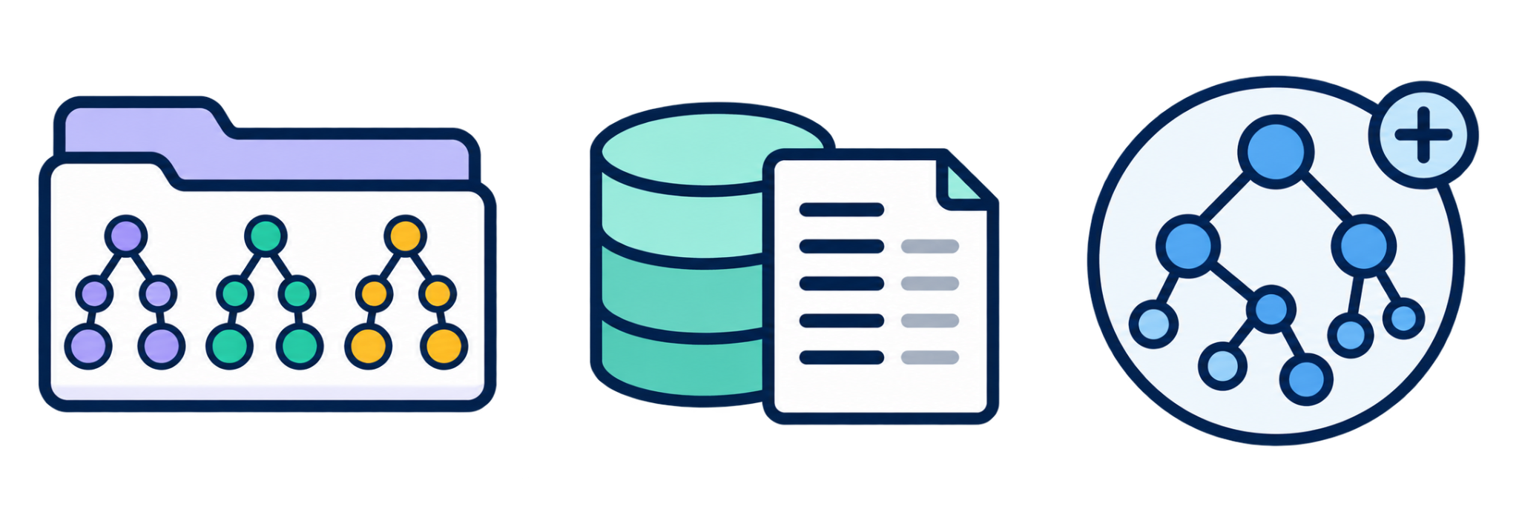
STEP 3 / RETRIEVE
The draft is structurally faithful. But what does it mean?
RIGOR gathers a context package from three complementary sources.
1 DOCUMENTATION
What do column names mean?
BM_DEP→ Bone Marrow
Depression
Defines cryptic names
1 ORDER
2 SEED
3 RETRIEVE
4 GENERATE
5 VALIDATE
6 MERGE
Notes:
[3:59–4:41] SPOKEN SCRIPT (73 words)
The seed is faithful, but it still doesn't say what BM_DEP means. So step three retrieves context from three sources. Documentation explains cryptic names and codes. External domain ontologies suggest established concepts. And the third source is the distinctive one: the ontology we have built so far. Earlier tables become evidence for the next. One query per table, built from its name, columns and foreign keys, retrieves the top three matches per source.
PRESENTER / POINTER: Walk the three cards; slow down on the growing core.
AUDIENCE TAKEAWAY: Three sources supply meaning; the growing core is unique to RIGOR.
SOURCE AND SCOPE: Paper Section 3.3 (all-MiniLM-L6-v2, Faiss, k = 3 per source).
IF RUNNING LATE, DROP: "One query per table, built from its name, columns and foreign keys, retrieves the top three matches per source."

Slide 14
STEP 3 / RETRIEVE
The draft is structurally faithful. But what does it mean?
RIGOR gathers a context package from three complementary sources.
1 DOCUMENTATION
2 EXTERNAL ONTOLOGIES
What do column names mean?
Which domain concepts exist?
BM_DEP→ Bone Marrow
Depression
Disease Ontology
Cell Ontology
Defines cryptic names
Suggests established concepts
1 ORDER
2 SEED
3 RETRIEVE
4 GENERATE
5 VALIDATE
6 MERGE
Notes:
[3:59–4:41] SPOKEN SCRIPT (73 words)
The seed is faithful, but it still doesn't say what BM_DEP means. So step three retrieves context from three sources. Documentation explains cryptic names and codes. External domain ontologies suggest established concepts. And the third source is the distinctive one: the ontology we have built so far. Earlier tables become evidence for the next. One query per table, built from its name, columns and foreign keys, retrieves the top three matches per source.
PRESENTER / POINTER: Walk the three cards; slow down on the growing core.
AUDIENCE TAKEAWAY: Three sources supply meaning; the growing core is unique to RIGOR.
SOURCE AND SCOPE: Paper Section 3.3 (all-MiniLM-L6-v2, Faiss, k = 3 per source).
IF RUNNING LATE, DROP: "One query per table, built from its name, columns and foreign keys, retrieves the top three matches per source."

Slide 15
STEP 3 / RETRIEVE
The draft is structurally faithful. But what does it mean?
RIGOR gathers a context package from three complementary sources.
1 DOCUMENTATION
2 EXTERNAL ONTOLOGIES
3 GROWING CORE
What do column names mean?
Which domain concepts exist?
What have we already defined?
BM_DEP→ Bone Marrow
Depression
Disease Ontology
Cell Ontology
PatientData + previously
accepted ontology terms
Defines cryptic names
Suggests established concepts
Reuses established concepts
1 ORDER
2 SEED
3 RETRIEVE
4 GENERATE
5 VALIDATE
6 MERGE
Notes:
[3:59–4:41] SPOKEN SCRIPT (73 words)
The seed is faithful, but it still doesn't say what BM_DEP means. So step three retrieves context from three sources. Documentation explains cryptic names and codes. External domain ontologies suggest established concepts. And the third source is the distinctive one: the ontology we have built so far. Earlier tables become evidence for the next. One query per table, built from its name, columns and foreign keys, retrieves the top three matches per source.
PRESENTER / POINTER: Walk the three cards; slow down on the growing core.
AUDIENCE TAKEAWAY: Three sources supply meaning; the growing core is unique to RIGOR.
SOURCE AND SCOPE: Paper Section 3.3 (all-MiniLM-L6-v2, Faiss, k = 3 per source).
IF RUNNING LATE, DROP: "One query per table, built from its name, columns and foreign keys, retrieves the top three matches per source."

Slide 16
STEP 3 / RETRIEVE
The draft is structurally faithful. But what does it mean?
RIGOR gathers a context package from three complementary sources.
1 DOCUMENTATION
2 EXTERNAL ONTOLOGIES
3 GROWING CORE
What do column names mean?
Which domain concepts exist?
What have we already defined?
BM_DEP→ Bone Marrow
Depression
Disease Ontology
Cell Ontology
PatientData + previously
accepted ontology terms
Defines cryptic names
Suggests established concepts
Reuses established concepts
ONE RETRIEVAL QUERY PER TABLE table + columns + FK targets → top-K per source
(e.g., admission → query: admission + patient_id,BM_DEP, ecog_stage+ PatientData)
1 ORDER
2 SEED
3 RETRIEVE
4 GENERATE
5 VALIDATE
6 MERGE
Notes:
[3:59–4:41] SPOKEN SCRIPT (73 words)
The seed is faithful, but it still doesn't say what BM_DEP means. So step three retrieves context from three sources. Documentation explains cryptic names and codes. External domain ontologies suggest established concepts. And the third source is the distinctive one: the ontology we have built so far. Earlier tables become evidence for the next. One query per table, built from its name, columns and foreign keys, retrieves the top three matches per source.
PRESENTER / POINTER: Walk the three cards; slow down on the growing core.
AUDIENCE TAKEAWAY: Three sources supply meaning; the growing core is unique to RIGOR.
SOURCE AND SCOPE: Paper Section 3.3 (all-MiniLM-L6-v2, Faiss, k = 3 per source).
IF RUNNING LATE, DROP: "One query per table, built from its name, columns and foreign keys, retrieves the top three matches per source."

Slide 17
STEP 4 / GENERATE
The LLM enriches a schema-grounded draft.
We prompt the Gen-LLM with the direct mapping, the retrieved context, and semantic enrichment instructions.
BEFORE / DIRECT MAPPING
Class: Admission
Class: Admission
SubClassOf:
SubClassOf:
admission_id some xsd:integer,
admission_id some xsd:integer,
patient_id some PatientData,
patient_id some PatientData,
BM_DEP only xsd:integer,
BM_DEP only xsd:integer,
ecog_stage only xsd:integer
ecog_stage only xsd:integer
DataProperty: admission_id
DataProperty: admission_id
ObjectProperty: patient_id
ObjectProperty: patient_id
DataProperty: BM_DEP
DataProperty: BM_DEP
DataProperty: ecog_stage
DataProperty: ecog_stage
1 ORDER
2 SEED
3 RETRIEVE
4 GENERATE
5 VALIDATE
6 MERGE
Notes:
[4:52–5:48] SPOKEN SCRIPT (98 words)
Step four: generate. We prompt the Gen-LLM with the direct mapping from step two, the retrieved context and our enrichment instructions. What comes back is a delta ontology: the same lines as on the left, with new ones inserted into the gaps. The tags show where each change came from. The foreign key becomes the named relation hasPatientData, and provenance links each property to its column: both from the schema. The labels come from the documentation, the link to bone marrow disease from the Disease Ontology, and the disjointness and the ECOG scale from the model's own knowledge.
PRESENTER / POINTER: Left to right on one row, then down the highlighted lines and their tags.
AUDIENCE TAKEAWAY: The LLM enriches a grounded draft, and every addition is traceable.
SOURCE AND SCOPE: Paper Sections 3.2-3.4. Row-aligned BEFORE/AFTER, both verified with the OWL API.

Slide 18
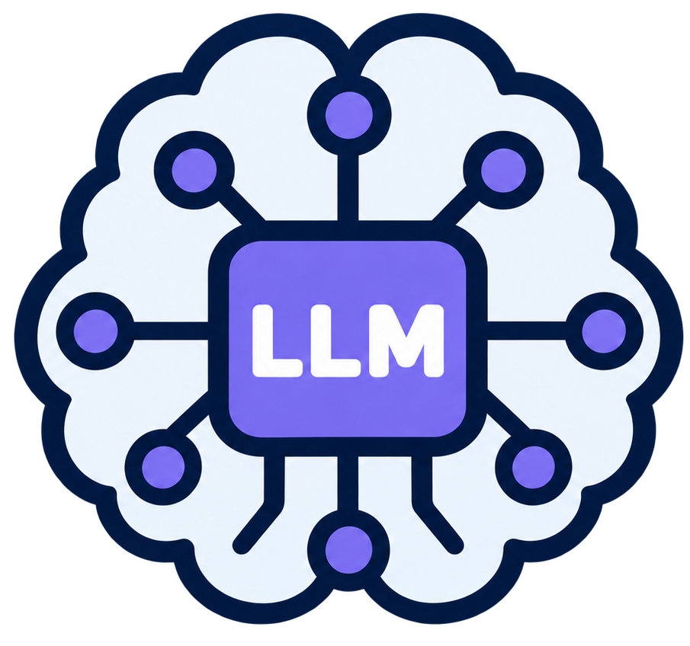
STEP 4 / GENERATE
The LLM enriches a schema-grounded draft.
We prompt the Gen-LLM with the direct mapping, the retrieved context, and semantic enrichment instructions.
BEFORE / DIRECT MAPPING
AFTER / ENRICHED ΔOᵣ (delta ontology)
Class: Admission
Class: Admission
SubClassOf:
SubClassOf:
admission_id some xsd:integer,
admission_id some xsd:integer,
patient_id some PatientData,
hasPatientData some PatientData,
SCHEMA
BM_DEP only xsd:integer,
BM_DEP only xsd:integer,
ecog_stage only xsd:integer
ecog_stage only xsd:integer
DataProperty: admission_id
DataProperty: admission_id
ObjectProperty: patient_id
ObjectProperty: hasPatientData
SCHEMA
DataProperty: BM_DEP
Gen-LLM
DataProperty: BM_DEP
Annotations:
rdfs:label "Bone Marrow Depression"@en,
DOCS
skos:relatedMatch obo:DOID_4961,
ONTOLOGY
prov:wasDerivedFrom admission:BM_DEP
SCHEMA
DataProperty: ecog_stage
DataProperty: ecog_stage
Annotations:
rdfs:label "ECOG Performance Status"@en,
DOCS
rdfs:comment "0 = fully active … 5 = dead"@en,
LLM
prov:wasDerivedFrom admission:ecog_stage
SCHEMA
1 ORDER
2 SEED
3 RETRIEVE
4 GENERATE
5 VALIDATE
6 MERGE
Notes:
[4:52–5:48] SPOKEN SCRIPT (98 words)
Step four: generate. We prompt the Gen-LLM with the direct mapping from step two, the retrieved context and our enrichment instructions. What comes back is a delta ontology: the same lines as on the left, with new ones inserted into the gaps. The tags show where each change came from. The foreign key becomes the named relation hasPatientData, and provenance links each property to its column: both from the schema. The labels come from the documentation, the link to bone marrow disease from the Disease Ontology, and the disjointness and the ECOG scale from the model's own knowledge.
PRESENTER / POINTER: Left to right on one row, then down the highlighted lines and their tags.
AUDIENCE TAKEAWAY: The LLM enriches a grounded draft, and every addition is traceable.
SOURCE AND SCOPE: Paper Sections 3.2-3.4. Row-aligned BEFORE/AFTER, both verified with the OWL API.

Slide 19

STEP 5 / VALIDATE
Why validate? Plausible fragments can still break the ontology.
STRUCTURAL ERROR · GRAPH CHECKS
Later table lab_result reuses a core property:
ObjectProperty: hasPatientData Domain: LabResult
Merged with PatientData Domain: Admission, OWL infers that every lab result is an admission (pitfall P19). Graph checks allow one domain per property.
1 ORDER
2 SEED
3 RETRIEVE
4 GENERATE
5 VALIDATE
6 MERGE
Notes:
[5:22–6:25] SPOKEN SCRIPT (110 words)
A capable LLM rarely gets syntax wrong. The real risk is a fragment that looks right but clashes with the ontology built so far. So step five validates every delta before it is merged. On the left, the model names the target class Patient, although the core already has PatientData. That is valid OWL, but now two classes mean the same thing. The Judge-LLM sees the core and asks to reuse it. On the right, a later table reuses hasPatientData with a second domain. OWL then infers that every lab result is an admission. Rule-based graph checks catch this. Failed fragments go back for correction, with up to two retries.
PRESENTER / POINTER: Left, right, then the correction strip.
AUDIENCE TAKEAWAY: The Judge catches clashes in meaning; rules catch clashes in structure.
SOURCE AND SCOPE: Paper Section 3.5 (Judge criterion 9: core ontology consistency; graph check: domain/range cardinality). Two domains = OOPS! pitfall P19, still reported in 3/9 RIGOR runs (Table 7). Examples verified with the OWL API (presentation/excerpts/slide10_*.omn).
IF ASKED: P19 is exactly the error that sometimes still slips through (3 of 9 runs); feeding validator output back into generation is our next step (slide 22).

Slide 20

STEP 5 / VALIDATE
Why validate? Plausible fragments can still break the ontology.
STRUCTURAL ERROR · GRAPH CHECKS
SEMANTIC ERROR · JUDGE-LLM
Later table lab_result reuses a core property:
Generated link for admission:
ObjectProperty: hasPatientData Domain: LabResult
ObjectProperty: hasPatient Range: Patient
Merged with PatientData Domain: Admission, OWL infers that every lab result is an admission (pitfall P19). Graph checks allow one domain per property.
Valid OWL, but the core ontology already has PatientData, now two classes mean the same thing. The JUDGE-LLM sees the core and asks to reuse it.
1 ORDER
2 SEED
3 RETRIEVE
4 GENERATE
5 VALIDATE
6 MERGE
Notes:
[5:22–6:25] SPOKEN SCRIPT (110 words)
A capable LLM rarely gets syntax wrong. The real risk is a fragment that looks right but clashes with the ontology built so far. So step five validates every delta before it is merged. On the left, the model names the target class Patient, although the core already has PatientData. That is valid OWL, but now two classes mean the same thing. The Judge-LLM sees the core and asks to reuse it. On the right, a later table reuses hasPatientData with a second domain. OWL then infers that every lab result is an admission. Rule-based graph checks catch this. Failed fragments go back for correction, with up to two retries.
PRESENTER / POINTER: Left, right, then the correction strip.
AUDIENCE TAKEAWAY: The Judge catches clashes in meaning; rules catch clashes in structure.
SOURCE AND SCOPE: Paper Section 3.5 (Judge criterion 9: core ontology consistency; graph check: domain/range cardinality). Two domains = OOPS! pitfall P19, still reported in 3/9 RIGOR runs (Table 7). Examples verified with the OWL API (presentation/excerpts/slide10_*.omn).
IF ASKED: P19 is exactly the error that sometimes still slips through (3 of 9 runs); feeding validator output back into generation is our next step (slide 22).

Slide 21
STEP 5 / VALIDATE
Why validate? Plausible fragments can still break the ontology.
STRUCTURAL ERROR · GRAPH CHECKS
SEMANTIC ERROR · JUDGE-LLM
Later table lab_result reuses a core property:
Generated link for admission:
ObjectProperty: hasPatientData Domain: LabResult
ObjectProperty: hasPatient Range: Patient
Merged with PatientData Domain: Admission, OWL infers that every lab result is an admission (pitfall P19). Graph checks allow one domain per property.
Valid OWL, but the core ontology already has PatientData, now two classes mean the same thing. The JUDGE-LLM sees the core and asks to reuse it.
Problems go back to the Gen-LLM (up to 2 retries). If it still fails, the Judge-LLM picks the better of the Gen-LLM’s final version and the plain direct mapping.
1 ORDER
2 SEED
3 RETRIEVE
4 GENERATE
5 VALIDATE
6 MERGE
CORRECTION ObjectProperty: hasPatientData Range: PatientData | ObjectProperty: labResultOf Domain: LabResult
Notes:
[5:22–6:25] SPOKEN SCRIPT (110 words)
A capable LLM rarely gets syntax wrong. The real risk is a fragment that looks right but clashes with the ontology built so far. So step five validates every delta before it is merged. On the left, the model names the target class Patient, although the core already has PatientData. That is valid OWL, but now two classes mean the same thing. The Judge-LLM sees the core and asks to reuse it. On the right, a later table reuses hasPatientData with a second domain. OWL then infers that every lab result is an admission. Rule-based graph checks catch this. Failed fragments go back for correction, with up to two retries.
PRESENTER / POINTER: Left, right, then the correction strip.
AUDIENCE TAKEAWAY: The Judge catches clashes in meaning; rules catch clashes in structure.
SOURCE AND SCOPE: Paper Section 3.5 (Judge criterion 9: core ontology consistency; graph check: domain/range cardinality). Two domains = OOPS! pitfall P19, still reported in 3/9 RIGOR runs (Table 7). Examples verified with the OWL API (presentation/excerpts/slide10_*.omn).
IF ASKED: P19 is exactly the error that sometimes still slips through (3 of 9 runs); feeding validator output back into generation is our next step (slide 22).

Slide 22
STEP 6 / MERGE
The ontology we built now helps build the next part.
Integrate the refined fragment; use the expanded core as retrieval context.
EXISTING CORE O₁
REFINED DELTA ΔO_{admission}
EXPANDED CORE O₂
PatientData
+
Admission
hasPatientData
Admission
PatientData
already validated
Relations · labels · provenance
+ enriched annotations
THE LOOP O₂ becomes a retrieval source for the next table → a coherent ontology grows.
1 ORDER
2 SEED
3 RETRIEVE
4 GENERATE
5 VALIDATE
6 MERGE
Notes:
[6:25–6:53] SPOKEN SCRIPT (49 words)
Step six: merge. The validated delta joins the core ontology. Because RIGOR reuses identifiers, this is a simple union of axioms. And here is the loop. The expanded ontology becomes a retrieval source for the next table. RIGOR never starts from scratch: each table builds on the ones before.
PRESENTER / POINTER: Core plus delta, then the arrow back to retrieval.
AUDIENCE TAKEAWAY: The ontology is both the output and the next input.
SOURCE AND SCOPE: Paper Section 3.6.

Slide 23
RIGOR / REASSEMBLING THE ARCHITECTURE
1. Follow the foreign keys
Start where the foreign-key dependencies begin.
(a)
Iterate
Schema S
FK-BFS
1 / 6
Notes:
[7:19–7:29] SPOKEN SCRIPT (18 words)
Let me put the pieces together, as in the paper's Figure 1. First, the schema decides the order.
PRESENTER / POINTER: Quick click. Reconnect, do not re-explain.
AUDIENCE TAKEAWAY: Order.
SOURCE AND SCOPE: Paper Fig. 1(a).

Slide 24
RIGOR / REASSEMBLING THE ARCHITECTURE
2. Anchor generation in the schema
The schema-grounded branch feeds the generation step.
(b)
Direct mapping
OWL seed DMᵣ
(a)
Iterate
Schema S
FK-BFS
2 / 6
Notes:
[7:29–7:37] SPOKEN SCRIPT (14 words)
Each table then gets its deterministic seed: the structural anchor for everything that follows.
PRESENTER / POINTER: Quick click.
AUDIENCE TAKEAWAY: Seed.
SOURCE AND SCOPE: Paper Fig. 1(b).

Slide 25
RIGOR / REASSEMBLING THE ARCHITECTURE
3. Retrieve the missing semantics
Context is retrieved independently from three sources.
(b)
Direct mapping
OWL seed DMᵣ
(a)
RETRIEVAL • top-k per source
(c)
External ontologies
Iterate
Domain alignments
Schema S
FK-BFS
(d)
Documentation
Cryptic fields and codes
(e)
Growing core ontology
Reuse validated IRIs
3 / 6
Notes:
[7:37–7:46] SPOKEN SCRIPT (15 words)
Three retrieval channels add meaning: external ontologies, documentation, and the core ontology built so far.
PRESENTER / POINTER: Quick click.
AUDIENCE TAKEAWAY: Retrieve.
SOURCE AND SCOPE: Paper Fig. 1(c-e).

Slide 26
RIGOR / REASSEMBLING THE ARCHITECTURE
4. Generate a delta ontology
The Gen-LLM receives the direct mapping and the retrieved context.
(b)
Direct mapping
OWL seed DMᵣ
(a)
RETRIEVAL • top-k per source
(c)
External ontologies
(f)
Iterate
Domain alignments
(g) ΔOᵣ
Schema S
FK-BFS
Gen-LLM
(d)
Documentation
creates ΔOᵣ
Cryptic fields and codes
(e)
Growing core ontology
Reuse validated IRIs
4 / 6
Notes:
[7:46–7:51] SPOKEN SCRIPT (10 words)
The Gen-LLM combines seed and context into a delta ontology.
PRESENTER / POINTER: Quick click.
AUDIENCE TAKEAWAY: Generate.
SOURCE AND SCOPE: Paper Fig. 1(f-g).

Slide 27
RIGOR / REASSEMBLING THE ARCHITECTURE
5. Validate before integration
Validate and refine each delta before it joins the core.
(b)
Direct mapping
OWL seed DMᵣ
(a)
RETRIEVAL • top-k per source
(c)
External ontologies
(h)
Iterate
(f)
Validate + refine
Domain alignments
(g) ΔOᵣ
Schema S
FK-BFS
Gen-LLM
Judge-LLM + rules
(d)
Documentation
creates ΔOᵣ
Cryptic fields and codes
(e)
Growing core ontology
Reuse validated IRIs
5 / 6
Notes:
[7:51–7:58] SPOKEN SCRIPT (12 words)
A Judge-LLM and rule-based checks validate the delta before it can join.
PRESENTER / POINTER: Quick click.
AUDIENCE TAKEAWAY: Validate.
SOURCE AND SCOPE: Paper Fig. 1(h).

Slide 28
RIGOR / REASSEMBLING THE ARCHITECTURE
6. Integrate and reuse the growing core
The growing core feeds the next generation iteration.
(b)
Direct mapping
OWL seed DMᵣ
(a)
RETRIEVAL • top-k per source
(c)
External ontologies
(h)
Iterate
(f)
Validate + refine
Domain alignments
(g) ΔOᵣ
Schema S
FK-BFS
Gen-LLM
Judge-LLM + rules
(d)
Documentation
creates ΔOᵣ
Cryptic fields and codes
(e)
Growing core ontology
(i)
Reuse validated IRIs
Integrate ΔOᵣ
Core Oₜ
Oₜ
6 / 6
Notes:
[7:33–7:44] SPOKEN SCRIPT (20 words)
And the validated delta is merged into the core, which feeds retrieval for the next table. That loop is RIGOR.
PRESENTER / POINTER: Trace the green return arrow from (i) back to (e).
AUDIENCE TAKEAWAY: Merge, and loop.
SOURCE AND SCOPE: Paper Fig. 1(i).

Slide 29

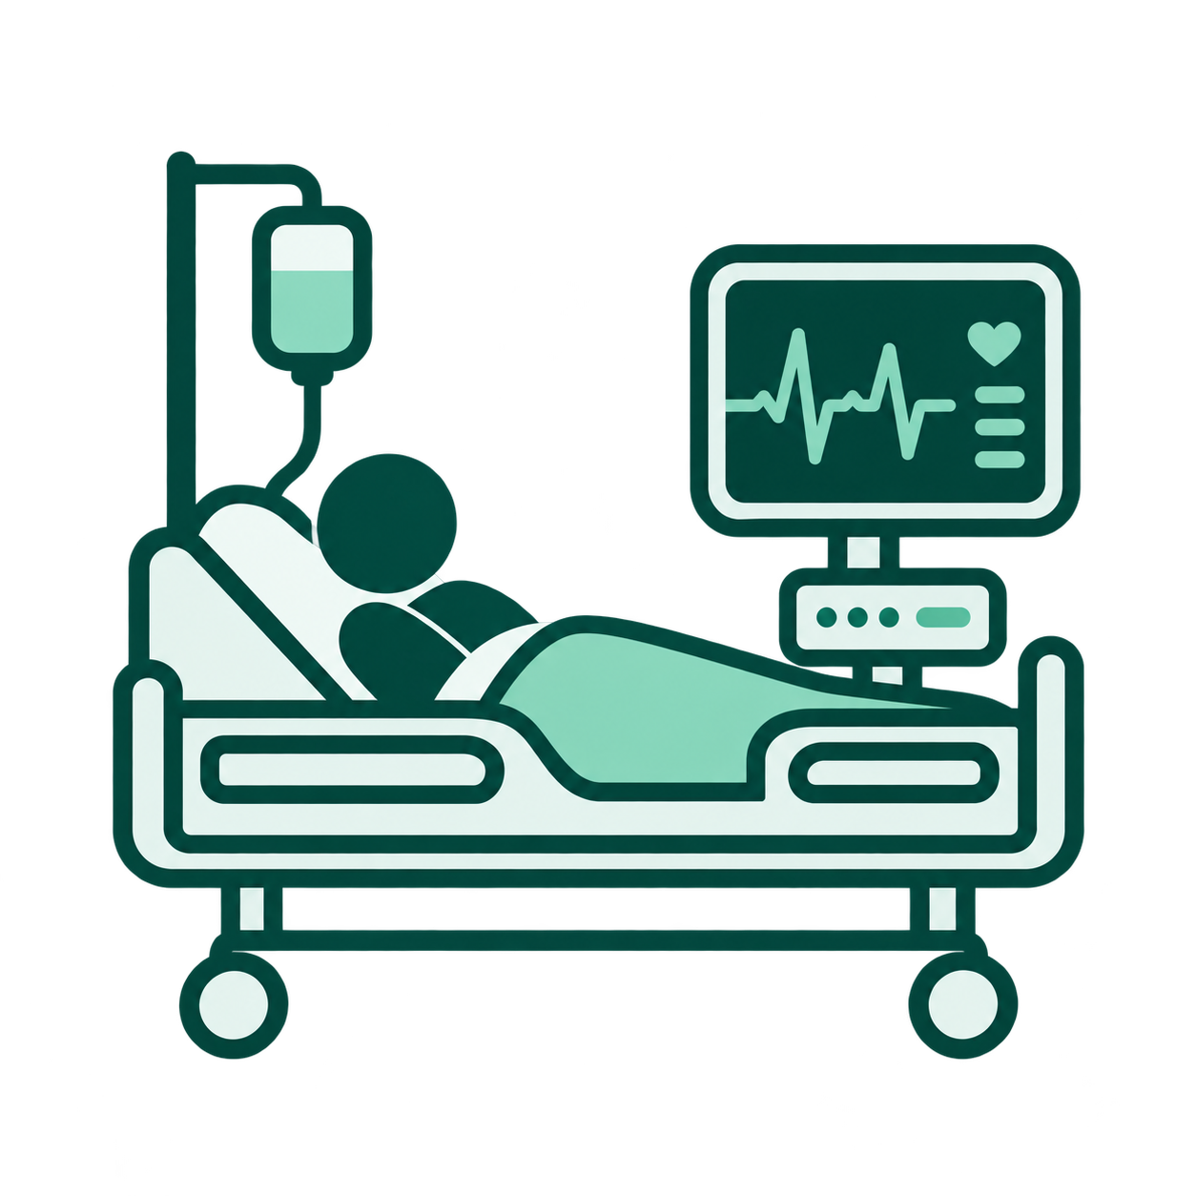
EVALUATION
Does the method work beyond our running example?
Three databases, three generator models, four methods, evaluated from complementary angles.
LIVER CANCER
eICU-CRD
16 tables · 350 columns
31 tables · 559 columns
specialist clinical registry
large ICU schema
Universitätsklinikum Leipzig
PhysioNet [Goldberger et al. 2000]
Medical Domain
Notes:
[7:44–8:19] SPOKEN SCRIPT (62 words)
Does this work beyond one example? We tested three databases: a private liver-cancer registry, the large eICU intensive-care schema, and Chinook, a music store, as a second domain. Three generator LLMs. And four methods: direct mapping, a zero-shot LLM, single-pass retrieval, and RIGOR. That gives thirty ontologies, judged by quality checks, an independent evaluation judge, ten human experts, and the BURR benchmark.
PRESENTER / POINTER: Datasets, then the four methods. Do not read every number.
AUDIENCE TAKEAWAY: Three databases, three LLMs, four methods, four kinds of evidence.
SOURCE AND SCOPE: Paper Sections 4.1-4.6. 30 ontologies = 3 LLMs x 3 methods x 3 databases + 3 direct mappings.

Slide 30

EVALUATION
Does the method work beyond our running example?
Three databases, three generator models, four methods, evaluated from complementary angles.
LIVER CANCER
eICU-CRD
CHINOOK
16 tables · 350 columns
31 tables · 559 columns
11 tables · 67 columns
specialist clinical registry
large ICU schema
music store
Universitätsklinikum Leipzig
PhysioNet [Goldberger et al. 2000]
Chinook Database [Rocha n.d.; accessed 2026]
Medical Domain
Music Domain
Notes:
[7:44–8:19] SPOKEN SCRIPT (62 words)
Does this work beyond one example? We tested three databases: a private liver-cancer registry, the large eICU intensive-care schema, and Chinook, a music store, as a second domain. Three generator LLMs. And four methods: direct mapping, a zero-shot LLM, single-pass retrieval, and RIGOR. That gives thirty ontologies, judged by quality checks, an independent evaluation judge, ten human experts, and the BURR benchmark.
PRESENTER / POINTER: Datasets, then the four methods. Do not read every number.
AUDIENCE TAKEAWAY: Three databases, three LLMs, four methods, four kinds of evidence.
SOURCE AND SCOPE: Paper Sections 4.1-4.6. 30 ontologies = 3 LLMs x 3 methods x 3 databases + 3 direct mappings.

Slide 31
EVALUATION
Does the method work beyond our running example?
Three databases, three generator models, four methods, evaluated from complementary angles.
LIVER CANCER
eICU-CRD
CHINOOK
16 tables · 350 columns
31 tables · 559 columns
11 tables · 67 columns
specialist clinical registry
large ICU schema
music store
Universitätsklinikum Leipzig
PhysioNet [Goldberger et al. 2000]
Chinook Database [Rocha n.d.; accessed 2026]
FOUR METHODS TO GENERATE AN ONTOLOGY FROM A RELATIONAL DATABASE SCHEMA
1
Direct Mapping
2
LLM baseline
3
Non-Iterative RAG
4
RIGOR
Deterministic
Table only
One-pass RAG
Ground + grow + check
Direct Mapping [Goldberger et al. 2000]
Ontology engineering with large language models [Mateiu & Groza, SYNASC 2023]
LLM-based Methods
Notes:
[7:44–8:19] SPOKEN SCRIPT (62 words)
Does this work beyond one example? We tested three databases: a private liver-cancer registry, the large eICU intensive-care schema, and Chinook, a music store, as a second domain. Three generator LLMs. And four methods: direct mapping, a zero-shot LLM, single-pass retrieval, and RIGOR. That gives thirty ontologies, judged by quality checks, an independent evaluation judge, ten human experts, and the BURR benchmark.
PRESENTER / POINTER: Datasets, then the four methods. Do not read every number.
AUDIENCE TAKEAWAY: Three databases, three LLMs, four methods, four kinds of evidence.
SOURCE AND SCOPE: Paper Sections 4.1-4.6. 30 ontologies = 3 LLMs x 3 methods x 3 databases + 3 direct mappings.

Slide 32
EVALUATION
Does the method work beyond our running example?
Three databases, three generator models, four methods, evaluated from complementary angles.
LIVER CANCER
eICU-CRD
CHINOOK
16 tables · 350 columns
31 tables · 559 columns
11 tables · 67 columns
specialist clinical registry
large ICU schema
music store
Universitätsklinikum Leipzig
PhysioNet [Goldberger et al. 2000]
Chinook Database [Rocha n.d.; accessed 2026]
FOUR METHODS TO GENERATE AN ONTOLOGY FROM A RELATIONAL DATABASE SCHEMA
1
Direct Mapping
2
LLM baseline
3
Non-Iterative RAG
4
RIGOR
Deterministic
Table only
One-pass RAG
Ground + grow + check
Direct Mapping [Goldberger et al. 2000]
Ontology engineering with large language models [Mateiu & Groza, SYNASC 2023]
LLM-based Methods
3 LLM METHOD × 3 DATABASE × 3 LLM = 27 ONTOLOGIES
Notes:
[7:44–8:19] SPOKEN SCRIPT (62 words)
Does this work beyond one example? We tested three databases: a private liver-cancer registry, the large eICU intensive-care schema, and Chinook, a music store, as a second domain. Three generator LLMs. And four methods: direct mapping, a zero-shot LLM, single-pass retrieval, and RIGOR. That gives thirty ontologies, judged by quality checks, an independent evaluation judge, ten human experts, and the BURR benchmark.
PRESENTER / POINTER: Datasets, then the four methods. Do not read every number.
AUDIENCE TAKEAWAY: Three databases, three LLMs, four methods, four kinds of evidence.
SOURCE AND SCOPE: Paper Sections 4.1-4.6. 30 ontologies = 3 LLMs x 3 methods x 3 databases + 3 direct mappings.

Slide 33
EVALUATION
Does the method work beyond our running example?
Three databases, three generator models, four methods, evaluated from complementary angles.
LIVER CANCER
eICU-CRD
CHINOOK
16 tables · 350 columns
31 tables · 559 columns
11 tables · 67 columns
specialist clinical registry
large ICU schema
music store
Universitätsklinikum Leipzig
PhysioNet [Goldberger et al. 2000]
Chinook Database [Rocha n.d.; accessed 2026]
FOUR METHODS TO GENERATE AN ONTOLOGY FROM A RELATIONAL DATABASE SCHEMA
1
Direct Mapping
2
LLM baseline
3
Non-Iterative RAG
4
RIGOR
Deterministic
Table only
One-pass RAG
Ground + grow + check
Direct Mapping [Goldberger et al. 2000]
Ontology engineering with large language models [Mateiu & Groza, SYNASC 2023]
LLM-based Methods
1 METHOD × 3 DATABASE = 3 ONTOLOGIES
3 LLM METHOD × 3 DATABASE × 3 LLM = 27 ONTOLOGIES
Notes:
[7:44–8:19] SPOKEN SCRIPT (62 words)
Does this work beyond one example? We tested three databases: a private liver-cancer registry, the large eICU intensive-care schema, and Chinook, a music store, as a second domain. Three generator LLMs. And four methods: direct mapping, a zero-shot LLM, single-pass retrieval, and RIGOR. That gives thirty ontologies, judged by quality checks, an independent evaluation judge, ten human experts, and the BURR benchmark.
PRESENTER / POINTER: Datasets, then the four methods. Do not read every number.
AUDIENCE TAKEAWAY: Three databases, three LLMs, four methods, four kinds of evidence.
SOURCE AND SCOPE: Paper Sections 4.1-4.6. 30 ontologies = 3 LLMs x 3 methods x 3 databases + 3 direct mappings.

Slide 34
EVALUATION
Does the method work beyond our running example?
Three databases, three generator models, four methods, evaluated from complementary angles.
LIVER CANCER
eICU-CRD
CHINOOK
16 tables · 350 columns
31 tables · 559 columns
11 tables · 67 columns
specialist clinical registry
large ICU schema
music store
Universitätsklinikum Leipzig
PhysioNet [Goldberger et al. 2000]
Chinook Database [Rocha n.d.; accessed 2026]
FOUR METHODS TO GENERATE AN ONTOLOGY FROM A RELATIONAL DATABASE SCHEMA
1
Direct Mapping
2
LLM baseline
3
Non-Iterative RAG
4
RIGOR
Deterministic
Table only
One-pass RAG
Ground + grow + check
Direct Mapping [Goldberger et al. 2000]
Ontology engineering with large language models [Mateiu & Groza, SYNASC 2023]
LLM-based Methods
1 METHOD × 3 DATABASE = 3 ONTOLOGIES
3 LLM METHOD × 3 DATABASE × 3 LLM = 27 ONTOLOGIES
3+27 = 30 ONTOLOGIES
Notes:
[7:44–8:19] SPOKEN SCRIPT (62 words)
Does this work beyond one example? We tested three databases: a private liver-cancer registry, the large eICU intensive-care schema, and Chinook, a music store, as a second domain. Three generator LLMs. And four methods: direct mapping, a zero-shot LLM, single-pass retrieval, and RIGOR. That gives thirty ontologies, judged by quality checks, an independent evaluation judge, ten human experts, and the BURR benchmark.
PRESENTER / POINTER: Datasets, then the four methods. Do not read every number.
AUDIENCE TAKEAWAY: Three databases, three LLMs, four methods, four kinds of evidence.
SOURCE AND SCOPE: Paper Sections 4.1-4.6. 30 ontologies = 3 LLMs x 3 methods x 3 databases + 3 direct mappings.

Slide 35
EVALUATION
Does the method work beyond our running example?
Three databases, three generator models, four methods, evaluated from complementary angles.
LIVER CANCER
eICU-CRD
CHINOOK
16 tables · 350 columns
31 tables · 559 columns
11 tables · 67 columns
specialist clinical registry
large ICU schema
music store
Universitätsklinikum Leipzig
PhysioNet [Goldberger et al. 2000]
Chinook Database [Rocha n.d.; accessed 2026]
FOUR METHODS TO GENERATE AN ONTOLOGY FROM A RELATIONAL DATABASE SCHEMA
1
Direct Mapping
2
LLM baseline
3
Non-Iterative RAG
4
RIGOR
Deterministic
Table only
One-pass RAG
Ground + grow + check
Direct Mapping [Goldberger et al. 2000]
Ontology engineering with large language models [Mateiu & Groza, SYNASC 2023]
30 ONTOLOGIES → checked by quality checks · LLM-as-a-Judge (GPT-5.4) · 10 human experts · BURR benchmark [1]
[1] BURR benchmark [Laskowski et al., PACMMOD 2025]
Notes:
[7:44–8:19] SPOKEN SCRIPT (62 words)
Does this work beyond one example? We tested three databases: a private liver-cancer registry, the large eICU intensive-care schema, and Chinook, a music store, as a second domain. Three generator LLMs. And four methods: direct mapping, a zero-shot LLM, single-pass retrieval, and RIGOR. That gives thirty ontologies, judged by quality checks, an independent evaluation judge, ten human experts, and the BURR benchmark.
PRESENTER / POINTER: Datasets, then the four methods. Do not read every number.
AUDIENCE TAKEAWAY: Three databases, three LLMs, four methods, four kinds of evidence.
SOURCE AND SCOPE: Paper Sections 4.1-4.6. 30 ontologies = 3 LLMs x 3 methods x 3 databases + 3 direct mappings.

Slide 36
RESULT 1 / VALID, WITH FEWER ERRORS
Every ontology is valid. RIGOR's have far fewer modeling errors.
All 30 ontologies are valid OWL2DL (RDFLib) and logically consistent (HermiT). So we look deeper.
1 VALID, FEWER ERRORS
2 KEEPS THE SCHEMA
3 ADDS MEANING
4 GOLD MAPPINGS
5 JUDGES
MODELING ERRORS FOUND BY OOPS!
pitfalls per ontology, fewer is better
Liver Cancer
eICU-CRD
Chinook
Avg
Direct Mapping
731
665
102
499
Claude
Mistral
DeepSeek
Claude
Mistral
DeepSeek
Claude
Mistral
DeepSeek
LLM baseline
422
397
403
434
440
421
95
74
81
307
Non-Iterative RAG
29
61
18
39
220
27
24
35
14
52
RIGOR
20
23
3
2
2
26
0
0
0
8
Same LLM, same database: Mistral on eICU, 220 without RIGOR, 2 with it. On Chinook, RIGOR has zero with every LLM.
OPPS! [Poveda-Villalón et al., IJSWIS 2014]
Notes:
[8:45–9:23] SPOKEN SCRIPT (63 words)
We climb from the easiest check to the hardest. First, the basics: all thirty ontologies are valid OWL and logically consistent, for every method. Modeling errors are another story: direct mapping averages about five hundred per ontology, RIGOR eight. Look at this column: same model, same database. The small Mistral model on eICU makes two hundred twenty errors without RIGOR, two with it. [pause]
PRESENTER / POINTER: One breath for validity; then the averages; then point at the Mistral eICU column.
AUDIENCE TAKEAWAY: Every ontology is valid; RIGOR's have far fewer modeling errors, with every LLM.
SOURCE AND SCOPE: Paper Sec. 4.7 (RDFLib, HermiT) and Table 7 (OOPS! totals per run). 72% of the other methods' pitfalls are P08, missing annotations.
IF RUNNING LATE, DROP: "for every method"
IF ASKED ABOUT CRITICAL ERRORS: P19 (multiple domains or ranges) is the only pitfall OOPS! rates critical, and it is the second-domain error from the validation slide. Per ontology: Direct Mapping 15, LLM baseline 17, Non-Iterative RAG 5.4, RIGOR 2.8; zero in 6 of RIGOR's 9 ontologies (Table 7). RIGOR's prompt allows one domain and one range, and the graph check rejects a second.

Slide 37
RESULT 2 / NOTHING IS LOST
Nothing is lost: RIGOR keeps the schema.
1 VALID, FEWER ERRORS
2 KEEPS THE SCHEMA
3 ADDS MEANING
4 GOLD MAPPINGS
5 JUDGES
KEEPS THE SCHEMA
columns covered, per ontology (%)
Liver Cancer
eICU-CRD
Chinook
Avg
Claude
Mistral
DeepSeek
Claude
Mistral
DeepSeek
Claude
Mistral
DeepSeek
Direct Mapping
97
99
78
91%
LLM baseline
94
31
89
96
68
86
100
50
52
74%
Non-Iterative RAG
41
6
12
22
28
46
58
16
78
34%
RIGOR
91
99
87
100
99
77
95
95
95
93%
Coverage: a column counts as covered when an ontology class or property name is similar to it (embedding similarity ≥ 0.55).
Notes:
[9:23–9:57] SPOKEN SCRIPT (55 words)
Fewer errors. But is anything lost? On average RIGOR covers ninety-three percent of the database columns, as much as direct mapping. Non-Iterative RAG , with the same retrieved context but no seed, covers a third, and swings with the LLM, from six to seventy-eight percent. With RIGOR, every LLM keeps at least seventy-seven percent, in every database. [pause]
PRESENTER / POINTER: RIGOR's average next to Direct Mapping's; then the red Non-Iterative RAG row.
AUDIENCE TAKEAWAY: RIGOR keeps the schema as well as Direct Mapping, with every LLM.
SOURCE AND SCOPE: Paper Table 9 (column coverage per run; embedding similarity >= 0.55).
IF RUNNING LATE, DROP: "and swings with the LLM, from six to seventy-eight percent"
IF ASKED WHY Non-Iterative RAG DROPS BUT THE BASELINE DOES NOT: the baseline only translates the table, so it keeps column names but adds no meaning. Non-Iterative RAG does everything in one pass with a lot of retrieved context and silently drops properties (e.g. 6 data properties for 350 Liver Cancer columns with Mistral, Table 8); nothing checks coverage. RIGOR starts from a seed with every column, works one table at a time, and its judge rejects fragments that drop a column.
IF ASKED ABOUT MODEL SIZE AND COST: with RIGOR, Mistral Small 24B reaches 98% coverage (Claude 95%) for about $0.12 across the three databases, against about $33 with Claude (Tables 9, 15).

Slide 38
RESULT 2 / NOTHING IS LOST
Nothing is lost: RIGOR keeps the schema.
1 VALID, FEWER ERRORS
2 KEEPS THE SCHEMA
3 ADDS MEANING
4 GOLD MAPPINGS
5 JUDGES
KEEPS THE SCHEMA
columns covered, per ontology (%)
Liver Cancer
eICU-CRD
Chinook
Avg
Claude
Mistral
DeepSeek
Claude
Mistral
DeepSeek
Claude
Mistral
DeepSeek
Direct Mapping
97
99
78
91%
LLM baseline
94
31
89
96
68
86
100
50
52
74%
Non-Iterative RAG
41
6
12
22
28
46
58
16
78
34%
RIGOR
91
99
87
100
99
77
95
95
95
93%
Non-Iterative RAG 6–78%. With RIGOR: ≥ 77% for every LLM, in every database.
Coverage: a column counts as covered when an ontology class or property name is similar to it (embedding similarity ≥ 0.55).
Notes:
[9:23–9:57] SPOKEN SCRIPT (55 words)
Fewer errors. But is anything lost? On average RIGOR covers ninety-three percent of the database columns, as much as direct mapping. Non-Iterative RAG , with the same retrieved context but no seed, covers a third, and swings with the LLM, from six to seventy-eight percent. With RIGOR, every LLM keeps at least seventy-seven percent, in every database. [pause]
PRESENTER / POINTER: RIGOR's average next to Direct Mapping's; then the red Non-Iterative RAG row.
AUDIENCE TAKEAWAY: RIGOR keeps the schema as well as Direct Mapping, with every LLM.
SOURCE AND SCOPE: Paper Table 9 (column coverage per run; embedding similarity >= 0.55).
IF RUNNING LATE, DROP: "and swings with the LLM, from six to seventy-eight percent"
IF ASKED WHY Non-Iterative RAG DROPS BUT THE BASELINE DOES NOT: the baseline only translates the table, so it keeps column names but adds no meaning. Non-Iterative RAG does everything in one pass with a lot of retrieved context and silently drops properties (e.g. 6 data properties for 350 Liver Cancer columns with Mistral, Table 8); nothing checks coverage. RIGOR starts from a seed with every column, works one table at a time, and its judge rejects fragments that drop a column.
IF ASKED ABOUT MODEL SIZE AND COST: with RIGOR, Mistral Small 24B reaches 98% coverage (Claude 95%) for about $0.12 across the three databases, against about $33 with Claude (Tables 9, 15).

Slide 39
RESULT 3 / MEANING IS ADDED
Meaning is added: labels, provenance and hierarchy.
1 VALID, FEWER ERRORS
2 KEEPS THE SCHEMA
3 ADDS MEANING
4 GOLD MAPPINGS
5 JUDGES
ADDS MEANING
Liver Cancer
eICU-CRD
Chinook
Avg
Claude
Mistral
DeepSeek
Claude
Mistral
DeepSeek
Claude
Mistral
DeepSeek
Direct Mapping
No labels, provenance or class hierarchy, in any run.
LLM baseline
Labels & comments
Non-Iterative RAG
680
134
736
877
157
743
98
14
64
389
RIGOR
1,029
1,137
341
1,291
1,684
435
357
362
359
777
Provenance links
Non-Iterative RAG
0
0
0
0
0
0
0
0
0
0
RIGOR
336
308
22
423
335
99
81
83
75
196
Class hierarchy
Non-Iterative RAG
0
0
0
0
0
0
0
0
0
0
(inheritance richness)
RIGOR
0.70
0.39
0.13
0.62
0.49
0.10
2.12
2.72
4.07
1.26
Only RIGOR adds labels, provenance and a class hierarchy: with every LLM, in every database.
Labels & comments: annotation assertions; provenance: prov:wasDerivedFrom.
Hierarchy: inheritance richness, subclass axioms per class [OntoQA: Tartir et al., KADASH 2005; OntoMetrics: Lantow, KEOD 2016].
Notes:
[9:57–10:21] SPOKEN SCRIPT (39 words)
Nothing is lost. Is meaning added? Direct mapping and the LLM baseline add none, in any run. Non-Iterative RAG adds labels, but no provenance and no class hierarchy. Only RIGOR adds all three, with every LLM, in every database. [pause]
PRESENTER / POINTER: Point at the red block first, then the three RIGOR rows.
AUDIENCE TAKEAWAY: Only RIGOR adds labels, provenance and a class hierarchy, with every LLM.
SOURCE AND SCOPE: Paper Table 8. Hierarchy as inheritance richness (subclass axioms per class; OntoQA, Tartir et al. 2005; OntoMetrics, Lantow 2016), computed from Table 8 counts. Shading is within each database.
IF RUNNING LATE, DROP: "Non-Iterative RAG adds labels, but no provenance and no class hierarchy."
IF ASKED 'DOES CHINOOK NEED SO MANY SUBCLASSES?': Count is not quality, so we report whether a hierarchy exists, and only RIGOR builds one. RIGOR's Chinook ontologies have zero OOPS! pitfalls and the judge ranks RIGOR first on all 11 Chinook tables; it does score RIGOR's conciseness lower there (2.59 vs 3.32 for the baseline, Table 10), so tighter hierarchies are future work.
DOMAIN PATTERN (notes only): inheritance richness is 0.10-0.70 on the clinical schemas and 2.1-4.1 on the music store; the LLM proposes more specializations in a familiar domain.

Slide 40
RESULT 4 / EXTERNAL BENCHMARK
RIGOR keeps the link to the data.
BURR [Laskowski et al., PACMMOD 2025]
1 VALID, FEWER ERRORS
2 KEEPS THE SCHEMA
3 ADDS MEANING
4 GOLD MAPPINGS
5 JUDGES
WHAT BURR CHECKS
SYSTEM
CLASSES
RELATIONS
ATTRIBUTES
Every ontology element must map back to the database.
W3C-Mapper / Ontop
0.53
0.11
0.39
CLASSES
person
→
Class: Person
rule-based
RDB2Onto
0.67
0.62
0.44
RELATIONS
paper.author_id
→
ObjectProperty: author
rule-based
ATTRIBUTES
person.name
→
DataProperty: name
OntoGenix
0.58
0.35
0.44
LLM-based
RIGOR
0.73
0.67
0.52
LLM + rules
Notes:
[10:33–11:20] SPOKEN SCRIPT (81 words)
Meaning is added. But is the link back to the data still correct? BURR, an external benchmark, checks exactly this: every class, relation and attribute must map back to the right table, foreign key or column, scored with F1 against a gold mapping. On BURR's ISWC scenario, RIGOR has the highest F1 on all three, ahead of rule-based and LLM-based systems. Relations stand out: zero point six seven against zero point one one, because foreign keys become named relations, like hasPatientData.
PRESENTER / POINTER: Left card first, then land on the RIGOR row.
AUDIENCE TAKEAWAY: Semantic enrichment did not break the correspondence that OBDA and KG population need.
SOURCE AND SCOPE: Paper Table 13. BURR = Laskowski et al., PACMMOD 2025; matching rule from BURR Section 4, Eq. 3. Left-card element names are illustrative.
IF RUNNING LATE, DROP: "scored with F1 against a gold mapping"
DO NOT SAY: 'BURR found LLMs trail rule-based systems'. BURR's results show Gemini 2.5 Pro ahead of the rule-based systems overall (rule-based systems win only on NPD).
IF ASKED ABOUT GEMINI 2.5 PRO (BURR Table 3, ISWC .65 / .68 / .56): in BURR it is a general-purpose LLM prompted with few-shot examples and a checklist to write the D2RQ mapping directly. It is a mapping generator, not an ontology-learning system that builds an enriched ontology, so we compare with ontology-learning systems. Against it, RIGOR's class F1 is higher, relations are on par, attributes lower, and RIGOR also produces labels, hierarchy and provenance. It is prompted, not fine-tuned.

Slide 41
RESULT 5 / LLM JUDGE AND HUMAN EXPERTS
An LLM judge and human experts both rank RIGOR first.
Blind evaluation: nobody knew which ontology came from which method.
1 VALID, FEWER ERRORS
2 KEEPS THE SCHEMA
3 ADDS MEANING
4 GOLD MAPPINGS
5 JUDGES
HOW THEY JUDGED For each table: its schema, 5 competency questions and four anonymized ontologies. Each scored 0–5 on accuracy, completeness, conciseness, adaptability, clarity, consistency and domain enrichment, then ranked 1st–4th.
LLM-AS-A-JUDGE · GPT-5.4
10 ONTOLOGY EXPERTS
100% of rankings put RIGOR 1st
70% of rankings put RIGOR 1st
Liver Cancer
eICU-CRD
Liver Cancer
eICU-CRD
Direct Mapping
2.05
2.13
Direct Mapping
2.95
2.59
LLM baseline
1.38
0.28
LLM baseline
2.74
3.01
Non-Iterative RAG
1.89
0.67
Non-Iterative RAG
2.39
1.24
RIGOR
3.93
3.64
RIGOR
3.44
3.53
Quality dimensions: accuracy, completeness, conciseness, adaptability, clarity, consistency, domain enrichment [Vrandečić, Handbook on Ontologies 2009; OntoQA: Tartir et al., KADASH 2005].
Notes:
[11:07–12:03] SPOKEN SCRIPT (91 words)
Automatic checks agree. Do evaluators agree? For each table, an LLM judge and ten ontology experts saw the schema, five competency questions, the questions the ontology must answer, and four anonymized ontologies. They scored each on seven quality dimensions and ranked them. The LLM judge put RIGOR first on every table, in all three databases. [pause] The experts put RIGOR first in seven of ten rankings, with the highest average score on both databases. [pause] Direct mapping gives structure without meaning. LLMs alone give meaning without structure. RIGOR gives both, and checks them.
PRESENTER / POINTER: The 'How they judged' box in one breath; then the two claims; then the closing strip.
AUDIENCE TAKEAWAY: Judged blind against competency questions, an LLM judge and human experts both rank RIGOR first.
SOURCE AND SCOPE: Paper Sec. 4.2 and 4.6 (5 expert-verified CQs per table, 7 dimensions, ranking), Table 1 (judge scores and first places: 58 of 58 tables), Table 11 (expert scores), Table 12 (Kendall's W 0.39-0.72). Judge evaluated the Claude ontologies; experts 4 medical tables, 28 of 40 first places.
IF RUNNING LATE, DROP: "with the highest average score on both databases"
IF ASKED HOW MANY: the judge ranked RIGOR first on 58 of 58 tables (16 Liver Cancer, 31 eICU-CRD, 11 Chinook); the experts in 28 of 40 rankings (10 experts x 4 tables).

Slide 42
FUTURE WORK
Next: Move the evaluation tools in the loop
RDFLib, the reasoner and OOPS! only checked our final ontologies. Next, they flag each error while RIGOR builds, and their feedback will be used to prompt the LLM to repair the ontology. → Live in our RIGOR App demo.
Notes:
[11:05–12:00] SPOKEN SCRIPT (96 words)
Where next? Today RIGOR reads schemas and documentation. The next step is to let the data speak. Imagine several patients whose records show bone marrow depression after cisplatin cycles. The rows alone show a pattern. The drug label adds that bone-marrow suppression is a known adverse reaction of cisplatin. Together, they let RIGOR propose new knowledge: a candidate association between cisplatin and bone marrow depression, with provenance to both sources. Candidate, not cause. Gemcitabine, radiotherapy or cirrhosis could also explain it. So an expert reviews it. We also want validator and reasoner feedback inside the loop.
PRESENTER / POINTER: Rows, label, code, left to right. Say 'candidate' or 'may have contributed', never 'caused'.
AUDIENCE TAKEAWAY: Instances plus documentation can propose knowledge; experts confirm it.
SOURCE AND SCOPE: Paper Section 5. Rows are synthetic. OWL verified (presentation/excerpts/slide22_future_candidate.omn): a typed individual with provenance, no causal axiom.
IF RUNNING LATE, DROP: "We also want validator and reasoner feedback inside the loop."
IF ASKED WHY NOT AN OWL CAUSAL AXIOM: OWL reasoning is deductive and open-world; it cannot derive causation from statistics, and 'Cisplatin SubClassOf causes some BoneMarrowDepression' would wrongly claim it for every case.

Slide 43
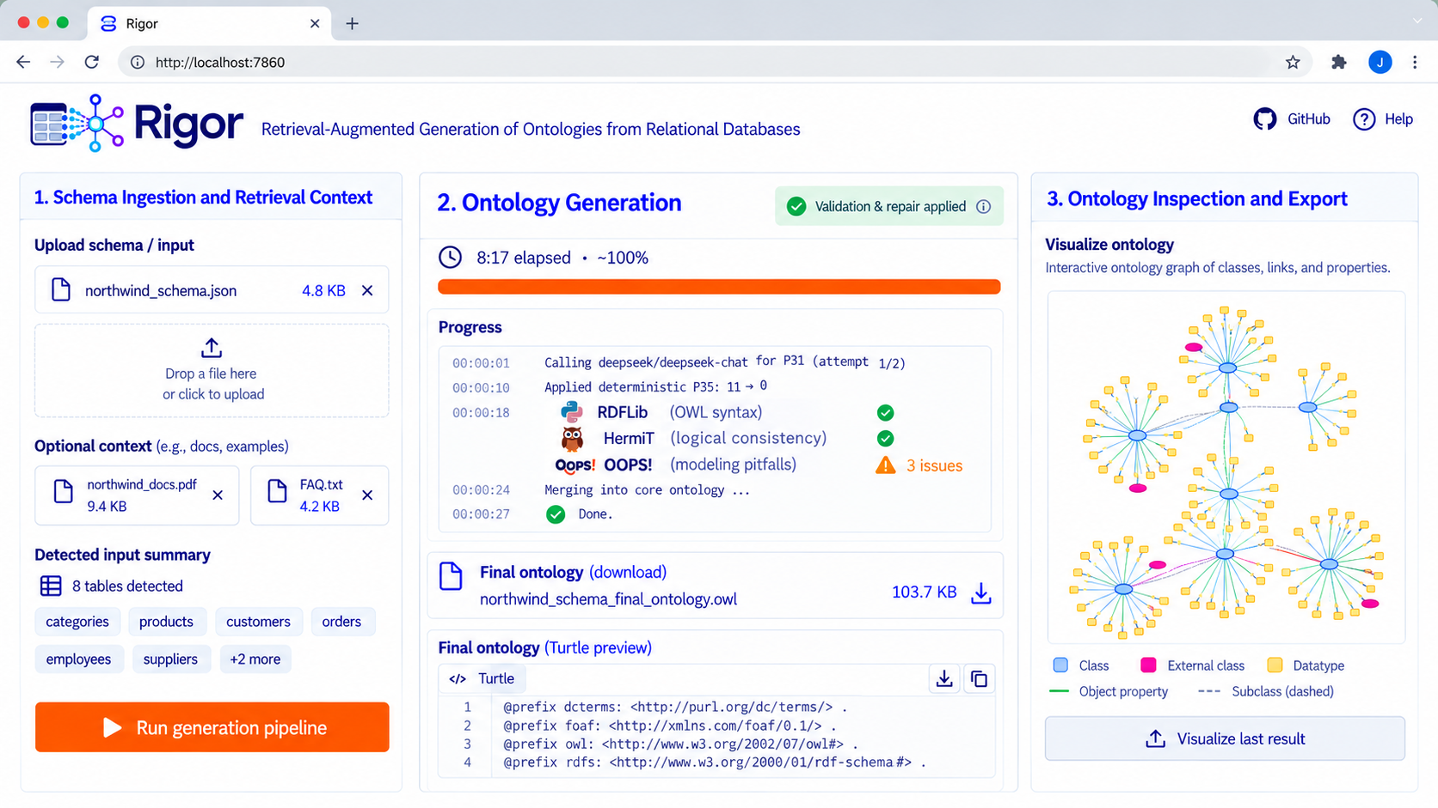


FUTURE WORK
Next: Move the evaluation tools in the loop
RDFLib, the reasoner and OOPS! only checked our final ontologies. Next, they flag each error while RIGOR builds, and their feedback will be used to prompt the LLM to repair the ontology. → Live in our RIGOR App demo.
Open source · MIT
Watch the demo video
RIGOR App [Fathallah, Nayyeri & Staab, ISWC 2026 Demos].
Notes:
[11:05–12:00] SPOKEN SCRIPT (96 words)
Where next? Today RIGOR reads schemas and documentation. The next step is to let the data speak. Imagine several patients whose records show bone marrow depression after cisplatin cycles. The rows alone show a pattern. The drug label adds that bone-marrow suppression is a known adverse reaction of cisplatin. Together, they let RIGOR propose new knowledge: a candidate association between cisplatin and bone marrow depression, with provenance to both sources. Candidate, not cause. Gemcitabine, radiotherapy or cirrhosis could also explain it. So an expert reviews it. We also want validator and reasoner feedback inside the loop.
PRESENTER / POINTER: Rows, label, code, left to right. Say 'candidate' or 'may have contributed', never 'caused'.
AUDIENCE TAKEAWAY: Instances plus documentation can propose knowledge; experts confirm it.
SOURCE AND SCOPE: Paper Section 5. Rows are synthetic. OWL verified (presentation/excerpts/slide22_future_candidate.omn): a typed individual with provenance, no causal axiom.
IF RUNNING LATE, DROP: "We also want validator and reasoner feedback inside the loop."
IF ASKED WHY NOT AN OWL CAUSAL AXIOM: OWL reasoning is deductive and open-world; it cannot derive causation from statistics, and 'Cisplatin SubClassOf causes some BoneMarrowDepression' would wrongly claim it for every case.

Slide 44
FUTURE WORK
Next: let the data speak.
Today RIGOR reads schemas. Instance data can propose new knowledge.
1 THE DATA
two tables, joined on admission_id
treatment
admission_id FK
drug
A1
cisplatin
A2
nivolumab
A3
cisplatin
admission
admission_id
patient_id
BM_DEP
A1
P1
1
A2
P2
0
A3
P3
1
Notes:
[12:00–12:49] SPOKEN SCRIPT (86 words)
Where next? Let the data speak. Today RIGOR reads schemas and documentation, but the data can show links the documentation does not contain. Here, the treatment table says which admissions received cisplatin, and the admission table records bone marrow depression. Joined on the admission id, every cisplatin admission has bone marrow depression. That link is not in the documentation, so RIGOR can propose it as candidate knowledge, with provenance to both columns. A pattern, not a cause: an expert reviews it before it joins the ontology.
PRESENTER / POINTER: A1 and A3 in both tables; then the pattern bars; then the candidate code and its badge.
AUDIENCE TAKEAWAY: Instance data can propose new, reviewable knowledge that the documentation does not contain.
SOURCE AND SCOPE: Rows are synthetic. OWL verified (presentation/excerpts/slide22_future_candidate.omn): a typed individual with provenance, no causal axiom.
IF RUNNING LATE, DROP: "Today RIGOR reads schemas and documentation, but"
IF ASKED WHY NOT AN OWL CAUSAL AXIOM: OWL reasoning is deductive and open-world; it cannot derive causation from statistics, and 'Cisplatin SubClassOf causes some BoneMarrowDepression' would wrongly claim it for every case. Other treatments or conditions could explain the pattern.
IF ASKED ABOUT PRIVACY: only aggregate statistics (co-occurrence counts) need to leave the database, not patient rows.

Slide 45
FUTURE WORK
Next: let the data speak.
Today RIGOR reads schemas. Instance data can propose new knowledge.
1 THE DATA
2 THE PATTERN
3 CANDIDATE KNOWLEDGE
two tables, joined on admission_id
what the joined rows show
A reviewable hypothesis
treatment
Every cisplatin admission has bone marrow depression.
Individual: cisplatin_bmdep
admission_id FK
drug
Types: CandidateAssociation
A1
cisplatin
Facts:
A2
nivolumab
hasDrug Cisplatin,
A3
cisplatin
cisplatin
2 of 2
hasCondition BoneMarrowDepression,
status "needs expert review"
admission
other drugs
0 of 1
Annotations:
prov:wasDerivedFrom treatment:drug,
admission_id
patient_id
BM_DEP
admissions with BM_DEP = 1
prov:wasDerivedFrom admission:BM_DEP
A1
P1
1
A2
P2
0
A PATTERN → an expert reviews it before it joins the ontology
A3
P3
1
Notes:
[12:00–12:49] SPOKEN SCRIPT (86 words)
Where next? Let the data speak. Today RIGOR reads schemas and documentation, but the data can show links the documentation does not contain. Here, the treatment table says which admissions received cisplatin, and the admission table records bone marrow depression. Joined on the admission id, every cisplatin admission has bone marrow depression. That link is not in the documentation, so RIGOR can propose it as candidate knowledge, with provenance to both columns. A pattern, not a cause: an expert reviews it before it joins the ontology.
PRESENTER / POINTER: A1 and A3 in both tables; then the pattern bars; then the candidate code and its badge.
AUDIENCE TAKEAWAY: Instance data can propose new, reviewable knowledge that the documentation does not contain.
SOURCE AND SCOPE: Rows are synthetic. OWL verified (presentation/excerpts/slide22_future_candidate.omn): a typed individual with provenance, no causal axiom.
IF RUNNING LATE, DROP: "Today RIGOR reads schemas and documentation, but"
IF ASKED WHY NOT AN OWL CAUSAL AXIOM: OWL reasoning is deductive and open-world; it cannot derive causation from statistics, and 'Cisplatin SubClassOf causes some BoneMarrowDepression' would wrongly claim it for every case. Other treatments or conditions could explain the pattern.
IF ASKED ABOUT PRIVACY: only aggregate statistics (co-occurrence counts) need to leave the database, not patient rows.

Slide 46


RIGOR / ISWC 2026
Thank you.
Questions?
FROM A DATABASE SCHEMA TO AN ONTOLOGY
PAPER + OPEN SOURCE
RIGOR
Paper
GitHub
📬 nadeen.fathallah@ki.uni-stuttgart.de
relational database
ontology
ISWC 2026 · Bari
Notes:
[12:00–12:33] SPOKEN SCRIPT (57 words)
To conclude. RIGOR anchors LLM generation in the database itself, grounds it in retrieved knowledge, and checks every step before the ontology grows. The result: meaning without losing structure, the link to the data intact, and ontologies that experts prefer. The paper and code are behind these QR codes. Thank you. I'm happy to take your questions.
PRESENTER / POINTER: Finish speaking by 13:30. Leave this slide up during questions; backups follow it.
AUDIENCE TAKEAWAY: Grounded, retrieved, validated.
SOURCE AND SCOPE: Recap of the paper; contact address on the slide.

