Slide 1
QuickForms Application Manager
Team Members
Dana Al-Rifai
Smita Borbaruah
Nadeen Kawash
Notes:
Do you have everything running
Everything is very abstract, there are no concrete examples of kinds of forms to be handled and the kinds of changes your tools will help them make
What is the overall application, is this for generic forms of any kind
Will there be a demo? at the very least some screenshots, how much development have you done to date? Havent you finished atleast one sprint and can say that

Slide 2
Overview
Client
Professor Liam Peyton
Application: QuickForms Application (PAL-IS, RPP)
Application using the QuickForms framework
Used in applications that use forms for data collection and report generation
Notes:
NADEEN
NEED TO OUTLINE CLIENT MORE AND CLIENTS ROLE IN THE QUICKFORMS APPS AND THEIR STAKE IN THE PROJECT
(our client develops tools using the Quickforms frameworks for hospitals, etc. )
Application:
A QuickForms application uses the QuickForms framework
This frameworkd is used in applications that use forms for data collection and report generation
Two examples of applications are PAL-IS and RPP.
PAL-IS is and RPP is
Problem?
Currently, these applications only provide the end user with the ability to enter data into forms and generate reports based on this data
Application users do not have the ability to make changes to forms on their own
This includes changes such as adding, deleting or editing options to drop down menus, changing labels, etc.
They must report back to our customer every time they need to make one of these changes which can be inconvenient for both the customer and the user

Slide 3
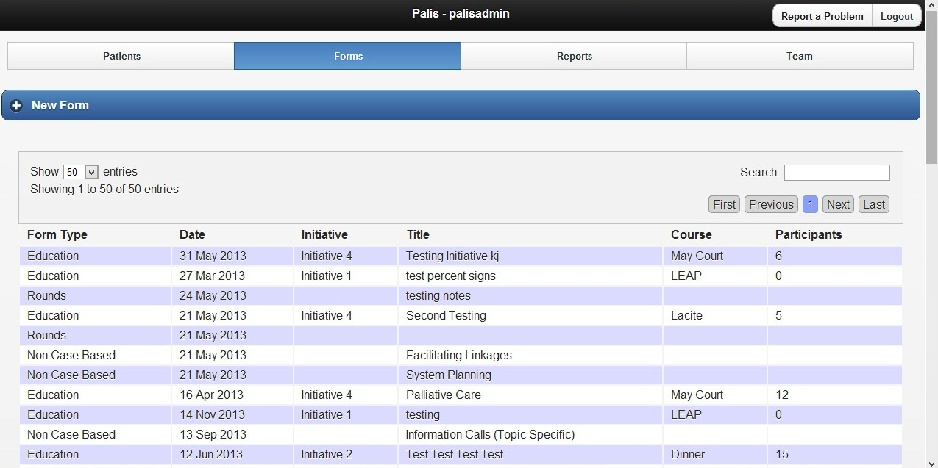
PAL-IS
Notes:
Put problem in here so nadeen can show

Slide 4
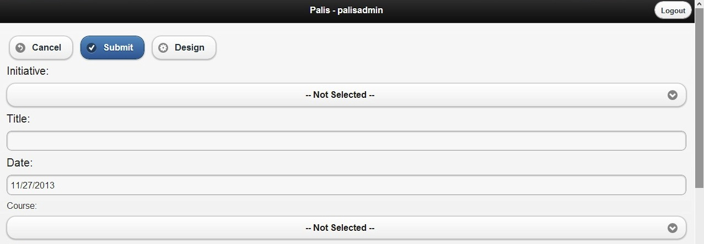
QuickForms Application Form
Problem
Applications users currently must report back to our customer in order to make changes to forms
Notes:
NADEEN
Example of a form
CHANGE PAGE TO DEFAULT PAGE
Palis is used by nurses andadministrators in pallative care to track patients in the community.

Slide 5
Overview
Solution: QuickForms Application Manager
a generic tool that helps manage applications developed using QuickForms framework
Will be used to edit all different types of forms
Will allow users makes changes to forms and profile settings on their own without having to report back to the customer
Notes:
NADEEN
Our solution to this is the QuickForms Application Manager
This is a generic tool that will help manage any application developed using the QuickForms framework.
It will be used to edit by any to manage forms of any kind
It will allow user to make changes to form templates and profile settings on their own and will
This eliminates the need to report back to our customer (developer) any time a change is required.

Slide 6
Project Plan
Agile development process
Test-driven development
Tests designed based on black-box testing strategies
Overall process split into 3 phases
Planning Phase
Development Phase
Release Phase
Notes:
SMITA
Our project plan follows the agile development process which consists of test driven development with tests designed based on black-box testing strategies. The overall process is split in to 3 main phases, the planning phase, the development phase and the release phase.

Slide 7
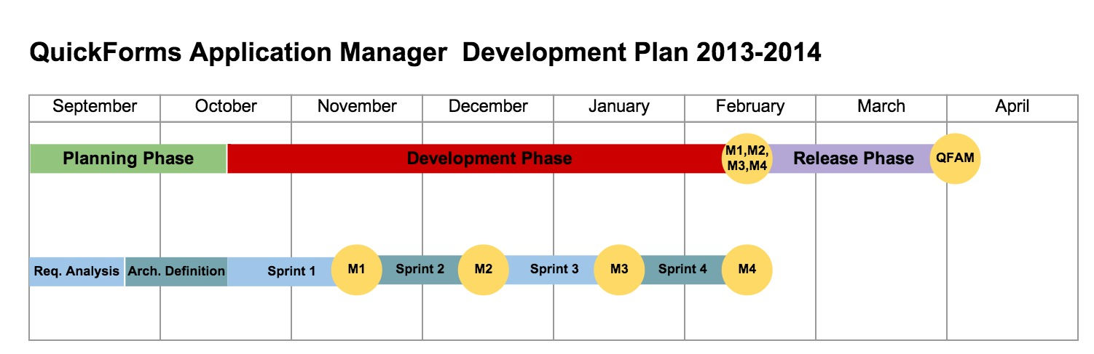
Project Timeline
Notes:
SMITA
This timeline outlines the overall process we are following.
We allocated the first month and a half to our planning phase, which we have completed.
The next four months have been allocated to the actual development of our application. This phase has been split into 4, 1-month sprints. We are currently in the middle of our second sprint.
The last month and a half of the process has been allocated to the release of our application to the customer.

Slide 8
(I) Planning Phase
Broken down into 2 sub-phases
(1) First Sub-Phase ✔ (Complete)
Requirements gathering
Requirements analysis
Prioritizing requirements
(2) Second Sub-Phase ✔ (Complete)
Architecture definition based on requirements
Finalize architecture & implementation decisions
Notes:
NADEEN
The first month and a half of our schedule was allocated to planning and requirements analysis. This phase consists of two subphases
The first phase was dedicated to the gathering of high-level requirements, requirements analysis and prioritizing requirements.
During the second subphase, we used these requirements to define our architecture and finalize any architecture and implementation decisions

Slide 9
(II) Development Phase
Phase broken up into 1-month iterative coding sprints
Progress evaluated on weekly basis throughout sprint
Progress of overall sprint evaluated at end of the month, development plan adjusted as required
Sprint 1: Prototype ✔ (Complete)
Sprint 2: Form editing capability (In Progress)
Sprint 3: Generic capability (Not Yet Started)
Sprint 4: Default configuration editing (Not Yet Started)
Notes:
NADEEN
The next four months of our schedule have been allocated to the development phase.
This phase has been broken up into 1-month iterative coding sprints
Progress is evaluated on a weekly basis throughout sprint
The Progress of the overall sprint is evaluated at end of the month
Based on this evaluation the development plan adjusted as required.
(OUTLINE GOALS OF EACH SPRINT)
Sprint 1: Prototype ✔ (Complete)
Sprint 2: Form editing capability (In Progress)
Sprint 3: Generic capability (Not Yet Started)
Sprint 4: Default configuration editing (Not Yet Started)
We are currently reaching the end of our second sprint.

Slide 10
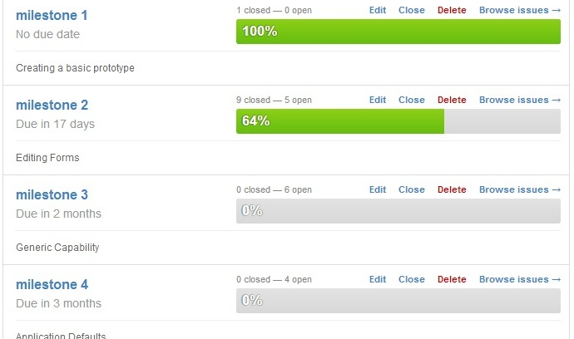
Milestones
Notes:
NADEEN
This figure reflects our progress so far.
UPDATE pic

Slide 11
(III) Release Phase
Scheduled to occur once all requirements outlined have been met
During this phase system will undergo
Integration
Intensive testing of integrated system
Documentation
Ready for release to client
Notes:
NADEEN

Slide 12
Infrastructure
Configuration Management: GitHub
Wiki: GitHub
Building: Travis CI
Testing: QUnit, Selenium, Manual usability testing
Notes:
SMITA
Now, I will talk a bit about the infrastructure and architecture of our application.
We are using GItHub to host both our project and our wiki page.
For the continuous integration of our code, we are using Travis CI which is a service that can be used via GitHub to build our project and also test it as well.
We are coding in HTML, JavaScript and .NET. For testing purposes, we have been using the QUnit testing framework to write unit tests for JavaScript. The QUnit framework is used primarily to test projects using JQuery, JQuery UI, and JMobile
We will also be using Selenium to automate user actions in the browser along with manual testing to test usability.

Slide 13
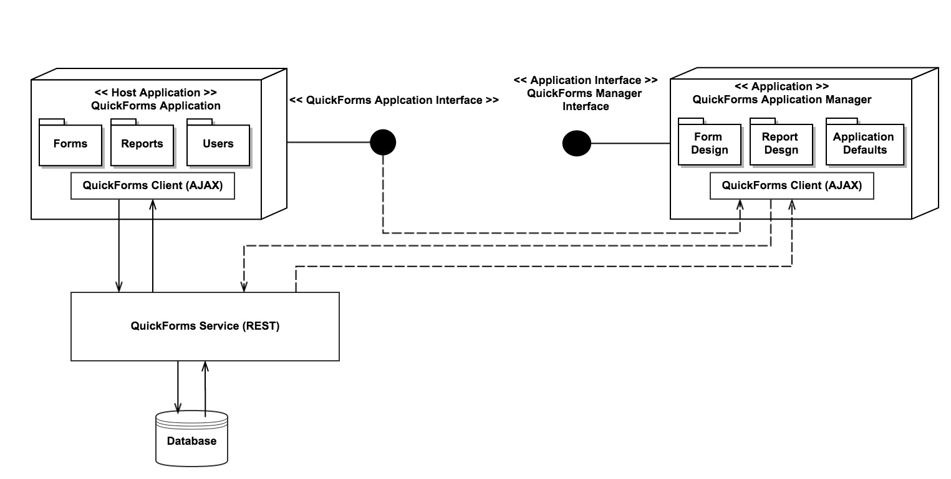
Architecture Overview
Notes:
SMITA
This diagram summarizes the overall architecture of the QuickForms Application Manager and how it is used by the host application.
The host application contains a QuickForm client which uses the QuickForms service to interact with the application database. Our application which is the managing tool, contains its own QuickForm client which uses the same QuickForms service to obtain data from the application’s database and make changes to the database. The QuickForms client of the managing tool also uses the interface of the QuickForms application to generate an editing page that mimics the look and feel of the host application in order to maintain the consistency of the UI design.

Slide 14
Key Challenges
Learning new programming languages
Online tutorials and examples
Understanding the QuickForms application architecture
Analyzing code
Collaborating with client’s developers
Coordinating group meetings
scheduling short, regular meetings throughout the week
long meetings during the weekend
Notes:
SMITA
Now a bit about some of the challenges we have faced throughout the process so far.
A key challenge we faced was having to learn new programming languages. All three of us have very minimal experience with JavaScript and .NET so in the beginning it did take more time than we expected to understand the architecture of the QuickForms application and how it works, and also to actually figure out how to develop our tool. To overcome these obstacles, we made sure to look through in-depth online tutorials and examples which helped us analyze the code of the QuickForms application. And we also collaborated with a developer of one of the QuickForms applications to make sure that we were on the right track and understood everything correctly.
Another challenge we faced in the beginning was coordinating group meetings because we all have very conflicting schedules. We found that even though we were communicating via email or text that we were lacking face to face communication between each other. What we also found that it was difficult to schedule meetings that were long enough to get any real work done during the week. To resolve this, we started scheduling very short meetings regularly throughout the week to touch base and make sure everyone is on the same page and any longer meetings were scheduled on the weekends as needed. And this approach has been a lot more effective for us.

Slide 15
Plans for Next Semester
complete two milestones
make application work generically
code integration
testing
code release preparation
Notes:
SMITA
Since our application right now only works specifically for one application and only for one form, our overall plans for next semester center around making our application work generically for any QuickForms application. We have a couple of more editing features to implement in the the next two milestones that need to be completed. And after this is all complete we can go on to fully integrate, and test our application to prepare for the release of our application to the customer.

Slide 16
DEMO
Notes:
SMITA
Now Dana will run a small demo to show what we have done so far, but before that, does anyone have any questions?

Slide 17
Thank you
Questions?

