Slide 1
QuickForms Application Manager
Team Members
Dana Al-Rifai
Smita Borbaruah
Nadeen Kawash

Slide 2
Overview
Client
Professor Liam Peyton
Application: QuickForms Application (PAL-IS, RPP)
Application using the QuickForms framework
Used in applications that use forms for data collection and report generation

Slide 3
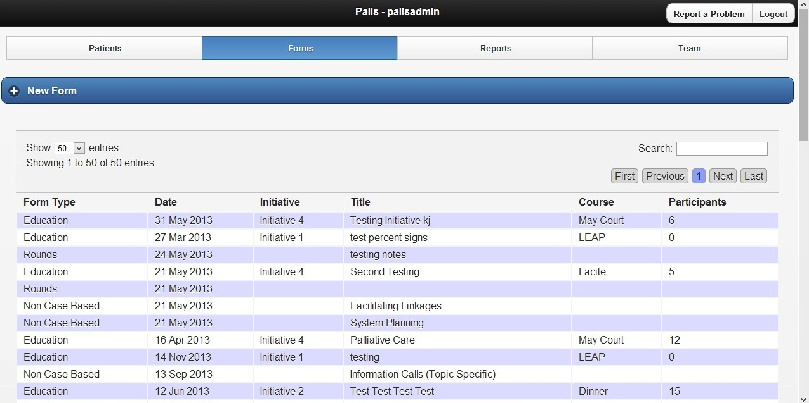
PAL-IS

Slide 4
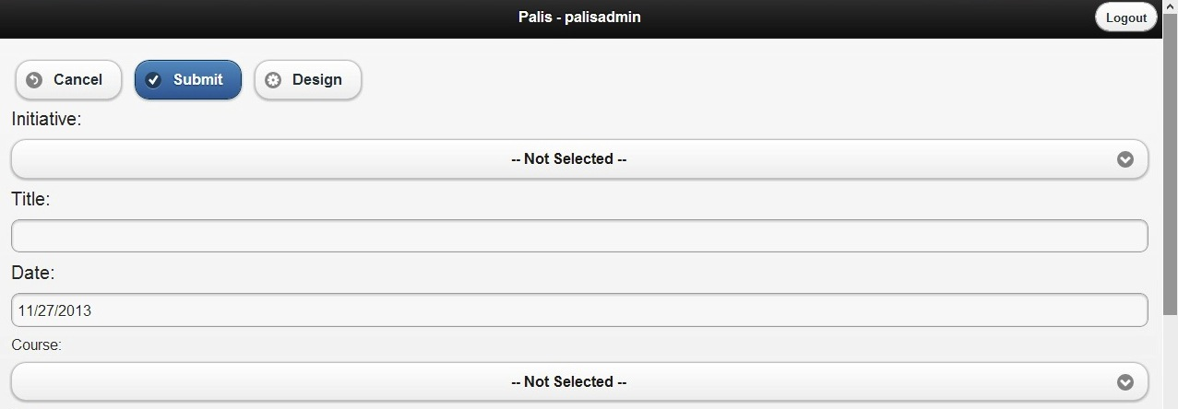
QuickForms Application Form
Problem
Applications users currently must report back to our customer in order to make changes to forms

Slide 5
Overview
Solution: QuickForms Application Manager
a generic tool that helps manage applications developed using QuickForms framework
Will be used to edit all different types of forms
Will allow users makes changes to forms and profile settings on their own without having to report back to the customer

Slide 6
Project Plan
Agile development process
Test-driven development
Tests designed based on black-box testing strategies
Overall process split into 3 phases
Planning Phase
Development Phase
Release Phase

Slide 7
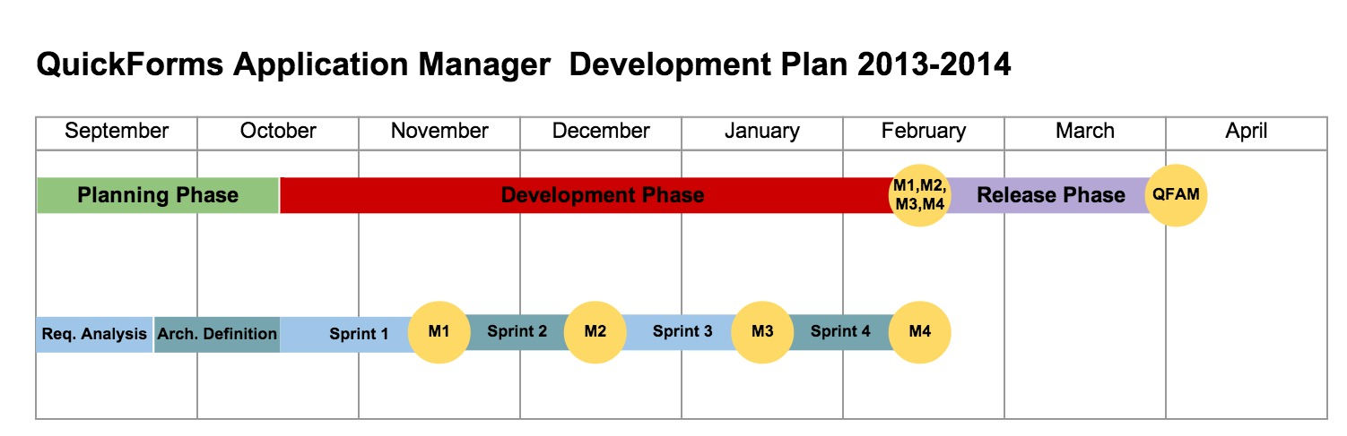
Project Timeline

Slide 8
(I) Planning Phase
Broken down into 2 sub-phases
(1) First Sub-Phase ✔ (Complete)
Requirements gathering
Requirements analysis
Prioritizing requirements
(2) Second Sub-Phase ✔ (Complete)
Architecture definition based on requirements
Finalize architecture & implementation decisions

Slide 9
(II) Development Phase
Phase broken up into 1-month iterative coding sprints
Progress evaluated on weekly basis throughout sprint
Progress of overall sprint evaluated at end of the month, development plan adjusted as required
Sprint 1: Prototype ✔ (Complete)
Sprint 2: Form editing capability (In Progress)
Sprint 3: Generic capability (Not Yet Started)
Sprint 4: Default configuration editing (Not Yet Started)

Slide 10
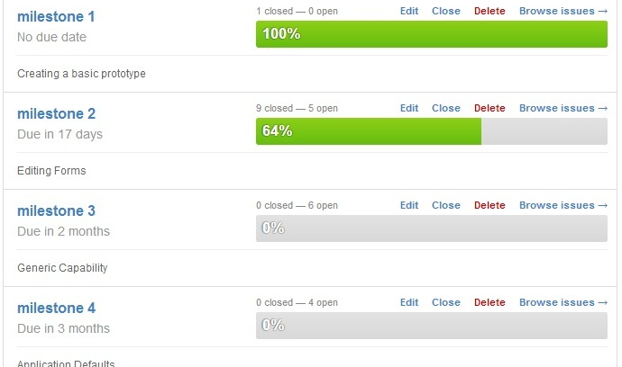
Milestones

Slide 11
(III) Release Phase
Scheduled to occur once all requirements outlined have been met
During this phase system will undergo
Integration
Intensive testing of integrated system
Documentation
Ready for release to client

Slide 12
Infrastructure
Configuration Management: GitHub
Wiki: GitHub
Building: Travis CI
Testing: QUnit, Selenium, Manual usability testing

Slide 13
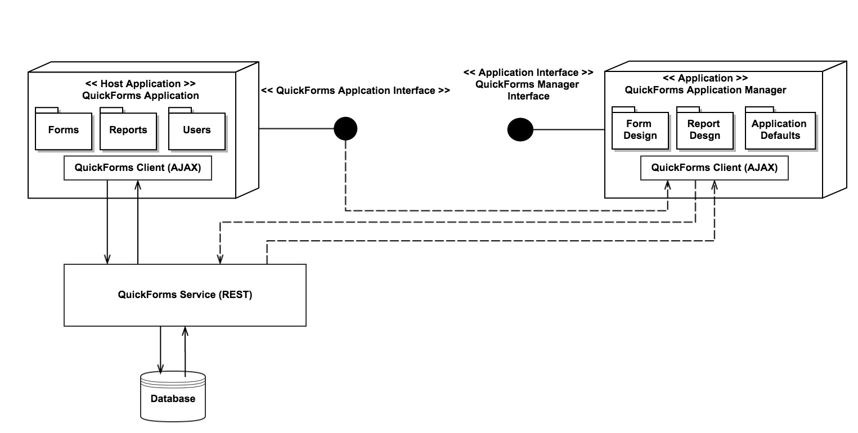
Architecture Overview

Slide 14
Key Challenges
Learning new programming languages
Online tutorials and examples
Understanding the QuickForms application architecture
Analyzing code
Collaborating with client’s developers
Coordinating group meetings
scheduling short, regular meetings throughout the week
long meetings during the weekend

Slide 15
Plans for Next Semester
complete two milestones
make application work generically
code integration
testing
code release preparation

Slide 16
DEMO

Slide 17
Thank you
Questions?

