Slide 1
MACHINE LEARNING · PRODUCT IMPACT
Next Best Action
An ML system that helps tradies act on the right job, at the right time — from rule-based prototype to a live, experiment-validated product.
A piece of work I'm proud of · end-to-end: problem → data → model → production → measured outcome

Slide 2
CONTENTS
What I'll walk through
1
The business & the opportunity
Context · the product journey · the real problem · why we started · the bet
2
Approach & architecture
The phased approach · end-to-end system design
3
The machine-learning model
Features & pipeline · why logistic regression
4
From model to product
Surfacing in-app · the team behind it
5
Results & reflection
Validation & results · lessons learned · principles for the role
Next Best Action · portfolio piece

Slide 3


CONTEXT
The business: a two-sided home-services marketplace
02
The company runs a marketplace that connects homeowners who need work done with tradespeople (“tradies”) who do it. Two customers, one platform.
Homeowners
Post a job, receive quotes, hire and pay a tradie.
The platform
Matches demand to supply; hosts the tools tradies run their work on.
Tradies
Quote, schedule, invoice and get paid.
Where this project lives — the Job Management product
▪ A tradie's workbench. Every accepted lead becomes a “job” they progress through quotes, appointments, invoices and payments.
▪ The problem space. Active tradies accumulate dozens — sometimes hundreds — of jobs in mixed states, with no signal for what to do next.
Next Best Action · portfolio piece

Slide 4
THE PRODUCT
From winning the work to getting paid — one connected journey
03
hipages gives tradies two connected products that span their whole working life. Every step along the way is a product feature.
① Lead Management
② Job Management — deliver the work & get paid
QUOTE & WIN
DO THE JOB
GET PAID & RUN IT
WIN THE WORK
Estimate
Invoice
Find & claim leads
Quote-inspection appointment
›
Job on-site appointment
›
Payments
Connect with homeowner
Quote
Accounting
Each box is a feature a tradie can adopt — estimates, quotes, appointments, invoicing, payments, even their accounting. Together, these run the tradie's entire business on hipages.
Next Best Action · portfolio piece

Slide 5
THE REAL PROBLEM
Not a sales problem — a feature-adoption problem
04
The suite is rich — but most tradies only ever adopt a handful of features. More value, and more loyalty, come from using more of them.
Why adoption is the real challenge
Two ways to drive adoption
▪ Tradies live in their jobs, not in a feature catalogue
▪ They rarely discover which feature helps at which moment
▪ Under-adoption → less value realised → weaker retention
▪ Pushing features at them just feels like being sold to
✕ The obvious play — cross-sell. Promote features, run campaigns, hope they bite. Intrusive, easy to ignore, low conversion.
✓ Our play — adoption underneath the need. Read each tradie's real jobs and surface the next action that genuinely helps. The right feature rides in beneath the need.
We don't sell the feature — we solve the moment. Help a tradie act on the right job, and feature adoption follows as a by-product. The open question: would that actually move retention and revenue? →
Next Best Action · portfolio piece

Slide 6
WHY WE STARTED
The founding signal: more actions → more retention → more revenue
05
Before building anything, the data made the case. Tradies who took more job-management actions renewed at far higher rates — and renewals are subscription revenue.
Levels off at ≈ +8 pp
the more they do, the longer they stay
More recommended actions
tradies nudged to quote, follow up, book, invoice
▼
Higher retention
engaged tradies are far less likely to churn (the curve →)
▼
More renewals
it's a paid subscription — staying = renewing
▼
More recurring revenue
retention compounds straight into MRR
Regenerated for clarity from the original treatment-effect (dose-response) analysis. Shape preserved; axes relabelled in plain language.
A 5 pp retention lift ≈ $350 extra MRR
Next Best Action · portfolio piece
Commercial case — the reason the project existed

Slide 7
THE OPPORTUNITY
The bet: score every job, surface one clear next action
06
If we can rank each job by how urgently it needs attention and recommend the single most impactful thing to do next, we turn an overwhelming list into a short, prioritised to-do — right inside the app.
1
2
3
4
›
›
›
Score
Prioritise
Recommend
Nudge
Every job gets an urgency probability — not a binary flag.
Surface the few jobs that matter now, hide the noise.
Attach one concrete next action (e.g. send quote, chase payment).
Show it in-product, where the tradie already works.
Success would look like: more tradies engaging with more of their jobs, jobs progressing further through the lifecycle, and ultimately stronger retention.
Next Best Action · portfolio piece

Slide 8
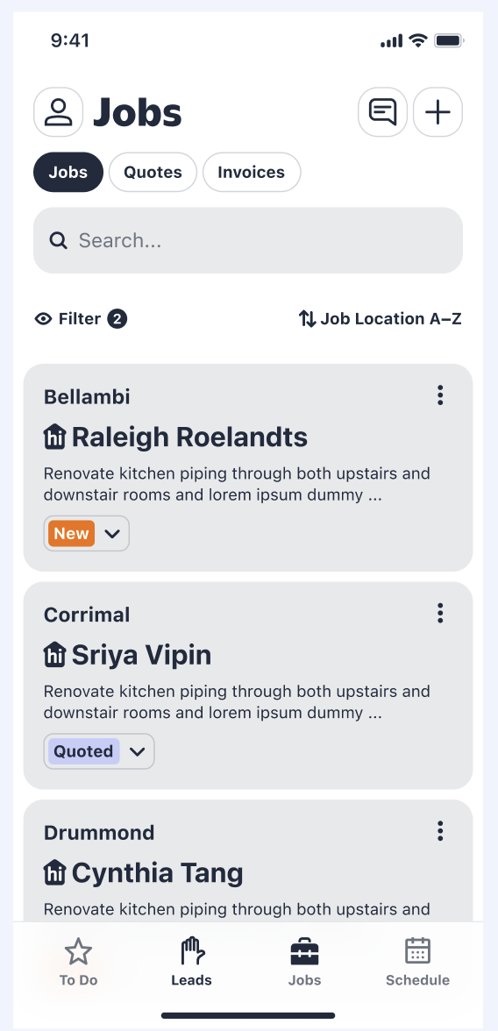
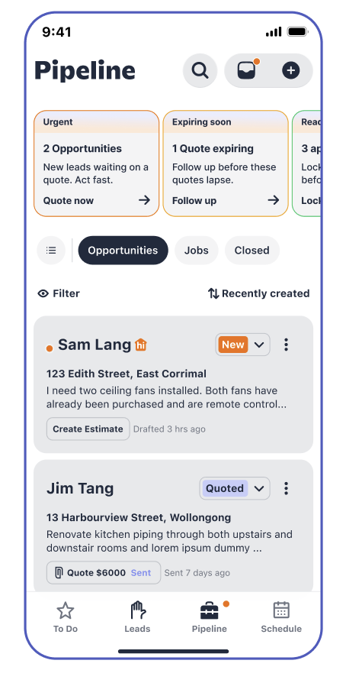
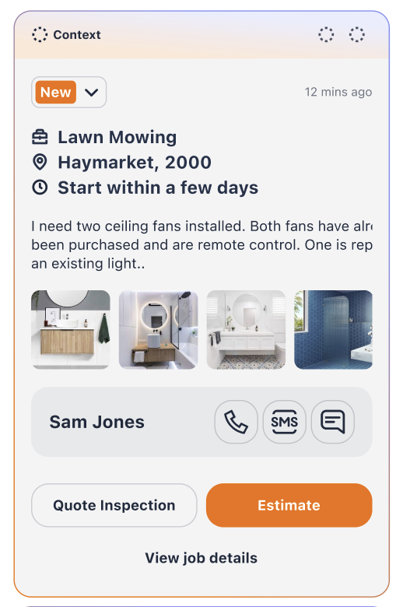
APPROACH
Pre Experience to Post Experience
07
Pre Experience for the Tradie
Post Experience for the Tradie
Next Best Action · portfolio piece

Slide 9
SYSTEM ARCHITECTURE
End to end: from data sources to a validated, in-app nudge
08
One pipeline, five stages — with experiment-based validation wrapped around the live product. Emphasis on modelling, output, validation and surfacing.
1 · Data sources
2 · Feature pipeline
3 · Modelling
4 · Output & serving
5 · Surfacing in-app
★
★
★
• Back-end job entities: jobs, quotes, estimates, invoices, appointments, payments
• Front-end engagement events (in-app actions)
• Subscription & lifecycle data
• → Lakehouse: bronze → silver → gold
• Clean, key & join (per-tradie per-job composite keys)
• 50+ features across 7 signal groups
• Platform engagement signals (actions taken in-app)
• Activity volume & velocity per account
• Distinguishes active operators from dormant ones
• Multinomial logistic regression
• Calibrated probability per job: Urgent / Follow-up / Cold / None
• Priority-ordered next-action logic
• → Scored-jobs table
• Smart Groups builder (Immediate / Follow-up, capped)
• Scheduled refresh + cache → serving layer
• Smart Groups at the top of the job list
• Tradie sees prioritised jobs + recommended action
• Acts in-product
›
›
›
›
★ Validation — experiment design (A/B Test) & measurement (the product is wrapped in a live 50/50 A/B test)
Randomise tradies → Test / Control
›
Capture real behaviour (events)
›
Metrics: key-action lift · retention · funnel
›
Daily monitoring dashboard → read-out
Closed loop: experiment findings feed the next iteration — retrain, re-target, refine the nudge.
Next Best Action · portfolio piece
Internal table / service names omitted — anonymised architecture

Slide 10
THE MODEL · FEATURES
50+ features across seven signal groups – Feature Pipeline
09
Engineered to capture not just a job's state, but how that state compares to what should happen next.
Recency
Frequency
Financial
days since last activity, job age, staleness bucket
counts of quotes, invoices, total entities
money at risk, overdue amount, quote/invoice size
Lifecycle
Behavioural
Engagement
completeness score, stage, entity-presence flags
status-vs-reality mismatch, work-done-no-invoice
platform action count & velocity per account
Next Best Action · portfolio piece

Slide 11
THE MODEL · CHOICE
Why logistic regression — interpretability with calibration
10
The setup
Why this model, not a black box
▪ Target: 4 classes — Urgent, Follow-up, Cold, none
▪ Multinomial, L2-regularised; standardised features
▪ Balanced class weights for the rare Follow-up class (~3%)
▪ 70/30 stratified split, fixed seed for reproducibility
▪ Interpretable: coefficients map to feature importance the business can trust
▪ Calibrated: a continuous probability, so we can rank and threshold
▪ Robust: weak signals compound sensibly into urgency
▪ Right-sized: no over-engineering for the data on hand
The key judgement call — proxy labels
We had no human-labelled ground truth, so the v1 rules became the training labels. The model's value isn't replicating rules — it's learning the interactions and edge cases rigid rules miss and producing a calibrated score instead of a hard flag. I was explicit that this caps the model's ceiling at the quality of the rules.
Next Best Action · portfolio piece

Slide 12
FROM MODEL TO PRODUCT
Turning scores into an in-app experience
11
A model in a notebook changes nothing. The scores were packaged into “Smart Groups” that meet the tradie where they already work.
1
2
3
4
Score jobs
Form groups
Pick the action
Surface in-app
›
›
›
Model ranks every active job by urgency
Top jobs split into “Immediate action” + “Follow up”, capped to a short list
A language model selects a concrete call-to-action + one-line reason per job
Shown at the top of the job list; refreshed on a schedule & cached
Design choice: the deterministic model decides which jobs matter (rankable, auditable); the language model handles the fuzzy, human bit — phrasing the right nudge. Each tool does what it's best at.
Next Best Action · portfolio piece

Slide 13
COLLABORATION
It took a cross-functional team — and a clear data role
12
This was never a solo modelling exercise. Shipping it meant working across four disciplines, each owning a different risk.
Product
Design
Engineering
Data
Framed the opportunity, defined success metrics, prioritised the rollout.
Shaped the Smart Group UI so a nudge felt helpful, not naggy.
Built the serving pipeline, the in-app surface and the refresh/caching.
Designed the solution, Owned the data, features, model and the experiment read-out.
Next Best Action · portfolio piece

Slide 14
VALIDATION & RESULTS
Success Metrics
13
Design: a 50/50 A/B test — half the tradies saw Smart Groups, half carried on as normal. We grouped what we tracked into three questions.
ENGAGEMENT
ADOPTION
REVENUE
Are tradies doing more?
Are they following the nudges?
Does it convert to dollars?
More tradies took action — and acted on more of their jobs.
They pushed jobs further along: book → complete → close.
Engaged tradies renew and stay — lifting recurring revenue.
+8 pts activated
Progression up
MRR ↑ (leading indicator)
HOW THE SUCCESS WAS JUDGED
PRIMARY
SECONDARY
GUARDRAIL
% of tradies taking a key action
Jobs progressing further through the lifecycle
Reached more tradies without overloading the same few
+8 pts vs control
book → complete → close
actions-per-tradie stayed healthy
Next Best Action · portfolio piece
Relative lifts, directional — not significance-tested

Slide 15
REFLECTION
What I'm proud of — and what I'd do differently
14
Why I'm proud of this
What I'd do differently next time
1
It hits the frontline, not the back office.
Most ML quietly optimises an internal process. This one is customer-facing — every tradie on web and app sees and uses what we built. Real product, real people, visible craft.
ML
Close the learning loop.
Capture which recommendations actually convert and feed that back as labels, so the model learns continuously rather than being retrained occasionally.
2
Outsized commercial impact.
Because engagement feeds retention, even a lean model drove recurring-revenue impact at scale, across the whole tradie base.
2
Pre-register & power the experiment.
Lock the primary metric and a significance test before launch, so the read-out is unambiguous.
3
It became the blueprint.
Its simple, interpretable design — and how the cross-functional team worked — made it the reference prototype for future ML / personalisation use cases.
3
Define “success” with product up front.
Agree what done means — e.g. in- vs out-of-platform completion — so measurement matches reality.
Next Best Action · portfolio piece

Slide 16
Thank you
Happy to go deeper on the data, the model, or the experiment.

