Slide 1
COURSE MANAGEMENT SYSTEM
Software Engineering Project – MID presentation
27th July 2022

Slide 2
TEAM 06
GROUP MEMBERS
2018 / E / 028
2018 / E / 073
2018 / E / 130
2018 / E / 151

Slide 3

INTRODUCTION
Course Management is little bit overhead.
By using a better computer system, we can handle these issues easily and efficiently.

Slide 4
FUNCTIONAL REQUIREMENTS
Head of Department - HOD
Can add a new course
Can select offering courses
Approve the courses added by MA
Managing Assistant - MA
Add courses details to the system
Send HOD to confirmation
Dean
Edit or update course details
Administrator
Manage users and system

Slide 5
FUNCTIONAL REQUIREMENTS
All users
view offering courses and details
API ports
To fetch the list of courses for each semester
To fetch any data relevant to a course

Slide 6
NON-FUNCTIONAL REQUIREMENTS
Security
Reliability
Responsiveness
Cost-effective

Slide 7
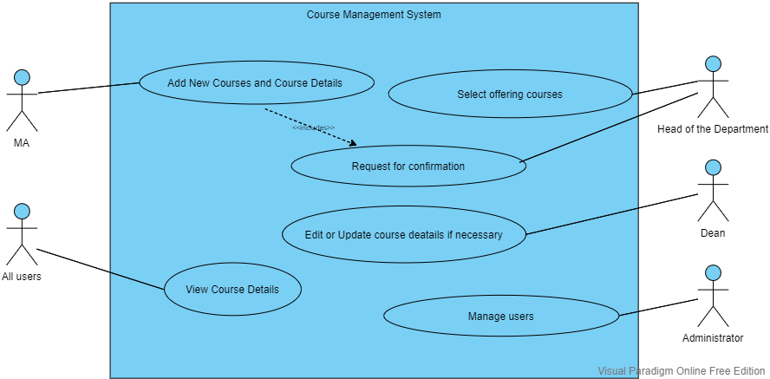
USECASE DIAGRAM

Slide 8
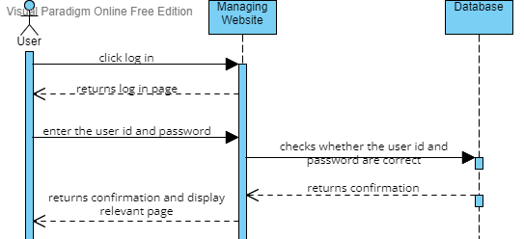
SEQUENCE DIAGRAM
User login
Here user can be HOD, MA, Dean or Administrator

Slide 9
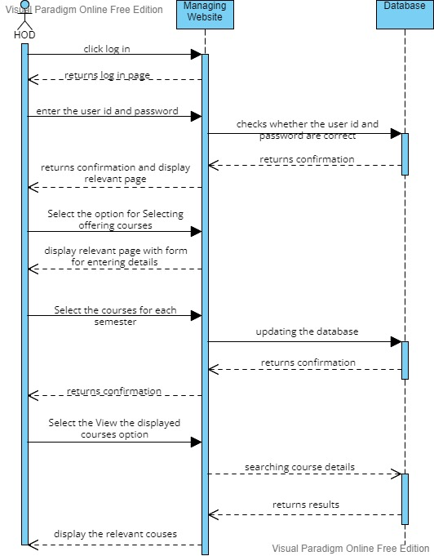
SEQUENCE DIAGRAM
HOD Perspective

Slide 10
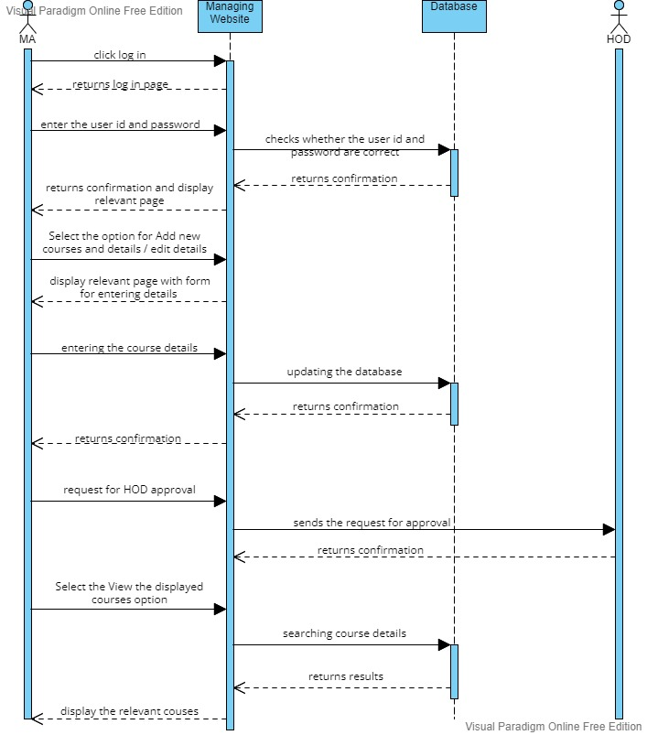
SEQUENCE DIAGRAM
MA Perspective

Slide 11

SEQUENCE DIAGRAM
Dean Perspective

Slide 12
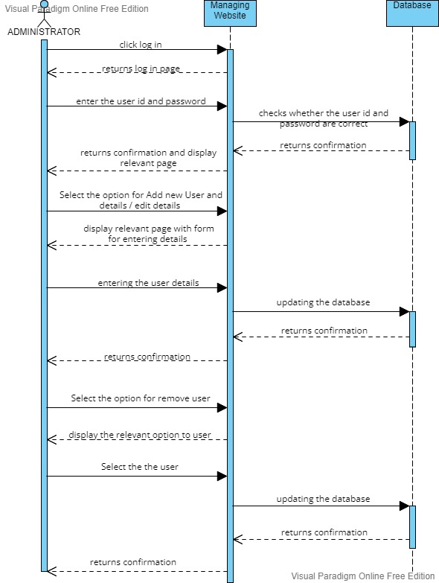
SEQUENCE DIAGRAM
Administrator Perspective

Slide 13
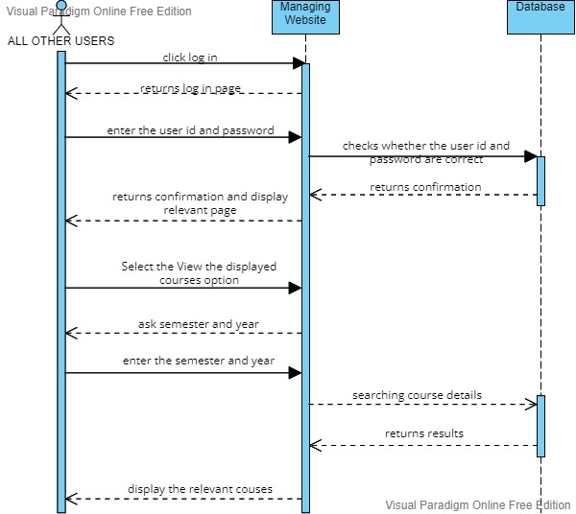
SEQUENCE DIAGRAM
All user Perspective
For this function no need to Log In

Slide 14
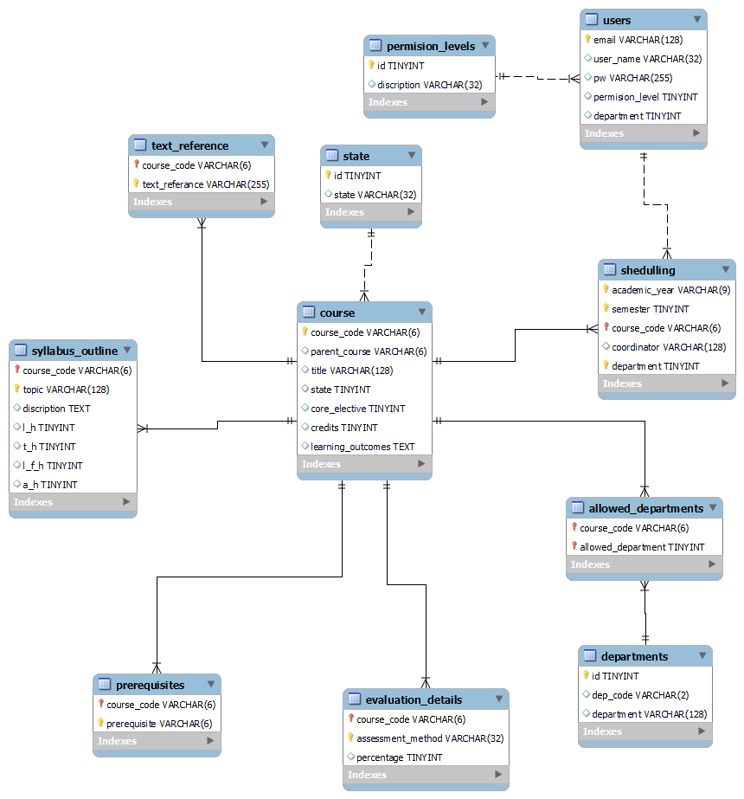
RELATIONAL SCHEMA

Slide 15
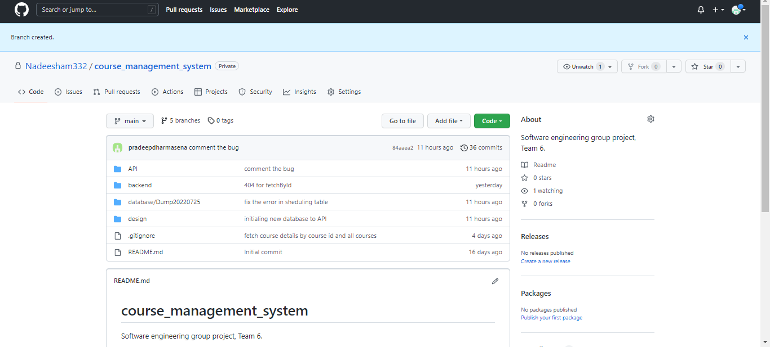
COLLABORATIVE

Slide 16
IMPLEMENTATION

Slide 17
PROJECT TIME LINE
WEEK 1
Brainstorming and idea generation
Planning
WEEK 5
Gathering requirements
WEEK 3 - 4
Idea selection
WEEK 2
WEEK 6-7
Creating the database
Finalizing
WEEK 15
Testing
WEEK 13-14
Implementation
WEEK 8-12

Slide 18
ACTION PLAN
ACTION | ASSIGNED TO | STATUS
Requirement gathering | Dharmasena, Munasingha | Finished
Analyze Requirements | Dharmasena | Finished
Project Plan | Dharmasena, Maduranga | Finished
Design ER, Use case and Sequence diagrams | Maduranga, Venuja | Finished
Design UI | Munasingha | In Progress
Create database, add dummy data | Maduranga, Dharmasena | Finished
Write procedures (database) | Dharmasena | In Progress
Backend development | Maduranga, Venuja | In Progress
Analyze test cases | Venuja | Upcoming
Frontend development | Munasingha | Upcoming
Apply test cases | Venuja, Maduranga | Upcoming
Final report | Venuja, Munasingha | Upcoming
Finalize the project | Venuja, Munasingha | Upcoming

Slide 19

THANK YOU !
~TEAM 06
Notes:
NOTE:
To change the image on this slide, select the picture and delete it. Then click the Pictures icon in the placeholder to insert your own image.

