Slide 1
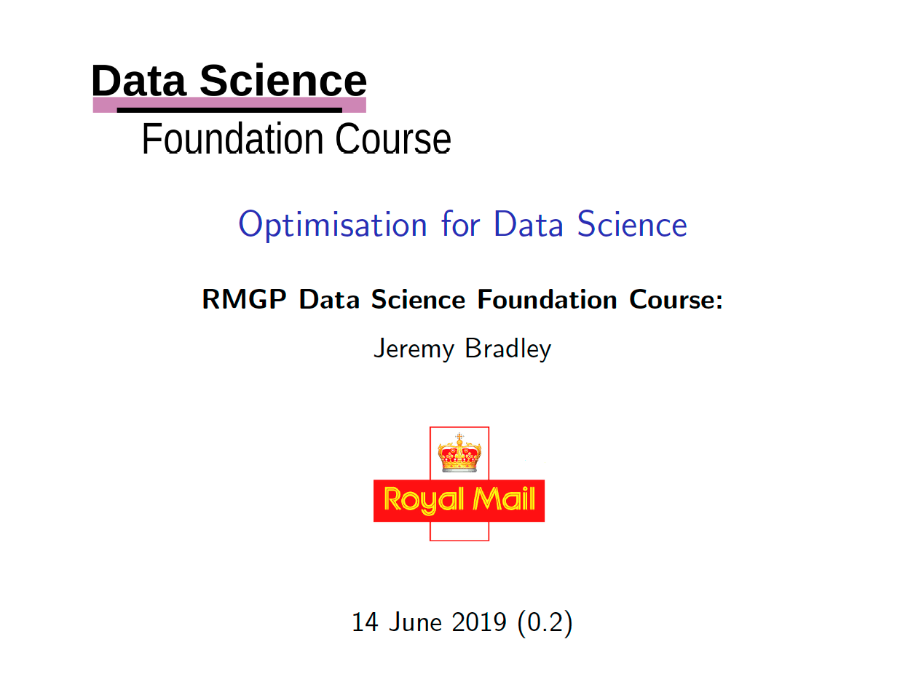
Heuristics for Final-mile Optimisation
Fabrice Durier
28 June 2019

Slide 2
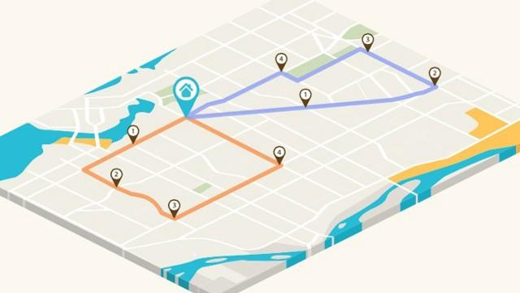
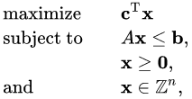
Optimisation Science
Objective
Minimise cost (combination of time and distance)
Alternative objectives
Save fuel
Reduce number of vans used
Increase capacity to service more locations

Slide 3
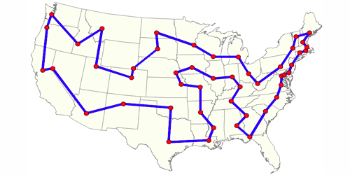
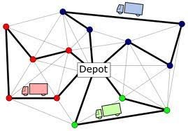
Optimisation Terminology
Travelling Salesman Problem (TSP) is the “shortest route between stops for a single van”
Many existing tools only tackle the travelling salesman problem.
Vehicle Routing Problem (VRP) is the “optimal set of tours for a fleet of vehicles to deliver to a set of stops”

Slide 4
Efficient Route Creation
Terminology
A depot/hub is a start and end point
A vehicle drives a tour or route from a depot
A tour consists of 1 or more stops

Slide 5
Why is it Hard?
A single van route of 61 deliveries has more possible solutions for delivery than the number of atoms in the universe!
1.0 x 10⁸¹ atoms versus 5.1 x 10⁸³ solutions

Slide 6
Why is it Hard?
61 deliveries split over 10 vans has 90,000,000,000 times as many solutions again!
1.0 x 10⁸¹ atoms versus 4.6 x 10⁹⁴ solutions

Slide 7
Why is it Hard?
We need to optimise 1000s of parcels being delivered in 100s of vans every day of the week from 100s of depots.
This is a bleeding-edge research problem!

Slide 8

Classical Optimisation
Minimise f(x,y,z) { Objective Function:
E.g. Cost, Distance, Time }
Subject to:
x, y, z > 0
x + y + z ≤ C { Constraints }
3x + 2y + z < K

Slide 9
Classical solution techniques
Problem is NP hard
Suffers from combinatorial explosion
Revolves around Mixed Integer Linear Programming where integer variables typically used to encode the network linkage, and continuous variables encode time slots, capacity limits, business processes…
Heuristics used to make problem tractable

Slide 10
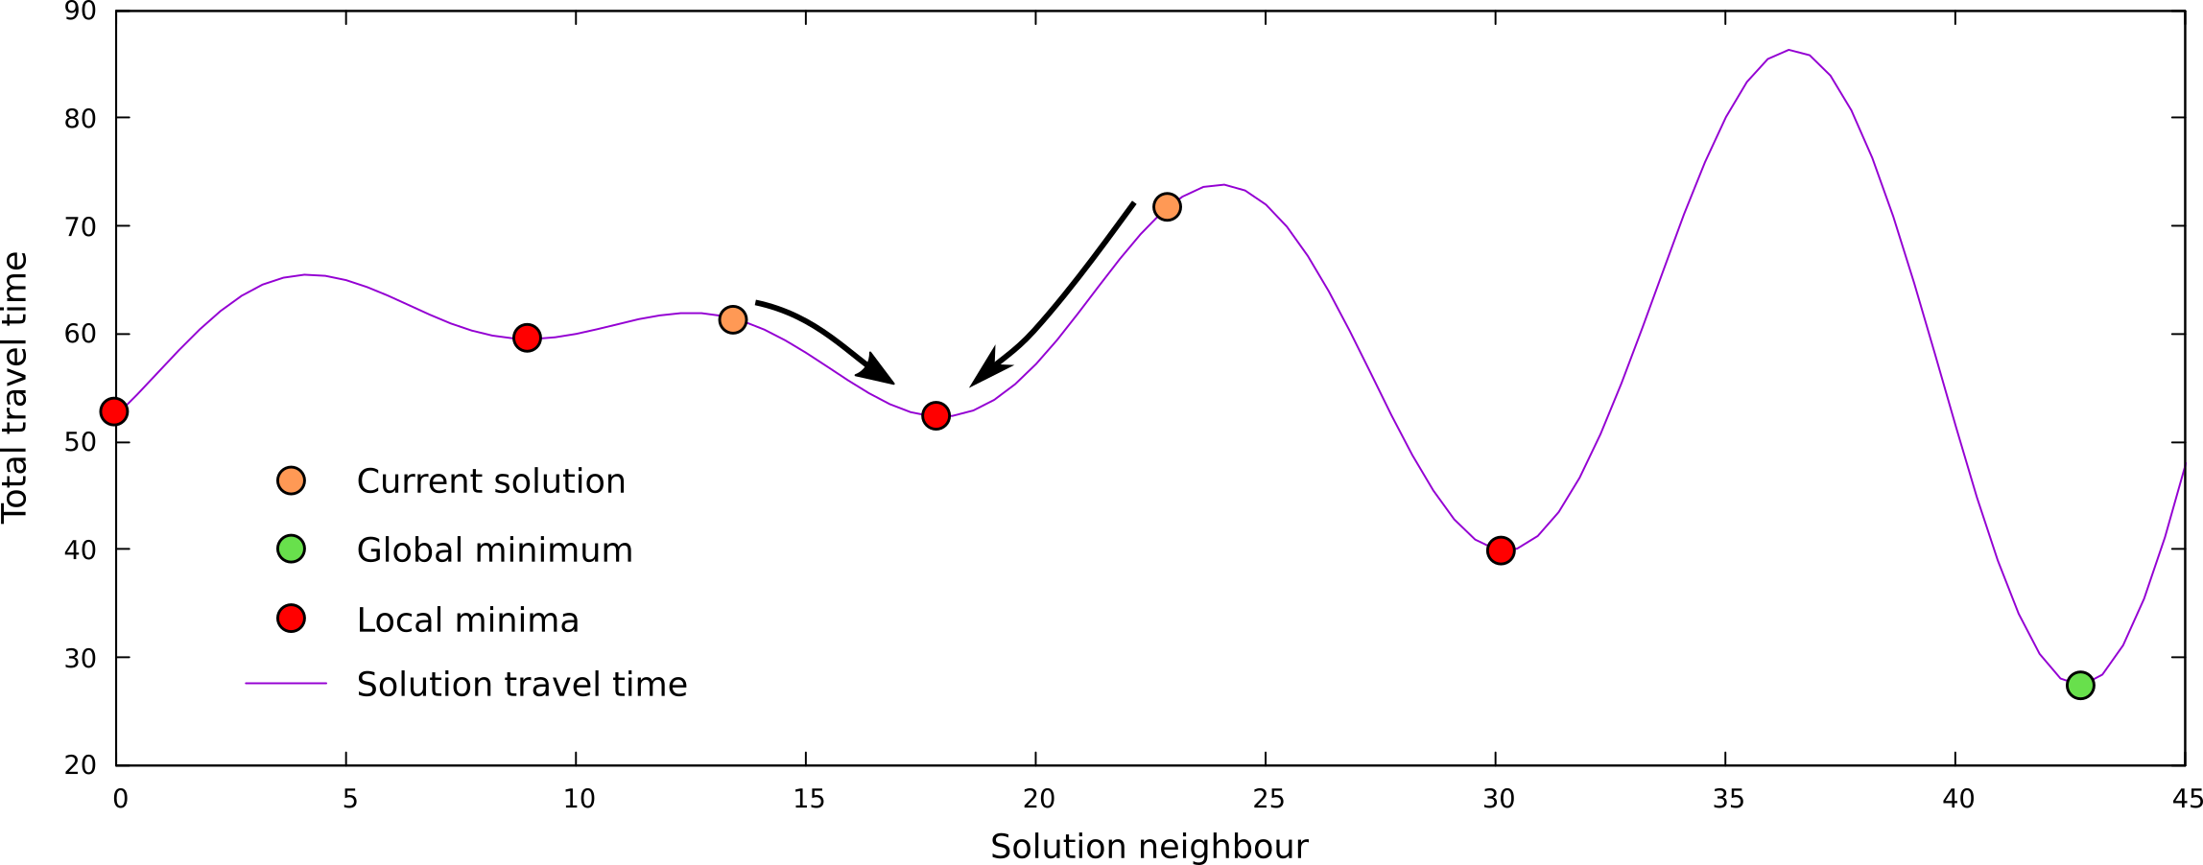
General Heuristic Approach
Abstract local improvement algorithm
Starting from an initial solution
Modify the solution using a heuristic
Check if the new solution is better:
If yes, replace current
Else, discard it

Slide 11
Local Improvement Heuristics

Slide 12
Local Search (LS)
Require a method for generating an initial solution
Start with initial solution
Create alternative solutions by performing simple operations:
Swap 2 different stops
Swap/Mirror segments of routes
Remove a stop and re-insert it between 2 other ones
Keep solution if improved objective function
Repeat from (2) from start with the improved solution

Slide 13

Heuristic: within-tour-swap

Slide 14

Heuristic: within-tour-swap

Slide 15

Heuristic: between-tour-swap

Slide 16

Heuristic: between-tour-swap

Slide 17
Global Improvement Heuristics

Slide 18
Large Neighbourhood Search (LNS)
Require a method for generating an initial solution
Start with initial solution
Create n concurrent solutions by performing one of the following:
Removing proportion p of stops in solution
Removing m complete tours from solution
For each solution replace removed reservations/stops using one of the following:
Random order replacement using Best Insertion
Replace using a partial order - based on Regret Measure
Keep one or more solutions with improved objective function
Repeat from (2) with all better solutions

Slide 19
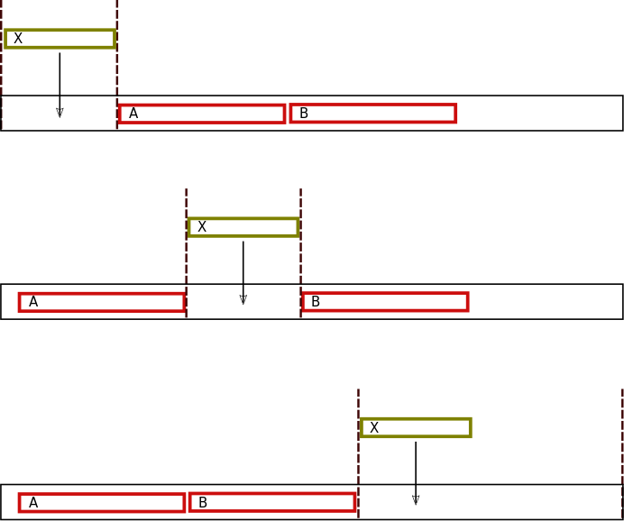
Best Insertion: Test insert new order

Slide 20
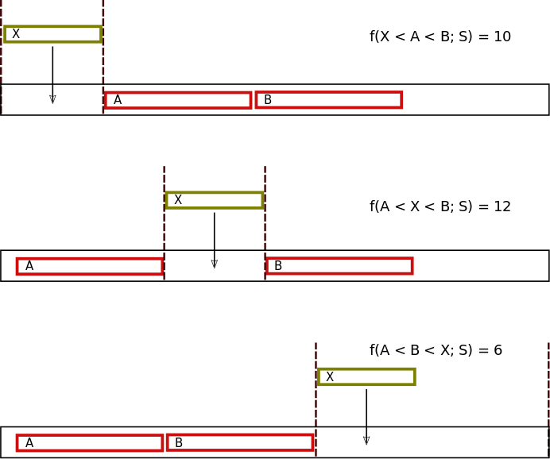
Best Insertion: Compare objective functions

Slide 21
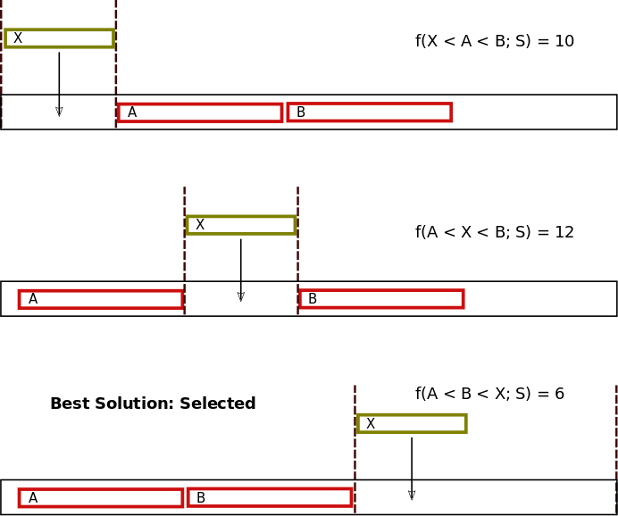
Best Insertion:
Solution found

Slide 22
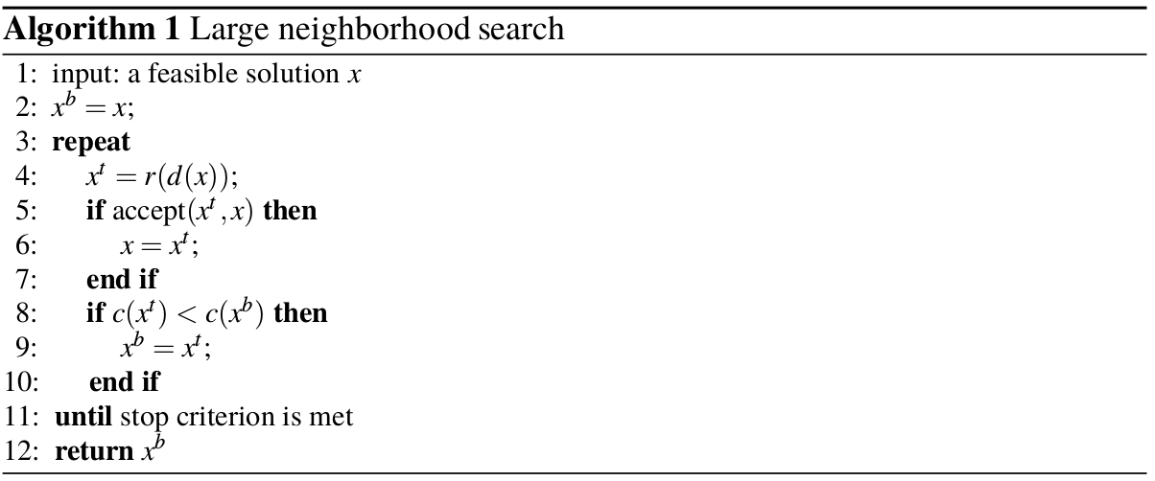
LNS: Generic Algorithm (Pisinger and Ropke 2010)

Slide 23
LNS: Generalisation
Require:
d(x) = partially stochastically destroy a solution, x
r(x) = fully stochastically repair a solution, x
c(x) = cost function of x
accept(x, y) = a criterion for accepting x compared to y
accept(x,y) = x if c(x) < c(y) else y; OR
accept(x,y) = x if c(x) < c(y) else x with probability q, y with probability (1- q)

Slide 24
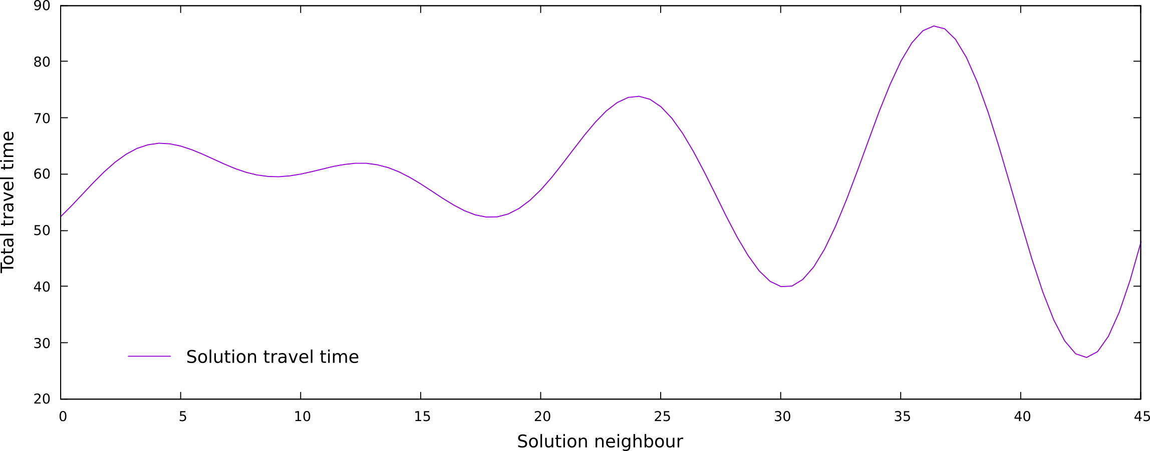
Solution Space

Slide 25
Local Search

Slide 26
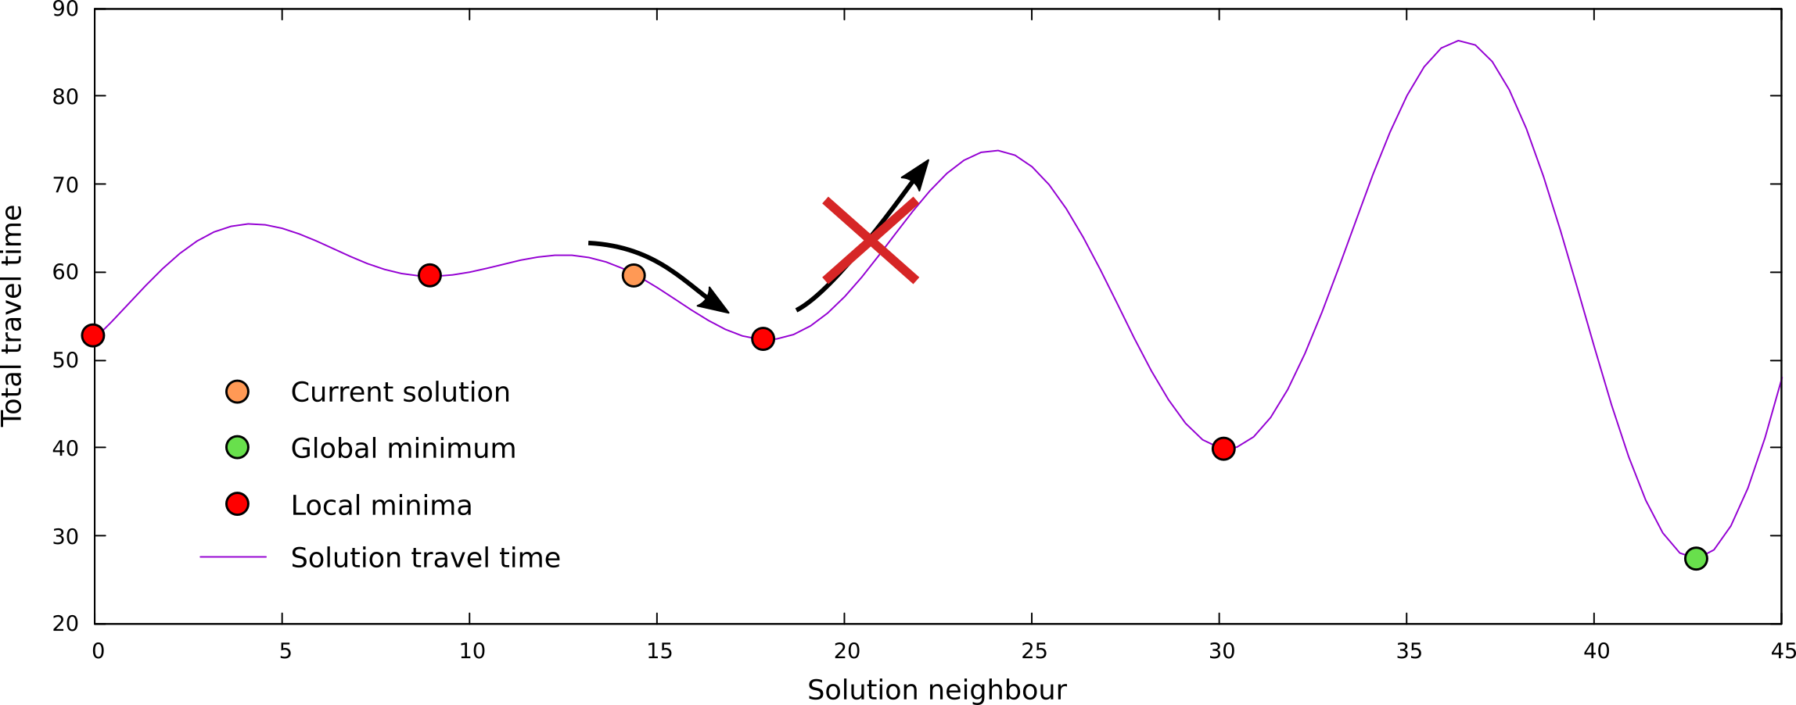
Getting Stuck with Local Searching

Slide 27
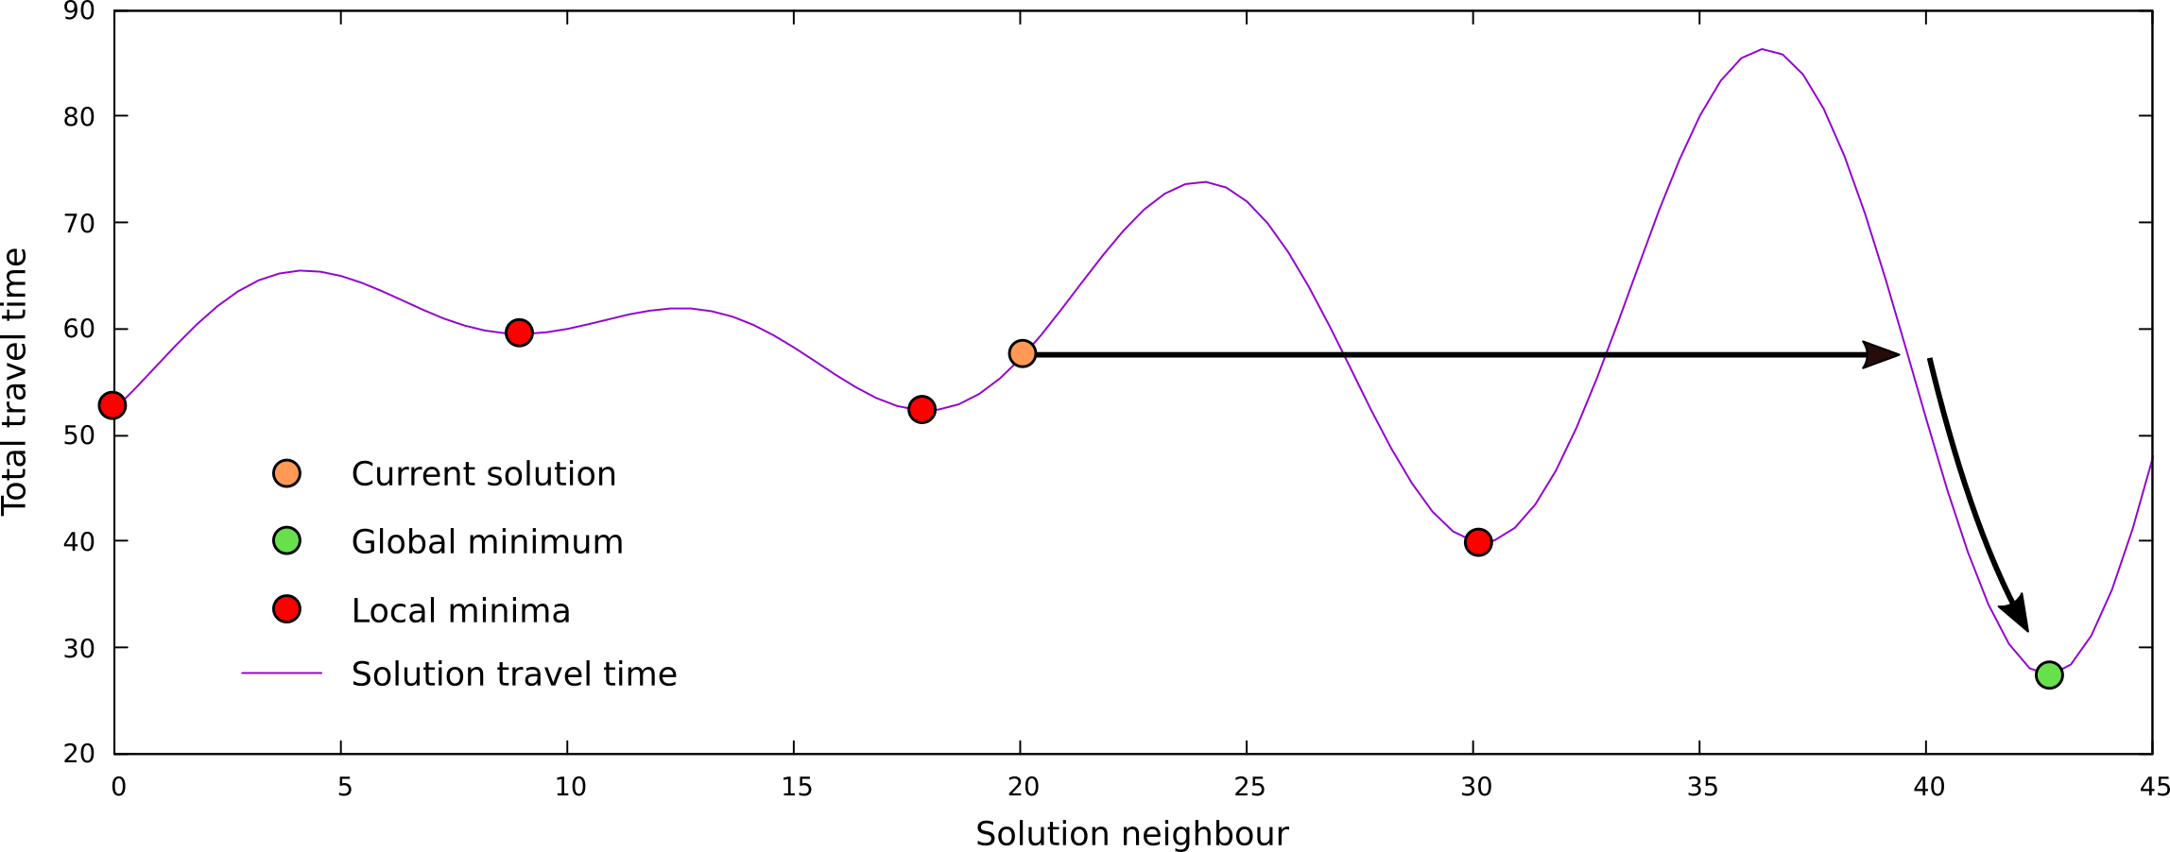
Large Neighbourhood Jumps

Slide 28
Hands-on Exercises

Slide 29
Tasks to-do
From a real RM problem, build an optimisation procedure from start to end:
Instantiate the problem: loading Delivery Point coordinates, as well as Travel Matrices, and operation constraints.
Initiate a set of routes with a simple approach.
Apply and compare a couple of Local Search heuristics
Apply a Large Neighbourhood Search and compare with previous heuristics
Produce Operation Manifests for the Business

Slide 30
Exercises to-do
From our optimisation procedure, experiment and develop the following:
Re-run notebook with bigger problem set
Run notebook with the alternative “Close-By” initialisation method and compare with previous results
Develop additional Local Search algorithm, such as a ”mirroring” operator
Introduce a stochastic acceptance criteria in the LNS procedure (code commented so far)
Combine LS within LNS heuristic!!!

