Slide 1
Egypt Food Crisis Analysis
How two currency devaluations reshaped what 105 million people can afford to eat
C-DE211: Data Analysis · Project 3 · Egypt University of Informatics · Spring 2026
Datasets: WFP Food Prices (16,000+ records) · WFP Market Metadata · FAO Food Security Indicators
9.4%
×2
p<0.05
R²=0.9962
Undernourishment
2024
Increase in
undernourishment
Devaluation
significance
Regression
model fit
Egypt Food Crisis Analysis · 1 / 14

Slide 2
The Setting
2016 Devaluation
Egypt imports more wheat than almost any country on earth. The food system runs on US dollars — grain, cooking oil, animal feed. But 105 million people earn and spend in Egyptian pounds.
EGP 8.8 → 18 per USD
November 3, 2016
50% overnight loss
When the pound falls, the gap between what food costs to import and what households can pay closes badly, and fast.
2022 Devaluations
EGP 15.7 → 30+ per USD
Three rounds: Mar–Dec 2022
Compounded by war
The November 2016 float cut the pound's value in half in a single day: from EGP 8.8 to 18 per USD. Retail food prices followed within the same quarter.
Result by 2024
The 2022 sequence was worse in absolute terms — it coincided with Russia's invasion of Ukraine, disrupting the exact grain corridors Egypt depends on most. By early 2023 the rate exceeded 30 EGP/USD.
Undernourishment: 9.4%
Up from 6.4% in 2019
~3 million more people
Egypt Food Crisis Analysis · 2 / 14

Slide 3
Datasets & Methodology
WFP Food Prices
WFP Market Metadata
FAO Food Security Indicators
wfp_food_prices_egy
wfp_markets_egy
fao_indicators_summary_egy
Monthly retail prices for 30+ commodities across Egypt's governorates, January 2010 – mid 2024. 16,234 observations after cleaning. Cereals, pulses, oils, dairy, meat, vegetables.
Administrative and geographic data for each monitored market — governorate, market type (retail/wholesale), coordinates. Enables the Cairo vs. national comparison in H2.
Annual series 2002–2024: Undernourishment (PoU), Moderate/Severe Food Insecurity, Severe Food Insecurity, and Cereal Import Dependency Ratio (CIDR).
Analysis Pipeline
01
02
03
04
05
Data Cleaning & Engineering
Exploratory Data Analysis
Hypothesis Testing
Correlation Analysis
Predictive Modeling
Standardize names, MoM inflation, pre/post flags, staple classification
Distributions, annual boxplots, correlation heatmaps
Mann-Whitney U (H1 & H2), one-way ANOVA (H3)
Spearman rank matrix across all 30+ commodity pairs
Linear regression — R² evaluation + residual inspection
Egypt Food Crisis Analysis · 3 / 14

Slide 4
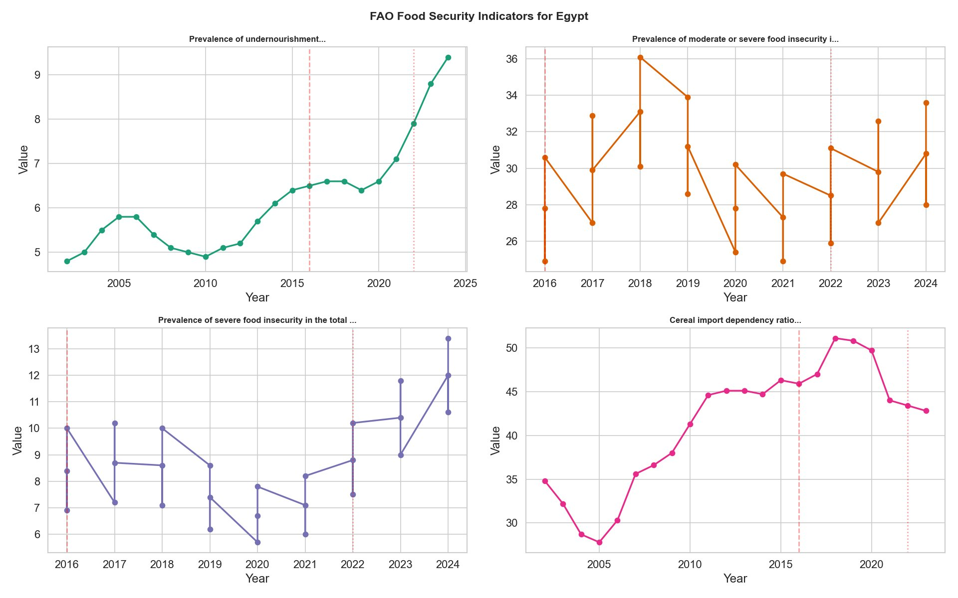
FAO Food Security Indicators — Egypt (2002–2024)
9.4%
Undernourishment
rate in 2024
×2
Rise since 2010
(4.9% in 2010 → 9.4% in 2024)
51%
Peak cereal import
dependency (2019–20)
33.4%
Moderate/severe food
insecurity, 2024
Red dashed = 2016 devaluation · Grey dotted = 2022 devaluation
Egypt Food Crisis Analysis · 4 / 14

Slide 5
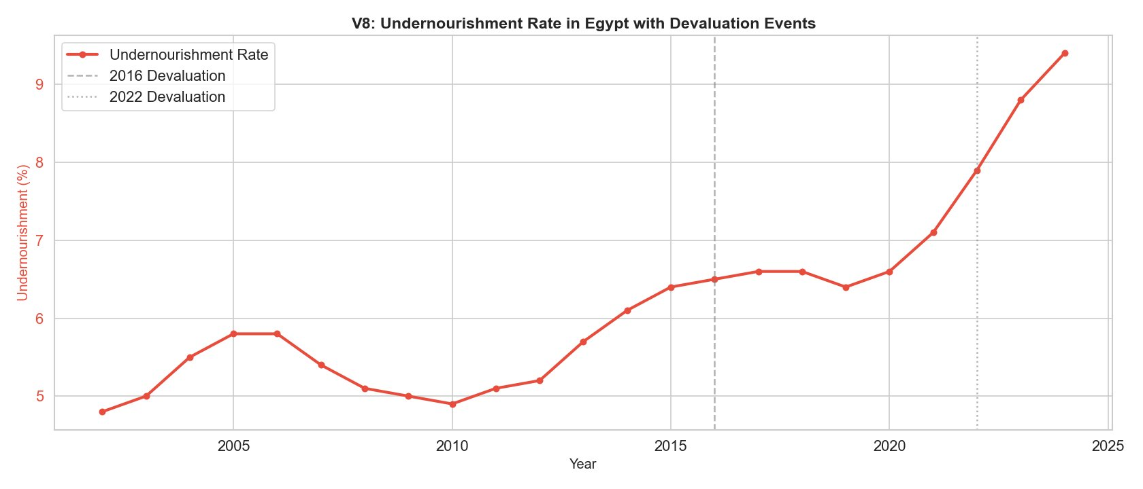
Undernourishment Rate — A 20-Year View
2010–2014
2016 Float
2022–2024
Flat near 5%.
Stable, pre-devaluation era.
Gradual uptick.
Price shock precedes welfare decline by ~2 years.
Acceleration to 9.4%.
~47% above the 2019 level of 6.4%.
Egypt Food Crisis Analysis · 5 / 14

Slide 6
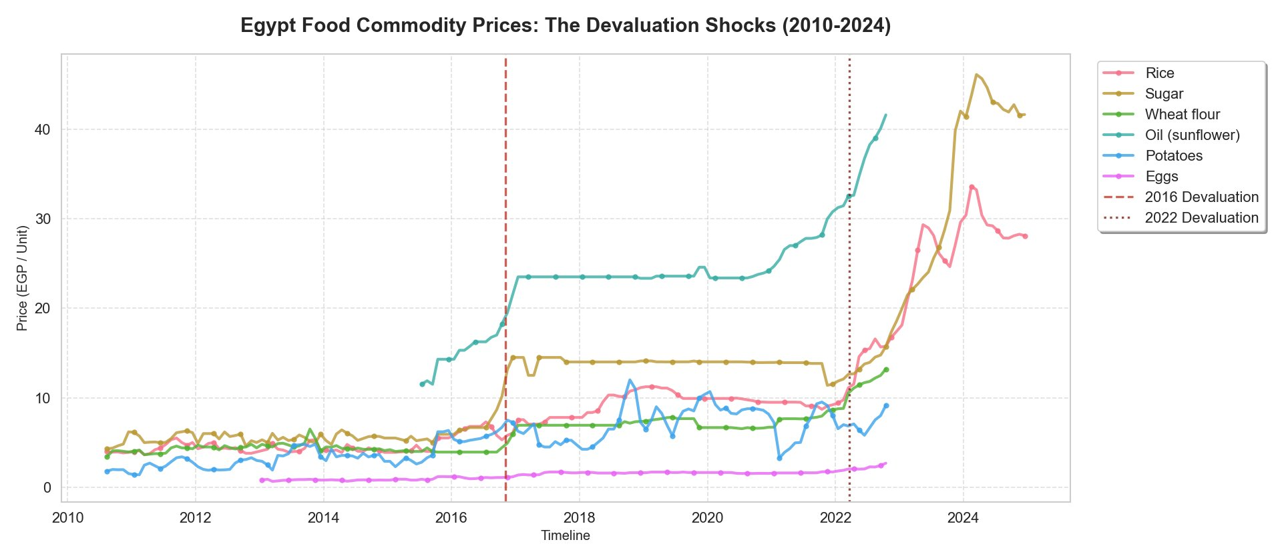
Food Commodity Prices 2010–2024 — The Two Shocks
2010–2015
2016 Shock
2022 Shock
All prices flat.
EGP pegged, stable.
Sunflower oil: 5 → 23 EGP.
Sugar: 5 → 14 EGP.
Oil → 41 EGP. Sugar → 45 EGP.
Wheat flour: 7 → 13 EGP.
Egypt Food Crisis Analysis · 6 / 14

Slide 7
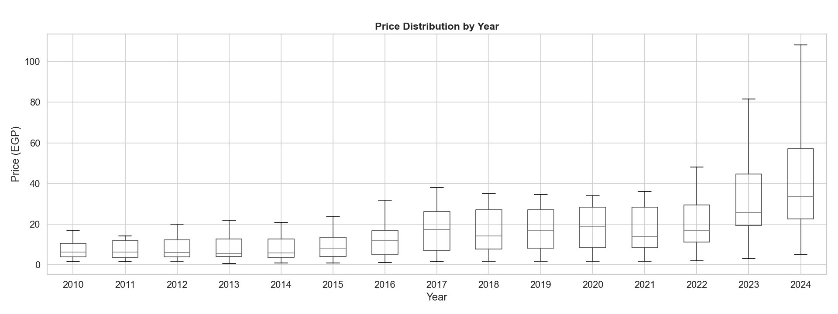
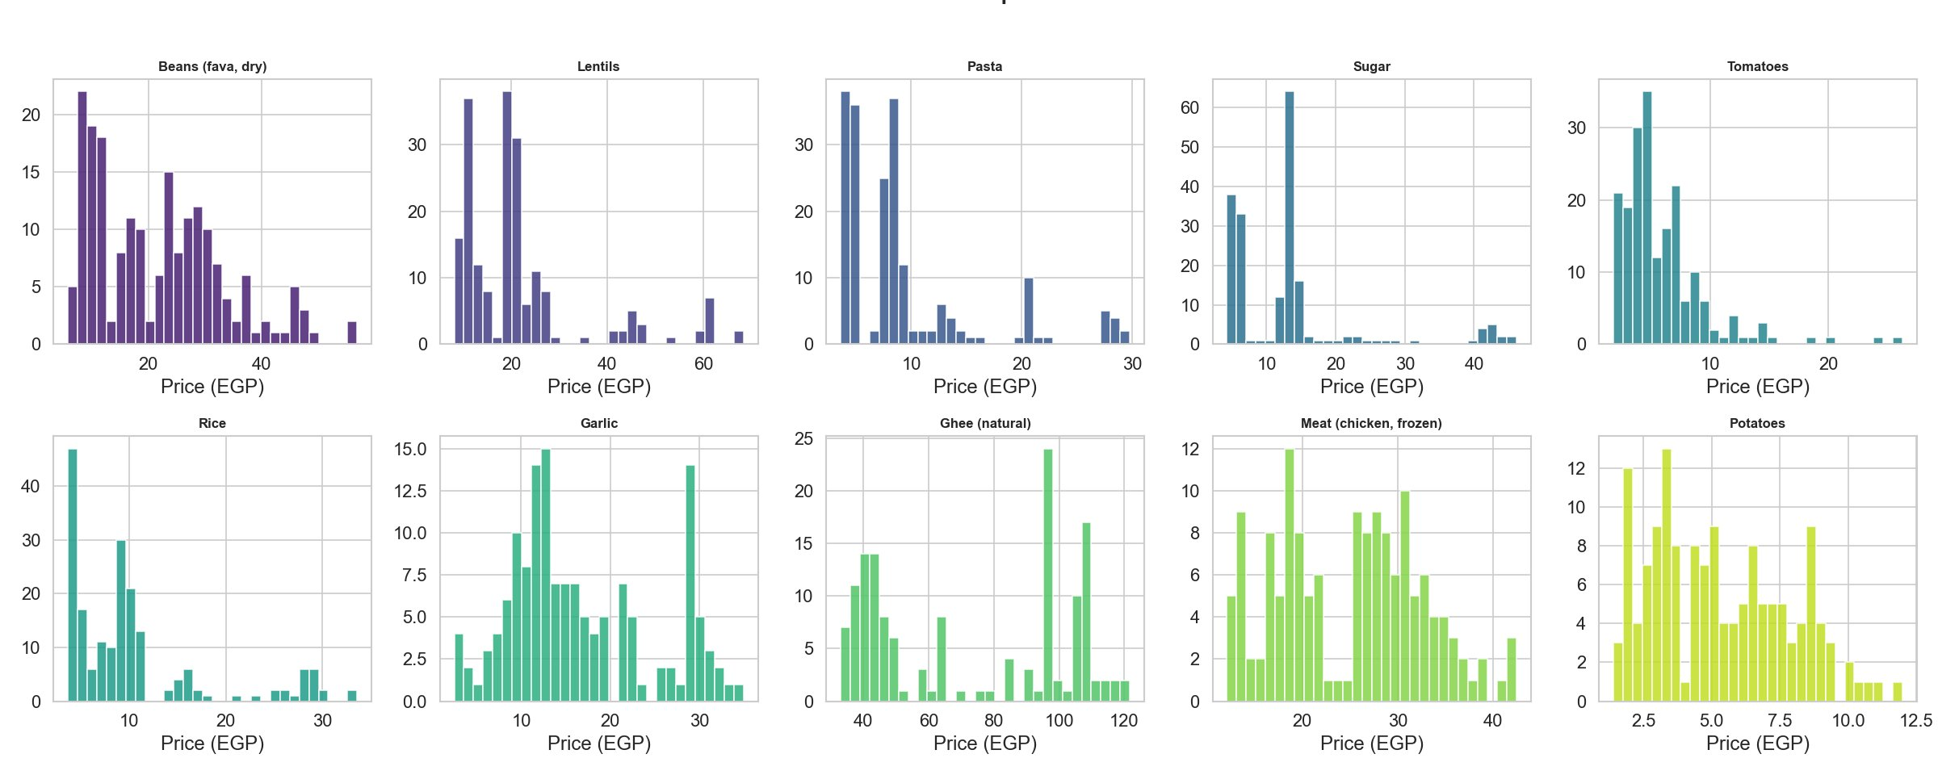
Exploratory Analysis — Price Distributions
Fig A · Annual box plots (2010–2024)
Median rose from ~8 EGP to ~27 EGP. IQR exploded post-2022.
Fig B · Per-commodity histograms
Bimodal patterns = two structural price eras (pre-2016 + post-2022).
WHY BOX PLOTS?
15 years × full distribution = 15 histograms if done naively. Box plots compress each year to a single element (median, IQR, whiskers), making year-over-year evolution readable in one panel. The non-parametric summary is appropriate because food prices are right-skewed — a mean ± SD summary would be misleading.
Egypt Food Crisis Analysis · 7 / 14

Slide 8
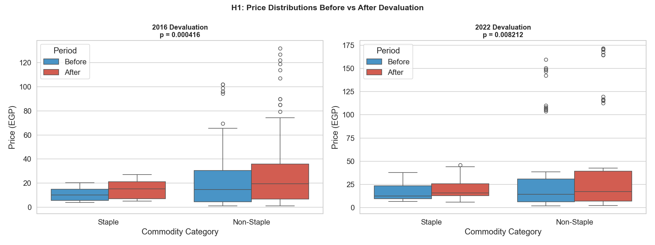
H1 — Did Devaluations Significantly Raise Food Prices?
✓ H1 SUPPORTED
Mann-Whitney U
p = 0.000416
2016 Devaluation
Mann-Whitney U
p = 0.008212
2022 Devaluation
95% confidence
level
Both p < 0.05
WHY MANN-WHITNEY U (NOT T-TEST)?
Shapiro-Wilk confirmed non-normality in all price distributions (p<0.001). The t-test requires normality. Mann-Whitney U is rank-based with no distributional assumptions — it tests whether one distribution is stochastically larger than the other. That is exactly the right question for devaluation analysis.
Blue = before devaluation · Red = after devaluation · Left panel: 2016 · Right panel: 2022
Egypt Food Crisis Analysis · 8 / 14

Slide 9
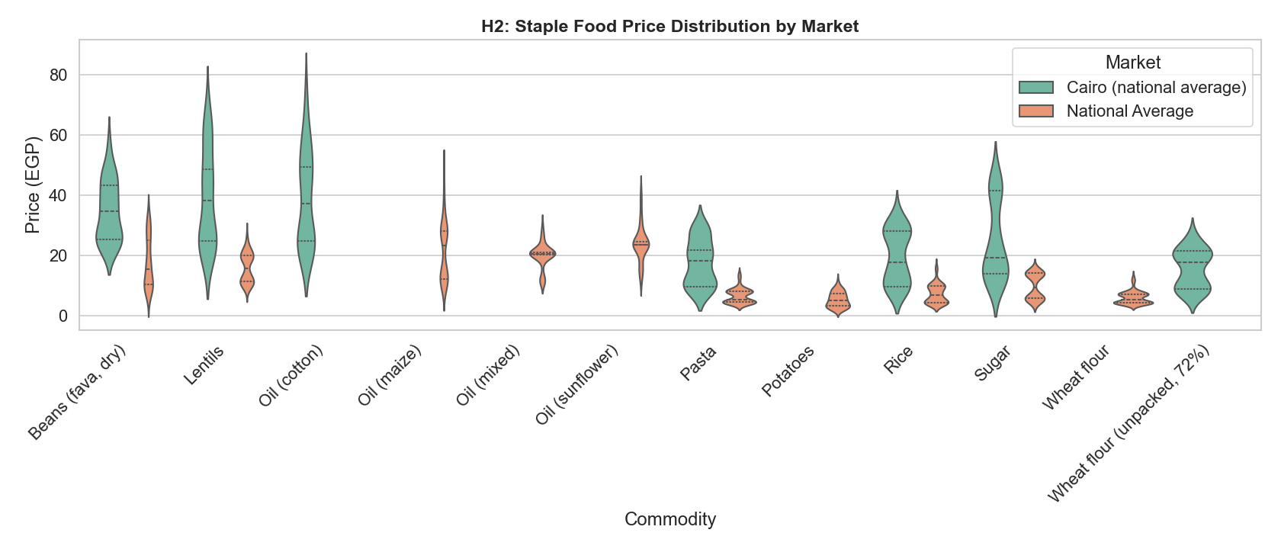
H2 — Are Cairo Prices Higher Than the National Average?
✓ H2 SUPPORTED
Cairo > National for all 12 staple commodities tested.
Oil (cotton)
Cairo peak ~87 EGP
National peak ~25 EGP
3.5× premium
Wheat flour
Near parity
Subsidy fully transmitted
System working here
Lentils / beans
~25–30% urban
premium. Higher
distribution costs.
WHY VIOLIN PLOTS (NOT BAR CHARTS)?
Several commodities have bimodal price distributions — a pre-2016 cluster and a post-2022 cluster. A bar of means falls between those two modes, representing a price that almost never actually occurred. Violin plots show the full empirical density, making structural price-level shifts visible without any parametric assumptions.
Egypt Food Crisis Analysis · 9 / 14

Slide 10
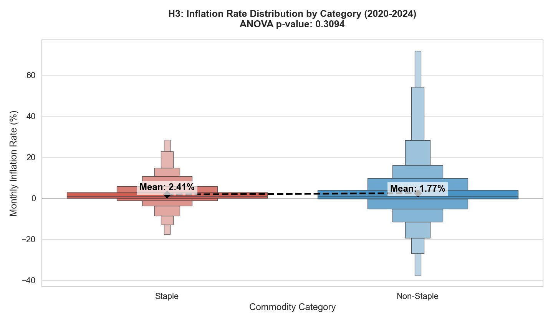
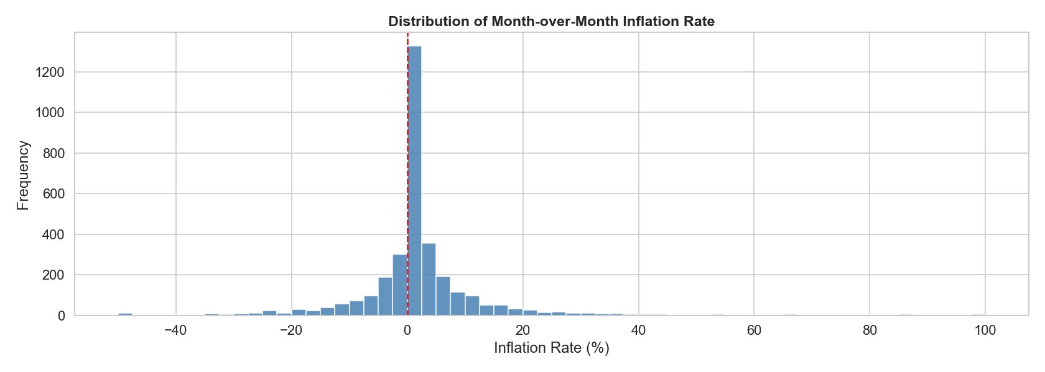
H3 — Do Staple Foods Inflate Faster Than Non-Staples?
Distribution of month-over-month inflation rates across all commodities. Centered near zero, right-skewed — inflation comes in bursts, not as a steady grind.
✗ H3 NOT SUPPORTED — p = 0.3094
Staple mean: 2.41% Non-Staple mean: 1.77%
Difference is not statistically significant.
WHAT THE NULL RESULT MEANS — AND WHY ANOVA HERE (NOT MANN-WHITNEY)?
Food inflation in Egypt hits the whole basket, not just staples. The macro FX driver overrides commodity-specific dynamics — meaning commodity-specific price caps provide uneven protection. ANOVA was used (not Mann-Whitney) because H3 compares mean monthly inflation rates — a derived variable that approaches normality by the Central Limit Theorem — rather than raw price distributions as in H1.
Egypt Food Crisis Analysis · 10 / 14

Slide 11
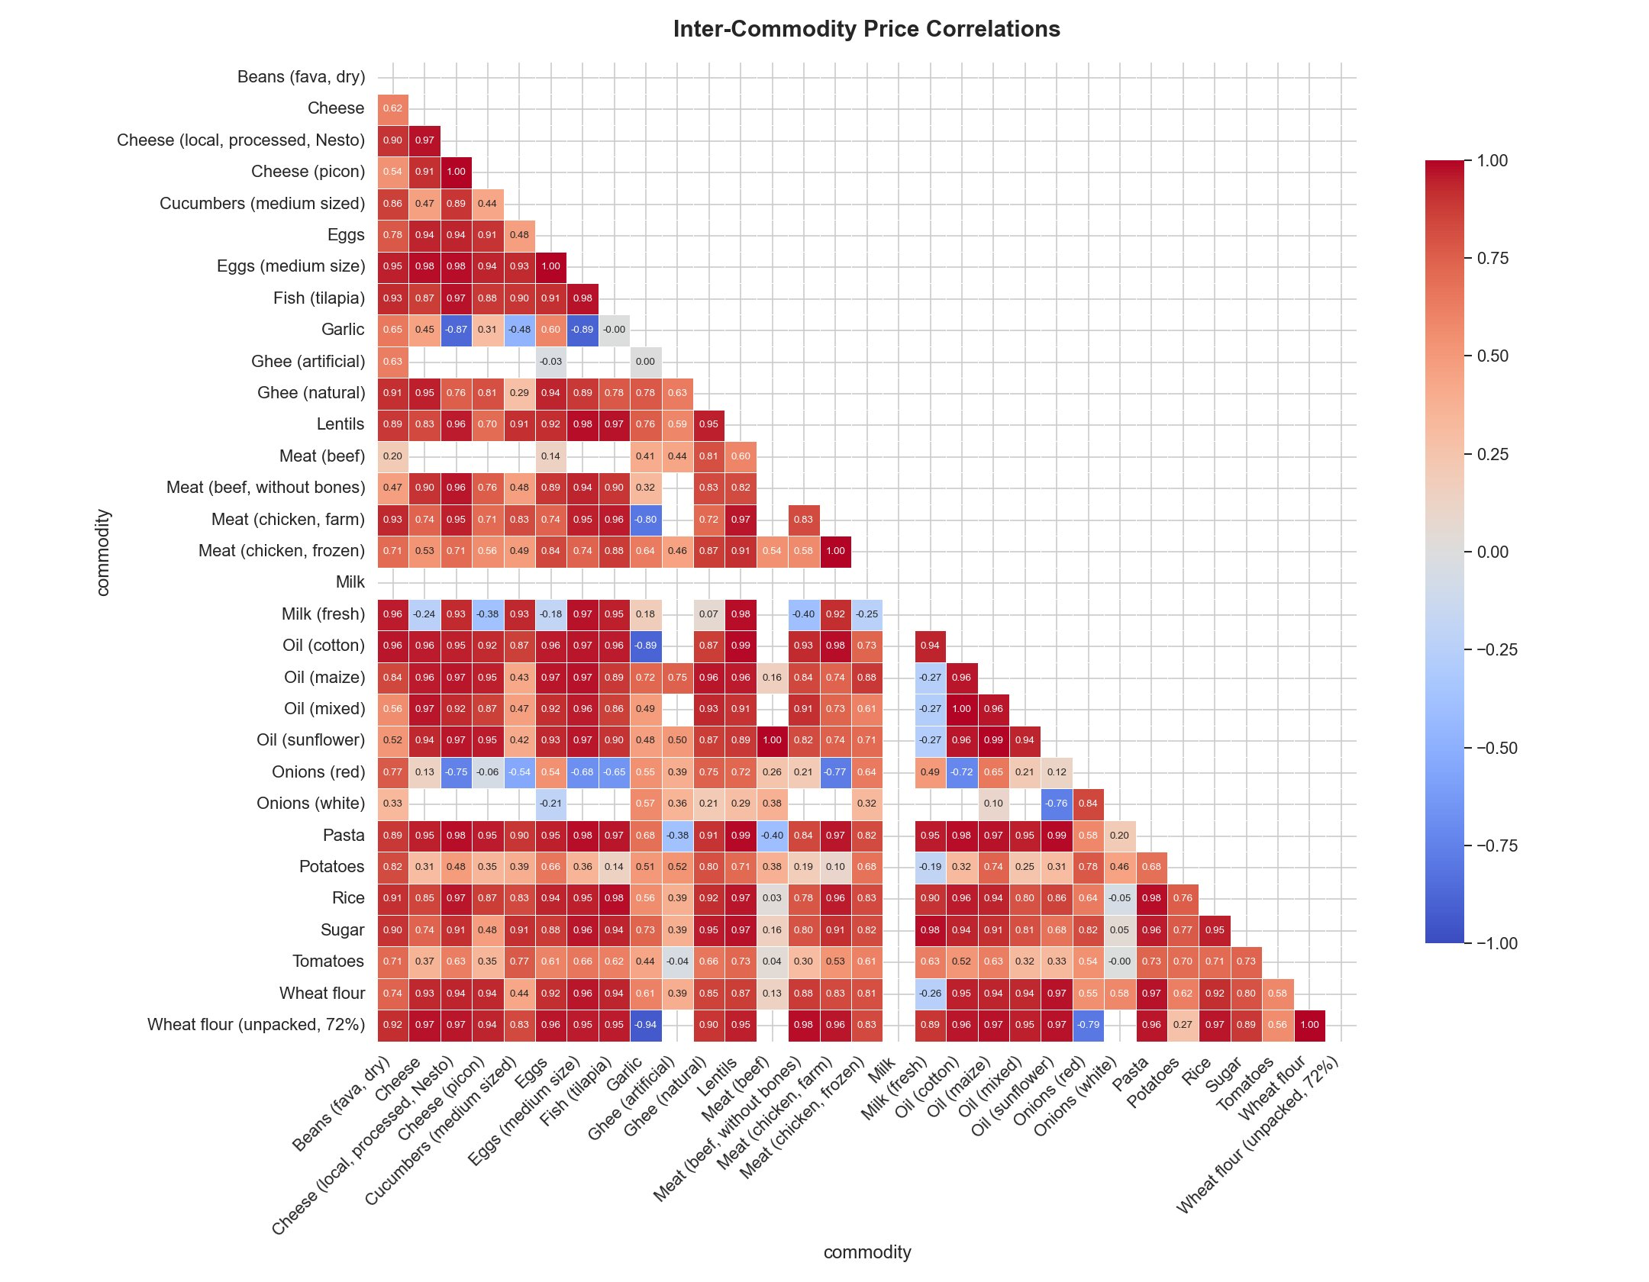
Inter-Commodity Price Correlations — One Dominant Driver
Spearman Correlation
Findings
r > 0.90
Most commodity pairs — a single latent factor (exchange rate) drives price movements across dairy, meat, oils, and cereals simultaneously.
r > 0.94
All four oil varieties (cotton, maize, sunflower, mixed) show near-perfect inter-correlation — identical import cost exposure.
Outliers
Garlic and artificial ghee show weaker correlations — likely locally price-set, insulated from FX shocks.
Spearman not Pearson — food prices are non-normal; Spearman's rank-based coefficient handles skew, outliers and shock-period non-linearities correctly.
Egypt Food Crisis Analysis · 11 / 14

Slide 12
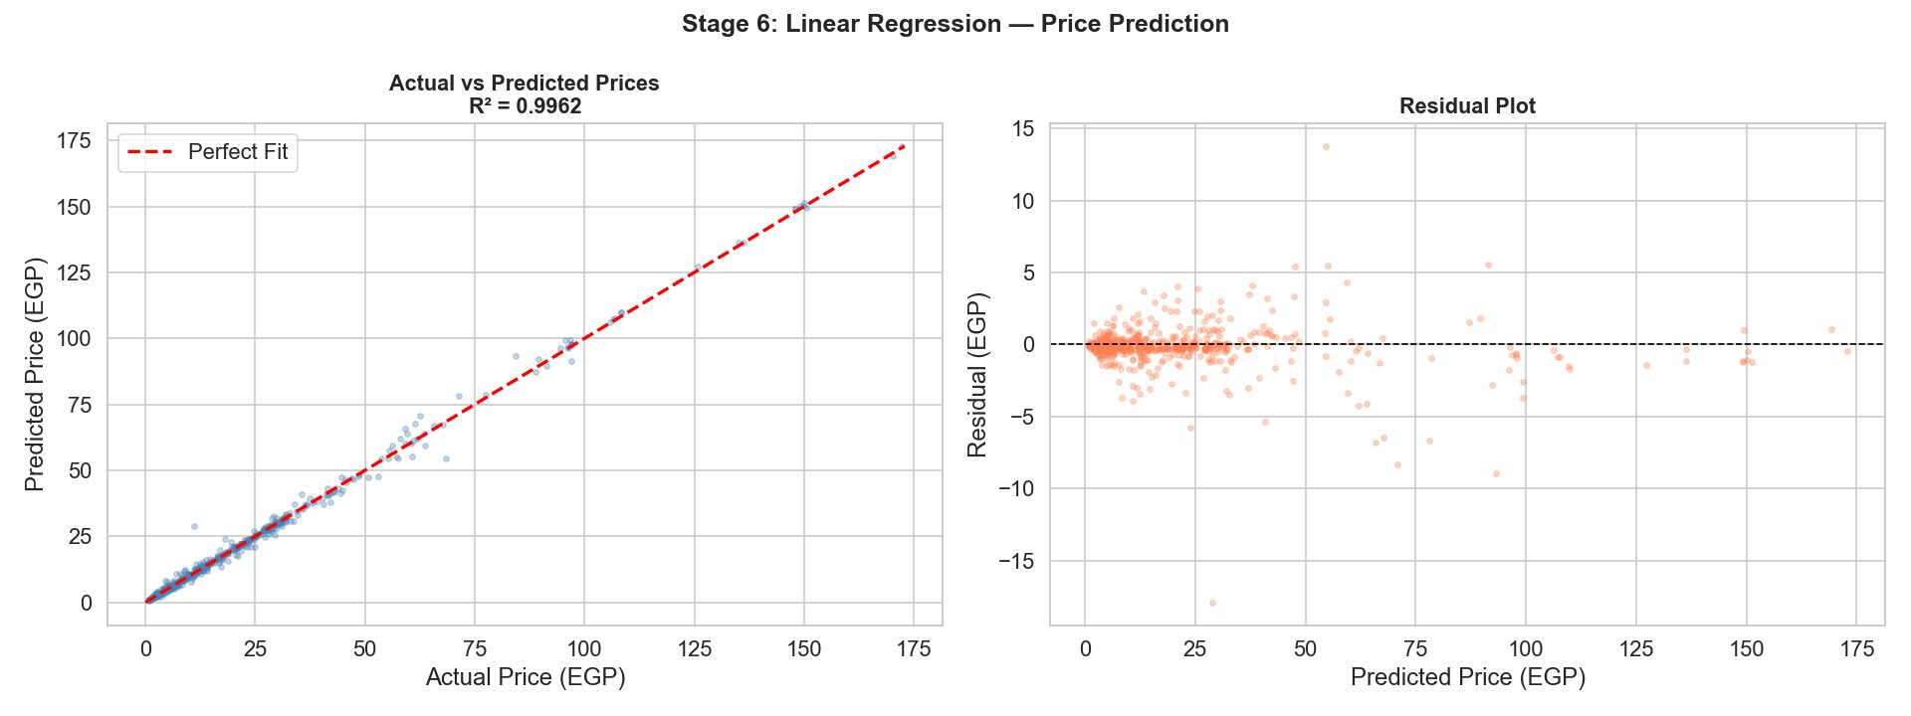
Linear Regression — Price Prediction Model
R² = 0.9962
of all price variance
explained by the model
Near-perfect fit
Data points track the
perfect-fit diagonal
across 0–175 EGP range.
Unbiased residuals
Errors centered at zero —
no systematic direction
or trend in mistakes.
WHY LINEAR REGRESSION (NOT RANDOM FOREST OR NEURAL NET)?
Heteroscedasticity
The goal is explanation, not prediction. Linear coefficients directly encode each feature's contribution to price — the information needed for policy recommendations. With Spearman r>0.90 across all commodity pairs, the data is near-linearly separable: a complex model adds no predictive gain while destroying interpretability. The heteroscedasticity at high prices suggests a log-price extension as future work.
Slight spread above 80 EGP:
freely-traded goods became
more volatile post-2022.
Egypt Food Crisis Analysis · 12 / 14

Slide 13
Key Findings
H1 — SUPPORTED
H2 — SUPPORTED
Devaluations drove prices up — hard
Cairo pays more for everything
Both the 2016 and 2022 devaluations caused statistically significant food price increases (p<0.05 in both cases). Sunflower oil went from 5 EGP to 41 EGP over the study period. The 2022 shock was worse in absolute terms because Russia-Ukraine compounded the FX effect.
Cairo prices exceed the national average for all 12 staple commodities tested. The gap is widest for freely-traded oils (3.5× premium on cotton oil) and narrowest for subsidized goods — wheat flour and potatoes near-equalize. The subsidy works where it targets.
H3 — NOT SUPPORTED
MODEL
Inflation hits the whole basket, not just staples
R² = 0.9962 — prices are highly predictable
No significant difference between staple and non-staple monthly inflation rates (ANOVA p=0.31). This means the FX channel is the dominant force — not commodity-specific supply shocks. Category-specific price controls provide uneven protection against a macro-level shock.
Linear regression captures 99.6% of all price variance. Consistent with the near-universal Spearman r>0.90 across 30+ commodity pairs. Egypt's food market behaves as a tightly integrated system with one dominant latent factor: the exchange rate.
Egypt Food Crisis Analysis · 13 / 14

Slide 14
Conclusions &
Policy Recommendations
Data & Tools
WFP VAM Food Security — Egypt
Food Price Dataset (HDXL)
Egypt's food crisis is fundamentally a currency problem. The macro FX channel hits the entire food basket simultaneously — as the H3 rejection confirms. Commodity-specific interventions provide uneven protection against a systemic shock. The intervention has to work at the macro level.
WFP Egypt Market Listing Dataset
Humanitarian Data Exchange 2024
FAO Suite of Food Security
Indicators — Egypt · FAOSTAT 2024
①
FX Reserves & IMF Standby
Maintain FX reserves and standby credit specifically for food import financing — to compress exchange rate overshoot when devaluations hit.
Central Bank of Egypt · Monetary
Policy Announcements 2016 & 2022
②
Import Diversification
Reduce wheat sourcing concentration from Russia/Ukraine. Geographic dependency amplified the 2022 shock dramatically.
World Bank (2023). Egypt Economic
Monitor: Crisis to Transformation.
③
Targeted Cash Transfers
Expand the Egypt Food Subsidy Card and index transfer amounts to actual food basket inflation monthly — broader, more cost-effective than commodity subsidies.
Python · Pandas · Matplotlib · Seaborn
SciPy · Scikit-learn · Plotly
④
Early Warning System
Monitor 5–6 sentinel commodities monthly. With r>0.90 across the basket, a small set reliably proxies the entire market.
C-DE211 · EUI · Spring 2026 · 14 / 14

