Slide 1
Host- based Intrusion detection system
tHIRD yEAR PROJECT
By nADIA nOORMOHAMED

Slide 2

what IS THE FUNCTIONALITY?
File Integrity Monitor
Cloud based file integrity Monitor

Slide 3
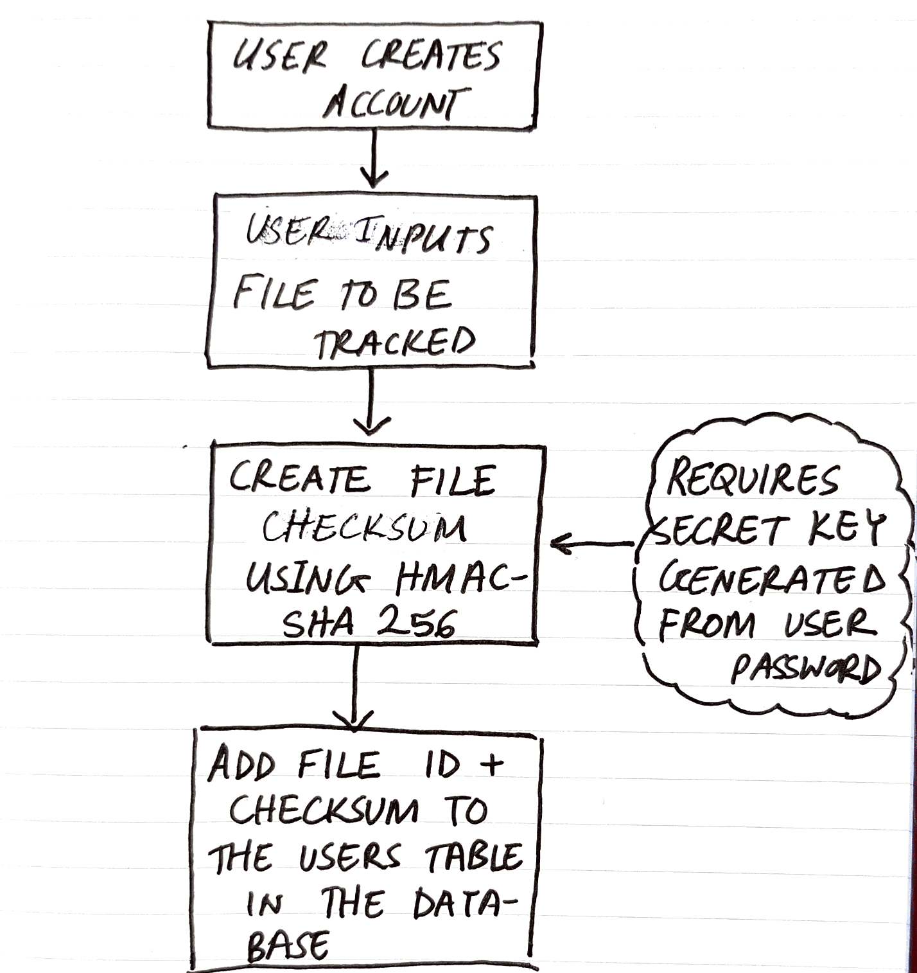
File integrity monitoring (NOT CLOUD-BASED): Preparation PHASE
SHA-256 is a public domain algorithm. Instead used HMAC SHA-256.
Secret key is derived from the user password.

Slide 4
Verification phase (NOT CLOUD-BASED)
Use user password to generate secret key
Obtain checksum from DB +
Generate new current checksum
Compare checksums

Slide 5
going FORWARDS: a Cloud based file integrity monitor
Data integrity and privacy is a major concern in this computing paradigm
An area of research.
Cloud computing is becoming more popular with time.
Currently researching approaches that take into consideration the efficiency and performance.
Cloud integrity + privacy
ID authentication, key distribution + management.

Slide 6
Finally…
An application that will be combined and utilized via an interface

Slide 7
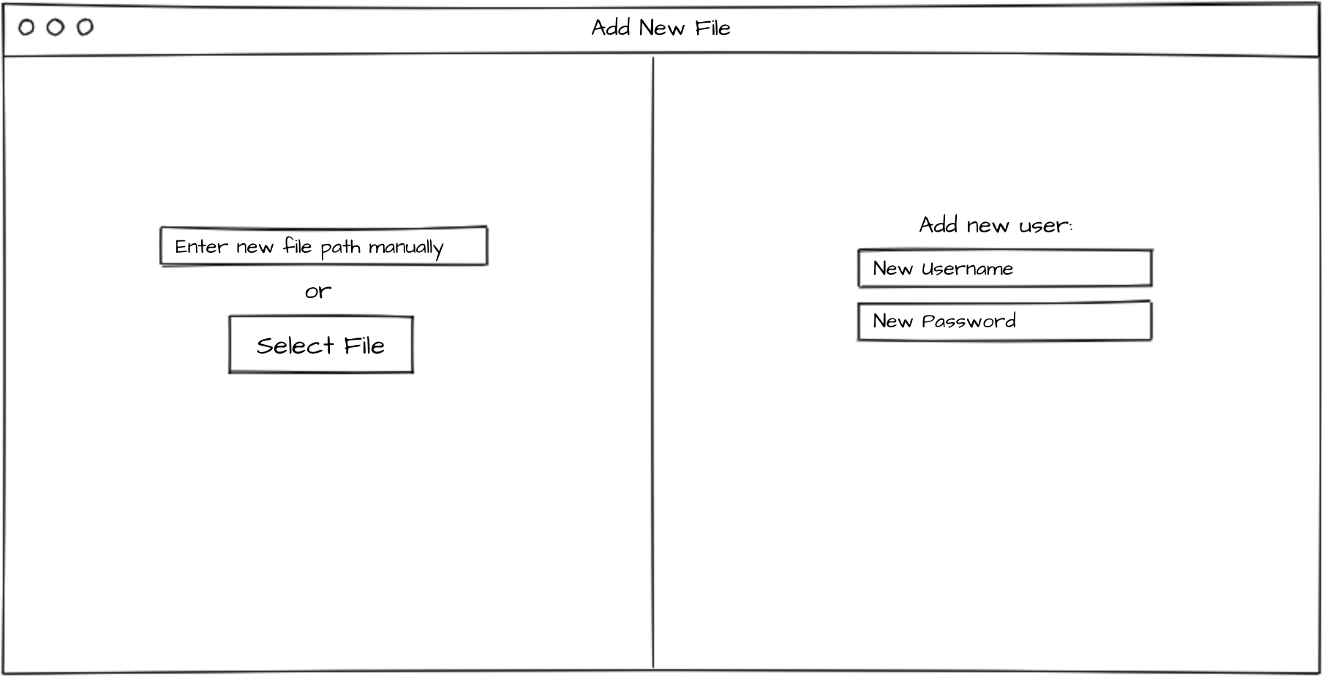
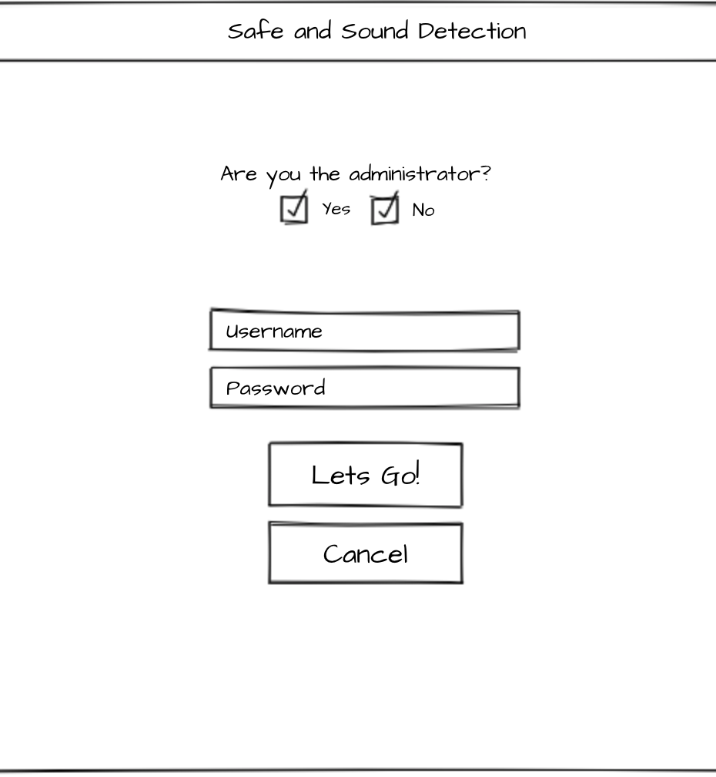
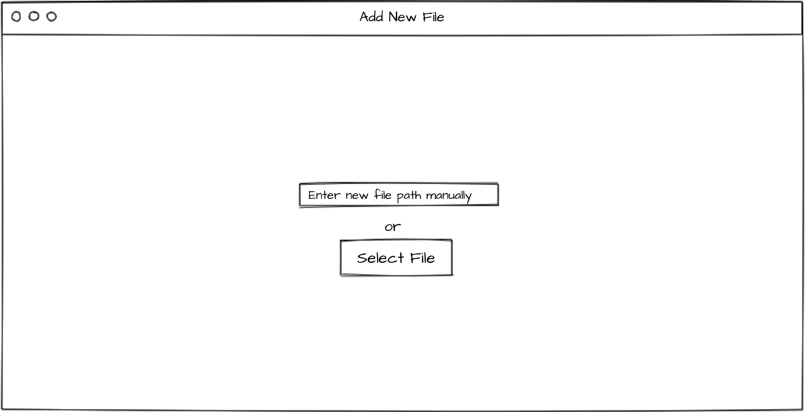

Slide 8

Thank you for Listening

